Slide 1
ᎣᏏᏲ
ᏂᎦᏚᏏᏁ ᏣᎳᎩ ᎠᏕᎶᏆᏍᏗ

Slide 2
ᏂᎦᏚᏏᏁ ᏣᎳᎩ ᎠᏕᎶᏆᏍᏗ
ᎢᏓᎴᎾ- Let’s begin
ᏣᎳᎩ ᎢᏗᏬᏂ- Let’s talk Cherokee

Slide 3
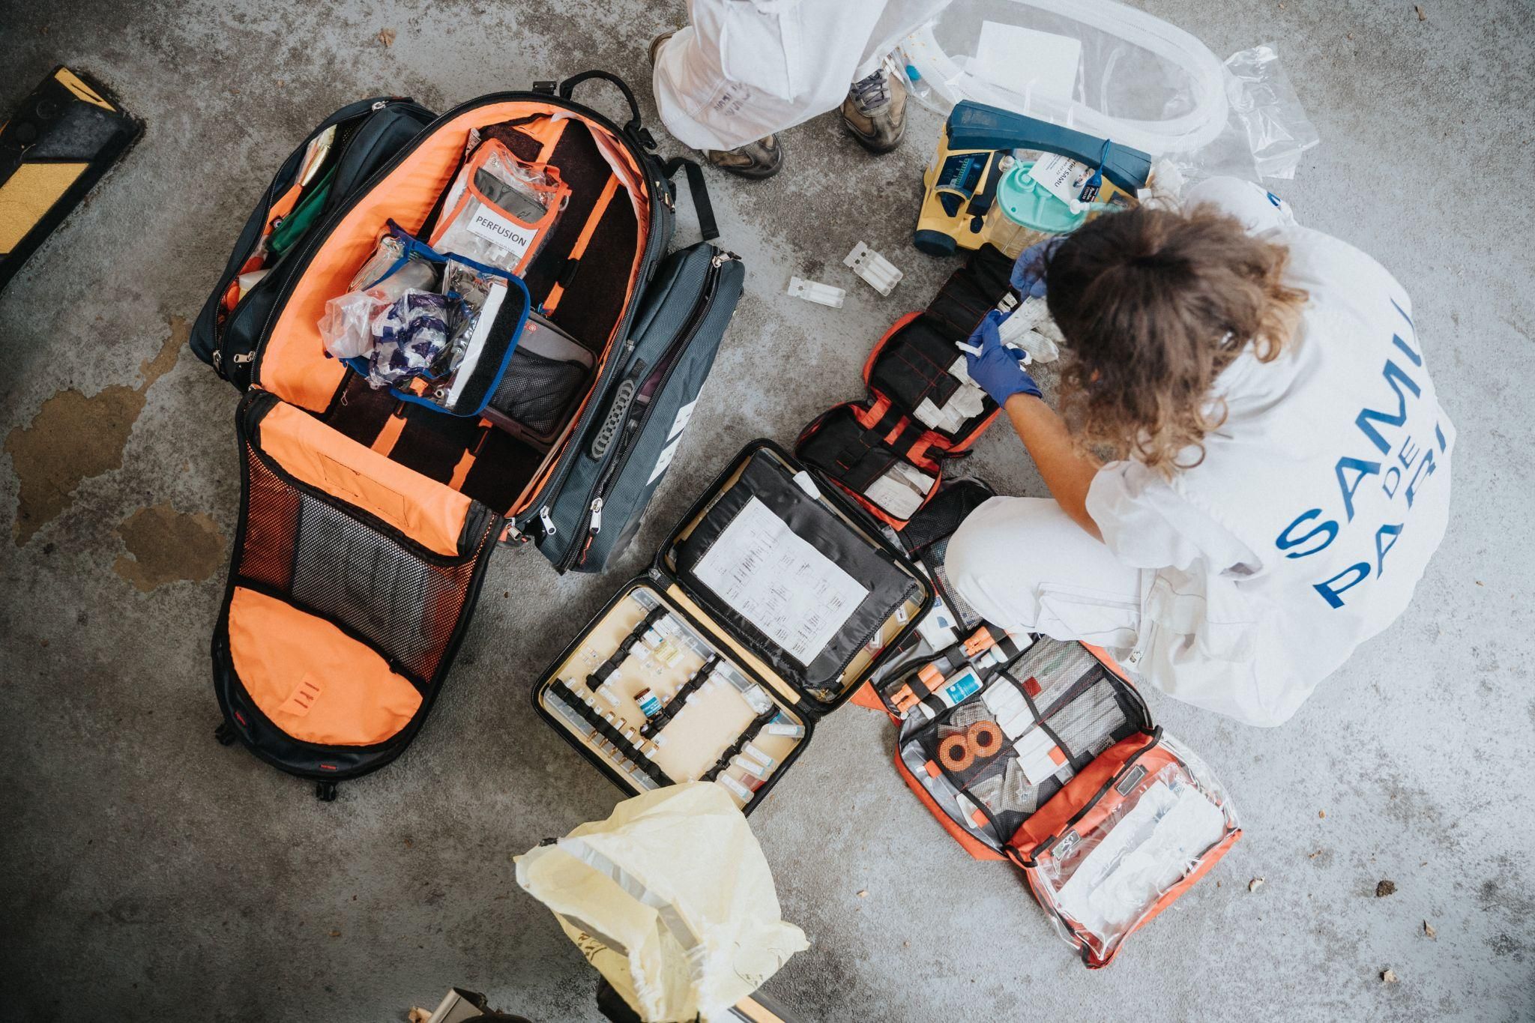
ᏐᏁᎵᏁ ᏣᎳᎩ ᎠᏕᎶᏆᏍᏗ
ᎪᎱᏍᏗ ᏅᎦᏖᏃᎲᎾ ᏱᏄᎵᏍᏔᏂ, ᎯᎠ ᏧᏓᎴᏅᏓ ᏧᎵᏍᎨᏗ ᏓᎩᎭ.

Slide 4
ᏂᎦᏚᏏᏁ ᏣᎳᎩ ᎠᏕᎶᏆᏍᏗ
ᎪᎱᏍᏗ ᏅᎦᏖᏃᎲᎾ ᏄᎵᏍᏔᏅ, ᎯᎠ ᏧᏓᎴᏅᏓ ᏧᎵᏍᎨᏗ ᏓᎩᎲ.

Slide 5
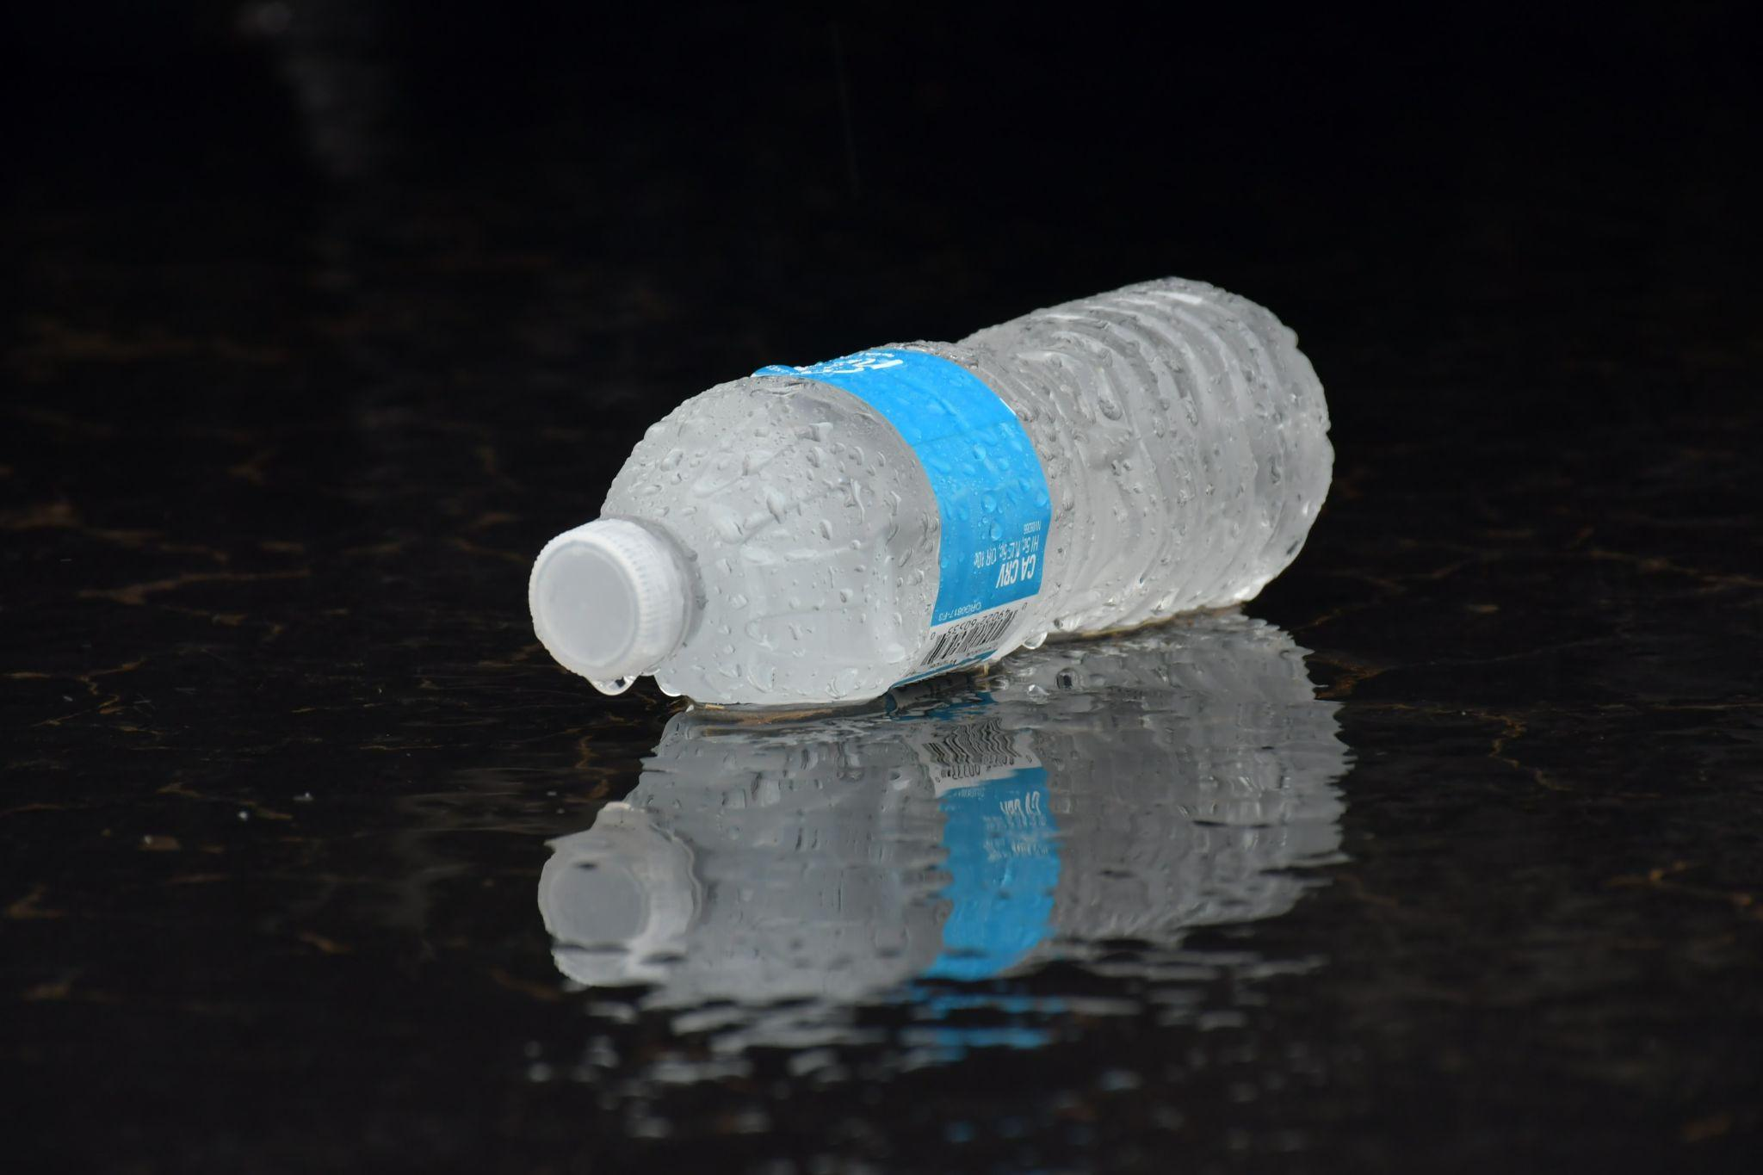
ᏐᏁᎵᏁ ᏣᎳᎩ ᎠᏕᎶᏆᏍᏗ
ᏃᎴ, ᎠᎹ ᎠᎩᏁ. ᎠᎹ ᎣᏍᏓ ᎠᏗᏔᏍᏗ ᎤᎵᏍᎨᏗ.

Slide 6
ᏂᎦᏚᏏᏁ ᏣᎳᎩ ᎠᏕᎶᏆᏍᏗ
ᏃᎴ, ᎠᎹ ᎠᎩᏁᎲ. ᎠᎹ ᎣᏍᏓ ᎠᏗᏔᏍᏗ ᎤᎵᏍᎨᏗ.

Slide 7
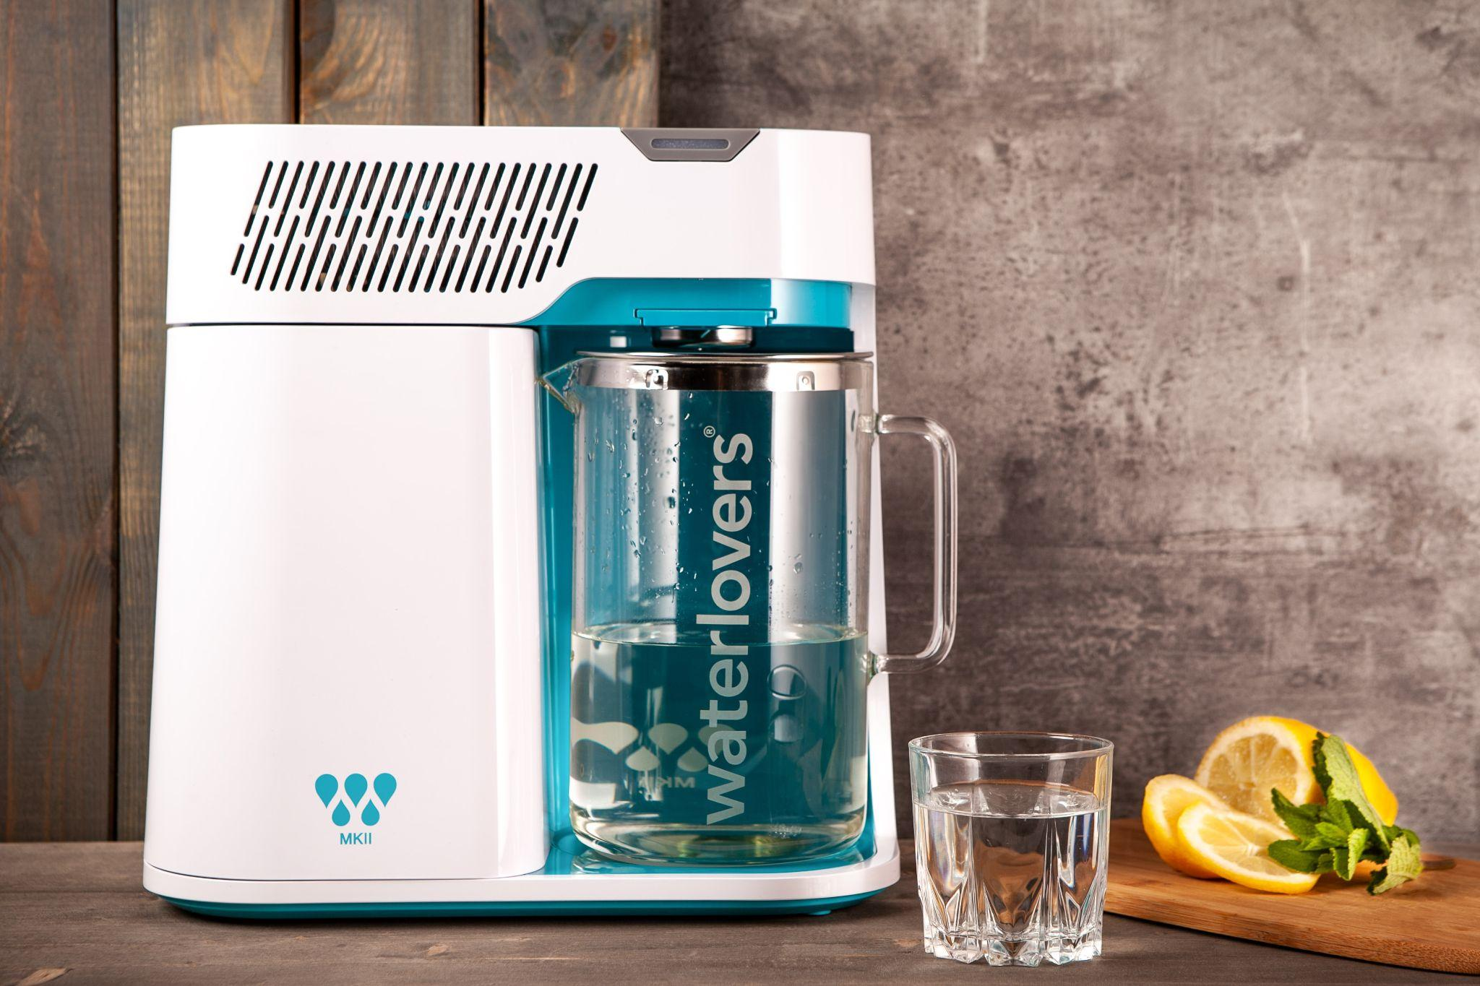
ᏐᏁᎵᏁ ᏣᎳᎩ ᎠᏕᎶᏆᏍᏗ
ᎥᏍᏊ, ᎠᎹ ᎬᎫᏍᏙᏗ ᎠᎩᎭ.

Slide 8
ᏂᎦᏚᏏᏁ ᏣᎳᎩ ᎠᏕᎶᏆᏍᏗ
ᎥᏍᏊ, ᎠᎹ ᎬᎫᏍᏙᏗ ᎠᎩᎲ.

Slide 9
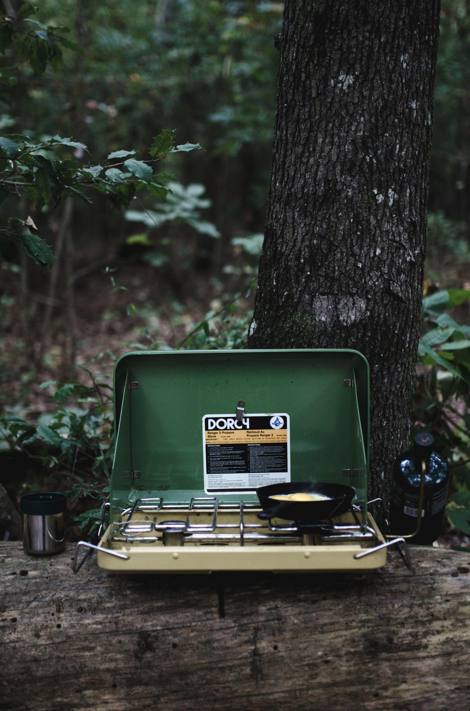
ᏐᏁᎵᏁ ᏣᎳᎩ ᎠᏕᎶᏆᏍᏗ
ᎤᏍᏗ ᎣᏏ ᎠᎩᎭ

Slide 10
ᏂᎦᏚᏏᏁ ᏣᎳᎩ ᎠᏕᎶᏆᏍᏗ
ᎤᏍᏗ ᎣᏏ ᎠᎩᎲ

Slide 11
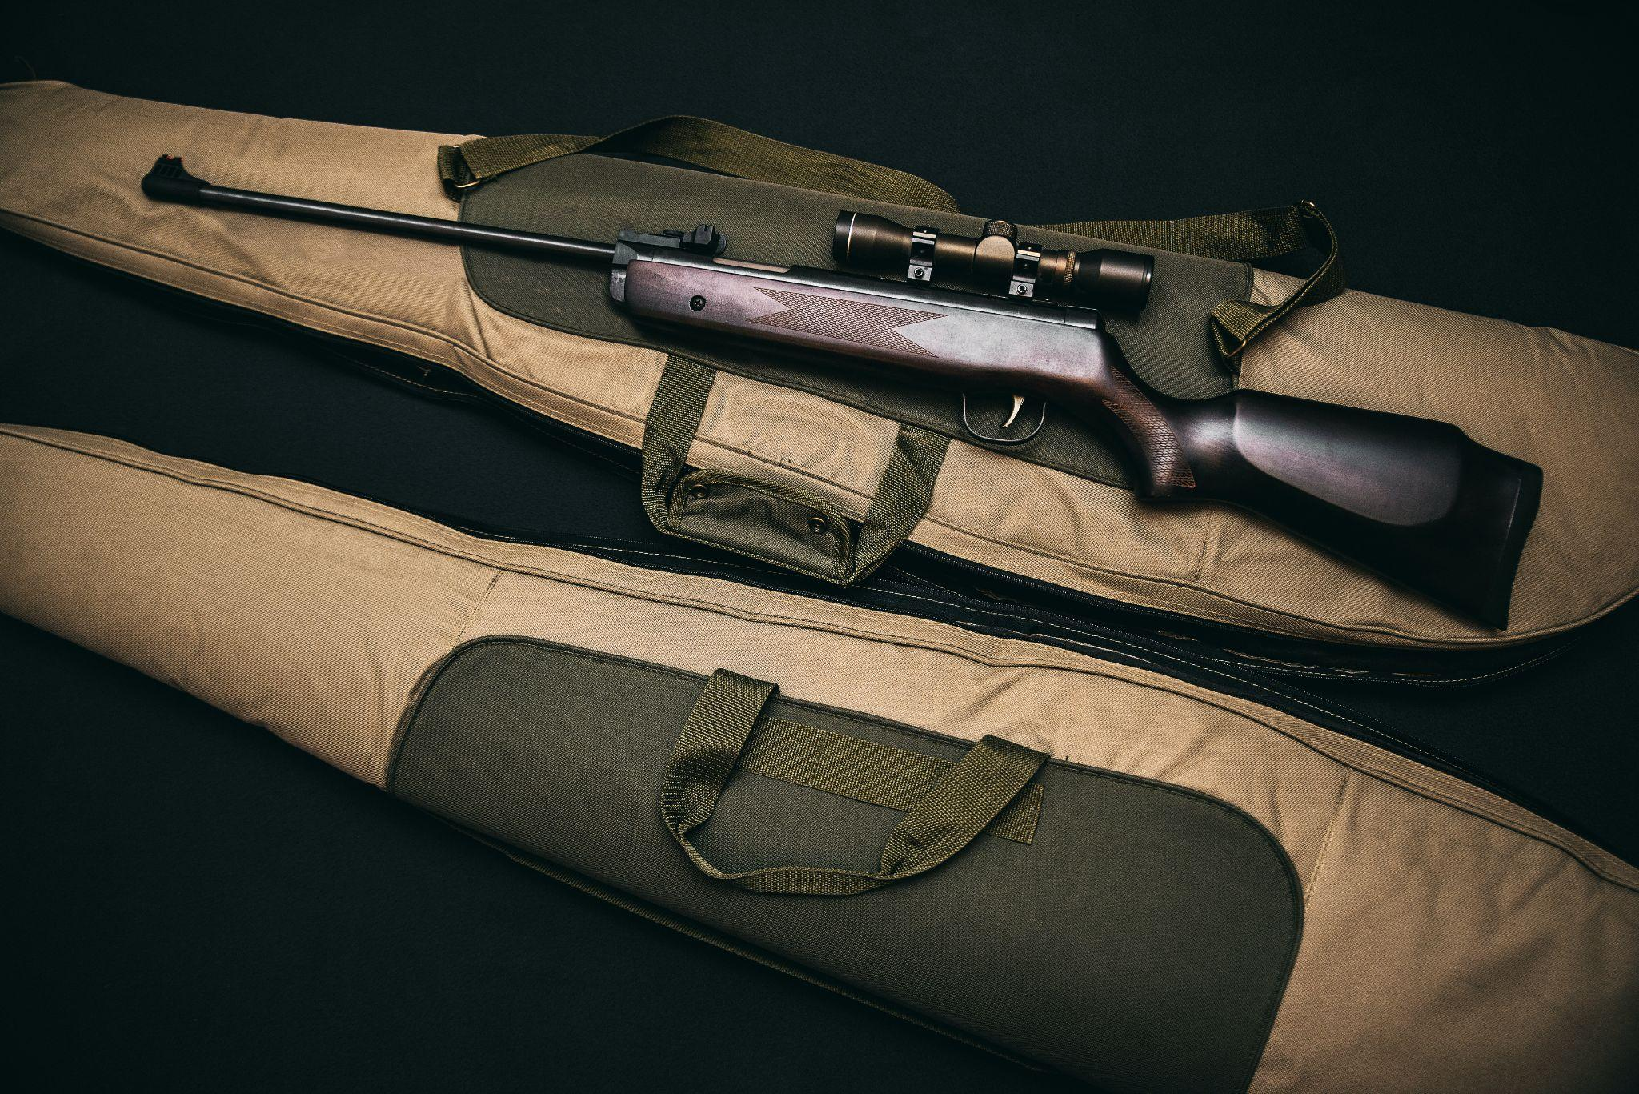
ᏐᏁᎵᏁ ᏣᎳᎩ ᎠᏕᎶᏆᏍᏗ
ᎦᎶᏇ ᎠᏋᏯ ᎠᎴ ᎦᏂ ᏍᏊ.

Slide 12
ᏂᎦᏚᏏᏁ ᏣᎳᎩ ᎠᏕᎶᏆᏍᏗ
ᎦᎶᏇ ᎠᏋᏴ ᎠᎴ ᎦᏂ ᏍᏊ.

Slide 13
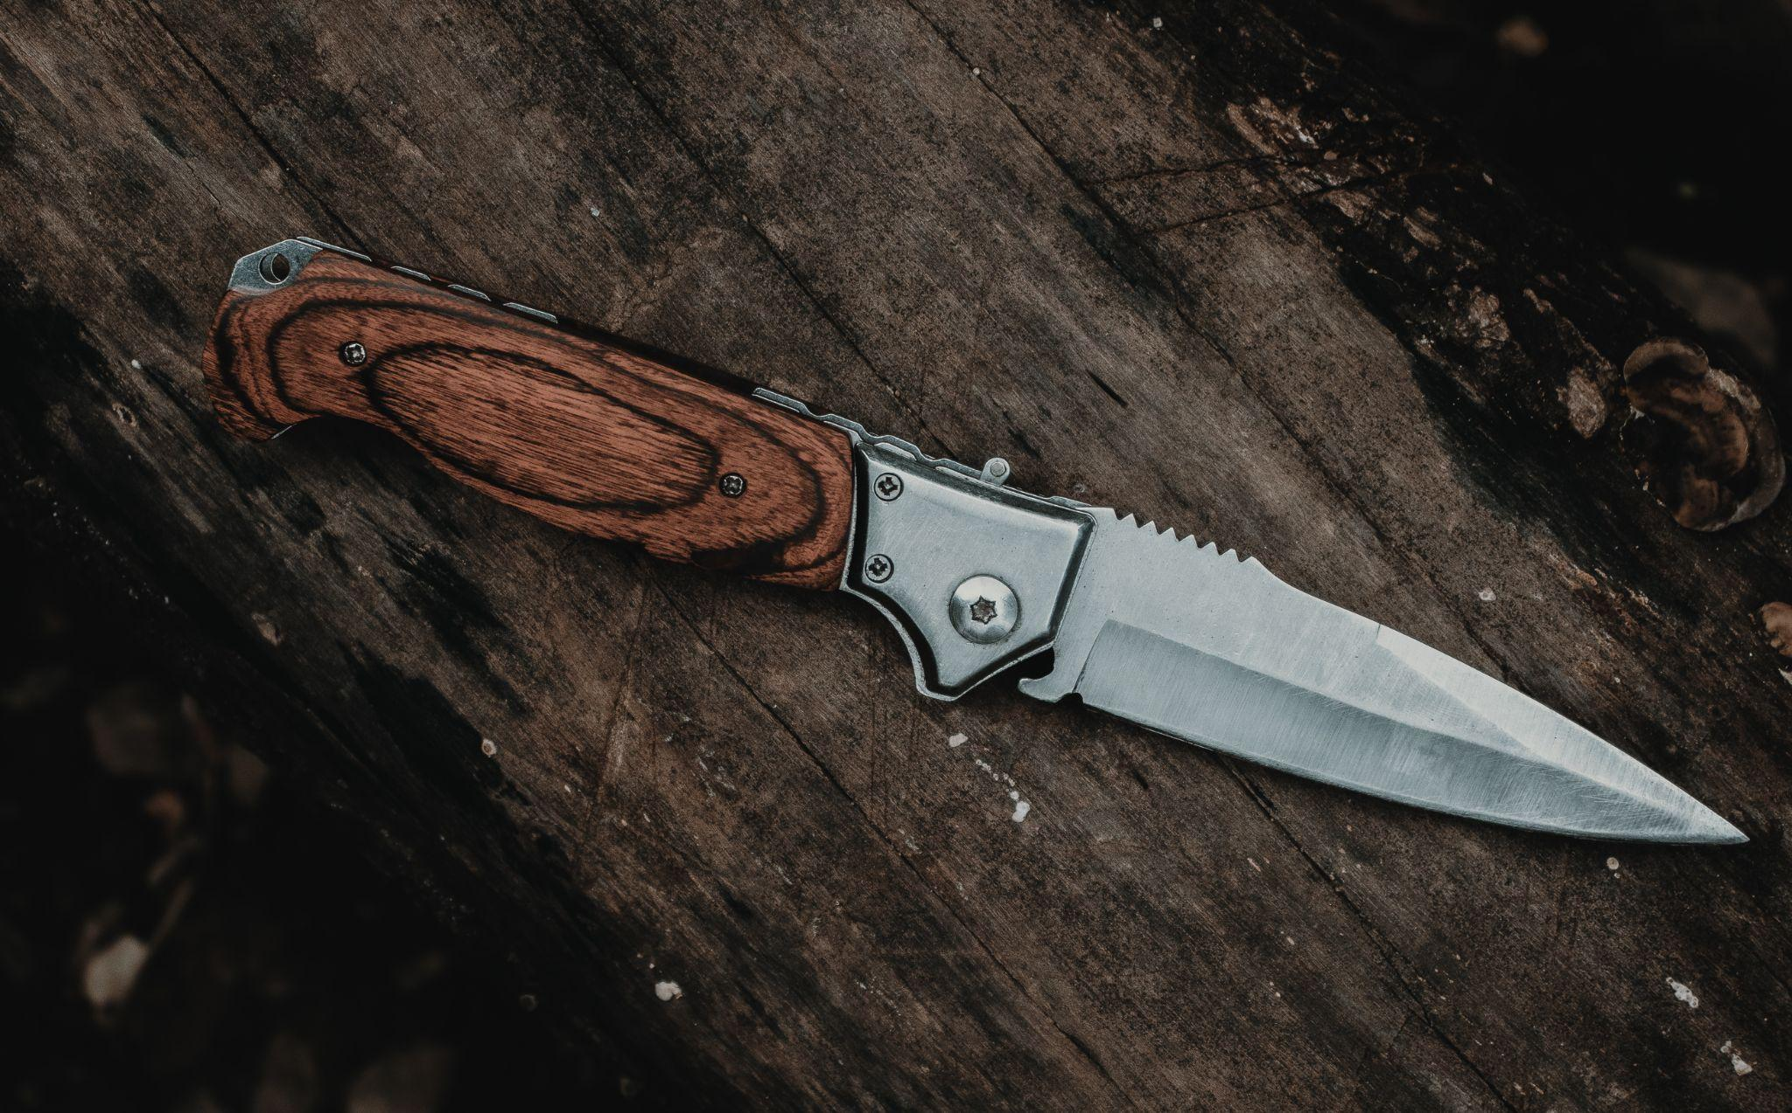
ᏐᏁᎵᏁ ᏣᎳᎩ ᎠᏕᎶᏆᏍᏗ
ᎭᏰᎵᏍᏗ ᎠᏋᏯ.

Slide 14
ᏂᎦᏚᏏᏁ ᏣᎳᎩ ᎠᏕᎶᏆᏍᏗ
ᎭᏰᎵᏍᏗ ᎠᏋᏴ.

Slide 15
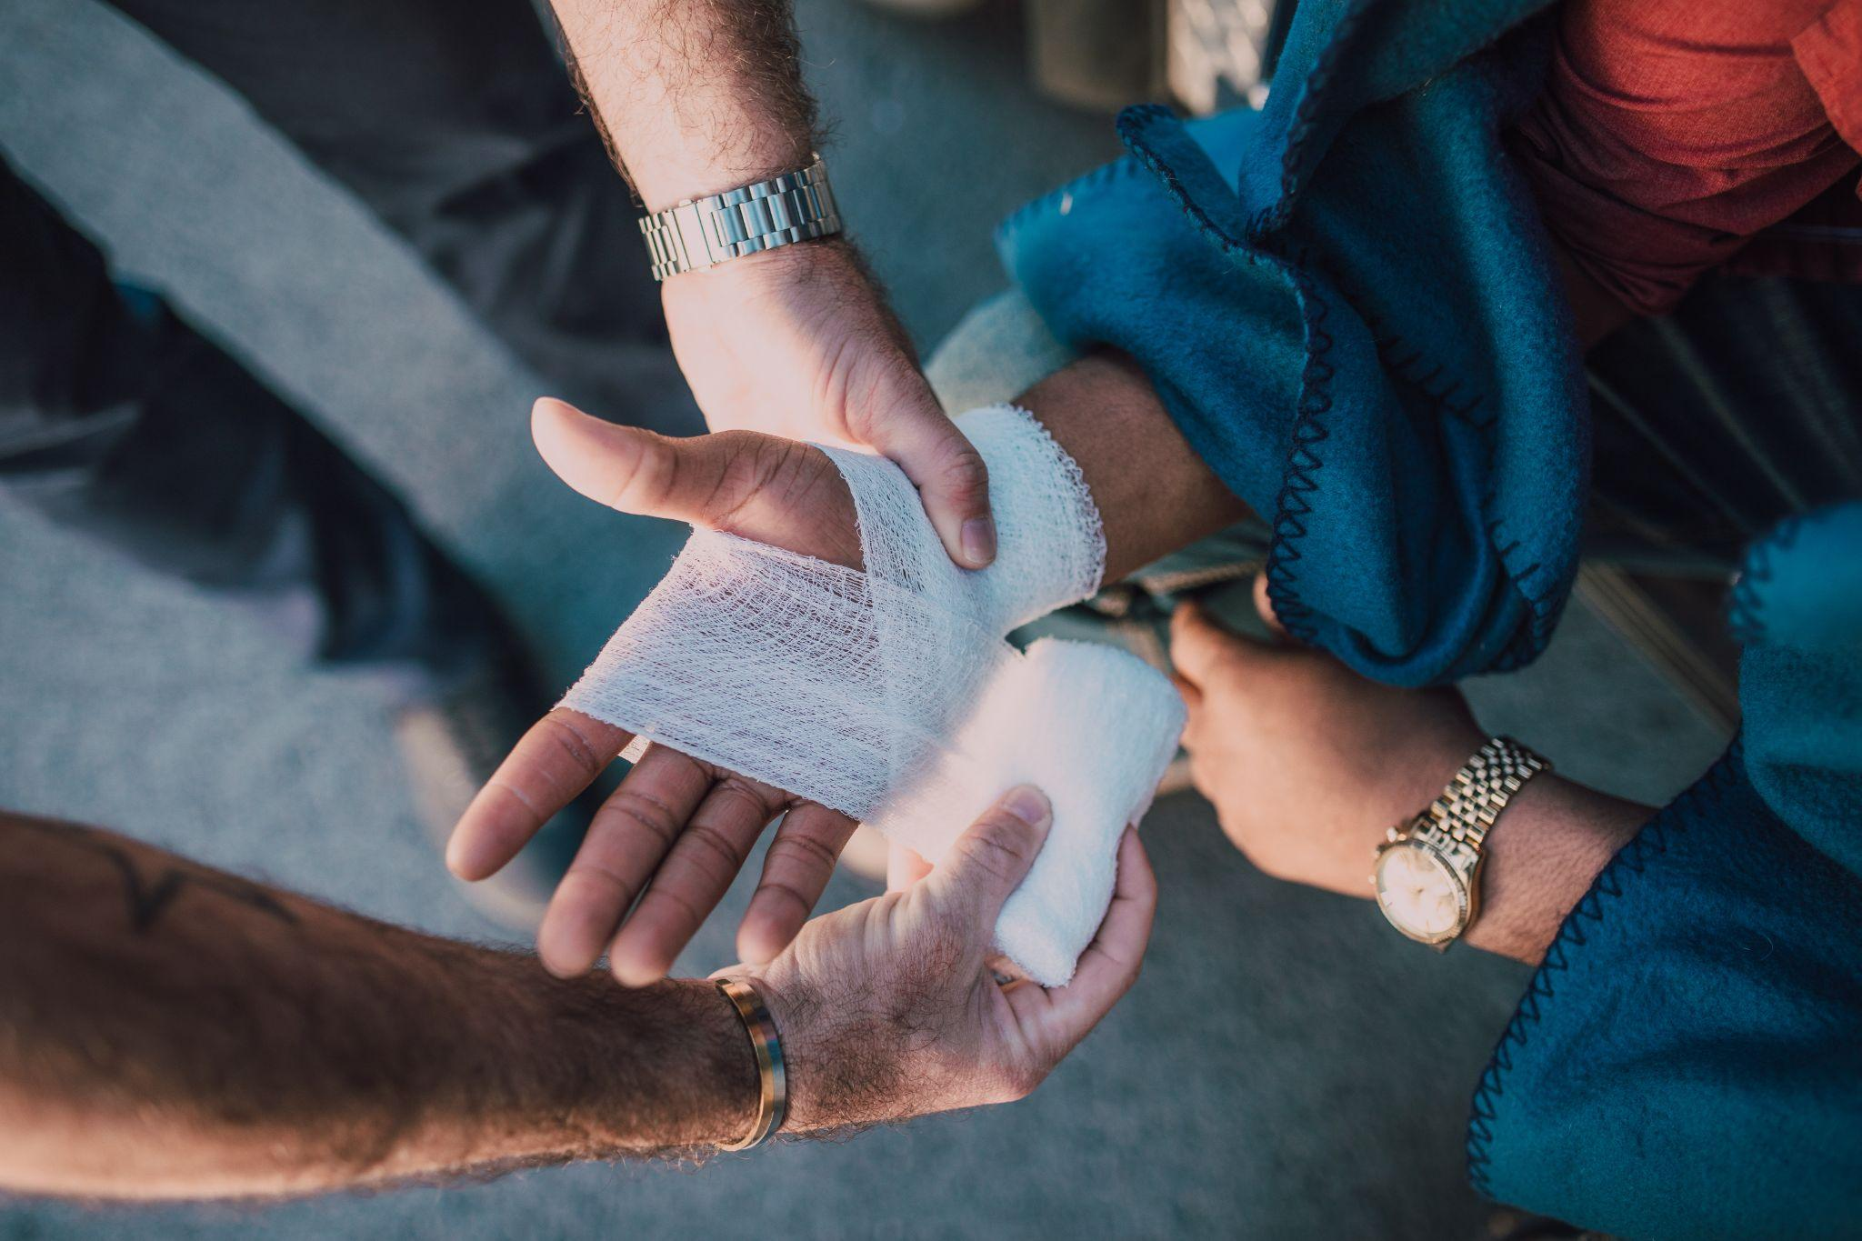
ᏐᏁᎵᏁ ᏣᎳᎩ ᎠᏕᎶᏆᏍᏗ
ᏗᏣᏢᏍᏙᏗ ᏓᎩᎾ.

Slide 16
ᏂᎦᏚᏏᏁ ᏣᎳᎩ ᎠᏕᎶᏆᏍᏗ
ᏗᏣᏢᏍᏙᏗ ᏓᎩᎾᎲ.

Slide 17
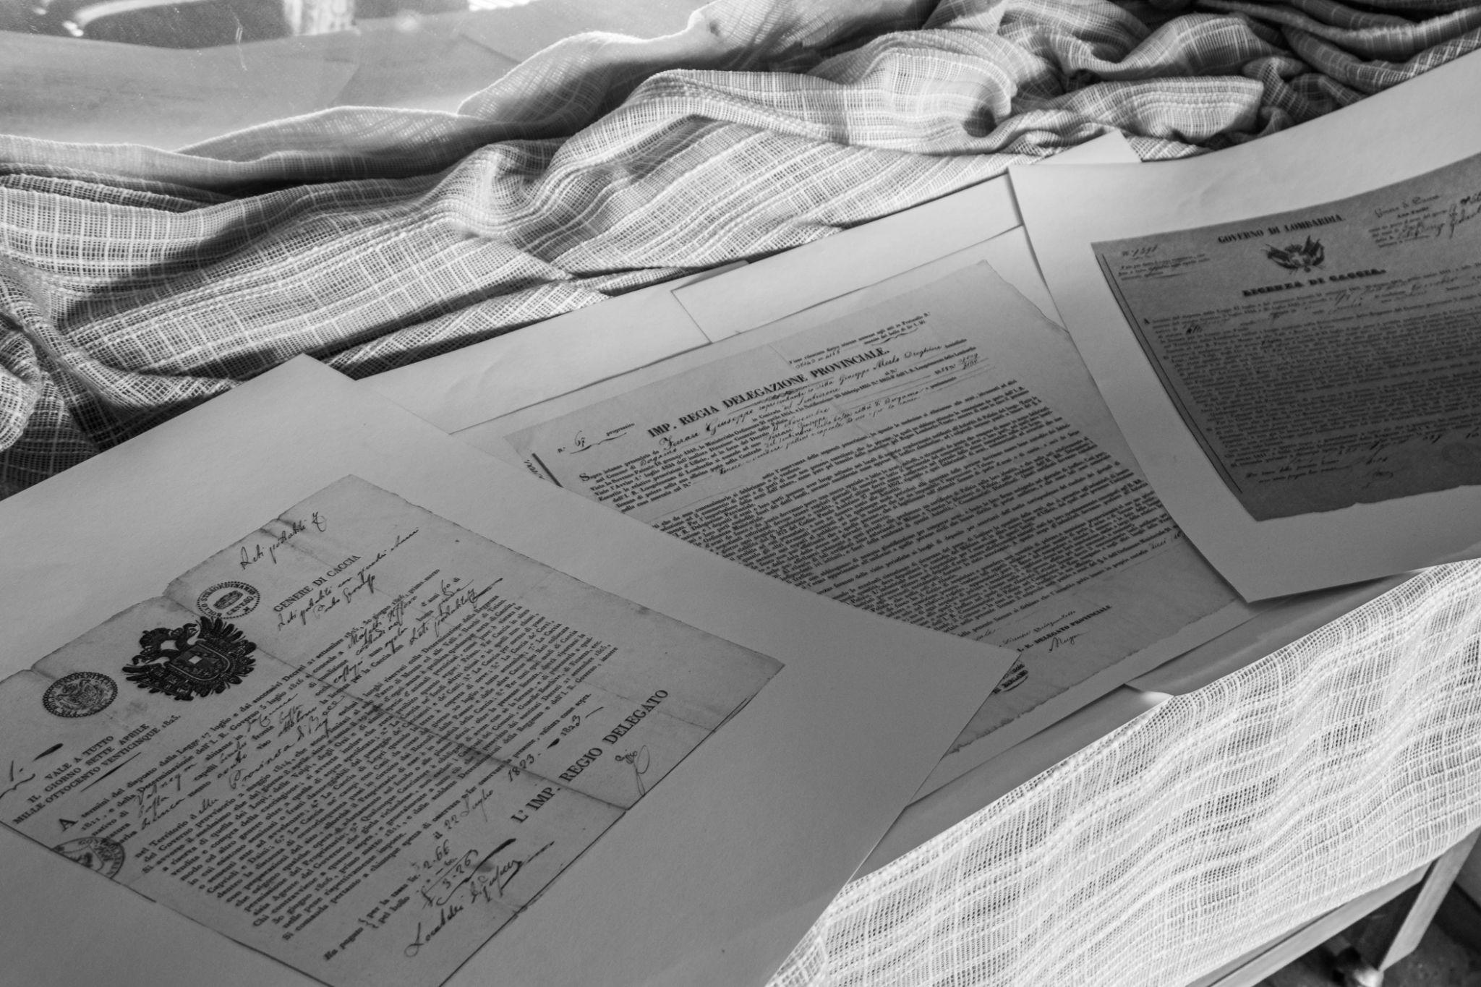
ᏐᏁᎵᏁ ᏣᎳᎩ ᎠᏕᎶᏆᏍᏗ
ᎯᎸᏍᎩ ᏗᏟᎶᏍᏔᏅ ᏗᎪᏪᎵ ᏧᎵᏍᎨᏗ ᏓᎩᎾ.

Slide 18
ᏂᎦᏚᏏᏁ ᏣᎳᎩ ᎠᏕᎶᏆᏍᏗ
ᎯᎸᏍᎩ ᏗᏟᎶᏍᏔᏅ ᏗᎪᏪᎵ ᏧᎵᏍᎨᏗ ᏓᎩᎾᎲ.

Slide 19
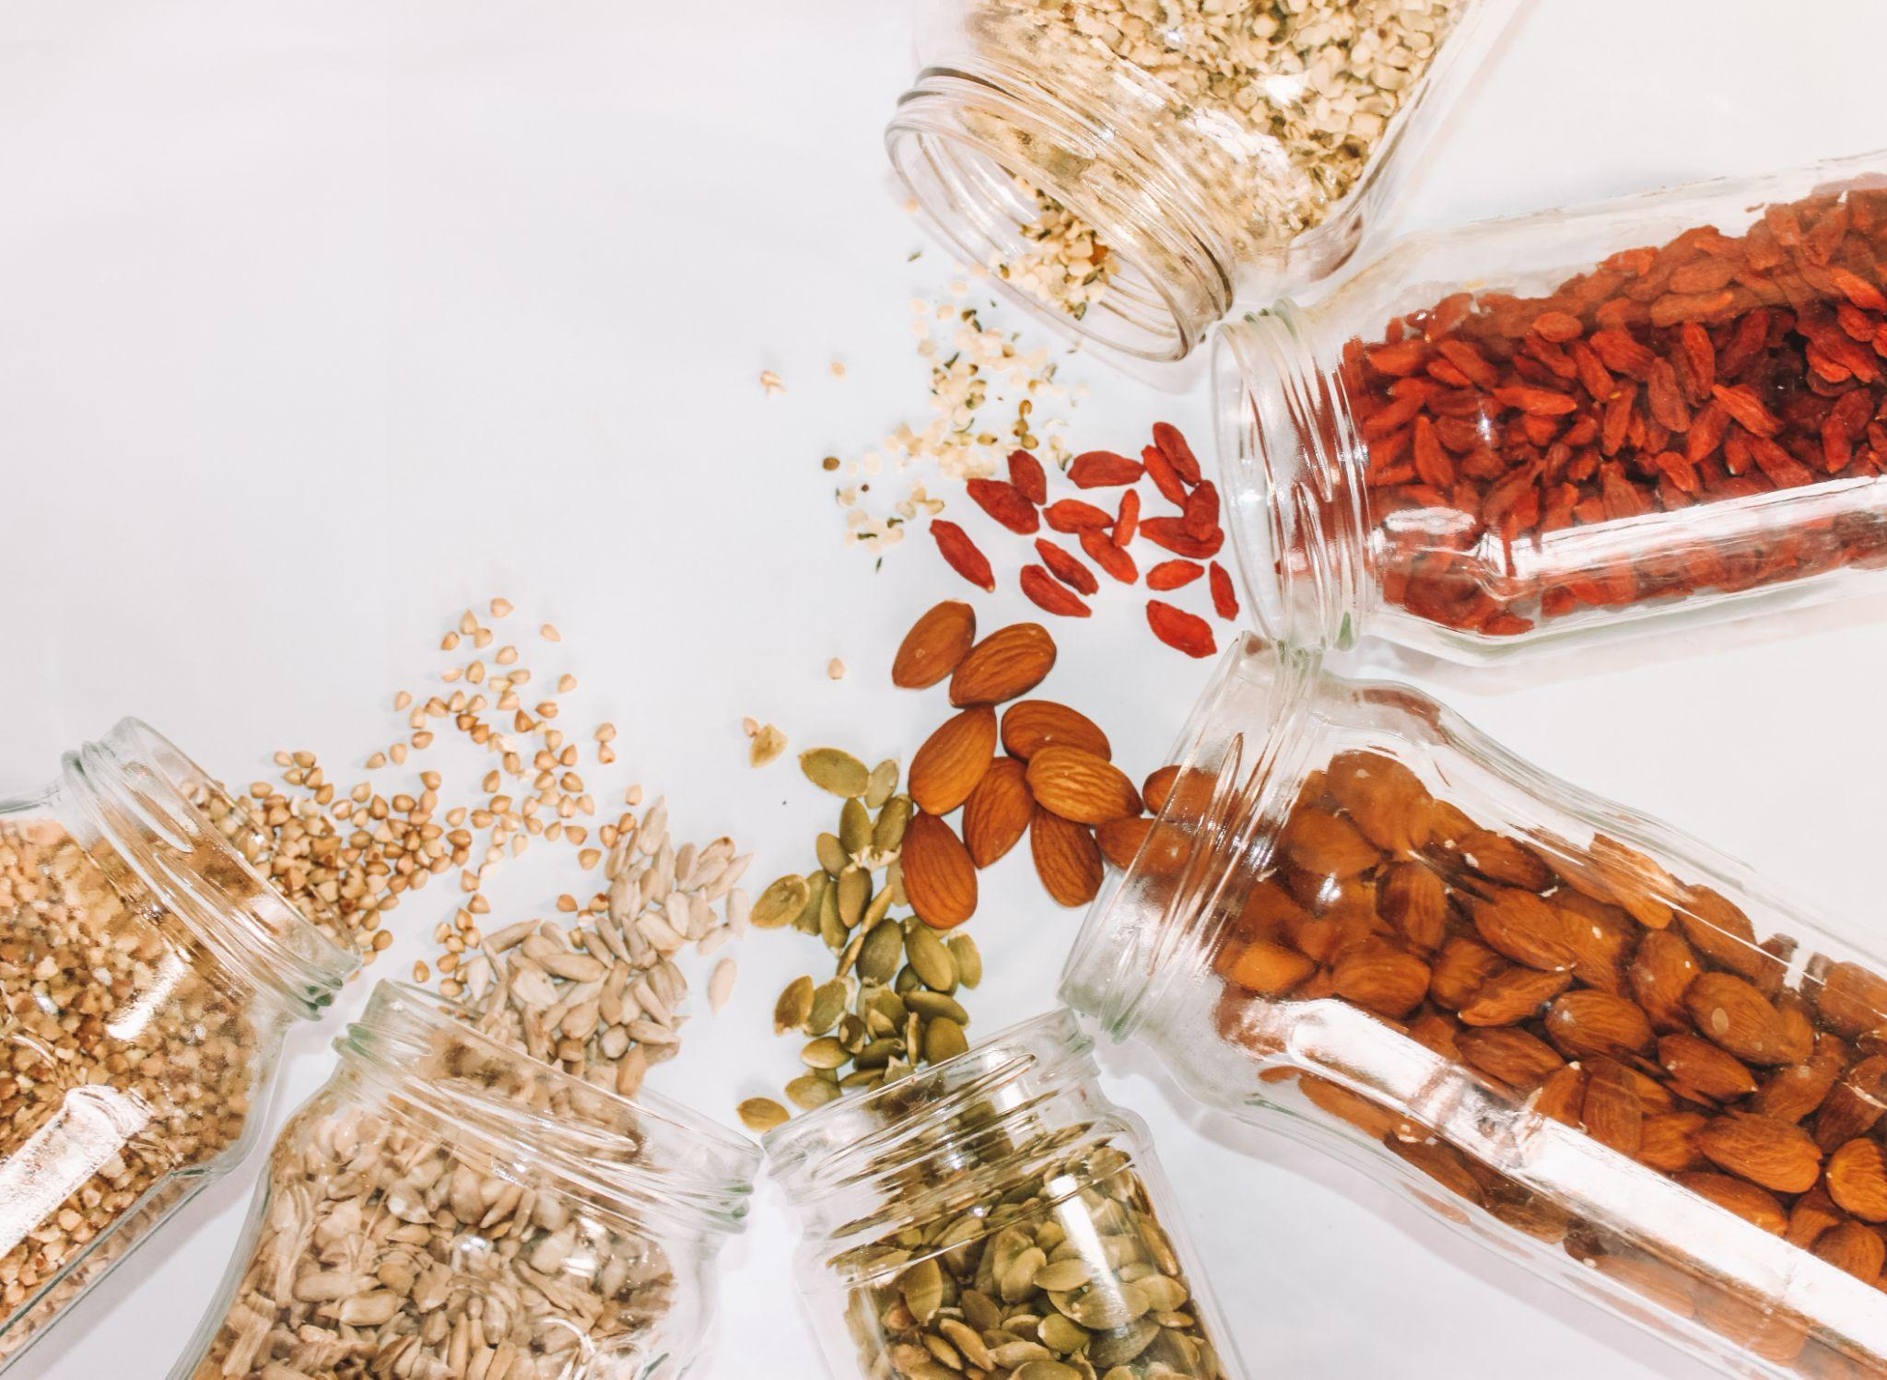
ᏐᏁᎵᏁ ᏣᎳᎩ ᎠᏕᎶᏆᏍᏗ
ᎤᏂᎧᏔ ᏧᏕᎴᏅᏓ ᏓᎩᎭ.

Slide 20
ᏂᎦᏚᏏᏁ ᏣᎳᎩ ᎠᏕᎶᏆᏍᏗ
ᎤᏂᎧᏔ ᏧᏕᎴᏅᏓ ᏓᎩᎲ.

Slide 21
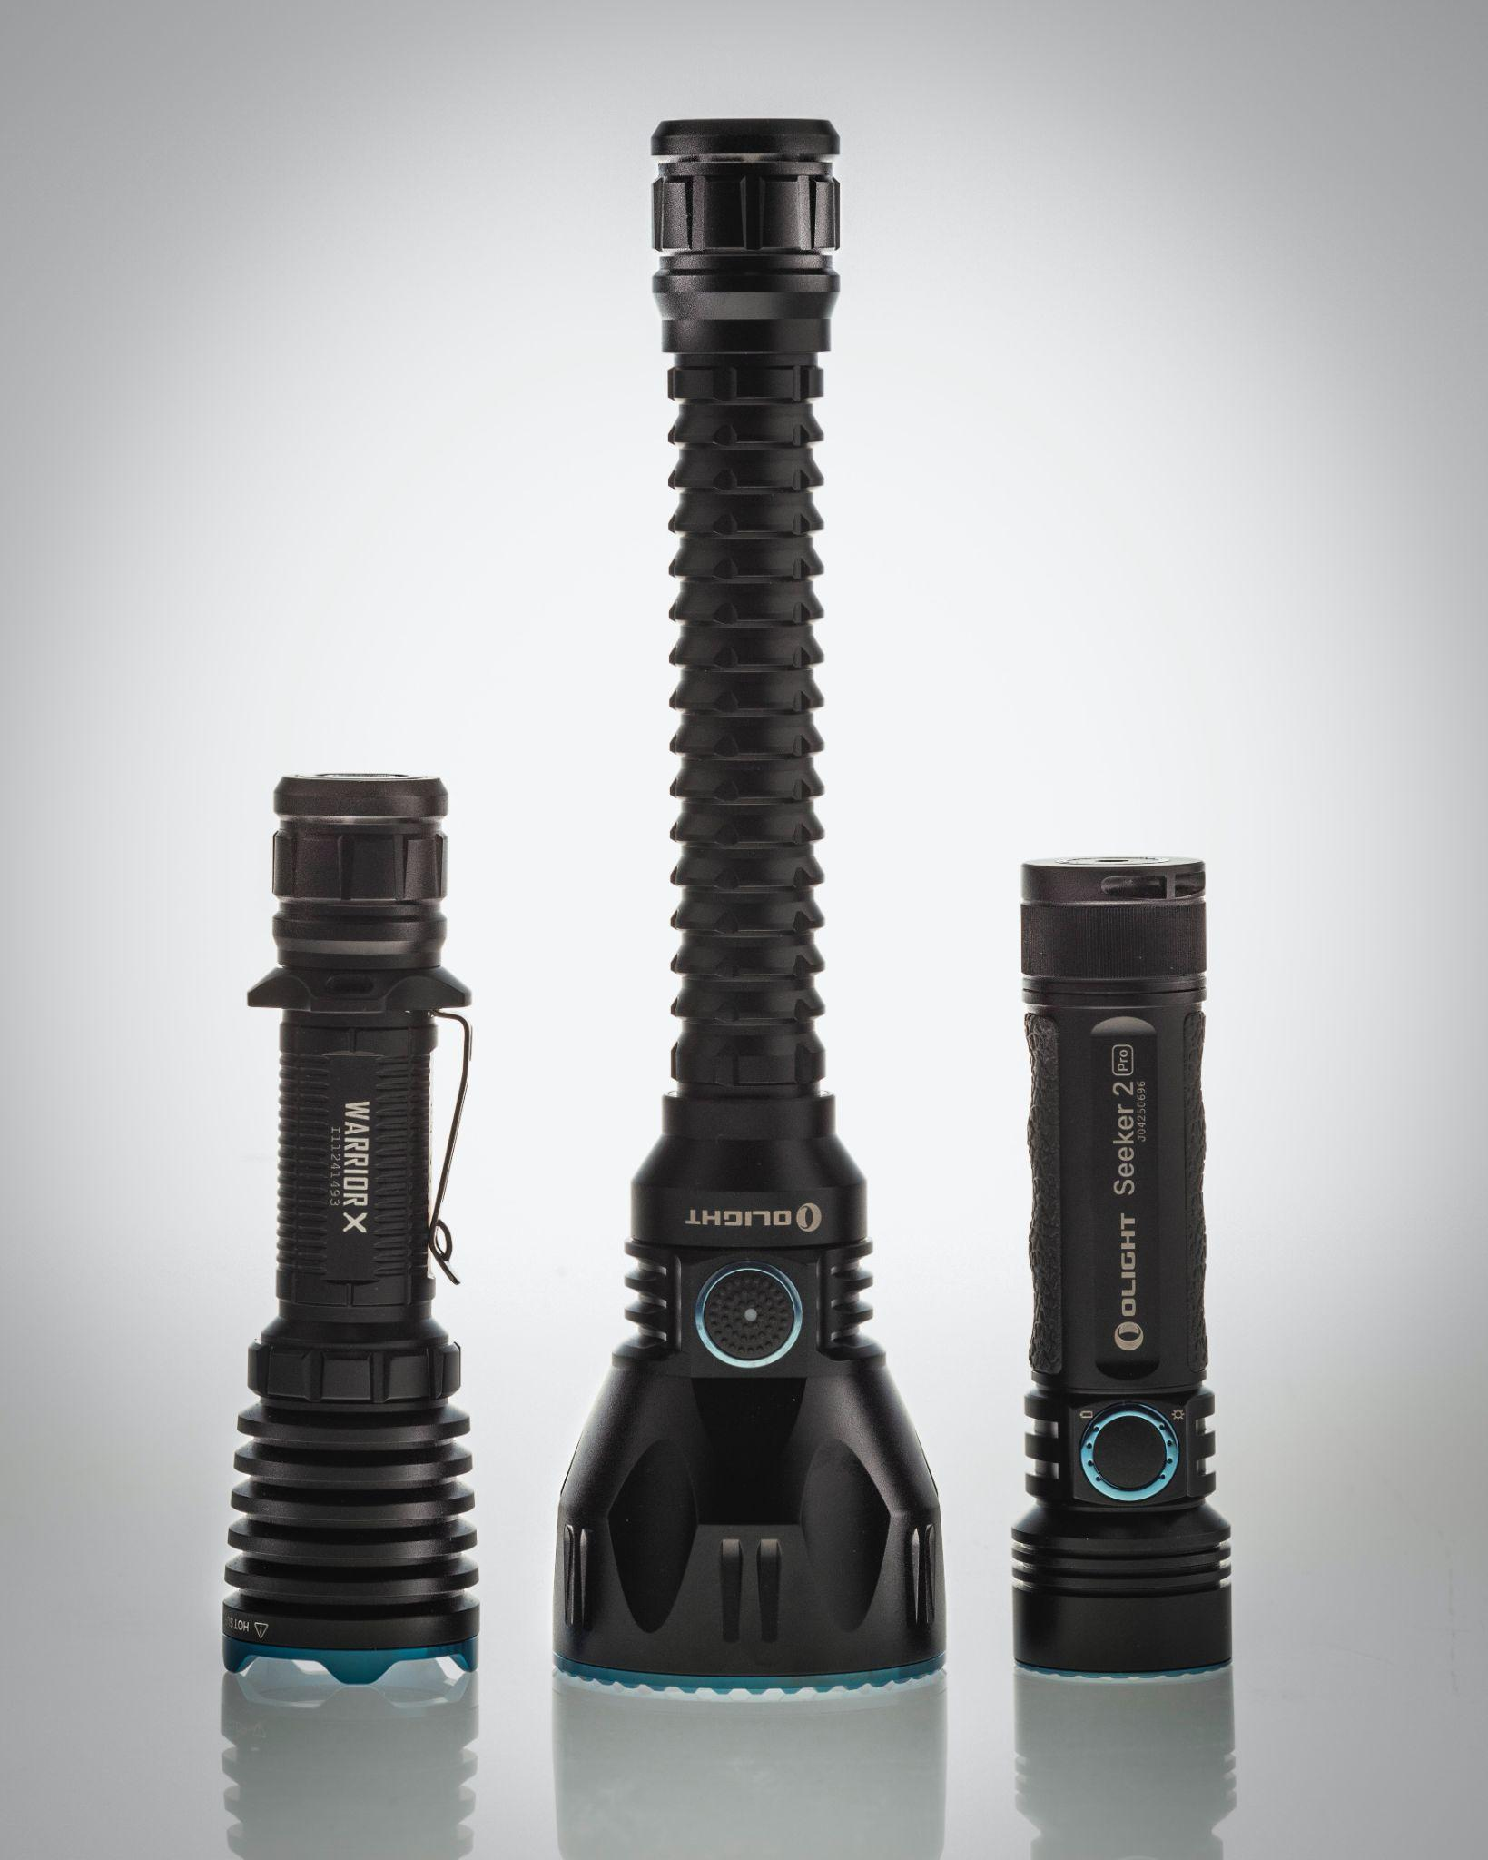
ᏐᏁᎵᏁ ᏣᎳᎩ ᎠᏕᎶᏆᏍᏗ
ᎯᎸᏍᎩ ᏗᏨᏍᏗ ᏓᏋᏯ.

Slide 22
ᏂᎦᏚᏏᏁ ᏣᎳᎩ ᎠᏕᎶᏆᏍᏗ
ᎯᎸᏍᎩ ᏗᏨᏍᏗ ᏓᏋᏴ.

Slide 23
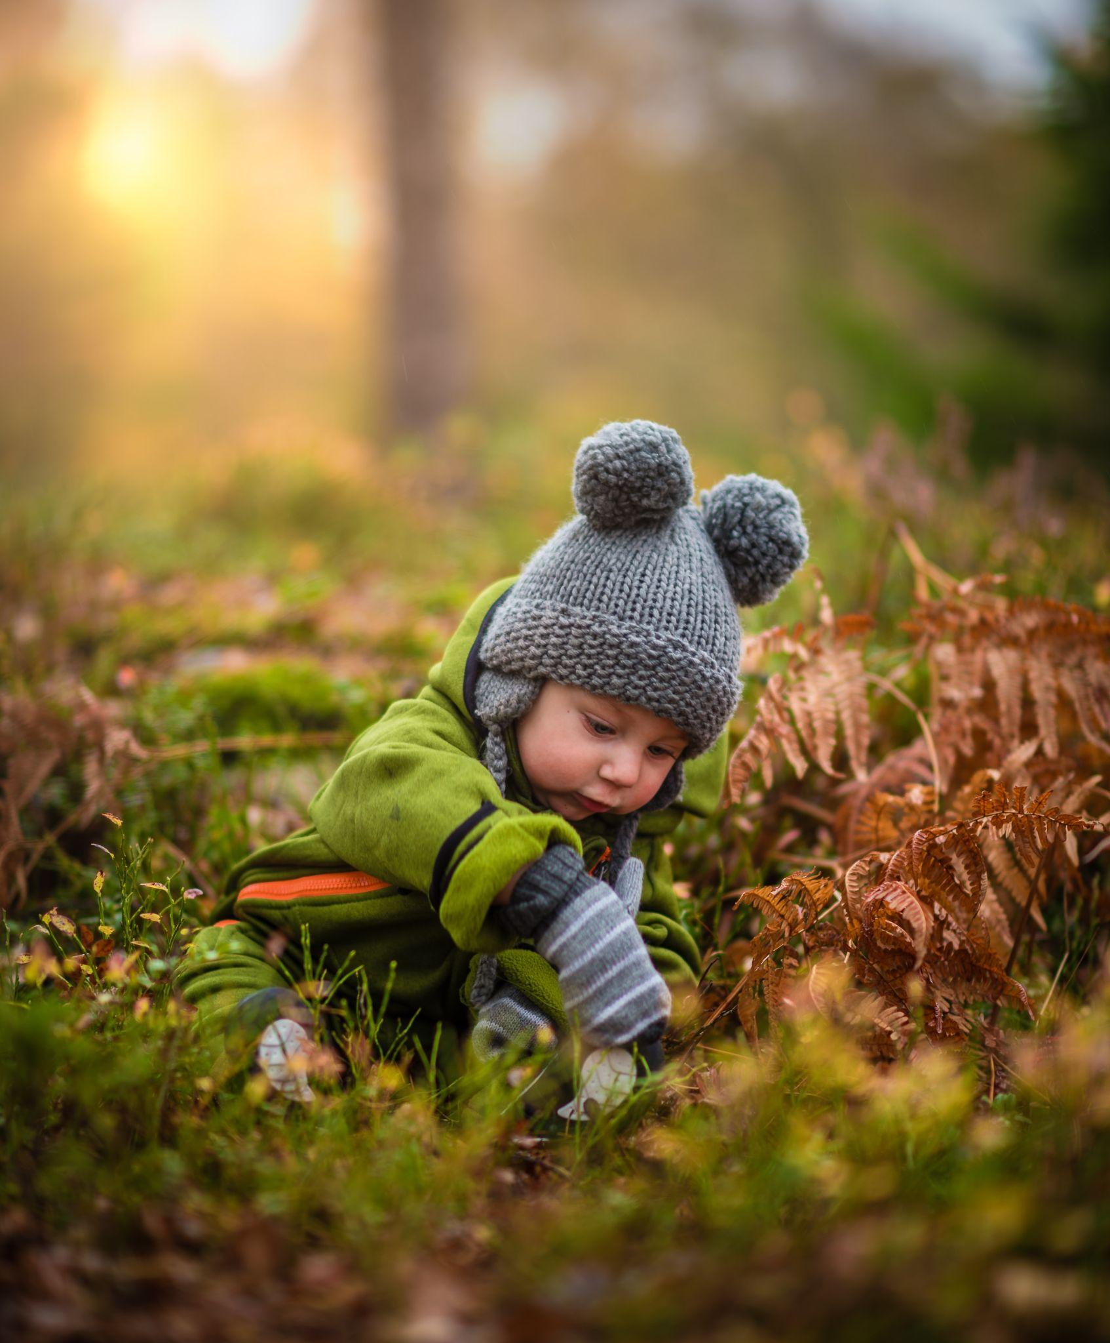
ᏐᏁᎵᏁ ᏣᎳᎩ ᎠᏕᎶᏆᏍᏗ
ᏗᎿᏬ ᏧᎦᎾᏩ ᏓᎩᎾ.

Slide 24
ᏂᎦᏚᏏᏁ ᏣᎳᎩ ᎠᏕᎶᏆᏍᏗ
ᏗᎿᏬ ᏧᎦᎾᏩ ᏓᎩᎾᎲ.

Slide 25
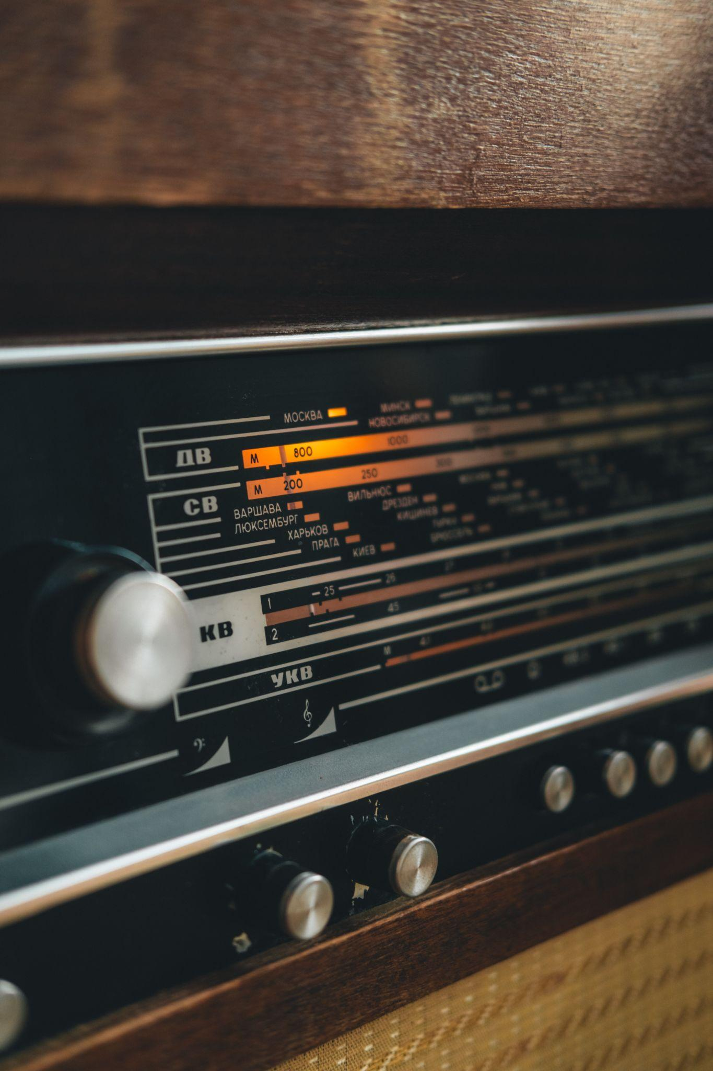
ᏐᏁᎵᏁ ᏣᎳᎩ ᎠᏕᎶᏆᏍᏗ
ᎦᏬᏂᏍᎩ ᎠᎩᎭ.

Slide 26
ᏂᎦᏚᏏᏁ ᏣᎳᎩ ᎠᏕᎶᏆᏍᏗ
ᎦᏬᏂᏍᎩ ᎠᎩᎲ.

Slide 27
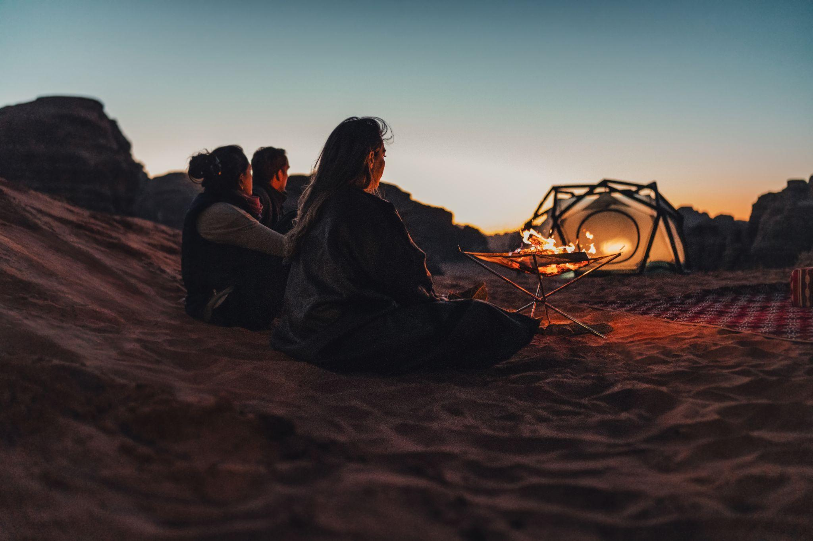
ᏐᏁᎵᏁ ᏣᎳᎩ ᎠᏕᎶᏆᏍᏗ
ᎦᎵᏦᏛᎢ ᎤᏴᏟ ᏣᎭᎷᎩᏍᎩ ᎠᎩᎾ.

Slide 28
ᏂᎦᏚᏏᏁ ᏣᎳᎩ ᎠᏕᎶᏆᏍᏗ
ᎦᎵᏦᏛᎢ ᎤᏴᏟ ᏣᎭᎷᎩᏍᎩ ᎠᎩᎾᎲ.

Slide 29
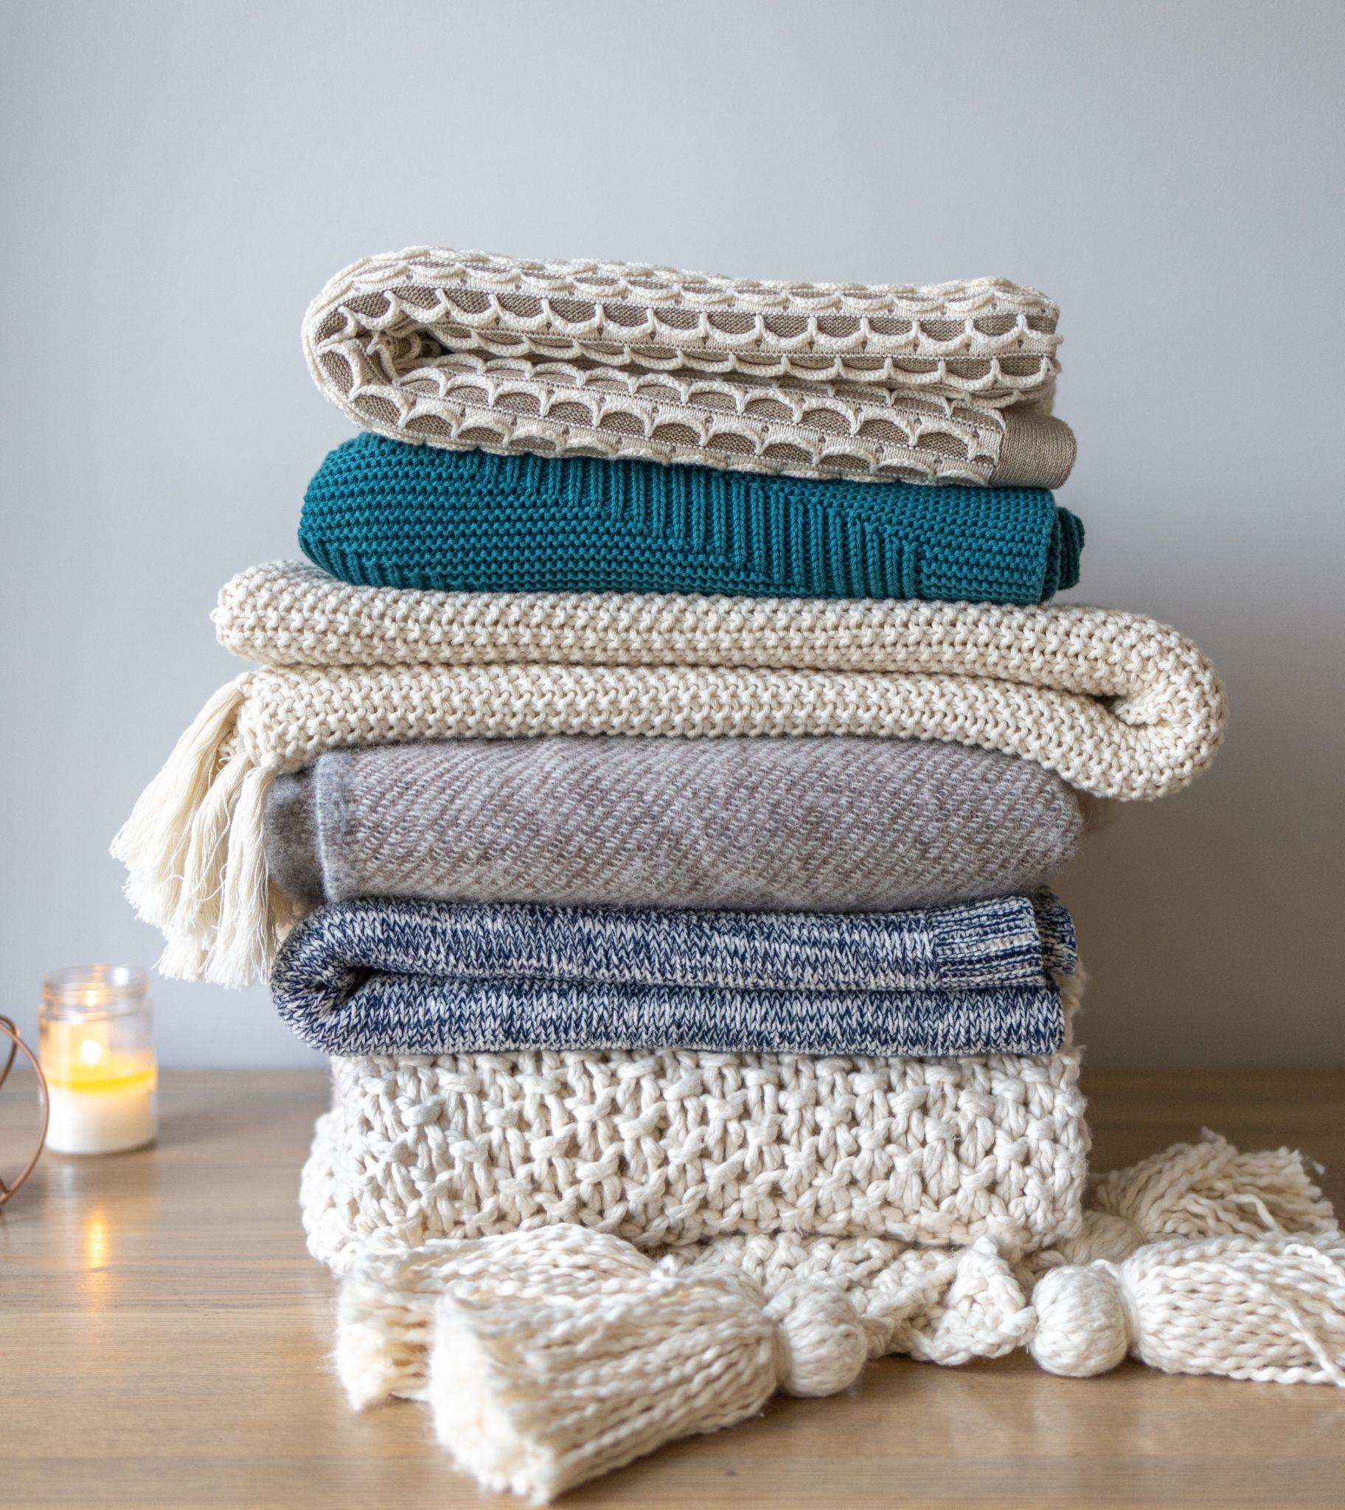
ᏐᏁᎵᏁ ᏣᎳᎩ ᎠᏕᎶᏆᏍᏗ
ᏧᏁᎦᎭ ᏓᎩᎾ.

Slide 30
ᏂᎦᏚᏏᏁ ᏣᎳᎩ ᎠᏕᎶᏆᏍᏗ
ᏧᏁᎦᎭ ᏓᎩᎾᎲ.

Slide 31
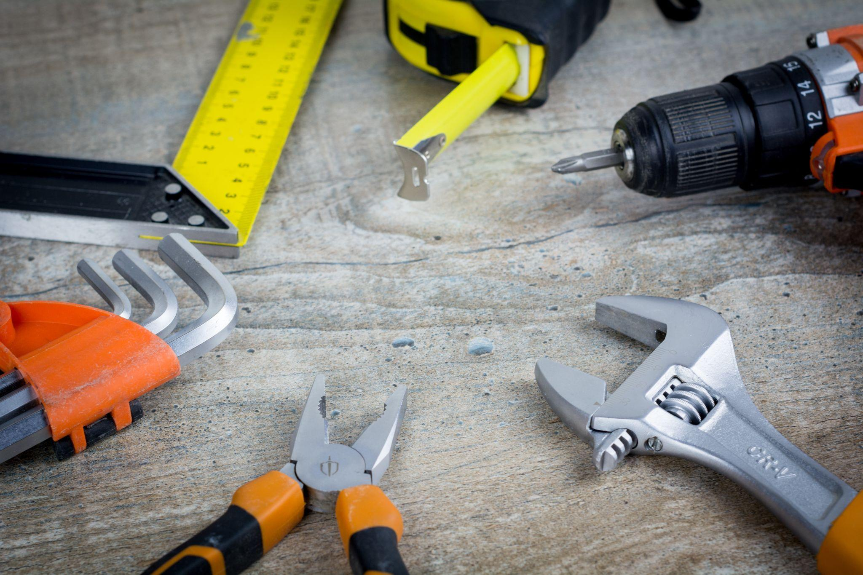
ᏐᏁᎵᏁ ᏣᎳᎩ ᎠᏕᎶᏆᏍᏗ
ᎦᏆᏕᏍᏙᏗ ᎠᎴ ᏗᎦᏂᏴᏙᏗ ᏓᏋᏯ.

Slide 32
ᏂᎦᏚᏏᏁ ᏣᎳᎩ ᎠᏕᎶᏆᏍᏗ
ᎦᏆᏕᏍᏙᏗ ᎠᎴ ᏗᎦᏂᏴᏙᏗ ᏓᏋᏴ.

Slide 33
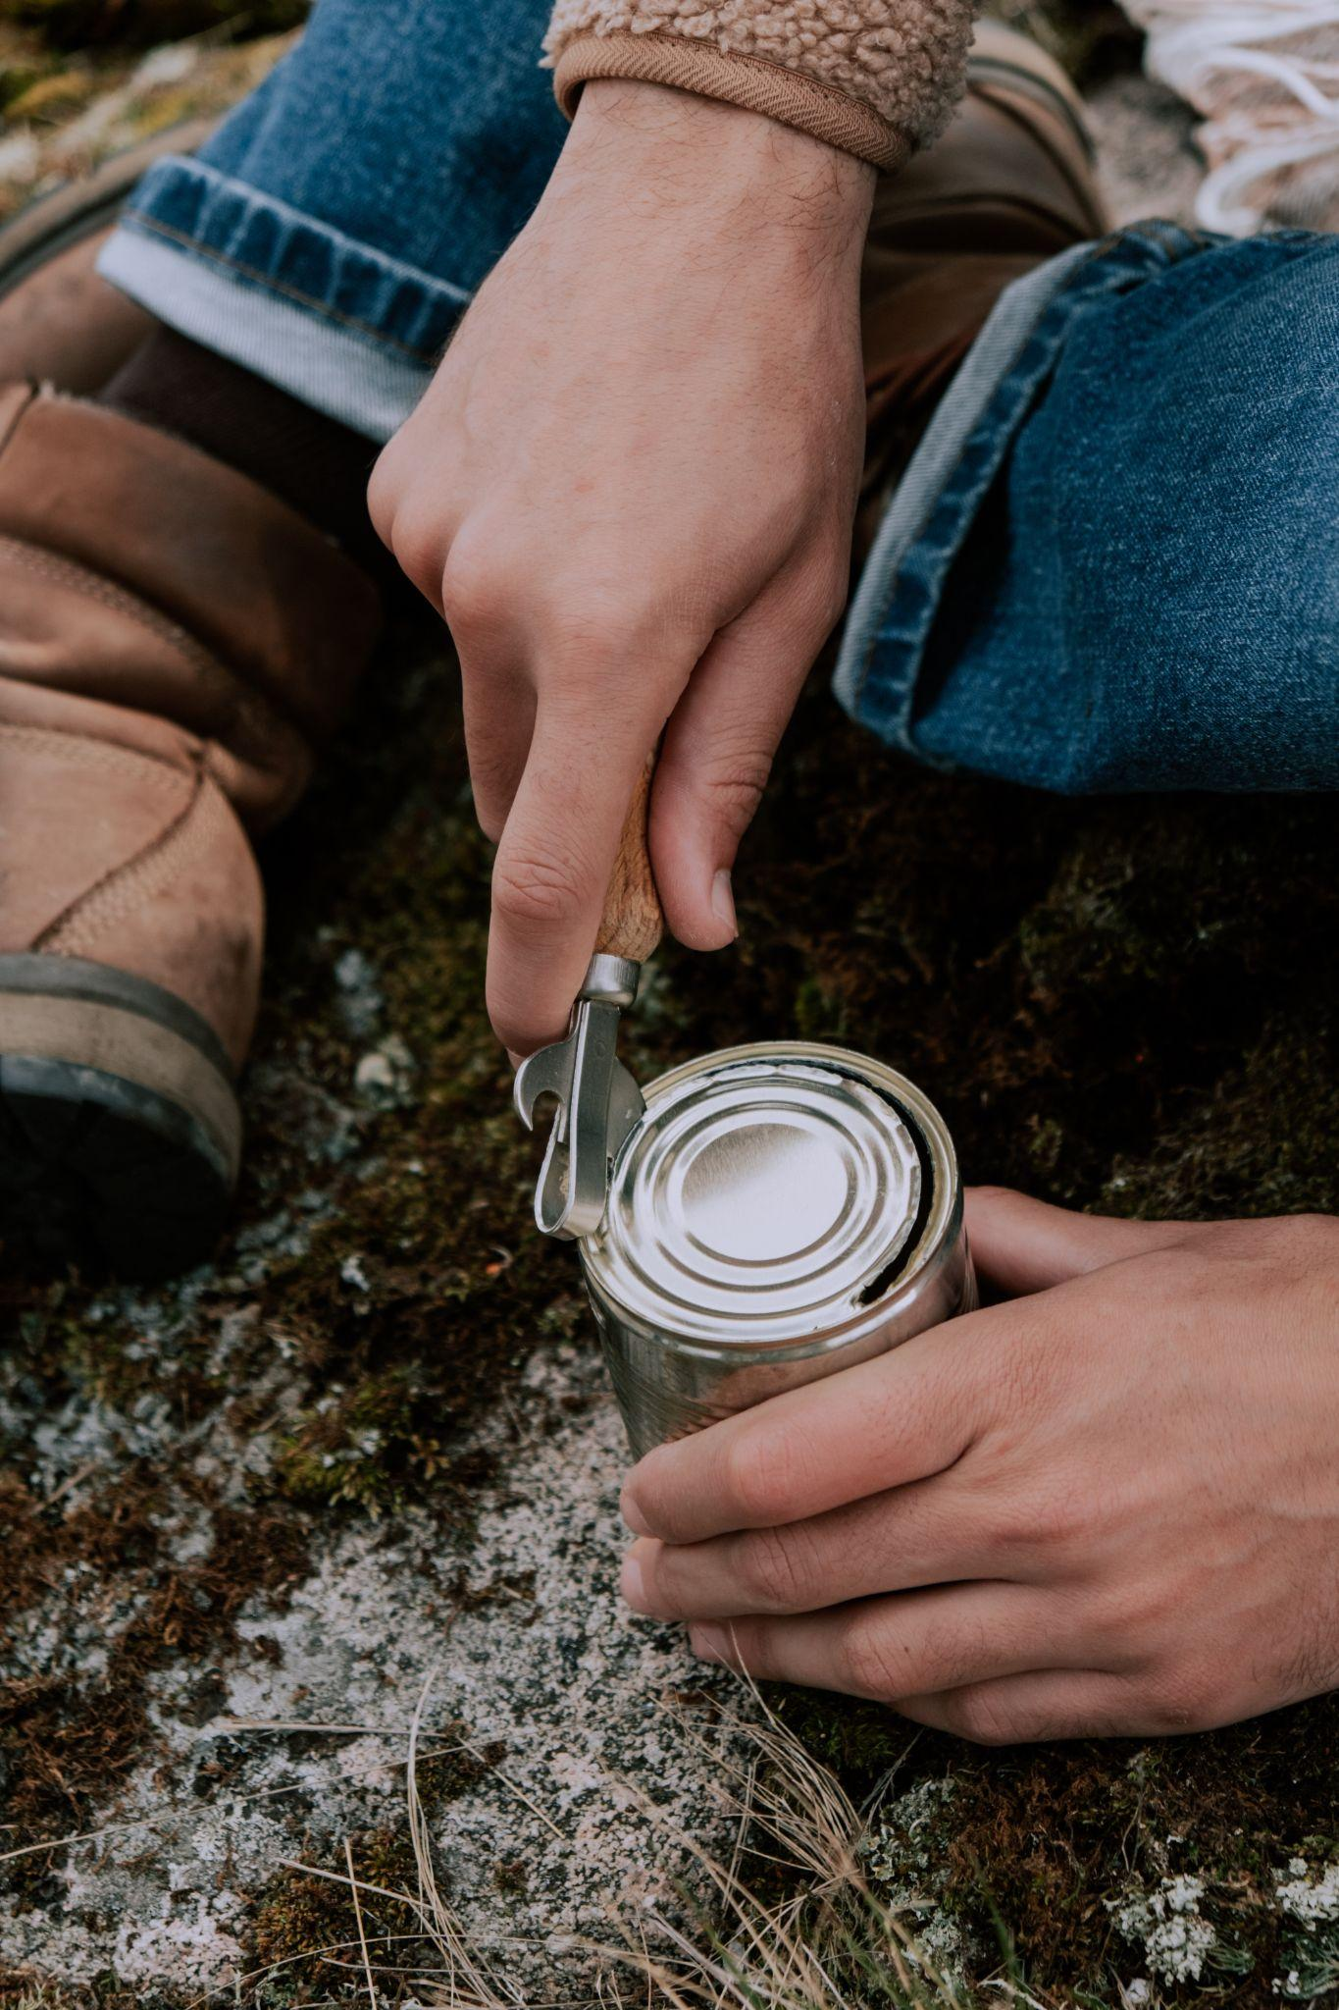
ᏐᏁᎵᏁ ᏣᎳᎩ ᎠᏕᎶᏆᏍᏗ
ᏔᎷᎩᏍᎩ ᎠᏍᏚᎢᏍᏙᏗ ᎠᏋᏯ.

Slide 34
ᏂᎦᏚᏏᏁ ᏣᎳᎩ ᎠᏕᎶᏆᏍᏗ
ᏔᎷᎩᏍᎩ ᎠᏍᏚᎢᏍᏙᏗ ᎠᏋᏴ.

Slide 35
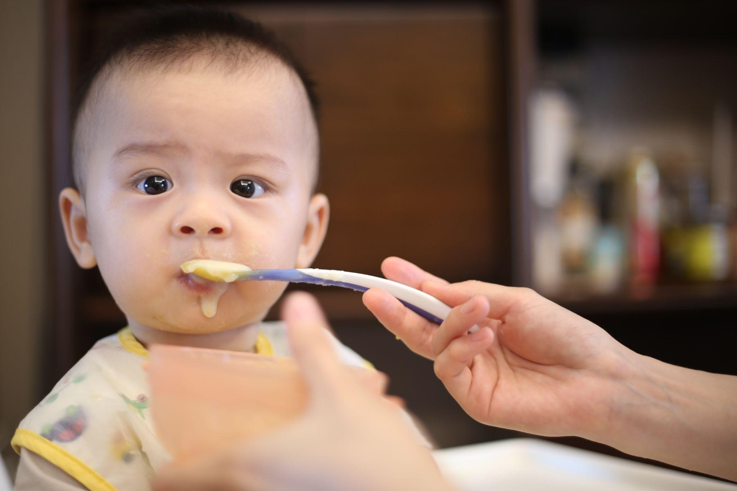
ᏐᏁᎵᏁ ᏣᎳᎩ ᎠᏕᎶᏆᏍᏗ
ᎤᏍᏗ ᎠᎵᏍᏓᏱᏗ ᏓᎩᎭ.

Slide 36
ᏂᎦᏚᏏᏁ ᏣᎳᎩ ᎠᏕᎶᏆᏍᏗ
ᎤᏍᏗ ᎠᎵᏍᏓᏱᏗ ᏓᎩᎲ.

Slide 37
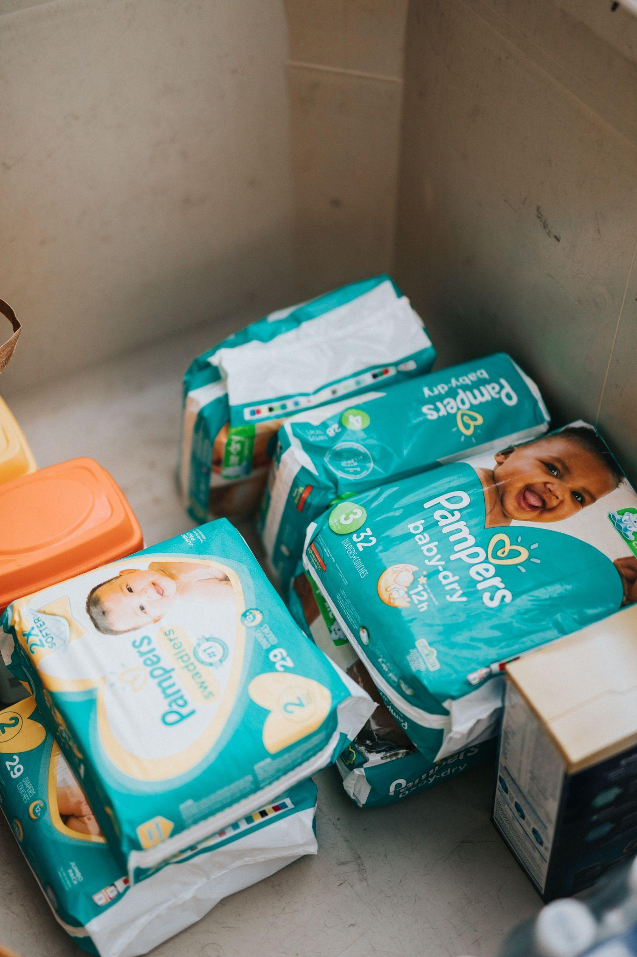
ᏐᏁᎵᏁ ᏣᎳᎩ ᎠᏕᎶᏆᏍᏗ
ᎥᏍᏊ, ᎢᎦᏓ ᏧᎾᏎᎶᏗ ᏓᎩᎾ.

Slide 38
ᏂᎦᏚᏏᏁ ᏣᎳᎩ ᎠᏕᎶᏆᏍᏗ
ᎥᏍᏊ, ᎢᎦᏓ ᏧᎾᏎᎶᏗ ᏓᎩᎾᎲ.

Slide 39
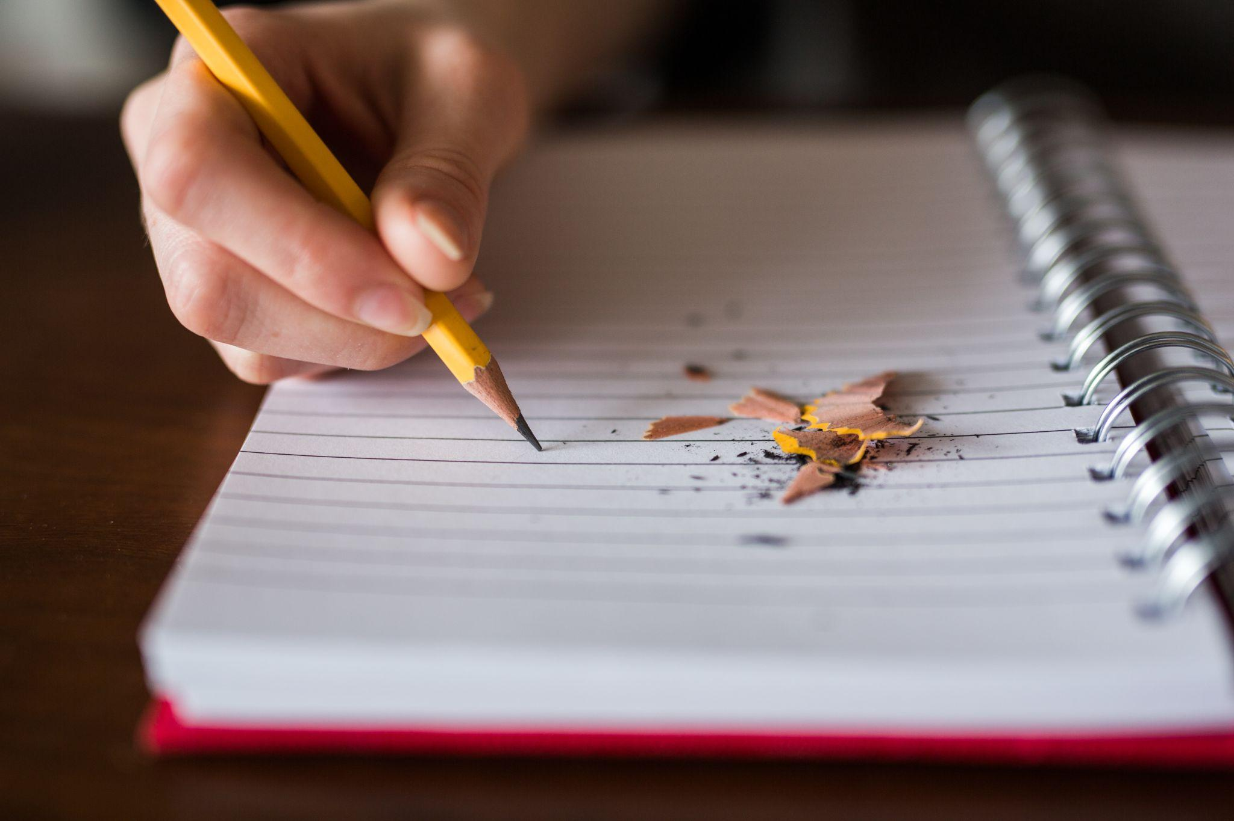
ᏐᏁᎵᏁ ᏣᎳᎩ ᎠᏕᎶᏆᏍᏗ
ᏗᎪᏪᎵ ᏓᎩᎾ.
ᎥᏍᏊ ᏗᎪᏪᎶᏗ ᏓᏋᏯ.

Slide 40
ᏂᎦᏚᏏᏁ ᏣᎳᎩ ᎠᏕᎶᏆᏍᏗ
ᏗᎪᏪᎵ ᏓᎩᎾᎲ.
ᎥᏍᏊ ᏗᎪᏪᎶᏗ ᏓᏋᏴ.

Slide 41
ᏂᎦᏚᏏᏁ ᏣᎳᎩ ᎠᏕᎶᏆᏍᏗ
ᎾᏛᏁᎲ- Verbs
Have something solid
ᎠᎩᎭ
ᏣᎭ
ᎤᎭ
ᎩᏂᎭ
ᎣᎩᏂᎭ
ᎢᎩᎭ
ᎣᎩᎭ
ᏍᏗᎭ
ᎢᏥᎭ
ᎤᏂᎭ

Slide 42
ᏂᎦᏚᏏᏁ ᏣᎳᎩ ᎠᏕᎶᏆᏍᏗ
ᎾᏛᏁᎲ- Verbs
Had something solid
ᎠᎩᎲ
ᏣᎲ/Ꭾ
ᎤᎲ/Ꭾ
ᎩᏂᎲ
ᎣᎩᏂᎲ
ᎢᎩᎲ
ᎣᎩᎲ
ᏍᏗᎲ/Ꭾ
ᎢᏥᎲ/Ꭾ
ᎤᏂᎲ/Ꭾ

Slide 43
ᏂᎦᏚᏏᏁ ᏣᎳᎩ ᎠᏕᎶᏆᏍᏗ
ᎾᏛᏁᎲ- Verbs
Have alive
ᎠᎩᎧ
ᏣᎧ
ᎤᏪᎧ
ᎩᏂᎧ
ᎣᎩᏂᎧ
ᎢᎩᎧ
ᎣᎩᎧ
ᏍᏗᎧ
ᎢᏥᎧ
ᎤᏂᎧ

Slide 44
ᏂᎦᏚᏏᏁ ᏣᎳᎩ ᎠᏕᎶᏆᏍᏗ
ᎾᏛᏁᎲ- Verbs
Had alive
ᎠᎩᎧᎲ
ᏣᎧᎲ
ᎤᏪᎧᎲ
ᎩᏂᎧᎲ
ᎣᎩᏂᎧᎲ
ᎢᎩᎧᎲ
ᎣᎩᎧᎲ
ᏍᏗᎧᎲ
ᎢᏥᎧᎲ
ᎤᏂᎧᎲ

Slide 45
ᏂᎦᏚᏏᏁ ᏣᎳᎩ ᎠᏕᎶᏆᏍᏗ
ᎾᏛᏁᎲ- Verbs
Have liquid
ᎠᎩᏁ
ᏣᏁ
ᎤᏁ
ᎩᏂᏁ
ᎣᎩᏂᏁ
ᎢᎩᏁ
ᎣᎩᏁ
ᏍᏗᏁ
ᎢᏥᏁ
ᎤᏂᏁ

Slide 46
ᏂᎦᏚᏏᏁ ᏣᎳᎩ ᎠᏕᎶᏆᏍᏗ
ᎾᏛᏁᎲ- Verbs
Had liquid
ᎠᎩᏁᎲ
ᏣᏁᎲ
ᎤᏁᎲ
ᎩᏂᏁᎲ
ᎣᎩᏂᏁᎲ
ᎢᎩᏁᎲ
ᎣᎩᏁᎲ
ᏍᏗᏁᎲ
ᎢᏥᏁᎲ
ᎤᏂᏁᎲ

Slide 47
ᏂᎦᏚᏏᏁ ᏣᎳᎩ ᎠᏕᎶᏆᏍᏗ
ᎾᏛᏁᎲ- Verbs
Have long
ᎠᏋᏯ
ᏨᏯ
ᎤᏮᏯ
ᎩᏅᏯ
ᎣᎩᏅᏯ
ᎢᎬᏯ
ᎣᎬᏯ
ᏍᏛᏯ
ᎢᏨᏯ
ᎤᏅᏯ

Slide 48
ᏂᎦᏚᏏᏁ ᏣᎳᎩ ᎠᏕᎶᏆᏍᏗ
ᎾᏛᏁᎲ- Verbs
Had long
ᎠᏋᏴ
ᏨᏴ
ᎤᏮᏴ
ᎩᏅᏴ
ᎣᎩᏅᏴ
ᎢᎬᏴ
ᎣᎬᏴ
ᏍᏛᏴ
ᎢᏨᏴ
ᎤᏅᏴ

Slide 49
ᏂᎦᏚᏏᏁ ᏣᎳᎩ ᎠᏕᎶᏆᏍᏗ
ᎾᏛᏁᎲ- Verbs
Have flexible
ᎠᎩᎾ
ᏣᎾ
ᎤᎾ
ᎩᏂᎾ
ᎣᎩᏂᎾ
ᎢᎩᎾ
ᎣᎩᎾ
ᏍᏗᎾ
ᎢᏥᎾ
ᎤᏂᎾ

Slide 50
ᏂᎦᏚᏏᏁ ᏣᎳᎩ ᎠᏕᎶᏆᏍᏗ
ᎾᏛᏁᎲ- Verbs
Had flexible
ᎠᎩᎾᎥ
ᏣᎾᎥ
ᎤᎾᎥ
ᎩᏂᎾᎥ
ᎣᎩᏂᎾᎥ
ᎢᎩᎾᎥ
ᎣᎩᎾᎥ
ᏍᏗᎾᎥ
ᎢᏥᎾᎥ
ᎤᏂᎾᎥ

Slide 51
ᏂᎦᏚᏏᏁ ᏣᎳᎩ ᎠᏕᎶᏆᏍᏗ
ᎾᏛᏁᎲ- Verbs Pronoun prefixes
 | B | B- vowel | A | A- vowel
I | agi | agw | tsi | g
you | Tsa | j | hi | h
he,she,it | u | uw | a,ga | g
You and I | gini | gin | ini | in
He,she and I (not you) | ogini | ogin | osdi | osd
All of us | igi | ig | idi | id
All of us (not you) | ogi | og | otsi | ots
You two | sdi | sd | sdi | sd
You all | itsi | its | itsi | its
they | uni | un | ani | an

Slide 52
ᏂᎦᏚᏏᏁ ᏣᎳᎩ ᎠᏕᎶᏆᏍᏗ
ᎾᏛᏁᎲ- Verbs
getting / Picking up something solid from the ground
ᎫᏖᎠ
ᎱᏖᎠ
ᎫᏖᎠ
ᎢᏄᏖᎠ
ᎣᏍᏚᏖᎠ
ᎢᏚᏖᎠ
ᎣᏧᏖᎠ
ᏍᏚᏖᎠ
ᎢᏧᏖᎠ
ᎠᏄᏖᎠ

Slide 53
ᏂᎦᏚᏏᏁ ᏣᎳᎩ ᎠᏕᎶᏆᏍᏗ
ᎾᏛᏁᎲ- Verbs
getting / Picking up something alive from the ground
ᏥᏁᎩ
ᎯᏁᎩ
ᎦᏁᎩ
ᎢᏂᏁᎩ
ᎣᏍᏗᏁᎩ
ᎢᏗᏁᎩ
ᎣᏥᏁᎩ
ᏍᏗᏁᎩ
ᎢᏥᏁᎩ
ᎠᏂᏁᎩ

Slide 54
ᏂᎦᏚᏏᏁ ᏣᎳᎩ ᎠᏕᎶᏆᏍᏗ
ᎾᏛᏁᎲ- Verbs
getting / Picking up something flexible from the ground
ᏥᏁ
ᎯᏁ
ᎦᏁ
ᎢᏂᏁ
ᎣᏍᏗᏁ
ᎢᏗᏁ
ᎣᏥᏁ
ᏍᏗᏁ
ᎢᏥᏁ
ᎠᏂᏁ

Slide 55
ᏂᎦᏚᏏᏁ ᏣᎳᎩ ᎠᏕᎶᏆᏍᏗ
ᎾᏛᏁᎲ- Verbs
getting / Picking up something liquid from the ground
ᏥᏁᎩ
ᎯᏁᎩ
ᎦᏁᎩ
ᎢᏂᏁᎩ
ᎣᏍᏗᏁᎩ
ᎢᏗᏁᎩ
ᎣᏥᏁᎩ
ᏍᏗᏁᎩ
ᎢᏥᏁᎩ
ᎠᏂᏁᎩ

Slide 56
ᏂᎦᏚᏏᏁ ᏣᎳᎩ ᎠᏕᎶᏆᏍᏗ
Where did you get your cap?
She’s getting a gallon of milk.
We’re going and getting rocks.
I’m picking up a baby
ᎭᏢ ᏣᏁᏎ ᏣᎵᏍᏚᎶ?
ᏑᏟᎶᏓ ᎢᎦ ᎤᏅᏗ ᎦᏁᎩ
ᏅᏯ ᏫᏓᏲᏧᏖᏌ.
ᎤᏍᏗ ᏫᏥᏁᎩ

