Slide 1
ᎣᏏᏲ
ᏔᎵᏍᎪ ᏔᎵᏁ ᏣᎳᎩ ᎠᏕᎶᏆᏍᏗ

Slide 2
ᏔᎵᏍᎪ ᏔᎵᏁ ᏣᎳᎩ ᎠᏕᎶᏆᏍᏗ
ᎢᏓᎴᎾ- Let’s begin
ᏣᎳᎩ ᎢᏗᏬᏂ- Let’s talk Cherokee

Slide 3
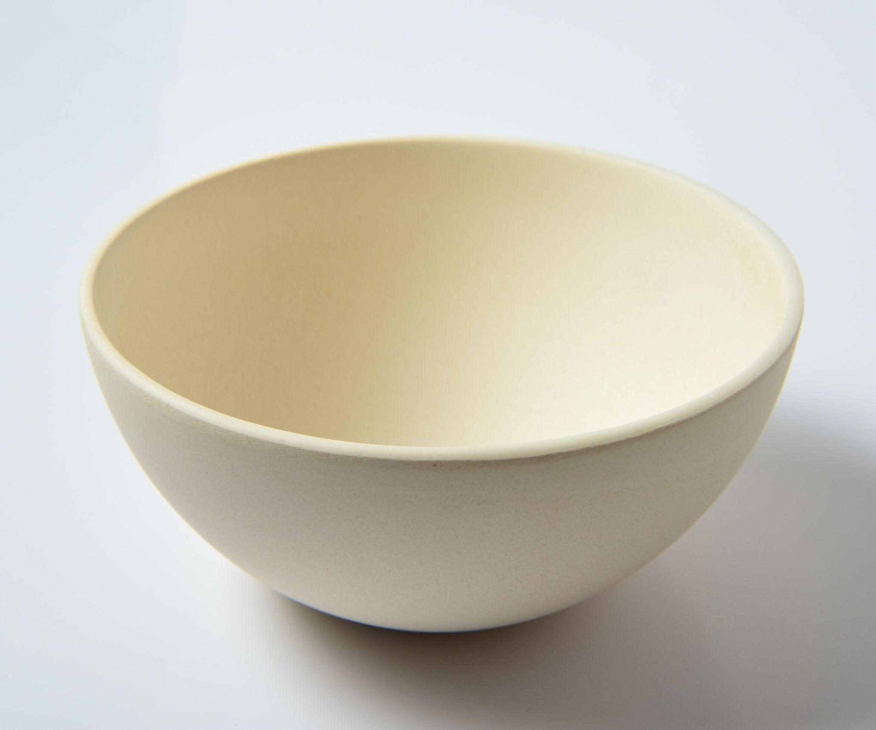
ᏔᎵᏍᎪ ᏔᎵᏁ ᏣᎳᎩ ᎠᏕᎶᏆᏍᏗ
ᎾᏛᏁᎲ- Verbs
solid
ᏍᎬᏏ- give it to me
ᎤᎭ- he/she has it
ᎤᎾᏪᏓ

Slide 4
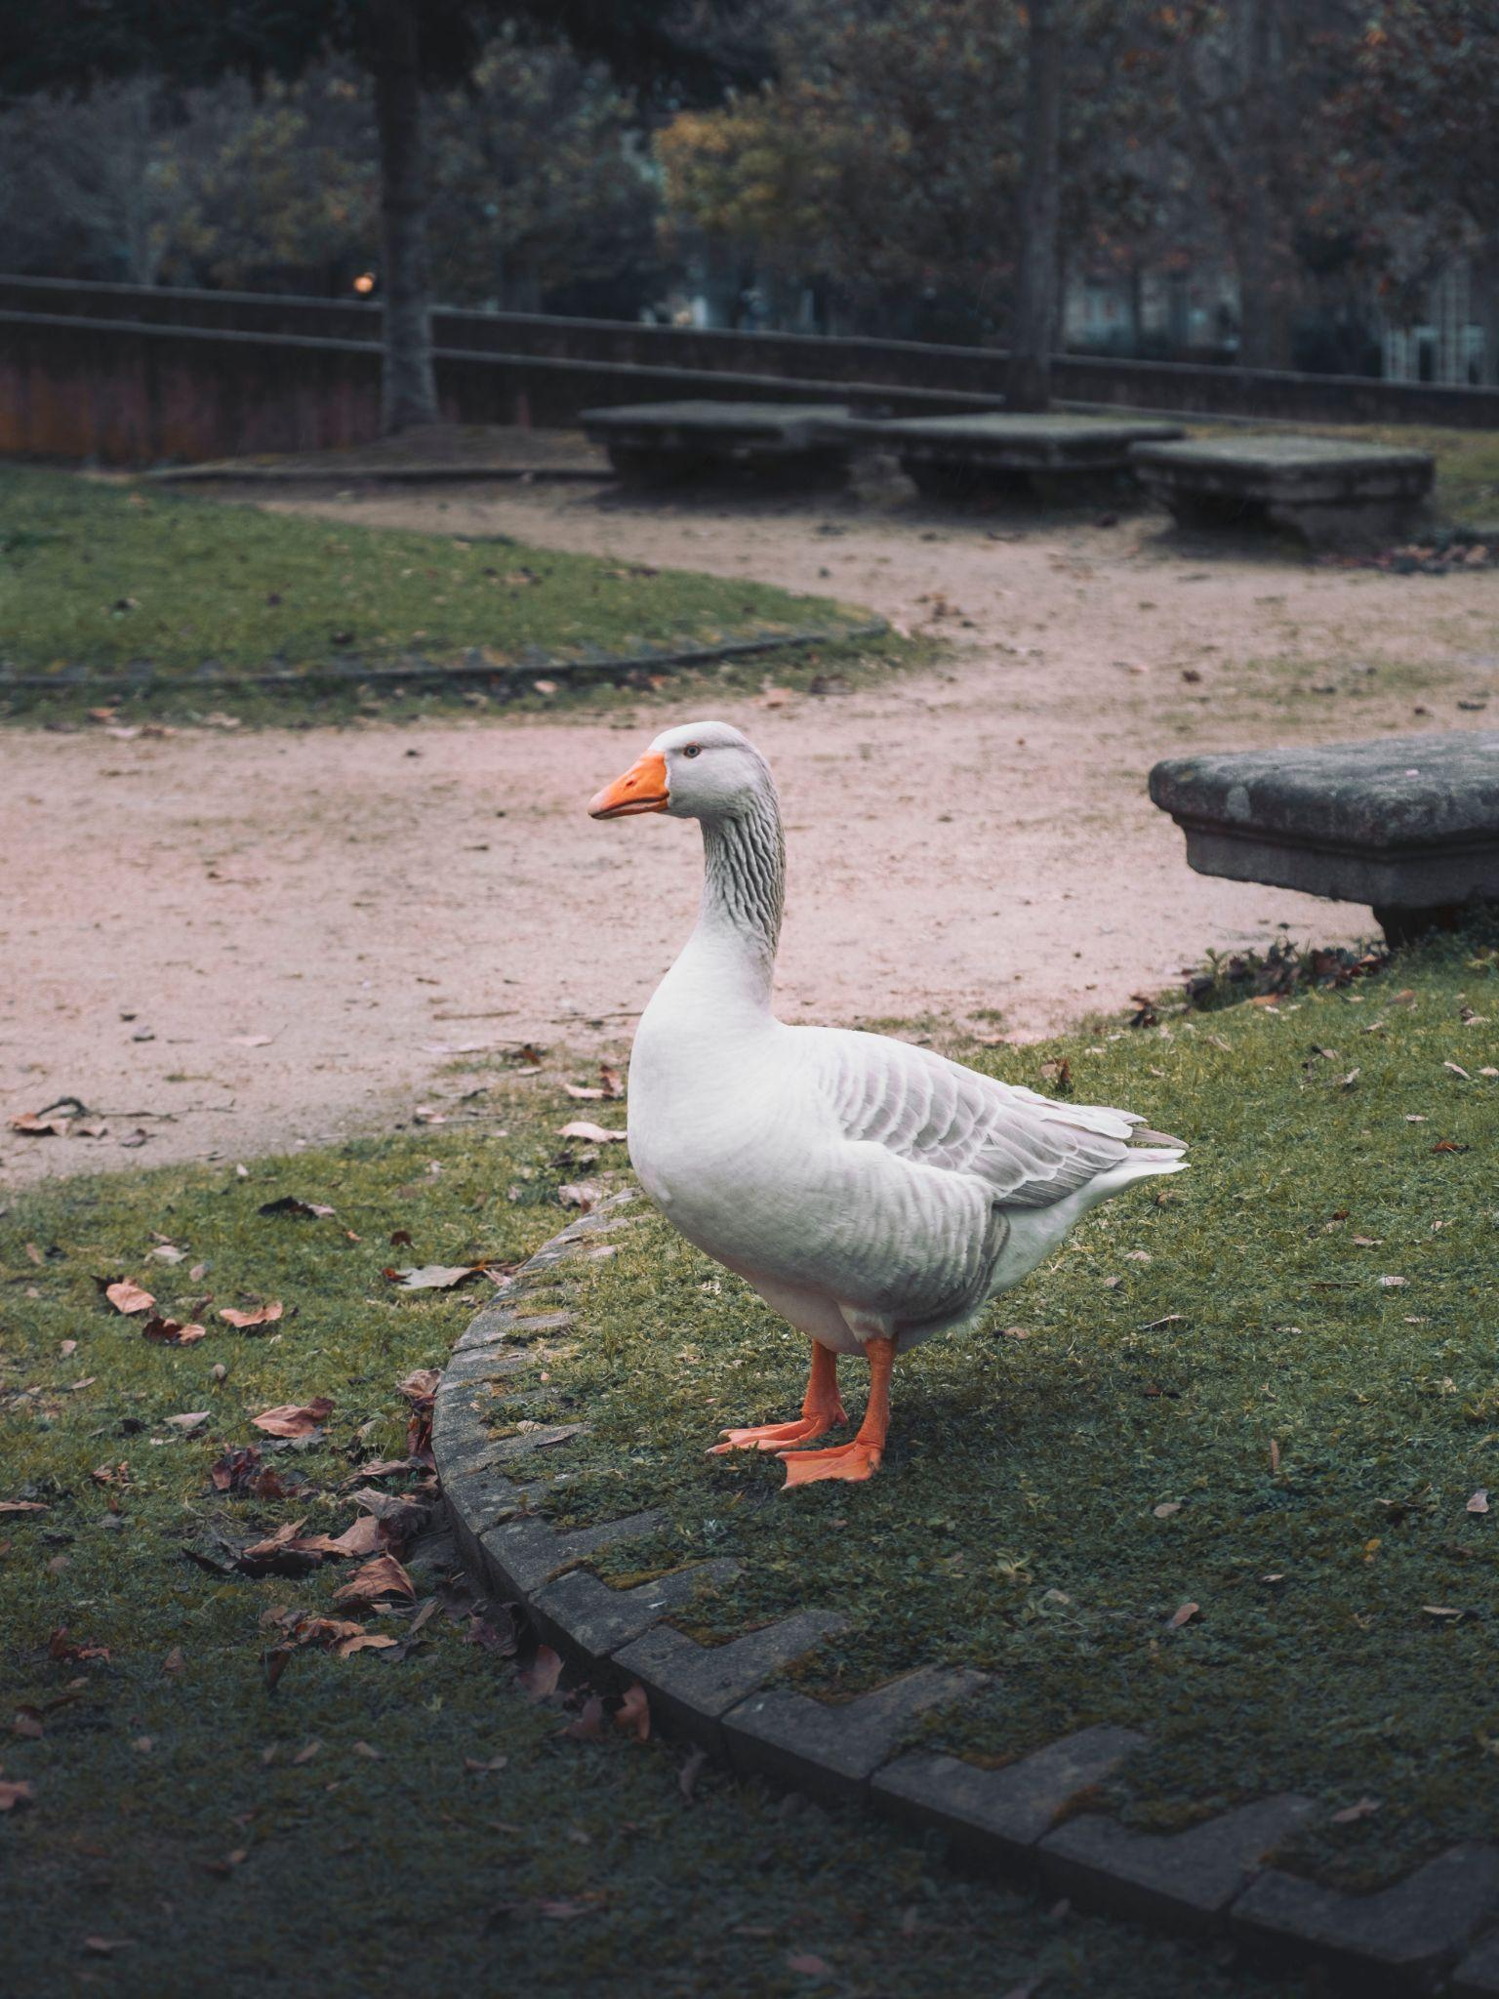
ᏔᎵᏍᎪ ᏔᎵᏁ ᏣᎳᎩ ᎠᏕᎶᏆᏍᏗ
ᎾᏛᏁᎲ- Verbs
alive
ᏍᎩᏯᎧᏏ- give it to me
ᎤᏪᎧ- he/she has it
ᏌᏌ

Slide 5
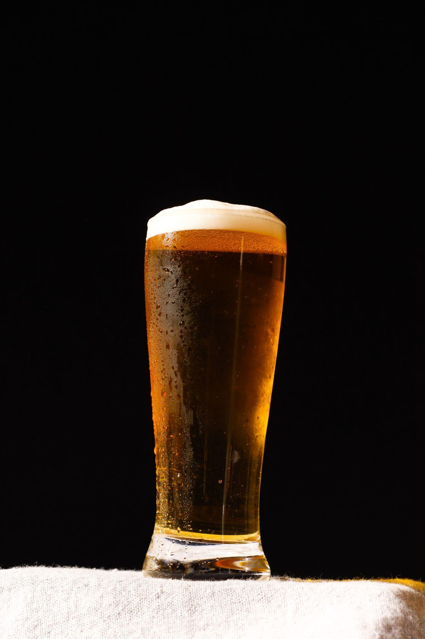
ᏔᎵᏍᎪ ᏔᎵᏁ ᏣᎳᎩ ᎠᏕᎶᏆᏍᏗ
ᎾᏛᏁᎲ- Verbs
liquid
ᏍᏁᎲᏏ- give it to me
ᎦᏁᏁ- he/she has it
ᎠᏗᏔᏍᏗ/ ᎤᏬᎩᏟ

Slide 6
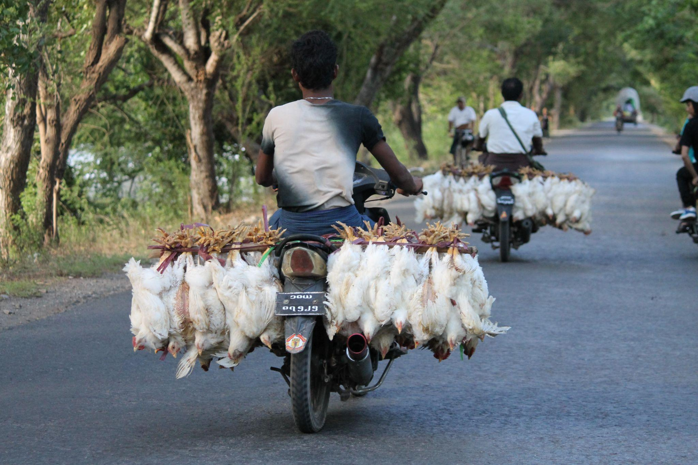
ᏔᎵᏍᎪ ᏔᎵᏁ ᏣᎳᎩ ᎠᏕᎶᏆᏍᏗ
ᎾᏛᏁᎲ- Verbs
flexible
ᏍᎩᏅᏏ- give it to me
ᎤᎾ- he/she has it
ᏥᏔᎦ ᎤᎵᏬᏨ

Slide 7
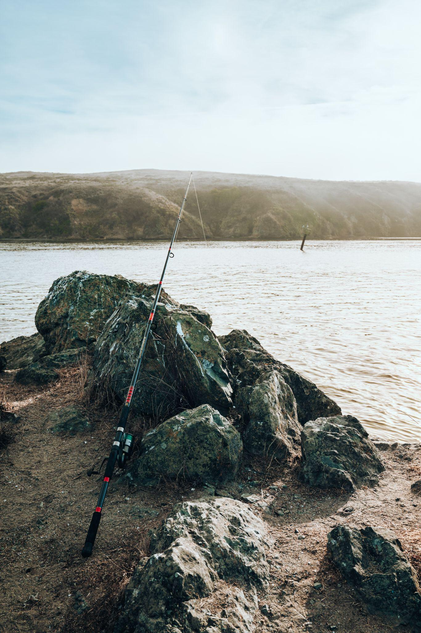
ᏔᎵᏍᎪ ᏔᎵᏁ ᏣᎳᎩ ᎠᏕᎶᏆᏍᏗ
ᎾᏛᏁᎲ- Verbs
long
ᏍᎩᏗᏏ- give it to me
ᎤᏮᏯ- he/she has it
ᏑᏗ

Slide 8
ᏔᎵᏍᎪ ᏔᎵᏁ ᏣᎳᎩ ᎠᏕᎶᏆᏍᏗ
Riddle Song (14th c)
I gave my love a cherry that had no stone.
I gave my love a chicken that had no bone.
I gave my love a baby with no crying.
And told my love a story that has no end.
ᎣᎩᏂᎵᏈᏗ ᎩᏔᏯ ᏥᏁᎸ ᎤᎧᏔ ᏄᎾᏑᏴ.
ᎣᎩᏂᎵᏈᏗ ᏥᏔᎦ ᏥᏯᎧᏁᎸ ᎪᎳ ᏄᎾᏑᏴ.
ᎣᎩᏂᎵᏈᏗ ᎤᏍᏗ ᎾᏠᏱᏍᎬᎾ ᏥᏯᎧᏁᎸ.
ᎣᎩᏂᎵᏈᏗ ᏥᏃᏎᎸ ᎾᏍᏆᏗᏍᎬᎾ ᎧᏃᎮᏓ.

Slide 9
ᏔᎵᏍᎪ ᏔᎵᏁ ᏣᎳᎩ ᎠᏕᎶᏆᏍᏗ
Riddle Song (14th c)
How can there be a cherry that has no stone?
How can there be a chicken that has no bone?
How can there be a baby with no crying?
How can you tell a story that has no end?
ᎯᎳ ᎡᎵ ᎩᏔᏯ ᎤᎧᏔ ᏄᏑᏴ ᏱᎩ?
ᎯᎳ ᎡᎵ ᏥᏔᎦ ᎪᎳ ᏄᏑᏴ ᏱᎩ?
ᎯᎳ ᎡᎵ ᎤᏍᏗ ᎾᏠᏱᏍᎬᎾ ᏱᎩ?
ᎯᎳ ᎡᎵ ᎧᏃᎮᏓ ᎾᏍᏆᏗᏍᎬᎾ ᏱᎩ

Slide 10
ᏔᎵᏍᎪ ᏔᎵᏁ ᏣᎳᎩ ᎠᏕᎶᏆᏍᏗ
Riddle Song (14th c)
A cherry when it’s blooming it has no stone.
A chicken when it’s pippin’ it has no bone.
A baby when it’s sleepin’ there’s no cryin’
And when I say I love you, it has no end.
ᎤᎧᏔ ᏄᏑᏴᎾ ᎨᏐ ᎩᏔᏯ ᏯᏥᎸᏍᎦ.
ᏥᏔᎦ ᎤᏪᏥ ᏱᎩ ᎪᎳ ᏄᏑᏴᎾ ᎨᏐ.
ᏱᎦᏟ ᎤᏍᏗ Ꮭ ᏯᏠᎯᎰ.
ᎾᏍᏆᏗᏍᎬᎾ ᎨᏐ ᏱᎬᏃᏎᎸ ᎬᎨᏳᏒ.

Slide 11
ᏔᎵᏍᎪ ᏔᎵᏁ ᏣᎳᎩ ᎠᏕᎶᏆᏍᏗ
ᎾᏛᏁᎲ- Verbs
Give me it
ᎡᏍᎬᏏ solid
ᎡᏍᎩᏯᎬᏏ alive
ᎡᏍᎩᏁᎲᏏ liquid
ᎡᏍᎩᏗᏏ long
ᎡᏍᎩᏅᏏ flexible

Slide 12
ᏔᎵᏍᎪ ᏔᎵᏁ ᏣᎳᎩ ᎠᏕᎶᏆᏍᏗ
ᎾᏛᏁᎲ- Verbs
Give me a piece of cake
Give me a match
Give me sons
Give me the coat
Give me the oil
ᎦᏚ ᎤᎦᎾᏍᏓ ᎠᎬᎭᎸᏓ ᏍᎬᏏ.
ᎠᏥᎳ ᎪᏢᏗ ᏍᎩᏗᏏ.
ᏗᏂᏲᏟ ᏗᏍᎩᏯᎧᏏ (bible).
ᎤᏩᏅ ᎦᏌᎴᏂ ᏍᎩᏅᏏ.
ᎪᎢ ᏍᎩᏁᎲᏏ.

Slide 13
ᏔᎷᏍᎪᎯᏁ ᏣᎳᎩ ᎠᏕᎶᏆᏍᏗ
ᎾᏛᏁᎲ- Verbs
Bringing something solid
ᏥᏲᎦ
ᎯᏲᎦ
ᎠᏲᎦ
ᎢᏂᏲᎦ
ᎣᏍᏗᏲᎦ
ᎢᏗᏲᎦ
ᎣᏥᏲᎦ
ᏍᏗᏲᎦ
ᎢᏥᏲᎦ
ᎠᏂᏲᎦ

Slide 14
ᏔᎷᏍᎪᎯᏁ ᏣᎳᎩ ᎠᏕᎶᏆᏍᏗ
ᎾᏛᏁᎲ- Verbs
Bringing something alive
ᏥᏃᎩ
ᎯᏃᎩ
ᎧᏃᎩ
ᎢᏂᏃᎩ
ᎣᏍᏗᏃᎩ
ᎢᏗᏃᎩ
ᎣᏥᏃᎩ
ᏍᏗᏃᎩ
ᎢᏥᏃᎩ
ᎠᏂᏃᎩ

Slide 15
ᏔᎷᏍᎪᎯᏁ ᏣᎳᎩ ᎠᏕᎶᏆᏍᏗ
ᎾᏛᏁᎲ- Verbs
Bringing something liquid
ᏥᏁᏤ
ᎯᏁᏤ
ᎦᏁᏤ
ᎢᏂᏁᏤ
ᎣᏍᏗᏁᏤ
ᎢᏗᏁᏤ
ᎣᏥᏁᏤ
ᏍᏗᏁᏤ
ᎢᏥᏁᏤ
ᎠᏂᏁᏤ

Slide 16
ᏔᎷᏍᎪᎯᏁ ᏣᎳᎩ ᎠᏕᎶᏆᏍᏗ
ᎾᏛᏁᎲ- Verbs
Bringing something long
ᏥᏃᎩ
ᎯᏃᎩ
ᎦᏃᎩ
ᎢᏂᏃᎩ
ᎣᏍᏗᏃᎩ
ᎢᏗᏃᎩ
ᎣᏥᏃᎩ
ᏍᏗᏃᎩ
ᎢᏥᏃᎩ
ᎠᏂᏃᎩ

Slide 17
ᏔᎷᏍᎪᎯᏁ ᏣᎳᎩ ᎠᏕᎶᏆᏍᏗ
ᎾᏛᏁᎲ- Verbs
Bringing something flexible
ᏥᏃᎩ
ᎯᏃᎩ
ᎦᏃᎩ
ᎢᏂᏃᎩ
ᎣᏍᏗᏃᎩ
ᎢᏗᏃᎩ
ᎣᏥᏃᎩ
ᏍᏗᏃᎩ
ᎢᏥᏃᎩ
ᎠᏂᏃᎩ

