Slide 1
ᎣᏏᏲ
ᏔᎵᏍᎪ ᎦᎵᏉᎩᏁ ᏣᎳᎩ ᎠᏕᎶᏆᏍᏗ

Slide 2
ᏔᎵᏍᎪ ᎦᎵᏉᎩᏁ ᏣᎳᎩ ᎠᏕᎶᏆᏍᏗ
ᎢᏓᎴᎾ- Let’s begin
ᏣᎳᎩ ᎢᏗᏬᏂ- Let’s talk Cherokee

Slide 3
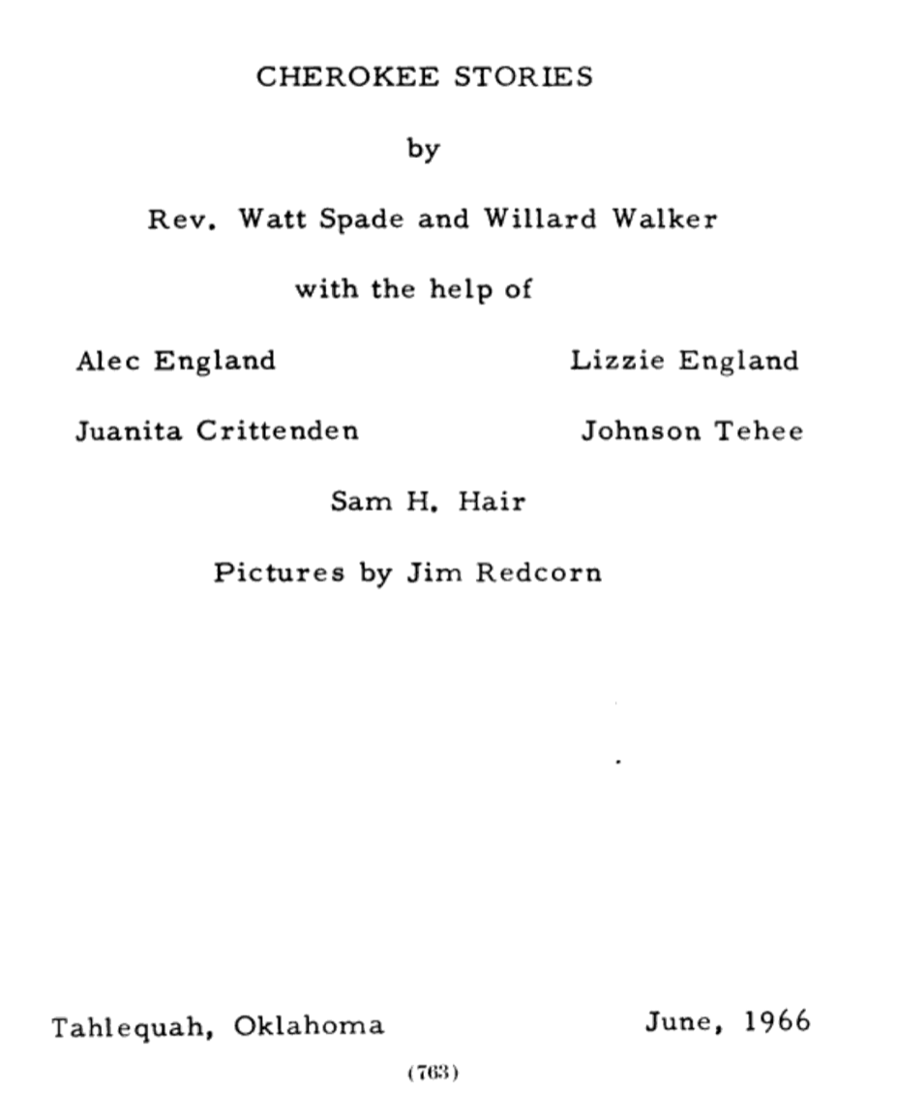
ᏔᎵᏍᎪ ᎦᎵᏉᎩᏁ ᏣᎳᎩ ᎠᏕᎶᏆᏍᏗ

Slide 4
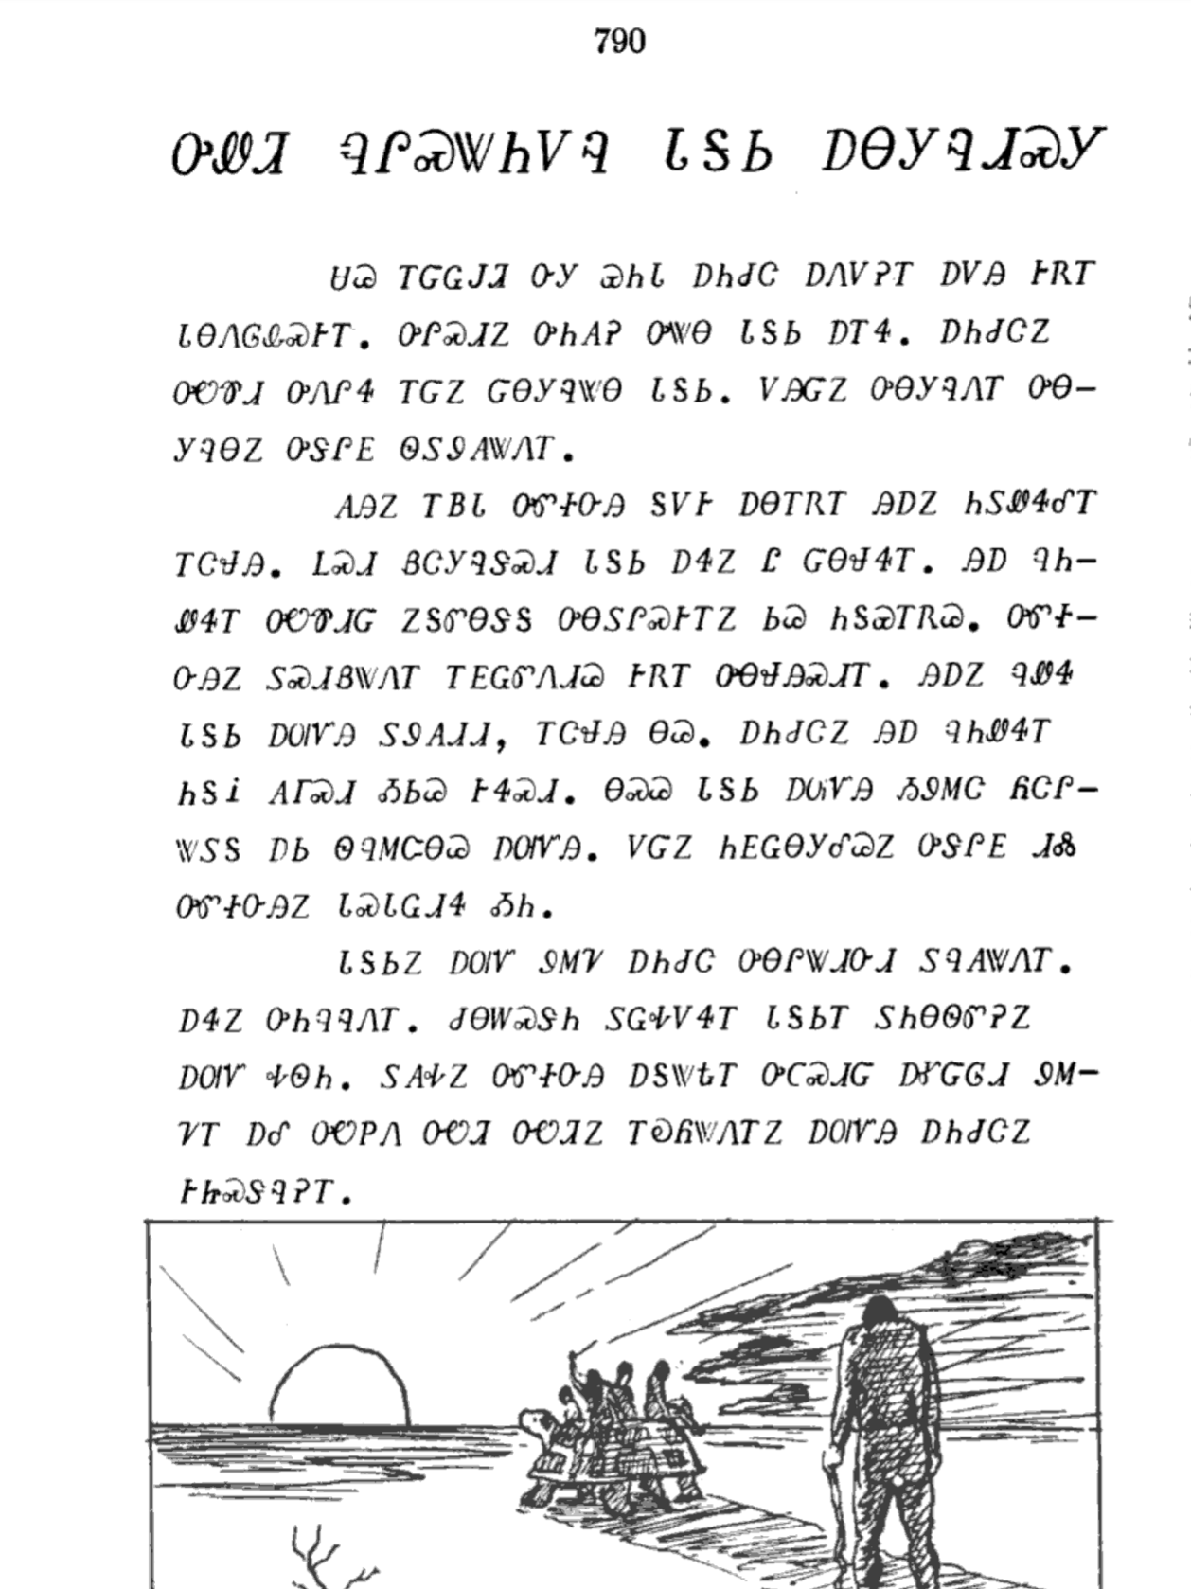
ᏔᎵᏍᎪ ᎦᎵᏉᎩᏁ ᏣᎳᎩ ᎠᏕᎶᏆᏍᏗ
ᎤᏪᏘ ᏄᎵᏍᏔᏂᏙᎸ ᏓᎦᏏ ᎠᏂᎩᎸᏗᏍᎩ

Slide 5
ᏔᎵᏍᎪ ᎦᎵᏉᎩᏁ ᏣᎳᎩ ᎠᏕᎶᏆᏍᏗ
ᏌᏊ ᎢᏳᏩᎫᏘ ᏅᎩ ᏯᏂᏓ ᎠᏂᏧᏣ ᎠᏁᏙᎮᎢ ᎠᏙᎯ ᎨᏒᎢ ᏓᎾᏁᎶᎲᏍᎨᎢ.

Slide 6
ᏔᎵᏍᎪ ᎦᎵᏉᎩᏁ ᏣᎳᎩ ᎠᏕᎶᏆᏍᏗ
ᎤᎵᏍᏗᏃ ᎤᏂᎪᎮ ᎤᏔᎾ ᏓᎦᏏ ᎠᎢᏎ.

Slide 7
ᏔᎵᏍᎪ ᎦᎵᏉᎩᏁ ᏣᎳᎩ ᎠᏕᎶᏆᏍᏗ
ᎠᏂᏧᏣᏃ ᎤᏬᏡᏗ ᎤᏁᎵᏎ ᎢᏳᏃ ᏳᎾᎩᎸᏔᎾ ᏓᎦᏏ.

Slide 8
ᏔᎵᏍᎪ ᎦᎵᏉᎩᏁ ᏣᎳᎩ ᎠᏕᎶᏆᏍᏗ
ᏙᎯᏳᏃ ᎤᎾᎩᎸᏁᎢ ᎤᎾᎩᎸᎾᏃ ᏭᏕᎵᎬ ᏫᏚᏭᎪᏔᏁᎢ.

Slide 9
ᏔᎵᏍᎪ ᎦᎵᏉᎩᏁ ᏣᎳᎩ ᎠᏕᎶᏆᏍᏗ
ᎪᎯᏃ ᎢᏴᏓ ᎤᏛᏐᏅᎯ ᎦᏙᎨ ᎠᎾᎢᏒᎢ ᎯᎠᏃ ᏂᏚᏪᏎᎴᎢ ᎢᏣᏠᎯ.

Slide 10
ᏔᎵᏍᎪ ᎦᎵᏉᎩᏁ ᏣᎳᎩ ᎠᏕᎶᏆᏍᏗ
ᏞᏍᏗ ᏰᏣᎩᎸᏕᏍᏗ ᏓᎦᏏ ᎠᏎᏃ Ꮭ ᏳᎾᏠᏎᎢ.

Slide 11
ᏔᎵᏍᎪ ᎦᎵᏉᎩᏁ ᏣᎳᎩ ᎠᏕᎶᏆᏍᏗ
ᎯᎠ ᏄᏂᏪᏎᎢ ᎤᏬᏡᏗᏳ ᏃᎦᏛᎾᏕᎦ ᎤᎾᏚᎵᏍᎨᎢᏃ ᏏᏊ ᏂᎦᏯᎢᏒᏊ.

Slide 12
ᏔᎵᏍᎪ ᎦᎵᏉᎩᏁ ᏣᎳᎩ ᎠᏕᎶᏆᏍᏗ
ᎤᏛᏐᏅᎯᏃ ᏚᏍᏗᏰᏔᏁᎢ ᎢᎬᏩᏛᏁᏗᏊ ᎨᏒᎢ ᎤᎾᏠᎯᏍᏗᎢ.

Slide 13
ᏔᎵᏍᎪ ᎦᎵᏉᎩᏁ ᏣᎳᎩ ᎠᏕᎶᏆᏍᏗ
ᎯᎠᏃ ᏄᏪᏎ ᏓᎦᏏ ᎠᎺᏉᎯ ᏚᏭᎪᏗᏗ, ᎢᏣᏠᎯ ᎾᏊ.

Slide 14
ᏔᎵᏍᎪ ᎦᎵᏉᎩᏁ ᏣᎳᎩ ᎠᏕᎶᏆᏍᏗ
ᎠᏂᏧᏣᏃ ᎯᎠ ᏄᏂᏪᏎᎢ ᏂᎦᎢ ᎪᎱᏍᏗ ᎣᏏᏊ ᎨᏎᏍᏗ.

Slide 15
ᏔᎵᏍᎪ ᎦᎵᏉᎩᏁ ᏣᎳᎩ ᎠᏕᎶᏆᏍᏗ
ᎾᏍᏊ ᏓᎦᏏ ᎠᎺᏉᎯ ᏱᏭᎷᏣ ᏲᏣᎵᏔᏚᎦ ᎠᏏ ᏫᏄᎷᏨᎾᏊ ᎠᎺᏉᎯ.

Slide 16
ᏔᎵᏍᎪ ᎦᎵᏉᎩᏁ ᏣᎳᎩ ᎠᏕᎶᏆᏍᏗ
ᏙᏳᏃ ᏂᎬᏩᎾᎩᎴᏊᏃ ᎤᏕᎵᎬ ᏗᏜ ᎤᏛᏐᏅᎯᏃ ᏓᏍᏓᏩᏗᏎ ᎣᏂ.

Slide 17
ᏔᎵᏍᎪ ᎦᎵᏉᎩᏁ ᏣᎳᎩ ᎠᏕᎶᏆᏍᏗ
ᏓᎦᏏᏃ ᎠᎺᏉ ᏭᎷᏤ ᎠᏂᏧᏣ ᎤᎾᎵᏔᏗᏅᏗ ᏚᏄᎪᏔᏁᎢ.

Slide 18
ᏔᎵᏍᎪ ᎦᎵᏉᎩᏁ ᏣᎳᎩ ᎠᏕᎶᏆᏍᏗ
ᎠᏎᏃ ᎤᏂᏄᎸᏁᎢ.

Slide 19
ᏔᎵᏍᎪ ᎦᎵᏉᎩᏁ ᏣᎳᎩ ᎠᏕᎶᏆᏍᏗ
ᏧᎾᎳᏍᏕᏂ ᏚᏩᎭᏙᏎ ᏓᎦᏏᎢ ᏚᏃᎾᏫᏛᎮᏃ ᎠᎺᏉ ᎭᏫᏂ.

Slide 20
ᏔᎵᏍᎪ ᎦᎵᏉᎩᏁ ᏣᎳᎩ ᎠᏕᎶᏆᏍᏗ
ᏚᎪᎭᏃ ᎤᏛᏐᏅᎯ ᎠᎦᏔᎿᎢ ᎤᏟᏍᏗᏳ ᎠᎹᏳᎶᏗ ᏭᎷᏤᎢ ᎠᎴ ᎤᏬᏢᏁ ᏅᏬᏘ ᏅᏬᏘᏃ ᎢᎧᏲᏔᏁᎢᏃ ᎠᎺᏉᎯ ᎠᏂᏧᏣᏃ ᎨᏥᏍᏕᎸᎮᎢ.

