Slide 1
ᎣᏏᏲ
ᏔᎵᏍᎪ ᏐᏁᎵᏁ ᏣᎳᎩ ᎠᏕᎶᏆᏍᏗ

Slide 2
ᏔᎵᏍᎪ ᏐᏁᎵᏁ ᏣᎳᎩ ᎠᏕᎶᏆᏍᏗ
ᎢᏓᎴᎾ- Let’s begin
ᏣᎳᎩ ᎢᏗᏬᏂ- Let’s talk Cherokee

Slide 3
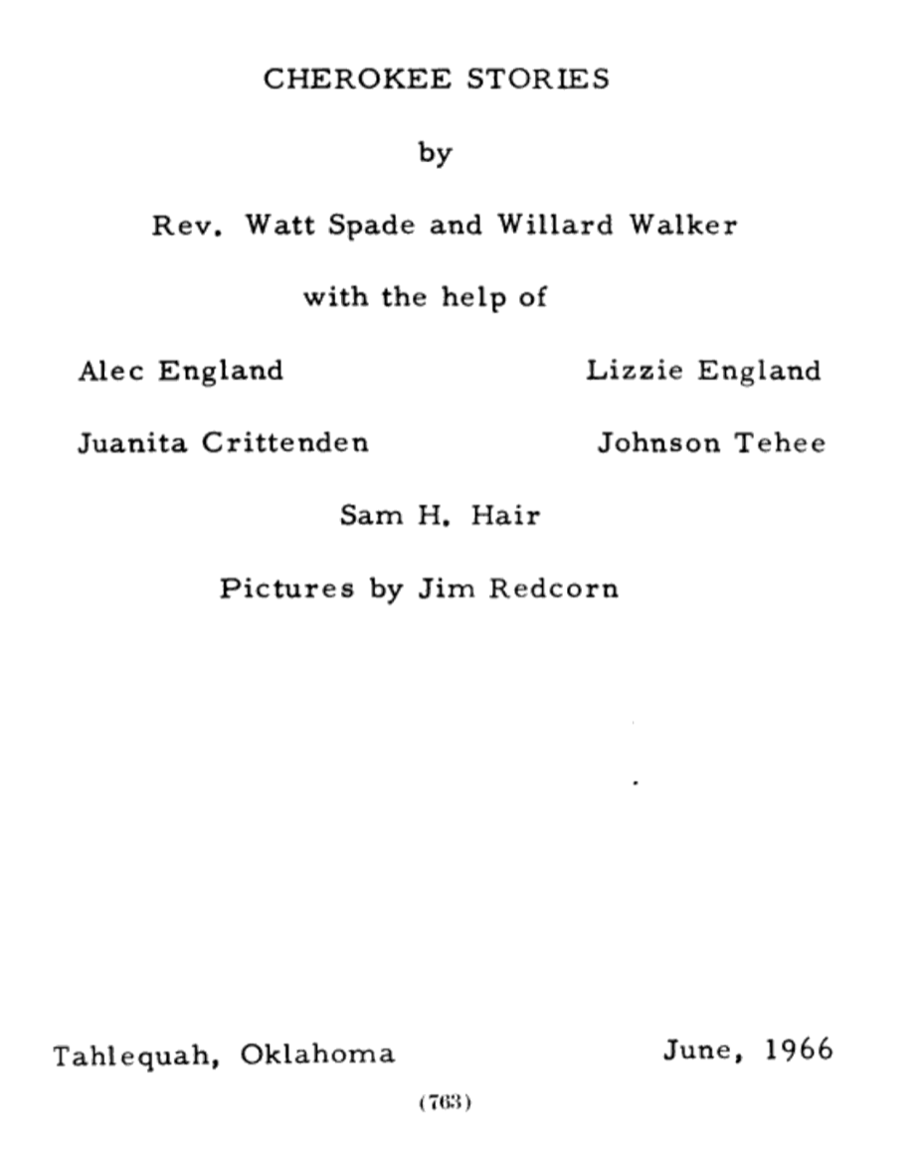
ᏔᎵᏍᎪ ᏐᏁᎵᏁ ᏣᎳᎩ ᎠᏕᎶᏆᏍᏗ

Slide 4
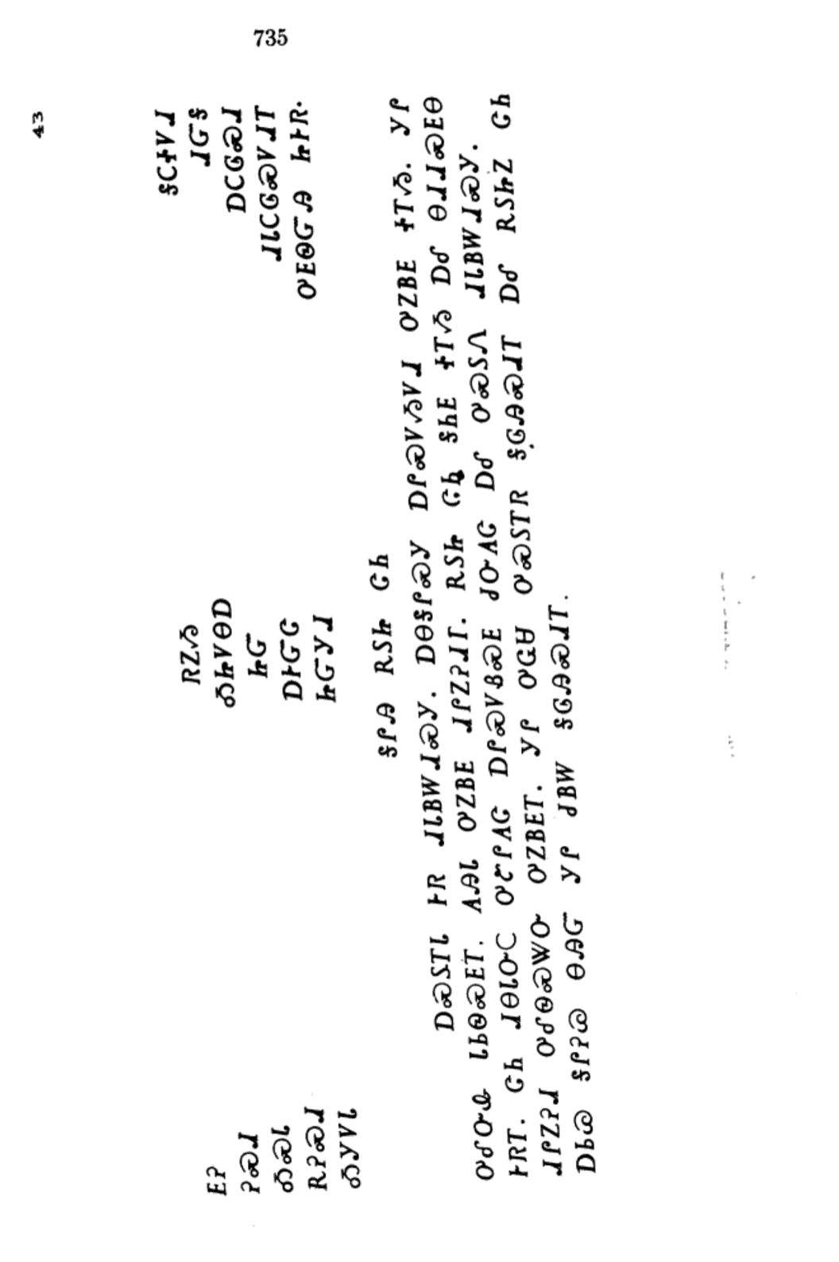
ᏔᎵᏍᎪ ᏐᏁᎵᏁ ᏣᎳᎩ ᎠᏕᎶᏆᏍᏗ
ᎦᎵᎯ ᎡᏚᏥ ᏣᏂ

Slide 5
ᏔᎵᏍᎪ ᏐᏁᎵᏁ ᏣᎳᎩ ᎠᏕᎶᏆᏍᏗ
ᎠᏍᏚᎢᏓ ᎨᏒ ᏗᏓᏴᎳᏗᏍᎩ.

Slide 6
ᏔᎵᏍᎪ ᏐᏁᎵᏁ ᏣᎳᎩ ᎠᏕᎶᏆᏍᏗ
ᎠᎾᎦᎵᏍᎩ ᎠᎵᏍᏙᏱᏙᏗ ᎤᏃᏴᎬ ᏐᎢᏱ.

Slide 7
ᏔᎵᏍᎪ ᏐᏁᎵᏁ ᏣᎳᎩ ᎠᏕᎶᏆᏍᏗ
ᎩᎵ ᎤᎴᏅᎲ ᏓᏏᏫᏍᎬᎢ.

Slide 8
ᏔᎵᏍᎪ ᏐᏁᎵᏁ ᏣᎳᎩ ᎠᏕᎶᏆᏍᏗ
ᎪᎯᏓ ᎤᏃᏴᎬ ᏗᎵᏃᎮᏗᎢ.

Slide 9
ᏔᎵᏍᎪ ᏐᏁᎵᏁ ᏣᎳᎩ ᎠᏕᎶᏆᏍᏗ
ᎡᏚᏥ ᏣᏂ ᎦᏂᎬ ᏐᎢᏱ ᎠᎴ ᎾᏗᏗᏍᎬᎾ ᎨᏒᎢ.

Slide 10
ᏔᎵᏍᎪ ᏐᏁᎵᏁ ᏣᎳᎩ ᎠᏕᎶᏆᏍᏗ
ᏣᏂ ᏗᎾᏓᏅᏟ ᎤᏑᎵᎪᏣ ᎠᎵᏍᏙᏰᏍᎬ ᏧᏅᎪᏣ ᎠᎴ ᎤᏍᏚᏁ ᏗᏓᏴᎳᏗᏍᎩ.

Slide 11
ᏔᎵᏍᎪ ᏐᏁᎵᏁ ᏣᎳᎩ ᎠᏕᎶᏆᏍᏗ
ᏗᎵᏃᎮᏗ ᎤᎴᏫᏍᏔᏅ ᎤᏃᏴᎬᎢ.

Slide 12
ᏔᎵᏍᎪ ᏐᏁᎵᏁ ᏣᎳᎩ ᎠᏕᎶᏆᏍᏗ
ᎩᎵ ᎤᏩᏌ ᎤᏍᏚᎢᏒ ᎦᎶᎯᏍᏗᎢ ᎠᎴ ᎡᏚᏥᏃ ᏣᏂ ᎠᏏᏊ ᎦᎵᎮᏊ ᎾᎯᏳ ᎩᎵ ᏧᏴᎳ ᎦᎶᎯᏍᏗ.

Slide 13
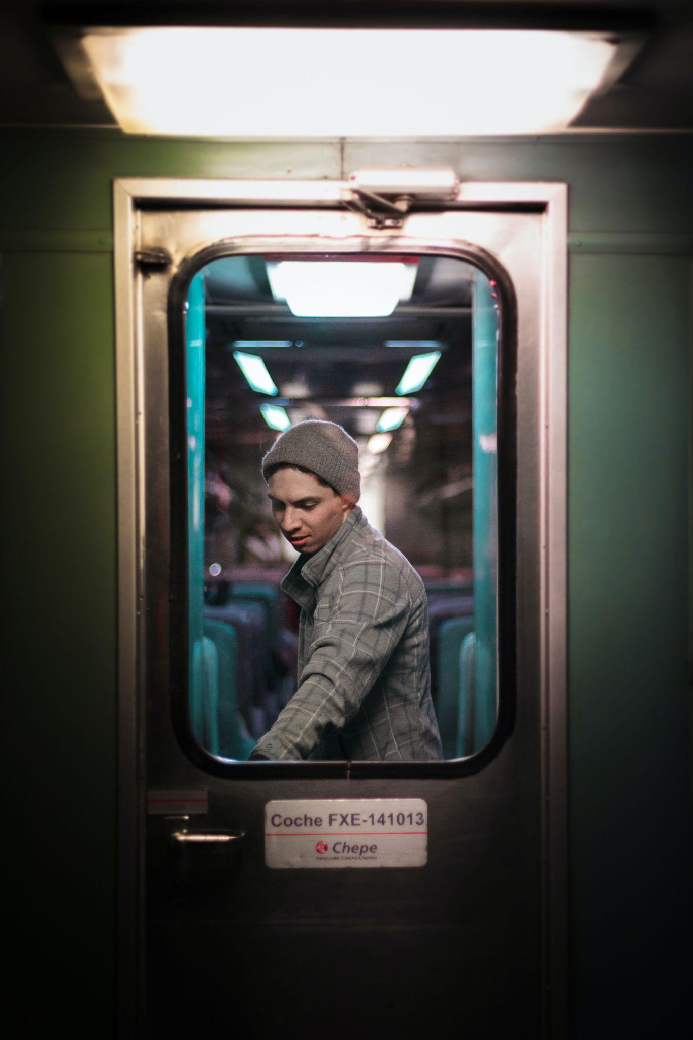
ᏔᎵᏍᎪ ᏐᏁᎵᏁ ᏣᎳᎩ ᎠᏕᎶᏆᏍᏗ
ᎠᏍᏚᎢ- he/she is opening it, turning it on
ᎦᎵᏉᎩ ᎢᏳᏩᏂᎸ ᎠᏍᏚᎢᏍᎪ ᎠᏓᎾᏅᎢ.
ᎤᏯᏅ ᎬᏗ ᎠᏍᏚᎢᏒ ᏓᎦᏏ.
ᏗᏍᏚᎢᏓ ᎢᎨᏎᏍᏗ ᏦᎳᏂ, ᏕᎯᏍᏚᏅᎢ.
ᏦᎳᏂ ᎯᏍᏚᎢ. ᎠᎧᏬᏍᏗ.
ᎦᎶᎯᏍᏗ ᎤᏍᏚᎢᏓ ᎨᏒ ᎠᏆᏕᎶᎰᏒ, ᏩᎩᏴᎸᎢ.

Slide 14
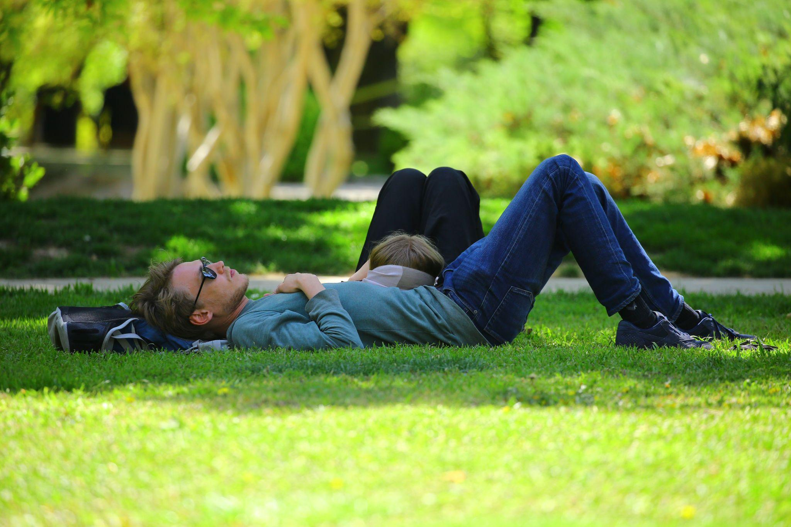
ᏔᎵᏍᎪ ᏐᏁᎵᏁ ᏣᎳᎩ ᎠᏕᎶᏆᏍᏗ
ᎦᏂᎦ- he/she is lying down
ᎡᎳᏗᏭ ᏥᏂᎨᏍᏗ.
ᎬᏃᏓᏍ Ꮎ ᎢᎾᏓ ᏥᎦᏂ?
ᎦᏍᎩᎸ ᎭᏫᏂ ᏗᏜ ᎦᏂᎦ ᏪᏌ.

Slide 15
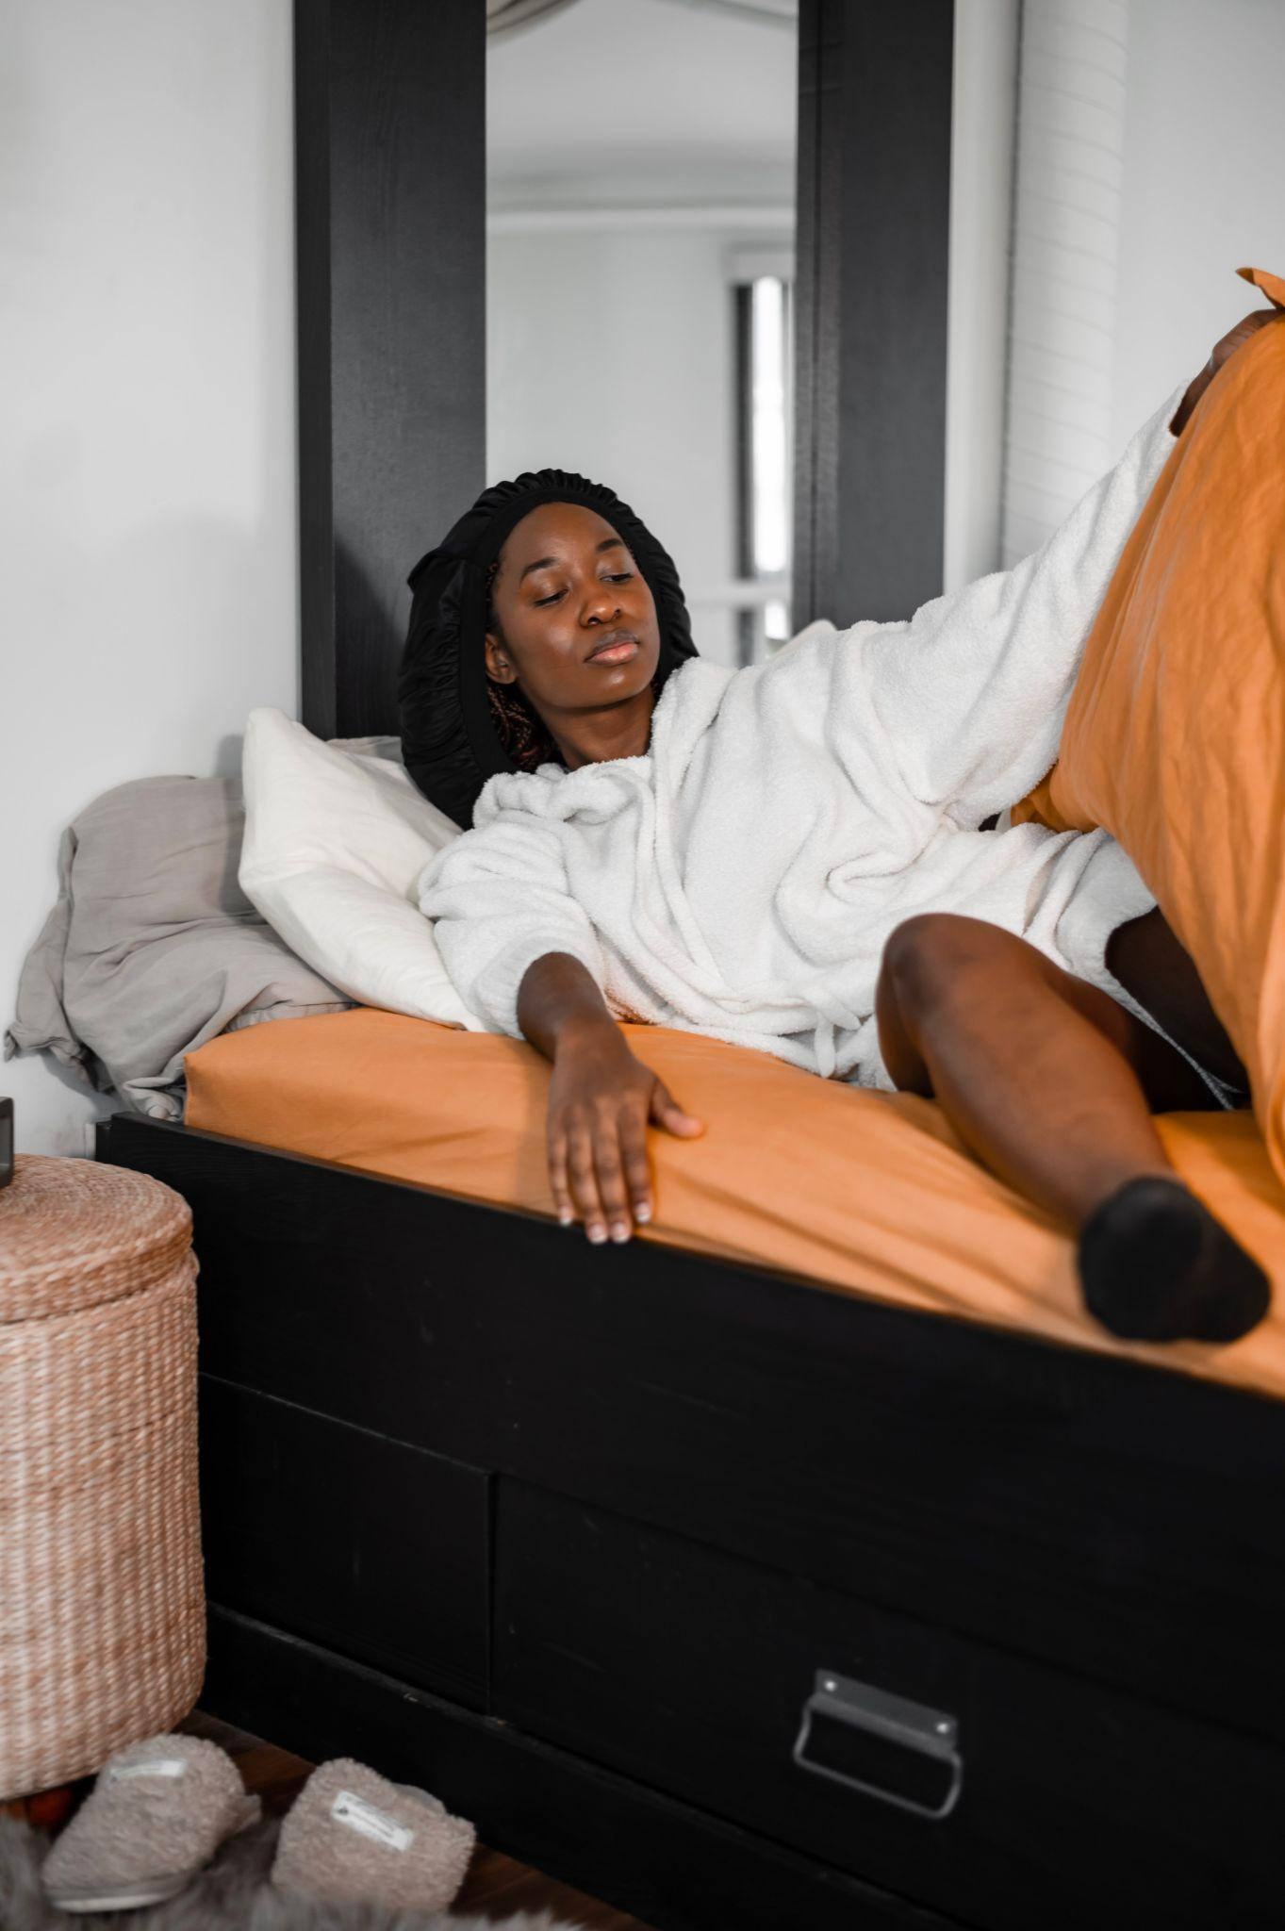
ᏔᎵᏍᎪ ᏐᏁᎵᏁ ᏣᎳᎩ ᎠᏕᎶᏆᏍᏗ
ᎠᏗᏗ- he/she is getting up (from lying down)
ᏑᏓᎵ ᎢᏳᏩᏂᎸ ᏑᎾᎴ ᎦᏗᏗᏍᎪ.
ᎯᎳ ᎢᏏᎾᎴ ᎭᏗᏗᏍᎪ ᏙᏓᏈᏕᎾ ᏑᎾᎴᎢ?
ᎤᎩᏥᏍᏕᏱ ᎠᏗᏗᏍᎪ ᏧᎸᏫᏍᏓᏁᏗ ᏱᎩ.

Slide 16
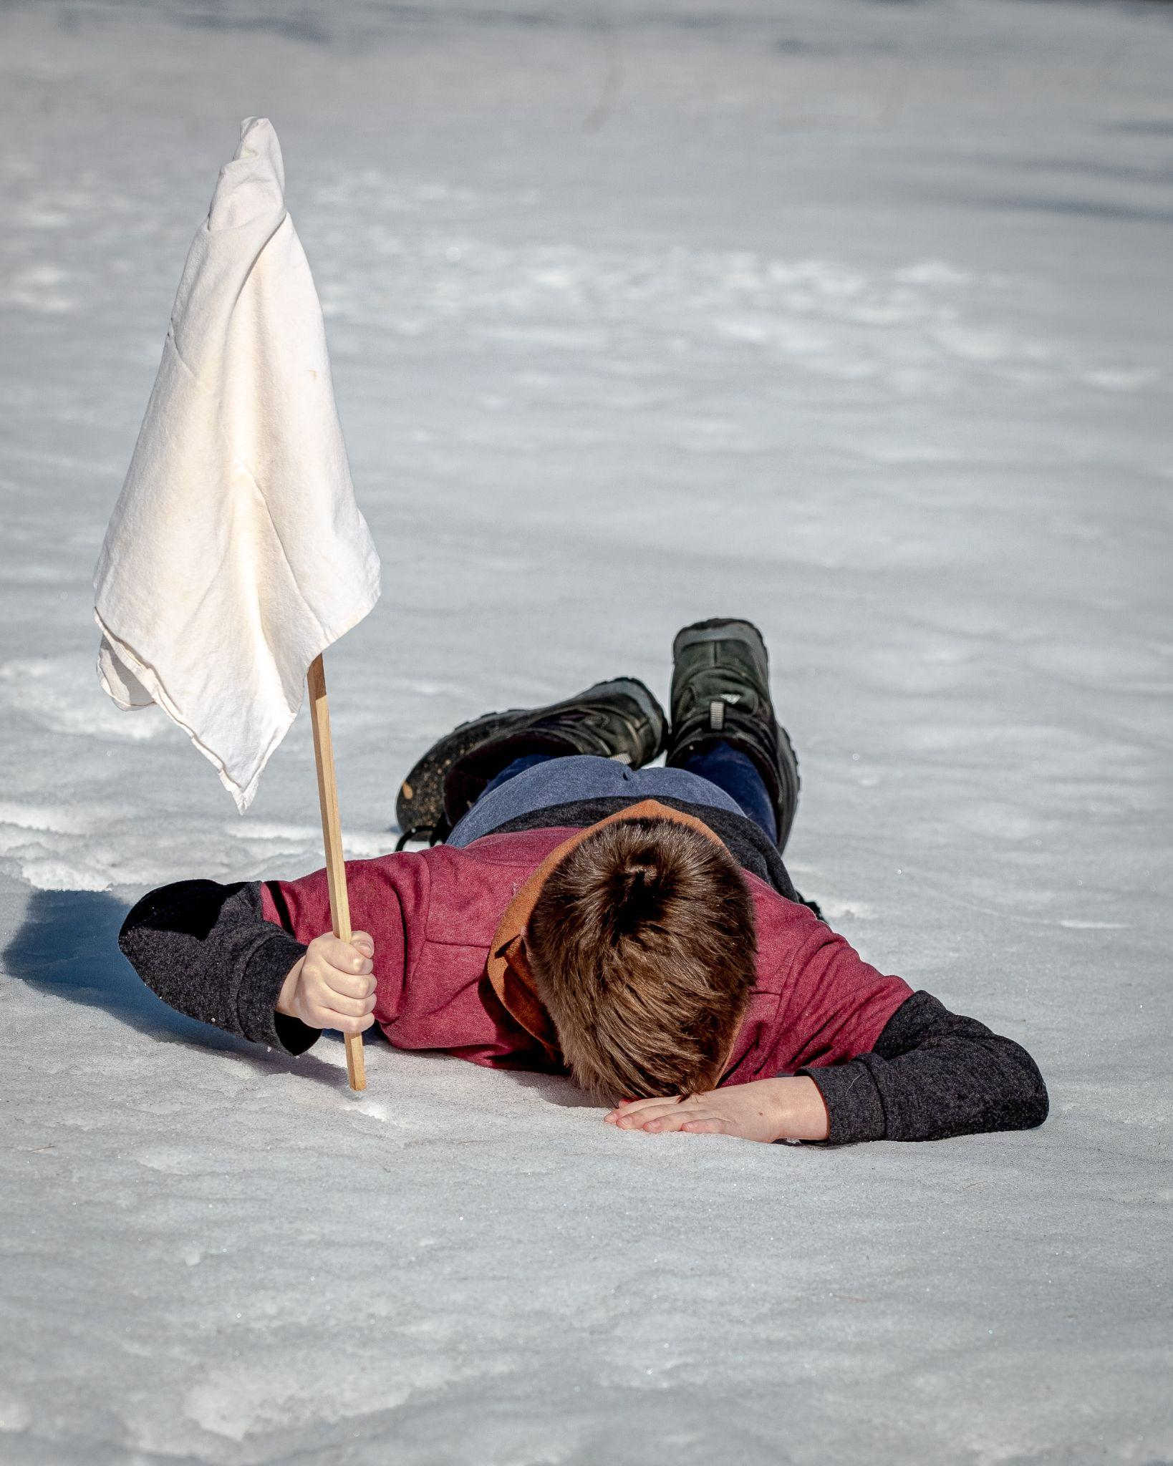
ᏔᎵᏍᎪ ᏐᏁᎵᏁ ᏣᎳᎩ ᎠᏕᎶᏆᏍᏗ
ᎠᏑᎵᎪᎦ- he/she is quitting, ceasing
ᎯᎳᏴ ᏧᎵᎪᏤ ᎰᎦᏍᎬ?
ᏞᏍᏗ ᏧᎵᎪᏨ.
ᎯᏍᎩ ᎢᏳᏩᏂᎸ ᏧᎸᏫᏍᏓᏁᏗ ᎤᏑᎵᎪᏨ.

Slide 17
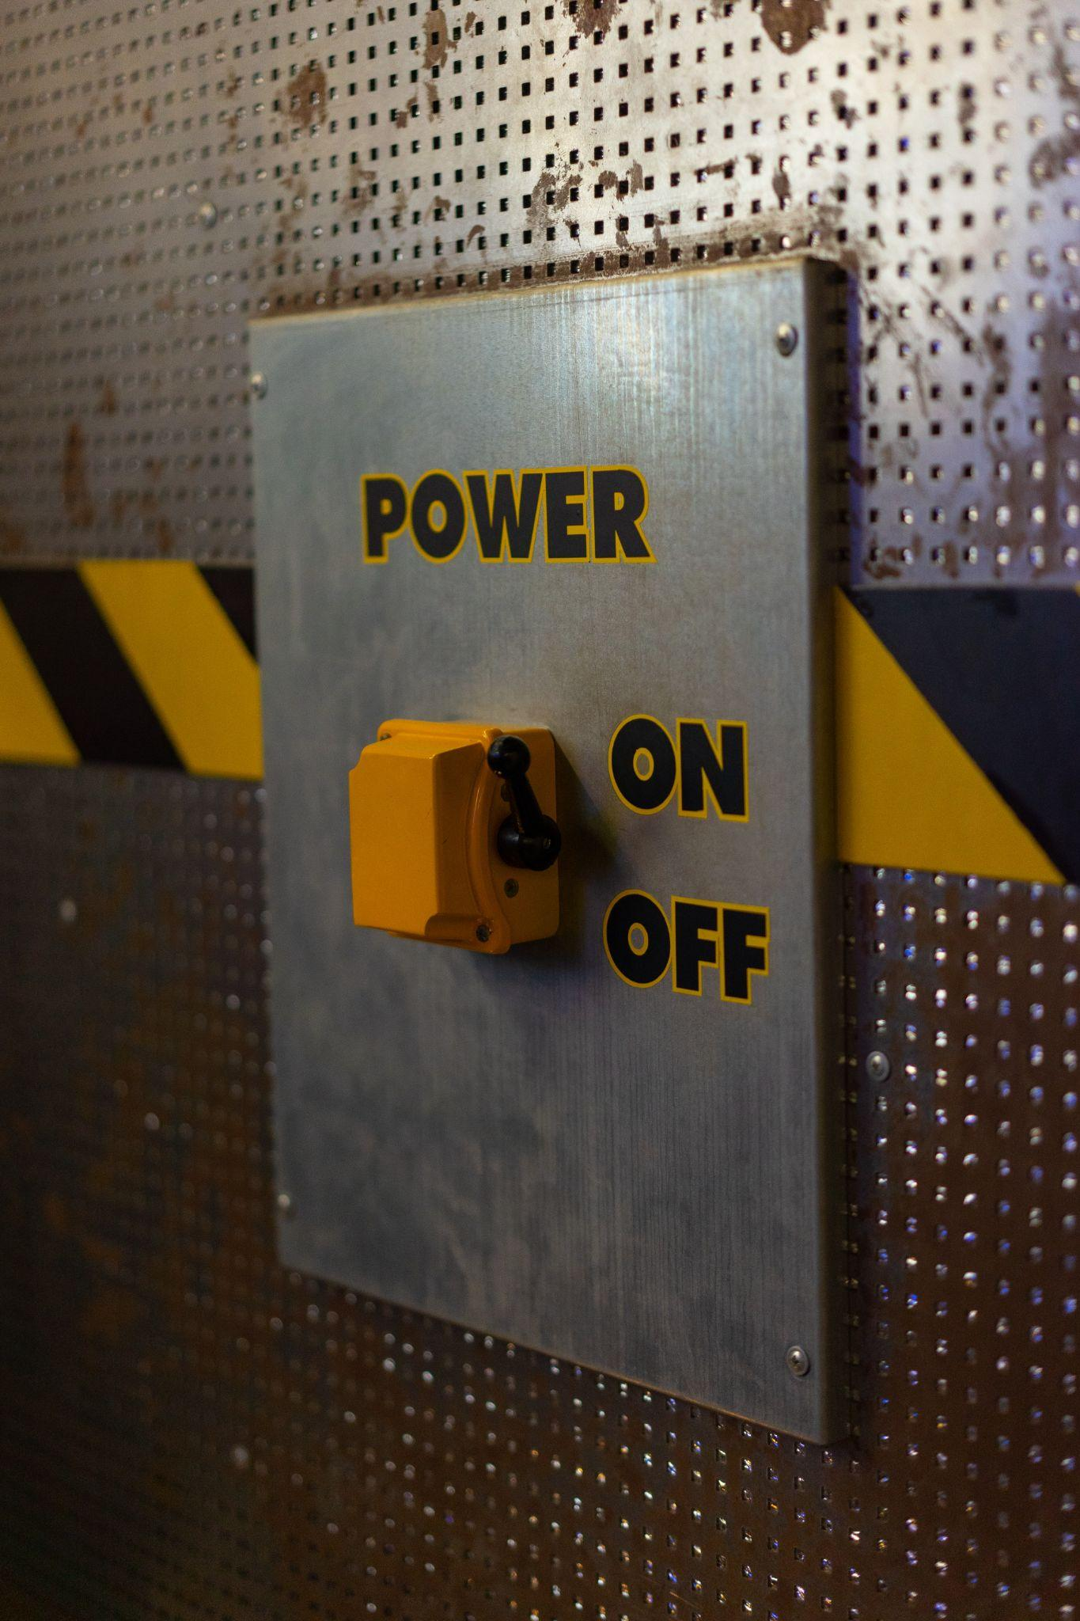
ᏔᎵᏍᎪ ᏐᏁᎵᏁ ᏣᎳᎩ ᎠᏕᎶᏆᏍᏗ
ᎠᏍᏚᎲᏍᎦ- he/she is closing it, turning it off, jailing him/her
ᎯᏍᏚᎲᎦ ᎦᎶᎯᏍᏗ.
ᎤᏴᏍᏕᏓ ᏱᎩ ᎩᎶ, ᎠᏍᏚᎲᏍᎪ.
ᏦᎳᏂ ᏓᎩᏍᏚᏅ.
ᎩᎳ ᏫᏥᏍᏚᎲᎦ ᏦᎳᏂ.

Slide 18
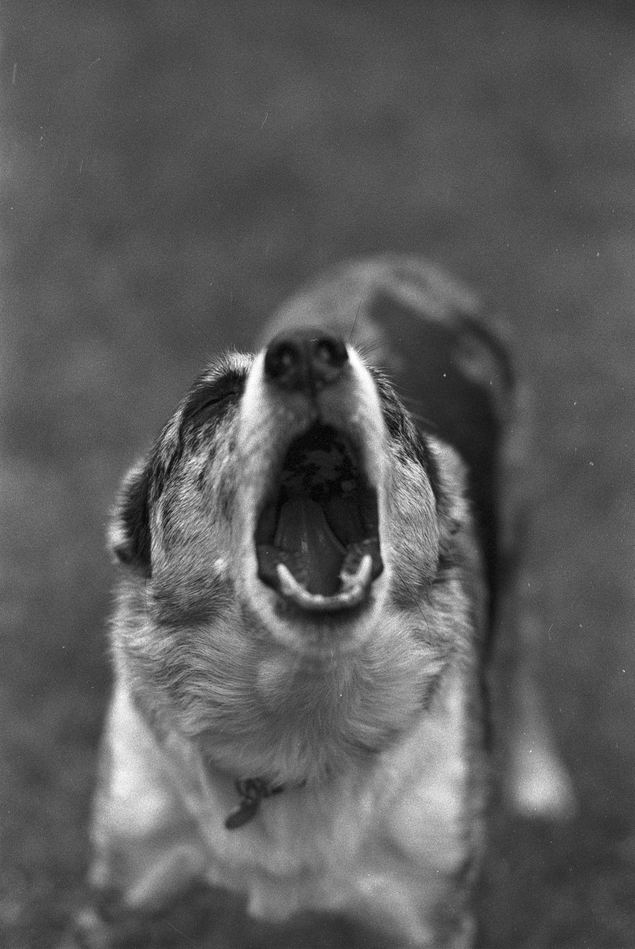
ᏔᎵᏍᎪ ᏐᏁᎵᏁ ᏣᎳᎩ ᎠᏕᎶᏆᏍᏗ
ᏓᏑᏫᏍᎦ- it is barking
ᎤᏒ ᏱᏄᎵᏍᏔᏅ, ᎩᏟ ᏓᏑᏫᏍᎪᎢ.
ᎩᏟ ᏗᎦᎴᏅᎯᏓ ᏥᏓᏑᏫᏍᎦ ᎦᏛᎩ.

Slide 19
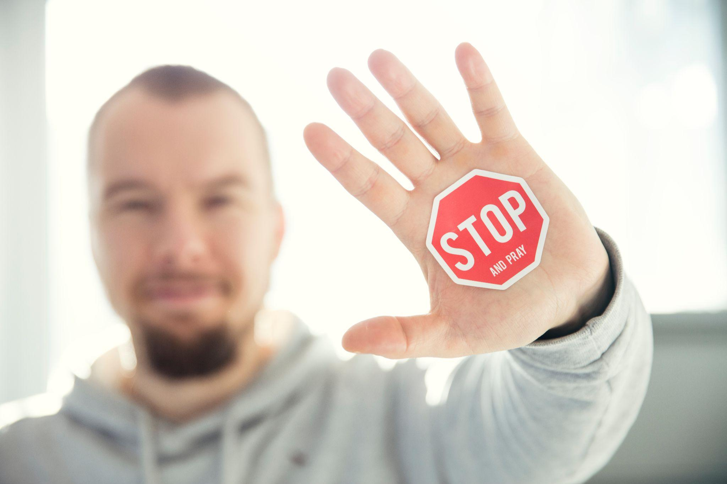
ᏔᎵᏍᎪ ᏐᏁᎵᏁ ᏣᎳᎩ ᎠᏕᎶᏆᏍᏗ
ᎠᎴᏫᏍᏗᎭ- it is stopping
ᎩᎶ ᎤᏯᏂᏍᎬ ᎤᏛᎦᏅ, ᎤᎴᏫᏍᏔᏅ.
ᎭᎴᏫᏍᏙᏓ ᏙᏆᎴᎳ.
ᎠᏓᏅᏙ ᏳᎴᏫᏍᏔᎾ, ᎠᏲᎱᏍᎪ ᏴᏫ.
ᎤᏓᏅᏙ ᎤᎴᏫᏍᏓᏁᎸ.

Slide 20
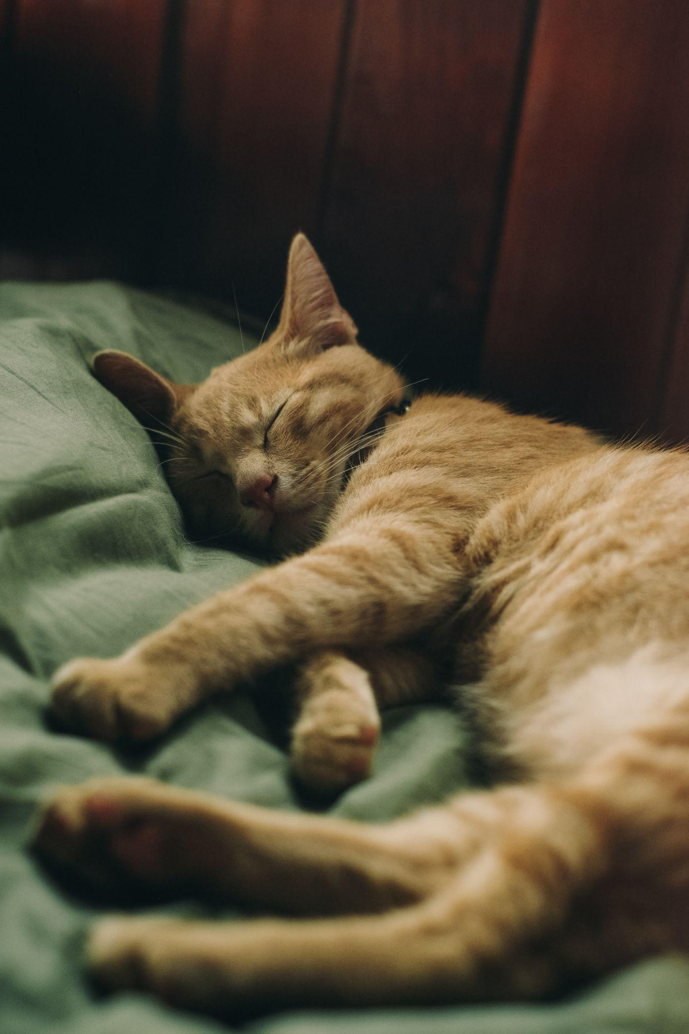
ᏔᎵᏍᎪ ᏐᏁᎵᏁ ᏣᎳᎩ ᎠᏕᎶᏆᏍᏗ
ᎦᏟᎭ- he/she is sleeping
ᎩᎳ ᎤᏒ ᎦᏳᎳ ᎦᏟᎰ.
ᏂᎪᎯᎸ ᎦᏍᎩᎸ ᎦᏟᎰ Ꮎ ᏪᏌ.
ᏌᏚ ᎢᏳᏩᏂᎸ ᎤᏒ ᎦᏳᎳ ᎤᏂᏢᏅ.

