Slide 1
ᎣᏏᏲ
ᏦᏍᎪᎯᏁ ᏣᎳᎩ ᎠᏕᎶᏆᏍᏗ

Slide 2
ᏦᏍᎪᎯᏁ ᏣᎳᎩ ᎠᏕᎶᏆᏍᏗ
ᎢᏓᎴᎾ- Let’s begin
ᏣᎳᎩ ᎢᏗᏬᏂ- Let’s talk Cherokee

Slide 3
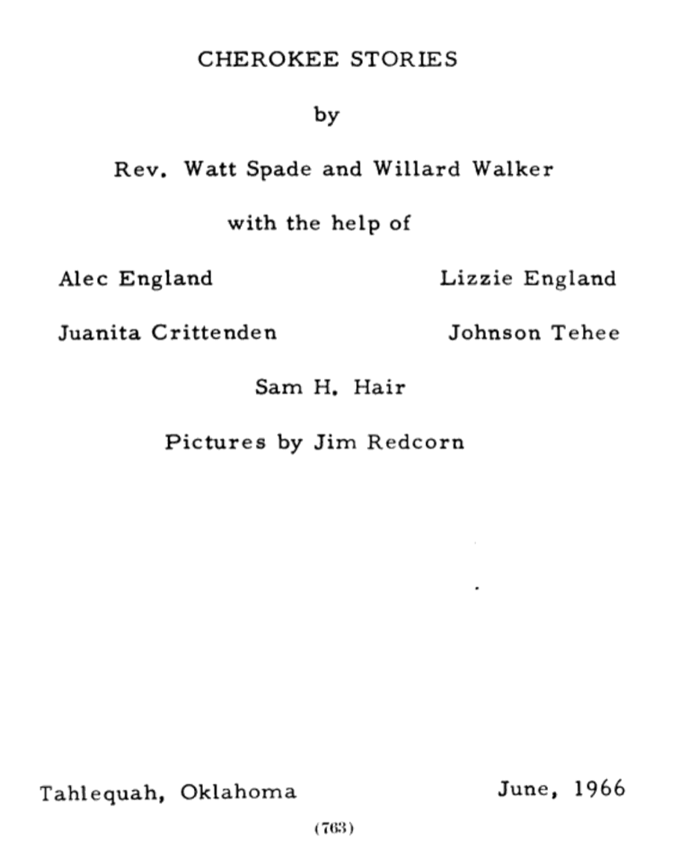
ᏦᏍᎪᎯᏁ ᏣᎳᎩ ᎠᏕᎶᏆᏍᏗ

Slide 4
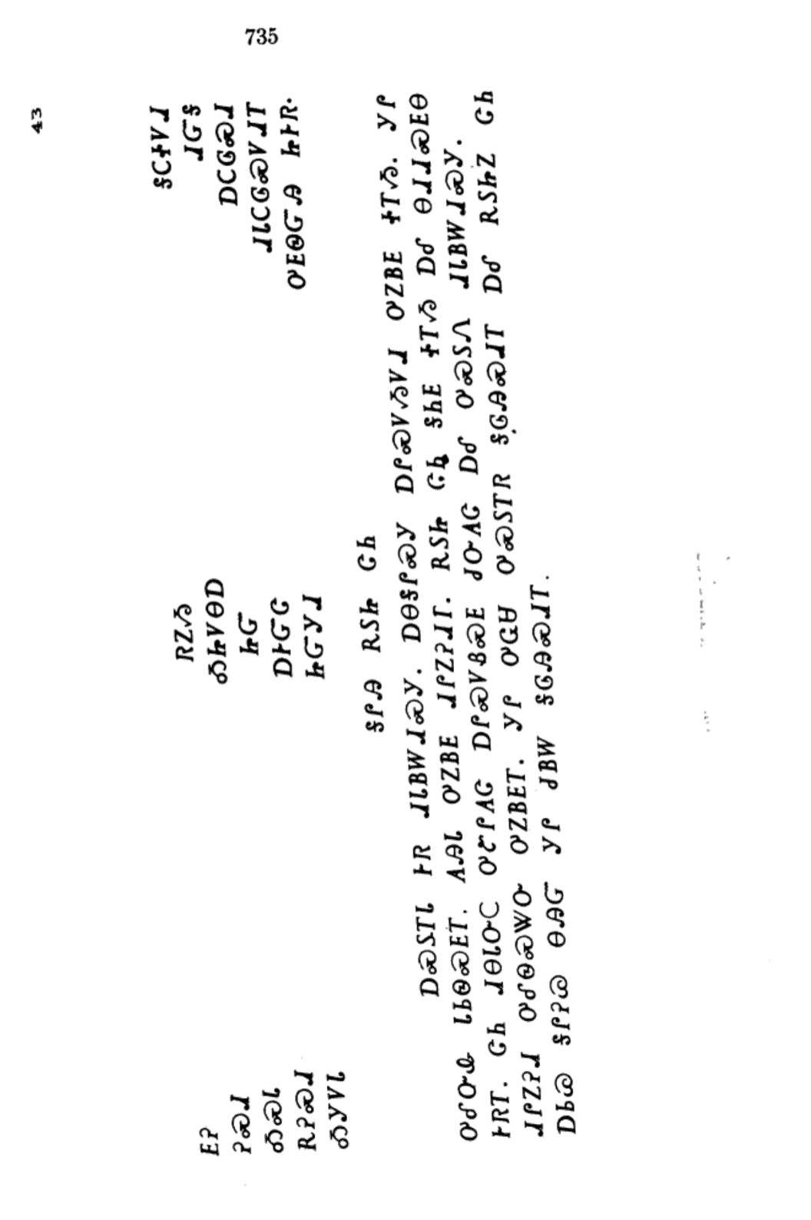
ᏦᏍᎪᎯᏁ ᏣᎳᎩ ᎠᏕᎶᏆᏍᏗ
ᎦᎵᎯ ᎡᏚᏥ ᏣᏂ

Slide 5
ᏦᏍᎪᎯᏁ ᏣᎳᎩ ᎠᏕᎶᏆᏍᏗ
ᎠᏍᏚᎢᏓ ᎨᏒ ᏗᏓᏴᎳᏗᏍᎩ.

Slide 6
ᏦᏍᎪᎯᏁ ᏣᎳᎩ ᎠᏕᎶᏆᏍᏗ
ᎠᎾᎦᎵᏍᎩ ᎠᎵᏍᏙᏱᏙᏗ ᎤᏃᏴᎬ ᏐᎢᏱ.

Slide 7
ᏦᏍᎪᎯᏁ ᏣᎳᎩ ᎠᏕᎶᏆᏍᏗ
ᎩᎵ ᎤᎴᏅᎲ ᏓᏏᏫᏍᎬᎢ.

Slide 8
ᏦᏍᎪᎯᏁ ᏣᎳᎩ ᎠᏕᎶᏆᏍᏗ
ᎪᎯᏓ ᎤᏃᏴᎬ ᏗᎵᏃᎮᏗᎢ.

Slide 9
ᏦᏍᎪᎯᏁ ᏣᎳᎩ ᎠᏕᎶᏆᏍᏗ
ᎡᏚᏥ ᏣᏂ ᎦᏂᎬ ᏐᎢᏱ ᎠᎴ ᎾᏗᏗᏍᎬᎾ ᎨᏒᎢ.

Slide 10
ᏦᏍᎪᎯᏁ ᏣᎳᎩ ᎠᏕᎶᏆᏍᏗ
ᏣᏂ ᏗᎾᏓᏅᏟ ᎤᏑᎵᎪᏣ ᎠᎵᏍᏙᏰᏍᎬ ᏧᏅᎪᏣ ᎠᎴ ᎤᏍᏚᏁ ᏗᏓᏴᎳᏗᏍᎩ.

Slide 11
ᏦᏍᎪᎯᏁ ᏣᎳᎩ ᎠᏕᎶᏆᏍᏗ
ᏗᎵᏃᎮᏗ ᎤᎴᏫᏍᏔᏅ ᎤᏃᏴᎬᎢ.

Slide 12
ᏦᏍᎪᎯᏁ ᏣᎳᎩ ᎠᏕᎶᏆᏍᏗ
ᎩᎵ ᎤᏩᏌ ᎤᏍᏚᎢᏒ ᎦᎶᎯᏍᏗᎢ ᎠᎴ ᎡᏚᏥᏃ ᏣᏂ ᎠᏏᏊ ᎦᎵᎮᏊ ᎾᎯᏳ ᎩᎵ ᏧᏴᎳ ᎦᎶᎯᏍᏗ.

Slide 13
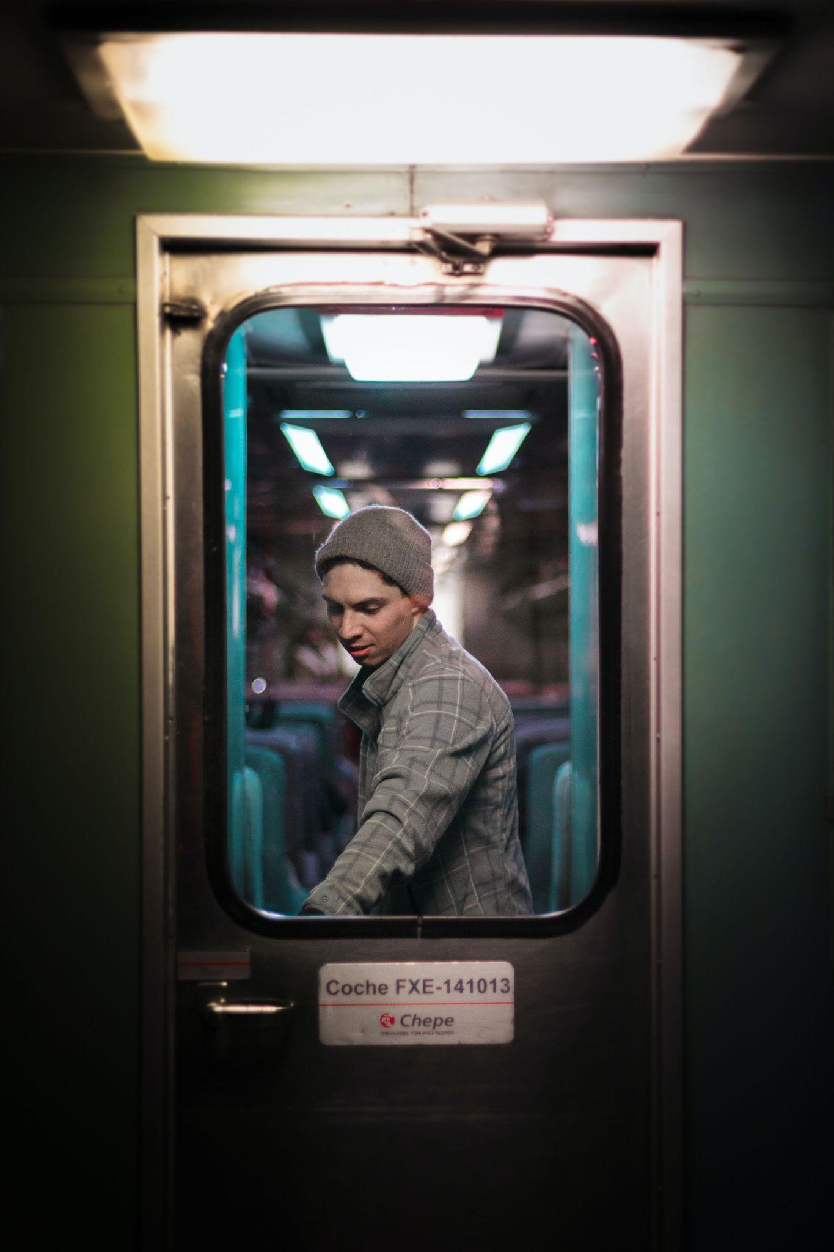
ᏦᏍᎪᎯᏁ ᏣᎳᎩ ᎠᏕᎶᏆᏍᏗ
ᎠᏍᏚᎢ- he/she is opening it, turning it on
ᎦᎵᏉᎩ ᎢᏳᏩᏂᎸ ᎠᏍᏚᎢᏍᎪ ᎠᏓᎾᏅᎢ.
ᎤᏯᏅ ᎬᏗ ᎠᏍᏚᎢᏒ ᏓᎦᏏ.
ᏗᏍᏚᎢᏓ ᎢᎨᏎᏍᏗ ᏦᎳᏂ, ᏕᎯᏍᏚᏅᎢ.
ᏦᎳᏂ ᎯᏍᏚᎢ. ᎠᎧᏬᏍᏗ.
ᎦᎶᎯᏍᏗ ᎤᏍᏚᎢᏓ ᎨᏒ ᎠᏆᏕᎶᎰᏒ, ᏩᎩᏴᎸᎢ.

Slide 14
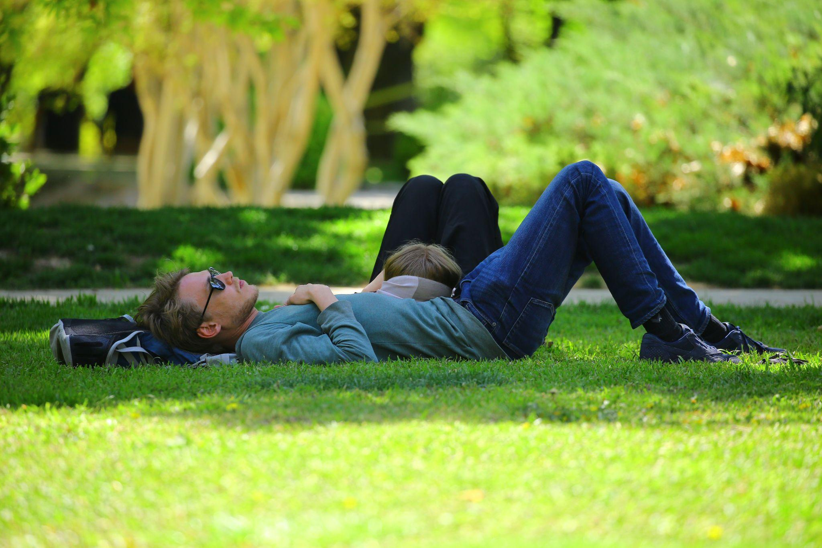
ᏦᏍᎪᎯᏁ ᏣᎳᎩ ᎠᏕᎶᏆᏍᏗ
ᎦᏂᎦ- he/she is lying down
ᎡᎳᏗᏭ ᏥᏂᎨᏍᏗ.
ᎬᏃᏓᏍ Ꮎ ᎢᎾᏓ ᏥᎦᏂ?
ᎦᏍᎩᎸ ᎭᏫᏂ ᏗᏜ ᎦᏂᎦ ᏪᏌ.

Slide 15
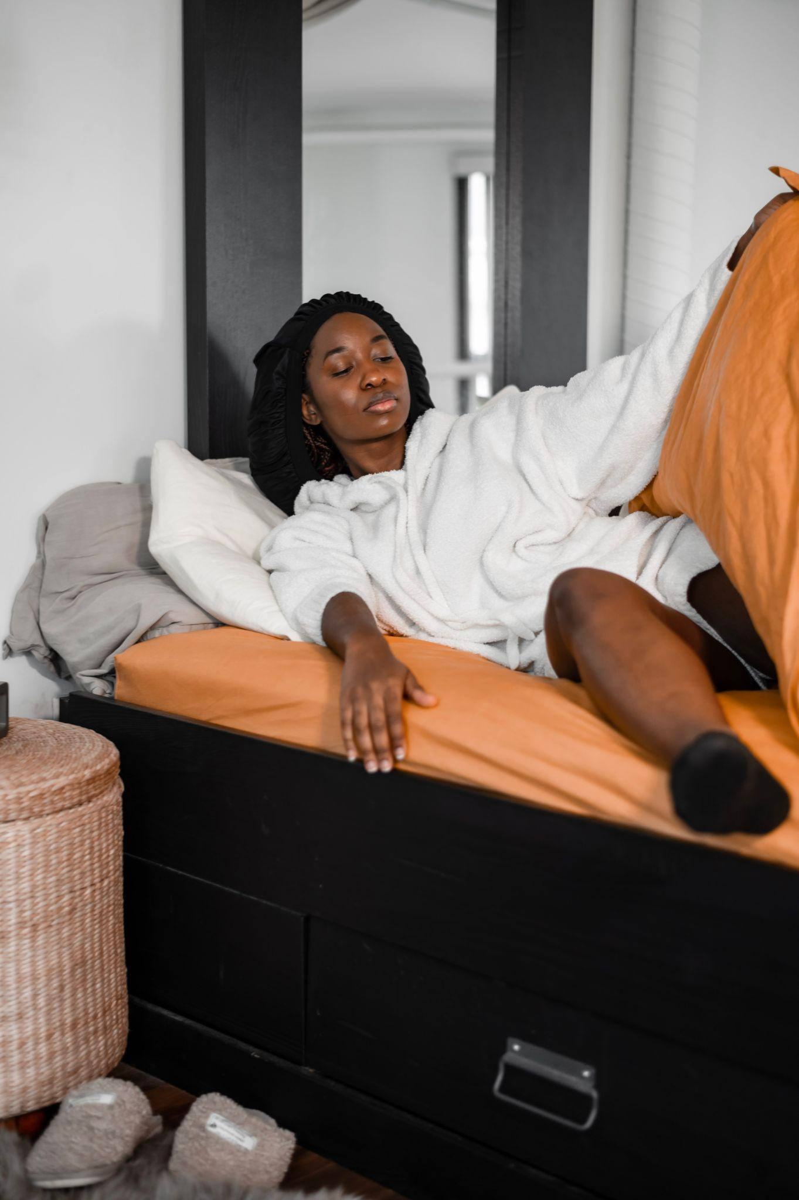
ᏦᏍᎪᎯᏁ ᏣᎳᎩ ᎠᏕᎶᏆᏍᏗ
ᎠᏗᏗ- he/she is getting up (from lying down)
ᏑᏓᎵ ᎢᏳᏩᏂᎸ ᏑᎾᎴ ᎦᏗᏗᏍᎪ.
ᎯᎳ ᎢᏏᎾᎴ ᎭᏗᏗᏍᎪ ᏙᏓᏈᏕᎾ ᏑᎾᎴᎢ?
ᎤᎩᏥᏍᏕᏱ ᎠᏗᏗᏍᎪ ᏧᎸᏫᏍᏓᏁᏗ ᏱᎩ.

Slide 16
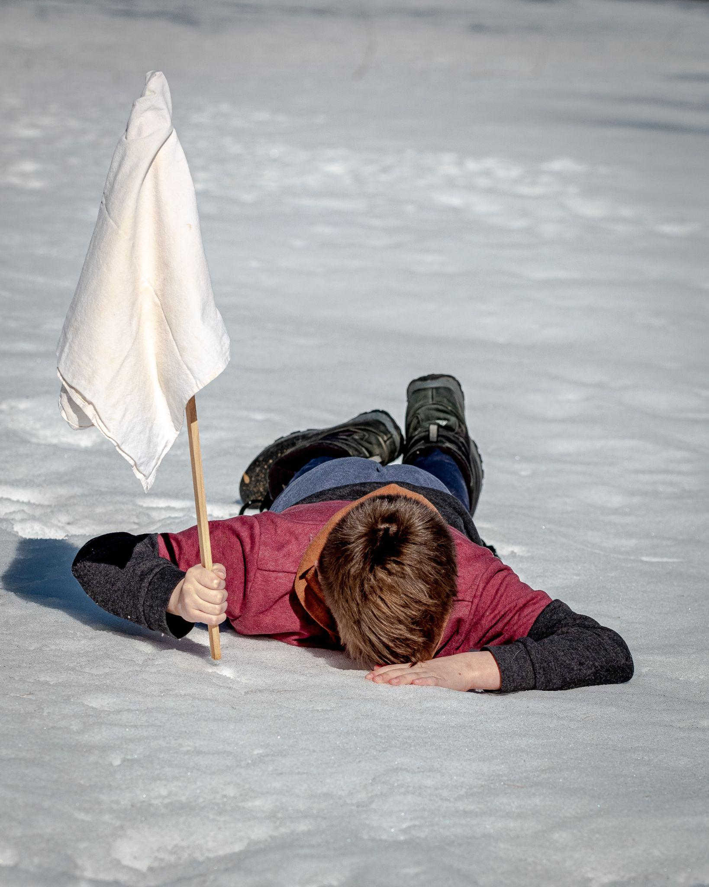
ᏦᏍᎪᎯᏁ ᏣᎳᎩ ᎠᏕᎶᏆᏍᏗ
ᎠᏑᎵᎪᎦ- he/she is quitting, ceasing
ᎯᎳᏴ ᏧᎵᎪᏤ ᎰᎦᏍᎬ?
ᏞᏍᏗ ᏧᎵᎪᏨ.
ᎯᏍᎩ ᎢᏳᏩᏂᎸ ᏧᎸᏫᏍᏓᏁᏗ ᎤᏑᎵᎪᏨ.

Slide 17
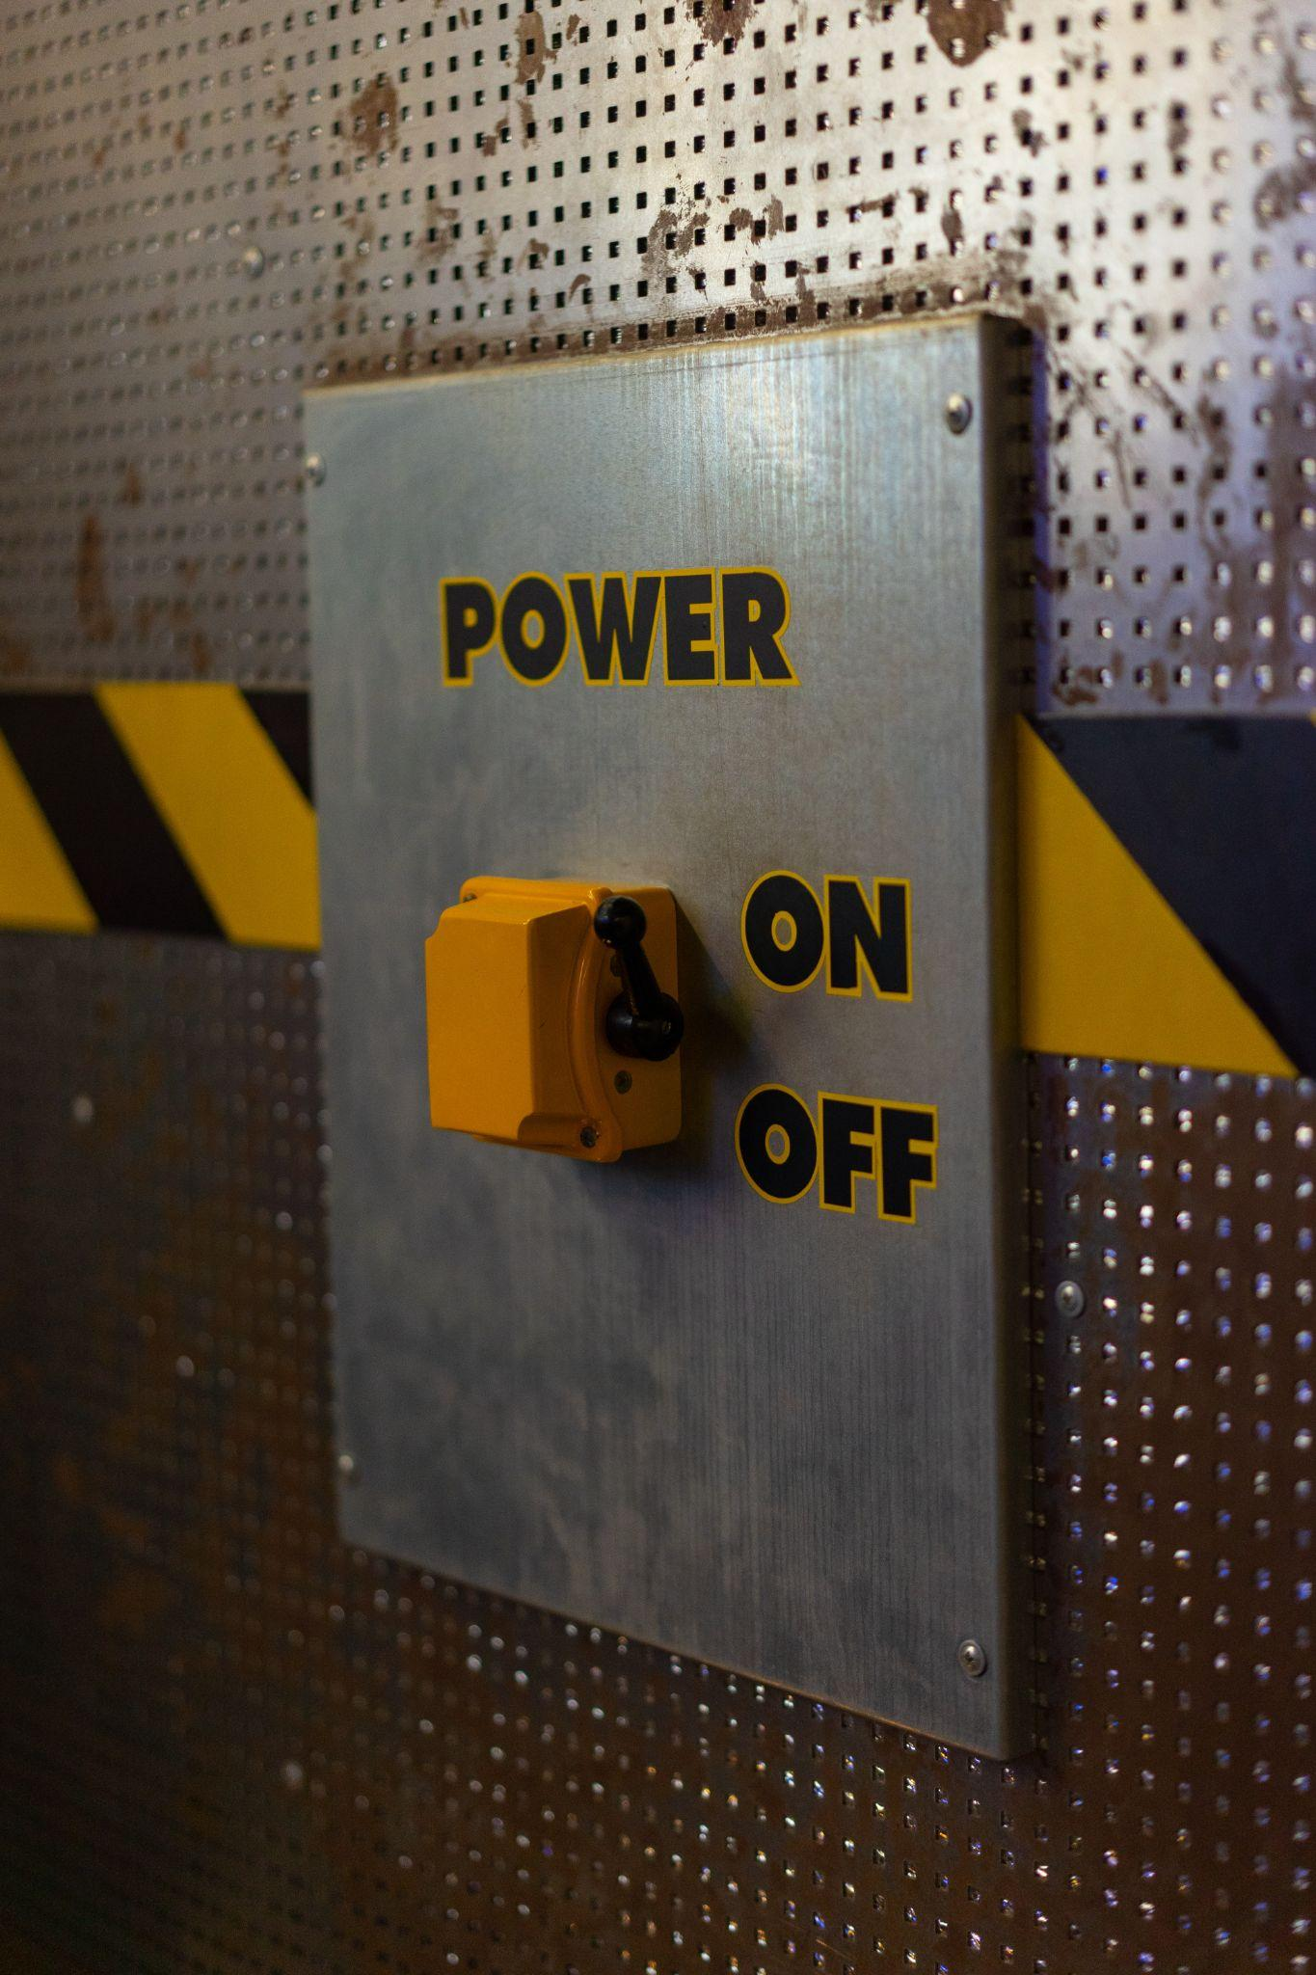
ᏦᏍᎪᎯᏁ ᏣᎳᎩ ᎠᏕᎶᏆᏍᏗ
ᎠᏍᏚᎲᏍᎦ- he/she is closing it, turning it off, jailing him/her
ᎯᏍᏚᎲᎦ ᎦᎶᎯᏍᏗ.
ᎤᏴᏍᏕᏓ ᏱᎩ ᎩᎶ, ᎠᏍᏚᎲᏍᎪ.
ᏦᎳᏂ ᏓᎩᏍᏚᏅ.
ᎩᎳ ᏫᏥᏍᏚᎲᎦ ᏦᎳᏂ.

Slide 18
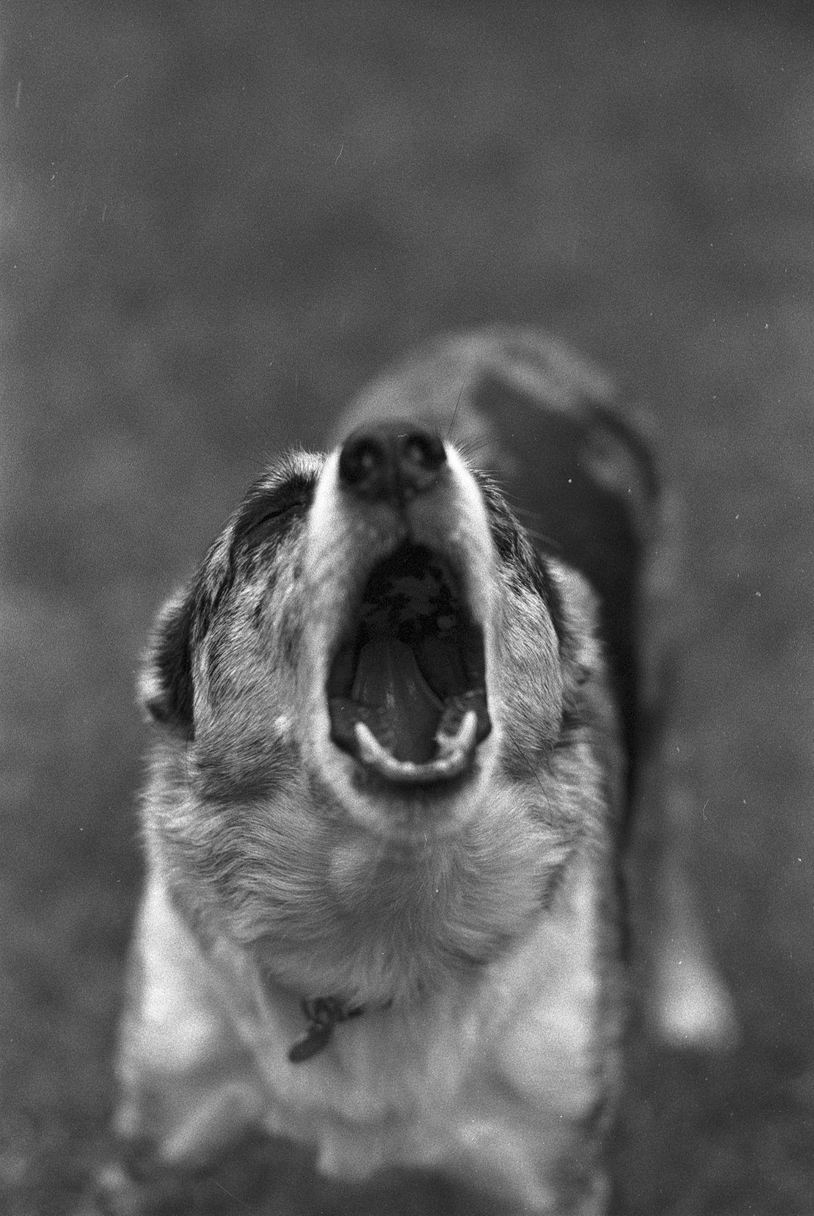
ᏦᏍᎪᎯᏁ ᏣᎳᎩ ᎠᏕᎶᏆᏍᏗ
ᏓᏑᏫᏍᎦ- it is barking
ᎤᏒ ᏱᏄᎵᏍᏔᏅ, ᎩᏟ ᏓᏑᏫᏍᎪᎢ.
ᎩᏟ ᏗᎦᎴᏅᎯᏓ ᏥᏓᏑᏫᏍᎦ ᎦᏛᎩ.

Slide 19
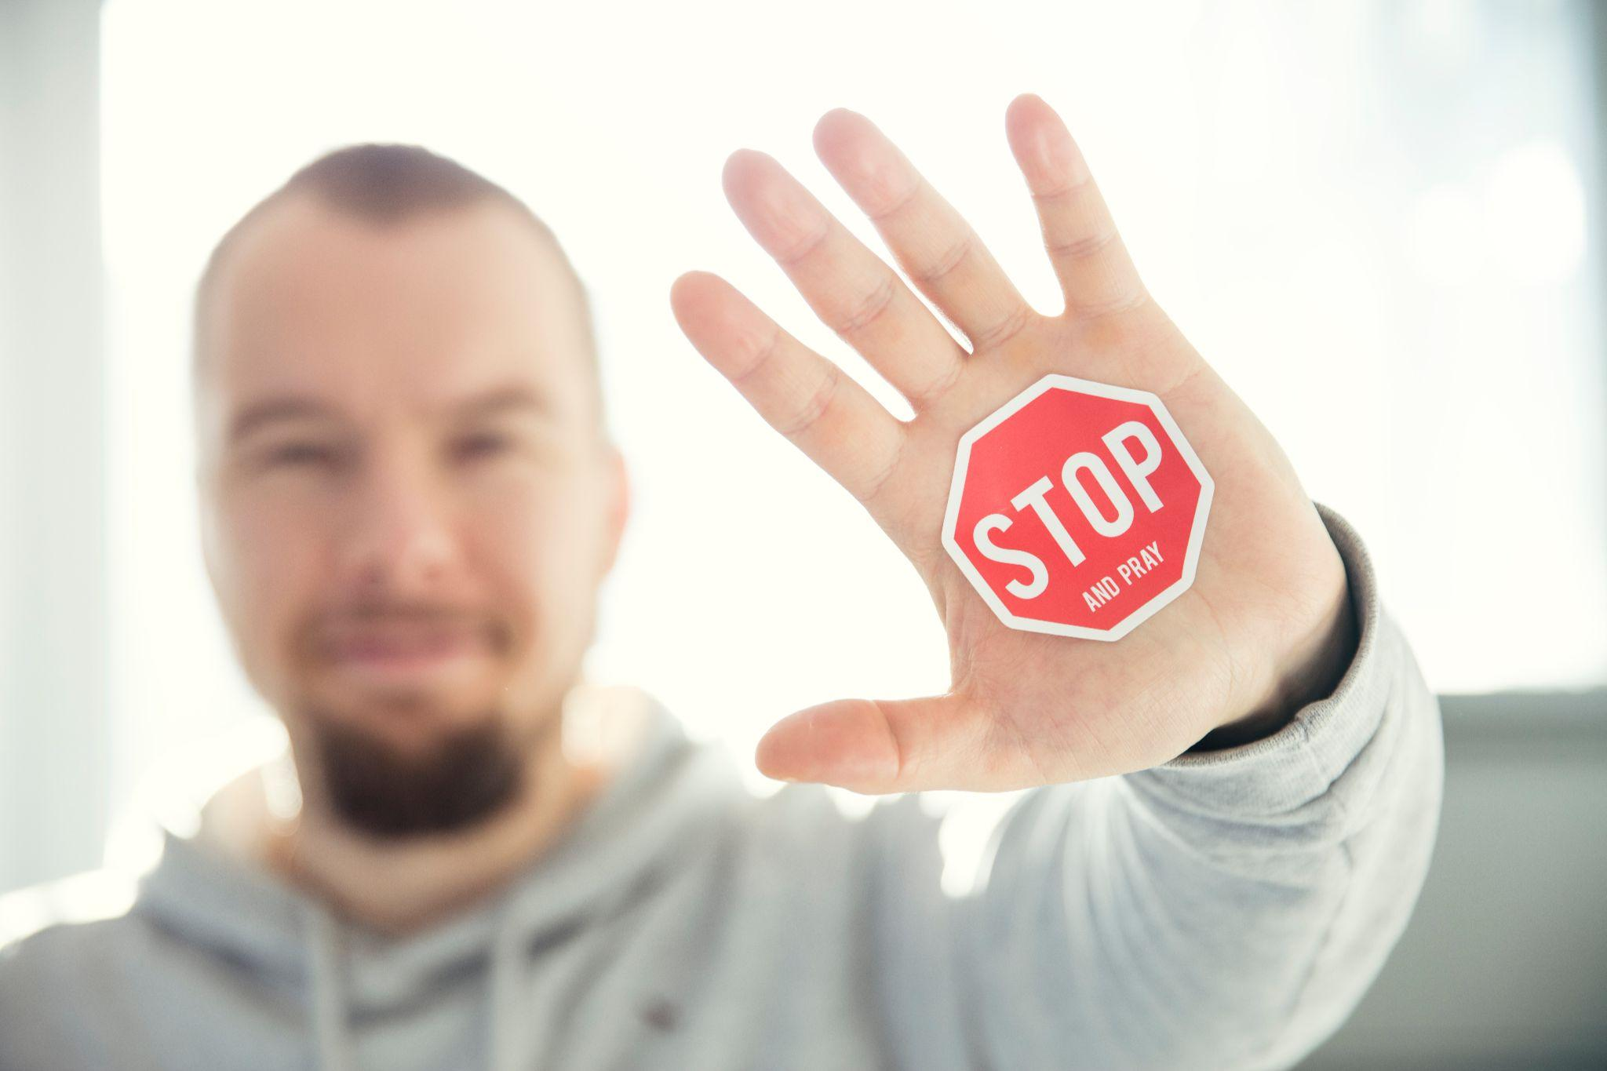
ᏦᏍᎪᎯᏁ ᏣᎳᎩ ᎠᏕᎶᏆᏍᏗ
ᎠᎴᏫᏍᏗᎭ- it is stopping
ᎩᎶ ᎤᏯᏂᏍᎬ ᎤᏛᎦᏅ, ᎤᎴᏫᏍᏔᏅ.
ᎭᎴᏫᏍᏙᏓ ᏙᏆᎴᎳ.
ᎠᏓᏅᏙ ᏳᎴᏫᏍᏔᎾ, ᎠᏲᎱᏍᎪ ᏴᏫ.
ᎤᏓᏅᏙ ᎤᎴᏫᏍᏓᏁᎸ.

Slide 20
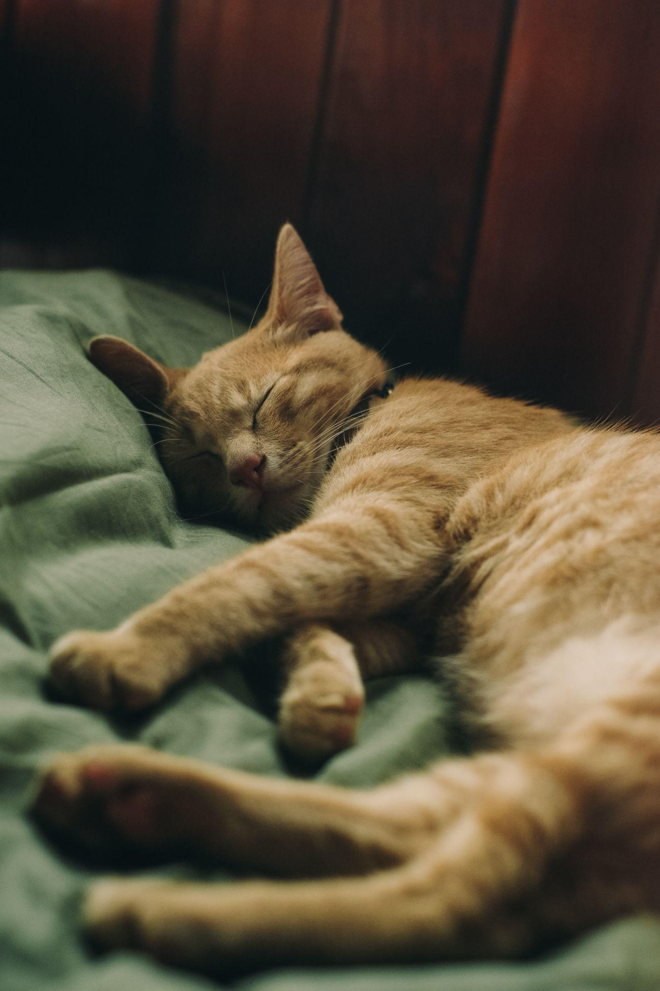
ᏦᏍᎪᎯᏁ ᏣᎳᎩ ᎠᏕᎶᏆᏍᏗ
ᎦᏟᎭ- he/she is sleeping
ᎩᎳ ᎤᏒ ᎦᏳᎳ ᎦᏟᎰ.
ᏂᎪᎯᎸ ᎦᏍᎩᎸ ᎦᏟᎰ Ꮎ ᏪᏌ.
ᏌᏚ ᎢᏳᏩᏂᎸ ᎤᏒ ᎦᏳᎳ ᎤᏂᏢᏅ.

