Slide 1
ᎣᏏᏲ
ᏦᏍᎪᎯ ᏔᎵᏁ ᏣᎳᎩ ᎠᏕᎶᏆᏍᏗ

Slide 2
ᏦᏍᎪᎯ ᏔᎵᏁ ᏣᎳᎩ ᎠᏕᎶᏆᏍᏗ
ᎢᏓᎴᎾ- Let’s begin
ᏣᎳᎩ ᎢᏗᏬᏂ- Let’s talk Cherokee

Slide 3
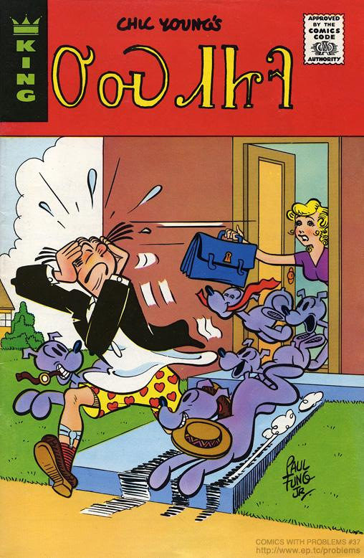
ᏦᏍᎪᎯ ᏔᎵᏁ ᏣᎳᎩ ᎠᏕᎶᏆᏍᏗ
ᎤᏍᏗᏥᎸ
1975

Slide 4
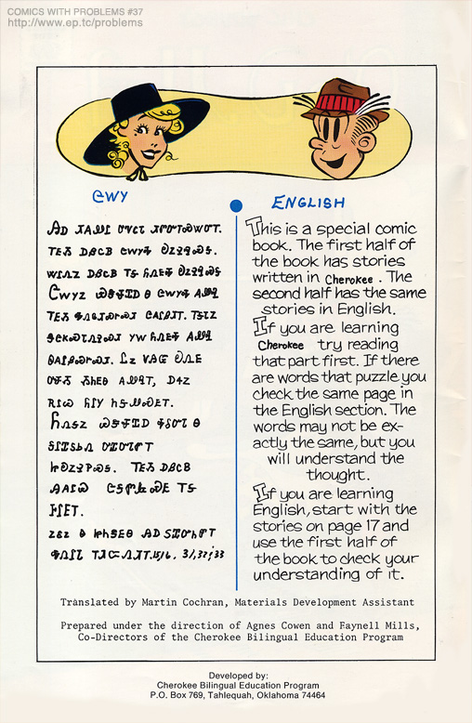
ᏦᏍᎪᎯ ᏔᎵᏁ ᏣᎳᎩ ᎠᏕᎶᏆᏍᏗ
ᏣᎳᎩ
ᎯᎠ ᏗᎪᏪᎵ ᎤᏉᏟᏓ ᏗᏛᏅᎢᏍᏔᏅᎢ

Slide 5
ᏦᏍᎪᎯ ᏔᎵᏁ ᏣᎳᎩ ᎠᏕᎶᏆᏍᏗ
ᎢᎬᏱ ᎠᏰᏟᏴ ᏣᎳᎩᎭ ᎧᏃᎮᎸᏍᎦ.

Slide 6
ᏦᏍᎪᎯ ᏔᎵᏁ ᏣᎳᎩ ᎠᏕᎶᏆᏍᏗ
ᏔᎵᏁᏃ ᎠᏰᏟᏴ ᎢᎦ ᏲᏁᎦᎭ ᎧᏃᎮᎸᏍᎦ.

Slide 7
ᏦᏍᎪᎯ ᏔᎵᏁ ᏣᎳᎩ ᎠᏕᎶᏆᏍᏗ
ᏣᎳᎩᏃ ᏯᏕᏠᏆᎠ Ꮎ ᏣᎳᎩᎭ ᎪᏪᎸ ᎢᎬᏱ ᎭᏁᎶᏗᏍᎨᏍᏗ ᏣᎪᎵᏰᏗᎢ.

Slide 8
ᏦᏍᎪᎯ ᏔᎵᏁ ᏣᎳᎩ ᎠᏕᎶᏆᏍᏗ
ᎢᎦᏓᏃ ᏕᏣᏦᏍᏓᏁᎮᏍᏗ ᎩᎳ ᏲᏁᎬᎭ ᎪᏪᎸ ᏫᎪᎵᏰᏍᎨᏍᏗ.

Slide 9
ᏦᏍᎪᎯ ᏔᎵᏁ ᏣᎳᎩ ᎠᏕᎶᏆᏍᏗ
ᏝᏃ ᏙᎯᏳ ᎧᏁᎬ ᎤᏠᏱ ᏱᏂᎬᎾ ᎪᏪᎸᎢ, ᎠᏎᏃ ᎡᎵᏊ ᏲᎵᎩ ᏂᎦᏪᏍᎬᎢ.

Slide 10
ᏦᏍᎪᎯ ᏔᎵᏁ ᏣᎳᎩ ᎠᏕᎶᏆᏍᏗ
ᏲᏁᎦᏃ ᏯᏕᏠᏆᎠ ᎭᎴᏅᏓ ᎦᎵᏆᏚᏏᏁ ᎤᏆᏅᏓᏛᎢ ᏥᎧᏃᎮᏢᏍᎦ.

Slide 11
ᏦᏍᎪᎯ ᏔᎵᏁ ᏣᎳᎩ ᎠᏕᎶᏆᏍᏗ
ᎢᎬᏱ ᎠᏰᏟᏴ ᎯᎪᎵᏯ ᏣᎦᏛᎲᏍᎬ ᎢᎦ ᎰᎵᎬᎢ.

Slide 12
ᏦᏍᎪᎯ ᏔᎵᏁ ᏣᎳᎩ ᎠᏕᎶᏆᏍᏗ
ᏃᎴᏃ Ꮎ ᏥᏂᏕᎬᎾ ᎯᎠ ᏚᏆᏅᏂᏛᎢ ᎭᏁᎵᏓ ᎢᏗᏨᏁᏗᎢ 15,16, 31,32,33

