Slide 1
ᎣᏏᏲ
ᏦᏍᎪᎯ ᏅᎩᏁ ᏣᎳᎩ ᎠᏕᎶᏆᏍᏗ

Slide 2
ᏦᏍᎪᎯ ᏅᎩᏁ ᏣᎳᎩ ᎠᏕᎶᏆᏍᏗ
ᎢᏓᎴᎾ- Let’s begin
ᏣᎳᎩ ᎢᏗᏬᏂ- Let’s talk Cherokee

Slide 3
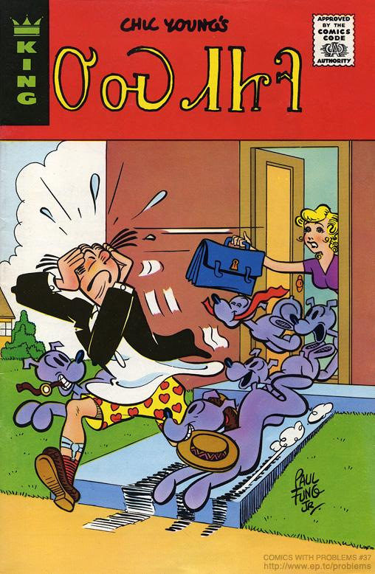
ᏦᏍᎪᎯ ᏅᎩᏁ ᏣᎳᎩ ᎠᏕᎶᏆᏍᏗ
ᎤᏍᏗᏥᎸ
1975

Slide 4
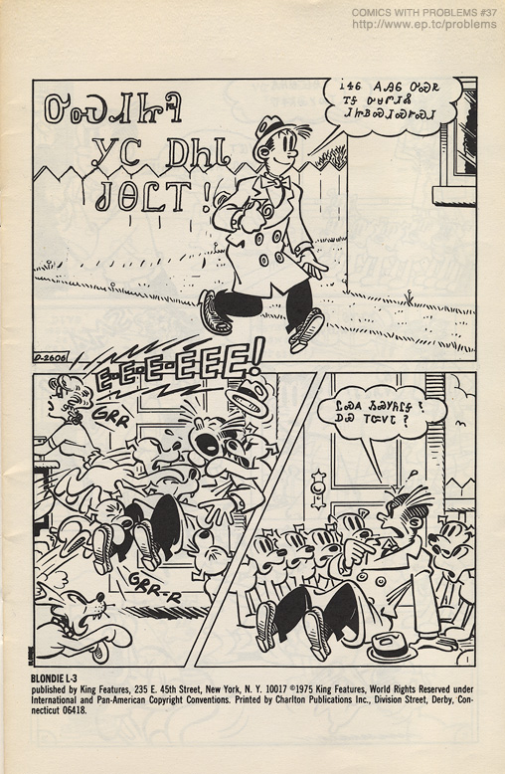
ᏦᏍᎪᎯ ᏅᎩᏁ ᏣᎳᎩ ᎠᏕᎶᏆᏍᏗ
ᎤᏍᏗᏥᎸ ᎩᏟ ᎠᏂᏓ ᏧᎾᏝᎢ!

Slide 5
ᏦᏍᎪᎯ ᏅᎩᏁ ᏣᎳᎩ ᎠᏕᎶᏆᏍᏗ
ᎥᏎᏮ ᎪᎯᏮ ᎤᏍᏒ ᎢᎦ ᎤᏌᏛᏗᏜ ᏗᏥᏴᏍᏗᏍᎨᏍᏗ

Slide 6
ᏦᏍᎪᎯ ᏅᎩᏁ ᏣᎳᎩ ᎠᏕᎶᏆᏍᏗ
ᏝᏍᎪ ᏱᏍᎩᏲᎵᎦ? ᎠᏯ ᎢᏨᏙᏓ?

Slide 7
ᏦᏍᎪᎯ ᏅᎩᏁ ᏣᎳᎩ ᎠᏕᎶᏆᏍᏗ
ᏙᎯᏳᎧᏲᎪ ᎢᏍᎩᏯᏦᏎᏓ.
ᏙᏳᎢ ᎥᏎᏃ Ꮭ ᏔᎵᏁ ᏱᏓᎦᏁᎵᏔᏂ!

Slide 8
ᏦᏍᎪᎯ ᏅᎩᏁ ᏣᎳᎩ ᎠᏕᎶᏆᏍᏗ
ᎠᏓᏤᏫ ᏨᎨᏩᎴ ᏍᎩᏔᏪᏙᏗ
Ꭳ, ᏙᎯᏳᎴ!

Slide 9
ᏦᏍᎪᎯ ᏅᎩᏁ ᏣᎳᎩ ᎠᏕᎶᏆᏍᏗ
ᏙᏳᎧᏲ ᎤᏁᎩᎵᏗ ᎢᏣᏓᏅᏘᏗ.

Slide 10
ᏦᏍᎪᎯ ᏅᎩᏁ ᏣᎳᎩ ᎠᏕᎶᏆᏍᏗ
ᎠᏓᏤᏫ ᎭᏫᏯᎡᏍ ᏃᏮ ᎤᏩᏂᏏᏗ!

Slide 11
ᏦᏍᎪᎯ ᏅᎩᏁ ᏣᎳᎩ ᎠᏕᎶᏆᏍᏗ
ᎣᏌᏂ! ᎩᎶᏮᎢᏳᏍᏗ ᏫᎬᏯᏕᎳᏕᎸᎢ ᎩᏟ ᏕᎨᎶᏣᏅᎢ.

Slide 12
ᏦᏍᎪᎯ ᏅᎩᏁ ᏣᎳᎩ ᎠᏕᎶᏆᏍᏗ
ᎠᎭᏂ… ᎦᏙᎲ ᎢᏣᎦᏙᏍᏗᏇ ᎥᏍᎨᎦ Ꮎ ᎢᏥᎸᏉᏗ ᏥᎩ.

Slide 13
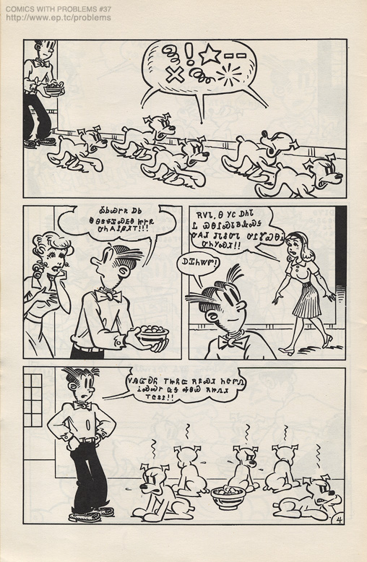
ᏦᏍᎪᎯ ᏅᎩᏁ ᏣᎳᎩ ᎠᏕᎶᏆᏍᏗ
ᎣᏏᏊᎨᏒ ᎠᏏ Ꮎ ᎾᏕᏠᏆᏍᎬᎾ ᏥᎨᏒ ᎤᏂᎪᎵᏰᏗᎢ!!!

Slide 14
ᏦᏍᎪᎯ ᏅᎩᏁ ᏣᎳᎩ ᎠᏕᎶᏆᏍᏗ
ᎡᏙᏓ, Ꮎ ᎩᏟ ᎠᏂᏓ Ꮭ ᏯᎾᎵᏍᏓᏴᎲᏍᎦ ᎤᎪᏗ ᏧᏓᎴᏅᏓ ᎤᎵᏑᏯᎾᎥ ᎤᏂᎩᏍᏗ!!

Slide 15
ᏦᏍᎪᎯ ᏅᎩᏁ ᏣᎳᎩ ᎠᏕᎶᏆᏍᏗ
ᎠᏆᏂᏔᏛ!

Slide 16
ᏦᏍᎪᎯ ᏅᎩᏁ ᏣᎳᎩ ᎠᏕᎶᏆᏍᏗ
ᏙᎯᏳᎧᏲ ᎢᏥᏲᏨ ᎡᏄᏍᏗ ᏂᏣᏛᏁ ᎥᏍᏊᎨ ᏩᎦ ᎭᏫᏯ ᎡᏥᏁᏗ ᎢᏣᏚᎵ!!

Slide 17
ᏦᏍᎪᎯ ᏅᎩᏁ ᏣᎳᎩ ᎠᏕᎶᏆᏍᏗ
ᎤᏠᏱᏊ ᎠᏴ ᏥᏓᏗᎩ!
ᎥᎥ_ ᎠᏴᎥᏍᏊ ᏖᎵᏙ ᏫᏍᎩᎵᏓᏏ

Slide 18
ᏦᏍᎪᎯ ᏅᎩᏁ ᏣᎳᎩ ᎠᏕᎶᏆᏍᏗ
ᎿᏊᏃ

