Slide 1
ᎣᏏᏲ
ᏅᎩᏁ ᏣᎳᎩ ᎠᏕᎶᏆᏍᏗ

Slide 2
ᏅᎩᏁ ᏣᎳᎩ ᎠᏕᎶᏆᏍᏗ
ᎢᏓᎴᎾ- Let’s begin
ᏣᎳᎩ ᎢᏗᏬᏂ- Let’s talk Cherokee

Slide 3
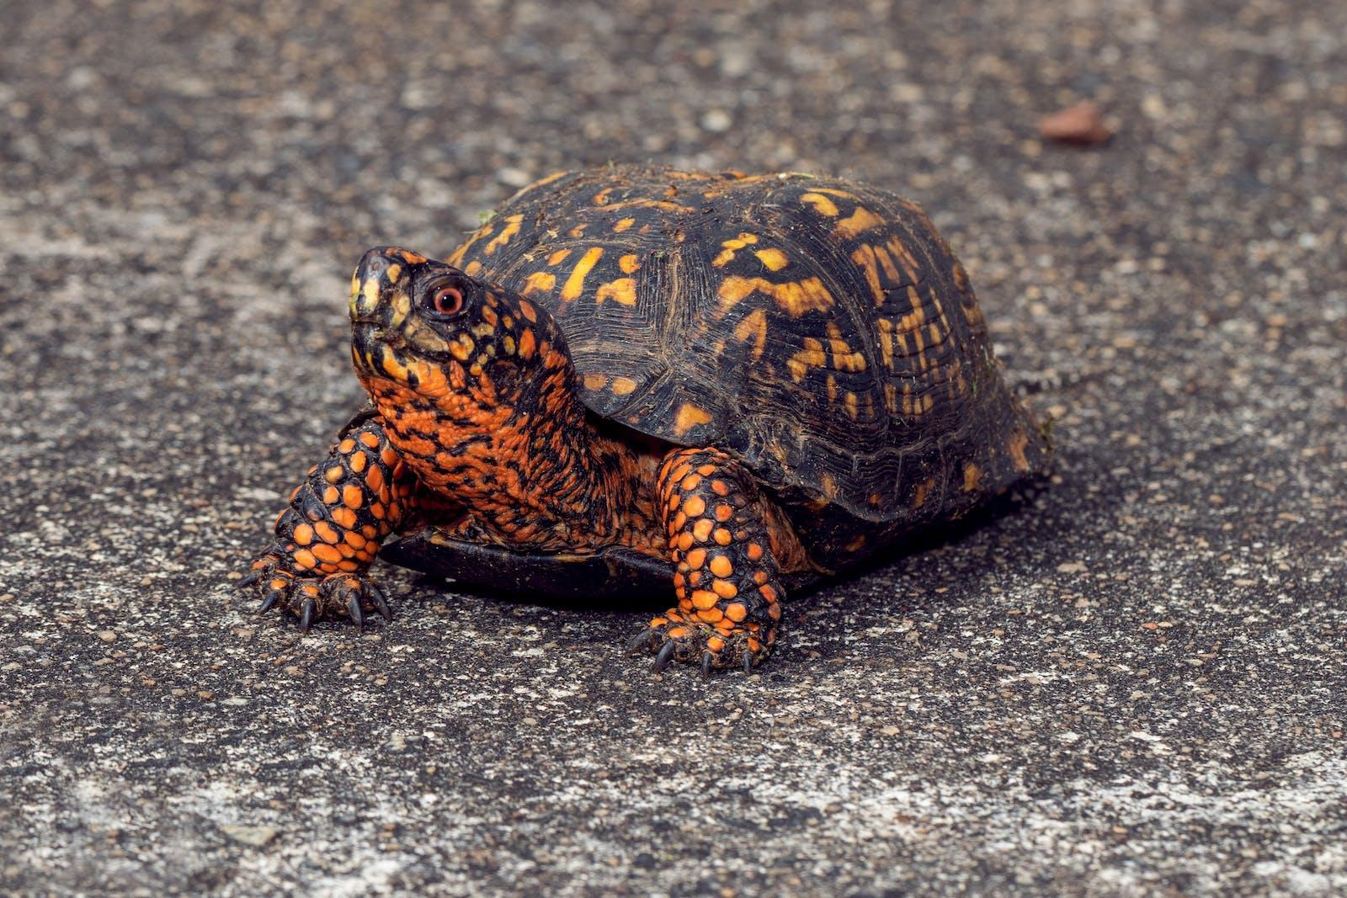
ᏅᎩᏁ ᏣᎳᎩ ᎠᏕᎶᏆᏍᏗ
ᏓᎦᏏ ᎠᎩᎧ. ᎧᏅᏑᎸ ᎢᏗᏅᎦᎳ.
ᏓᎦᏏ ᎠᎩᎧ. Ꮩ ᎤᏍᏗ ᏣᎧ? X3
ᎧᏅᏑᎸ ᎢᏗᏅᎦᎳᎢ.

Slide 4
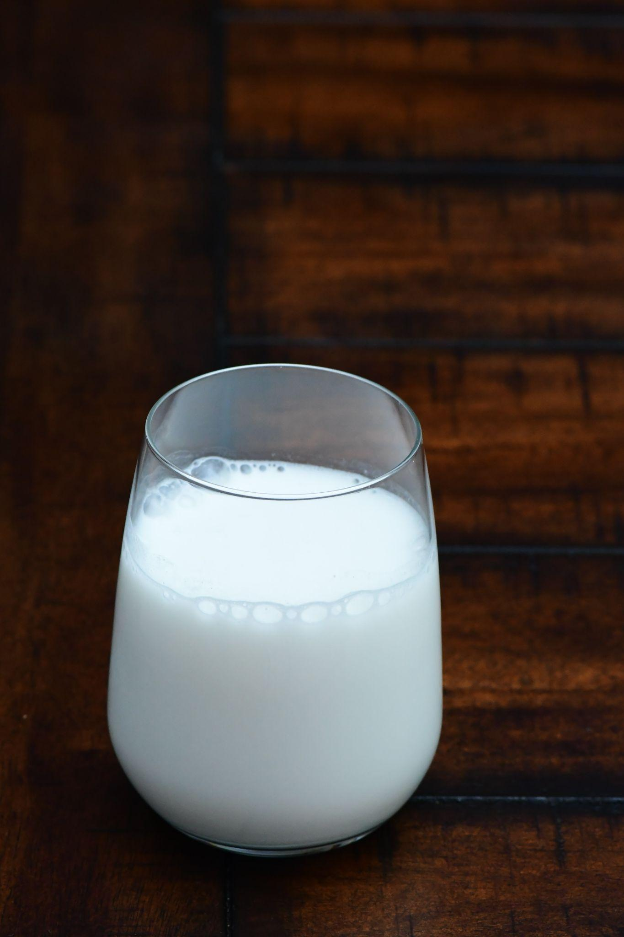
ᏅᎩᏁ ᏣᎳᎩ ᎠᏕᎶᏆᏍᏗ
ᎯᎠ ᎤᏅᏗ. ᎧᏅᏑᎸ ᎢᏗᏅᎦᎳ.
ᎤᏅᏗ ᎠᎩᏁ, Ꮩ ᎤᏍᏗ ᏣᏁ? X3
ᎧᏅᏑᎸ ᎢᏗᏅᎦᎳᎢ.

Slide 5
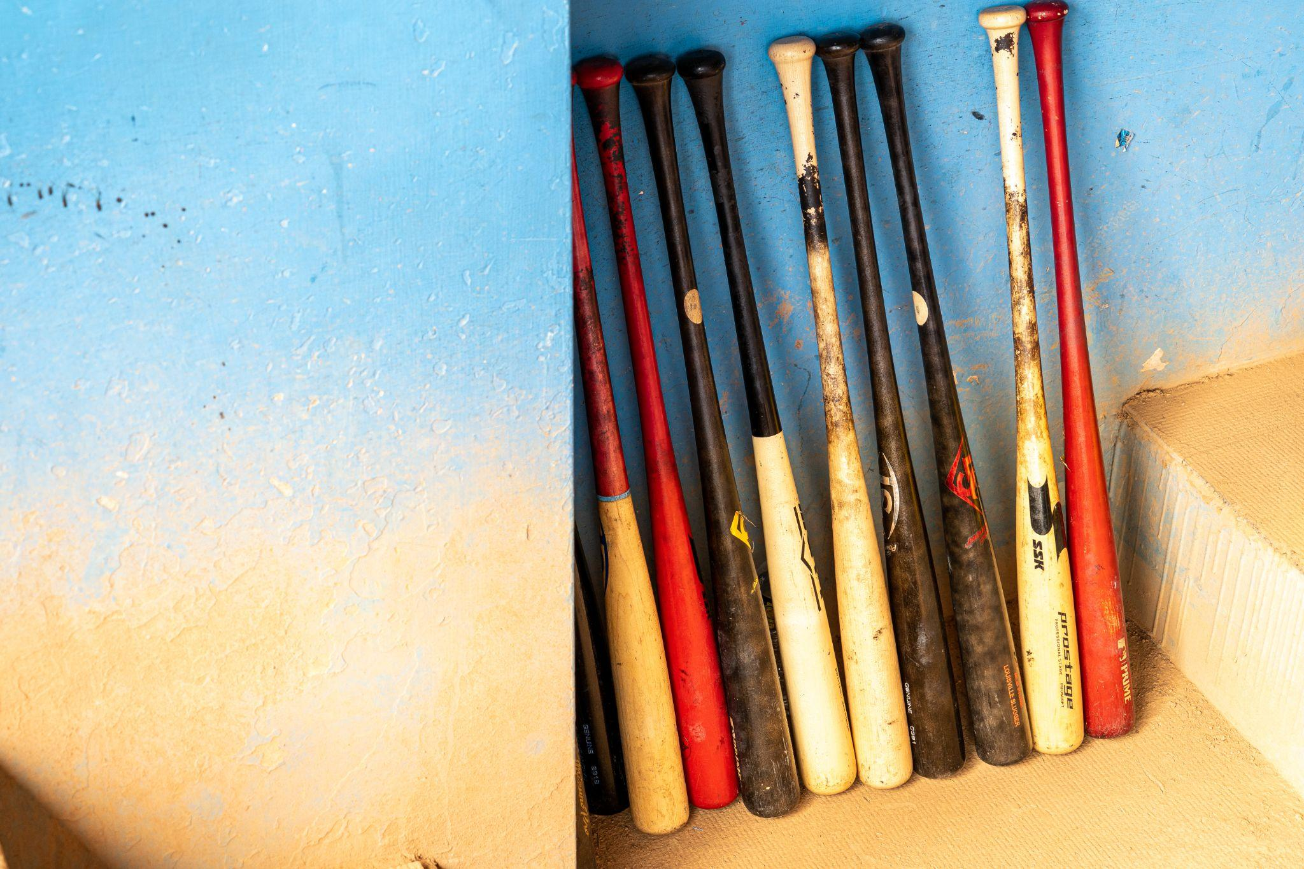
ᏅᎩᏁ ᏣᎳᎩ ᎠᏕᎶᏆᏍᏗ
ᏣᎾᏘᏍ ᏳᏍᏗ ᎨᏒ ᎯᎠ? ᎯᎠ ᎪᏍᏛᏂᏍᏗ. ᎧᏅᏑᎸ ᎢᏗᏅᎦᎳ.
ᎪᏍᏛᏂᏍᏗ ᎠᏋᏯ, Ꮩ ᎤᏍᏗ ᏨᏯ? X3
ᎧᏅᏑᎸ ᎢᏗᏅᎦᎳᎢ.

Slide 6
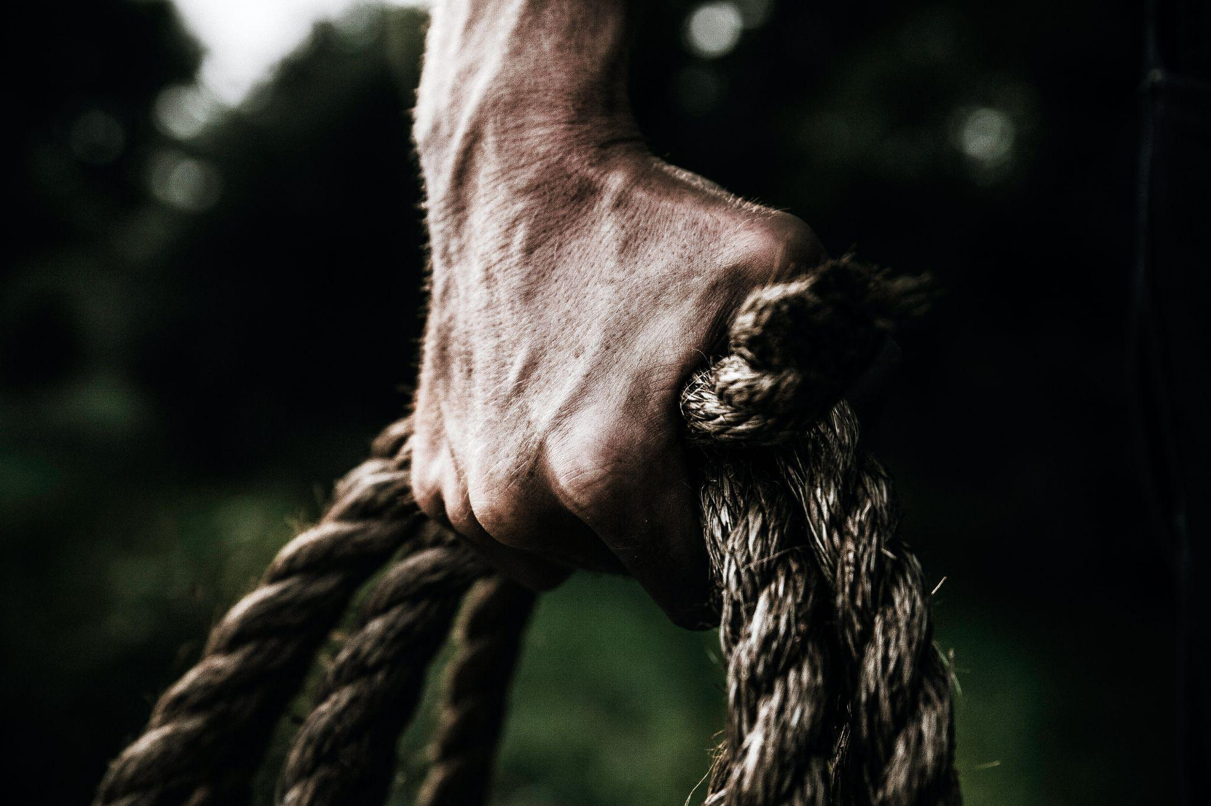
ᏅᎩᏁ ᏣᎳᎩ ᎠᏕᎶᏆᏍᏗ
Ꮒ! ᏍᏕᏱᏓ ᎠᎩᎾ. ᎧᏅᏑᎸ ᎢᏗᏅᎦᎳ.
ᏍᏕᏱᏓ ᎠᎩᎾ, Ꮩ ᎤᏍᏗ ᏣᎾ? X3
ᎧᏅᏑᎸ ᎢᏗᏅᎦᎳᎢ.

Slide 7
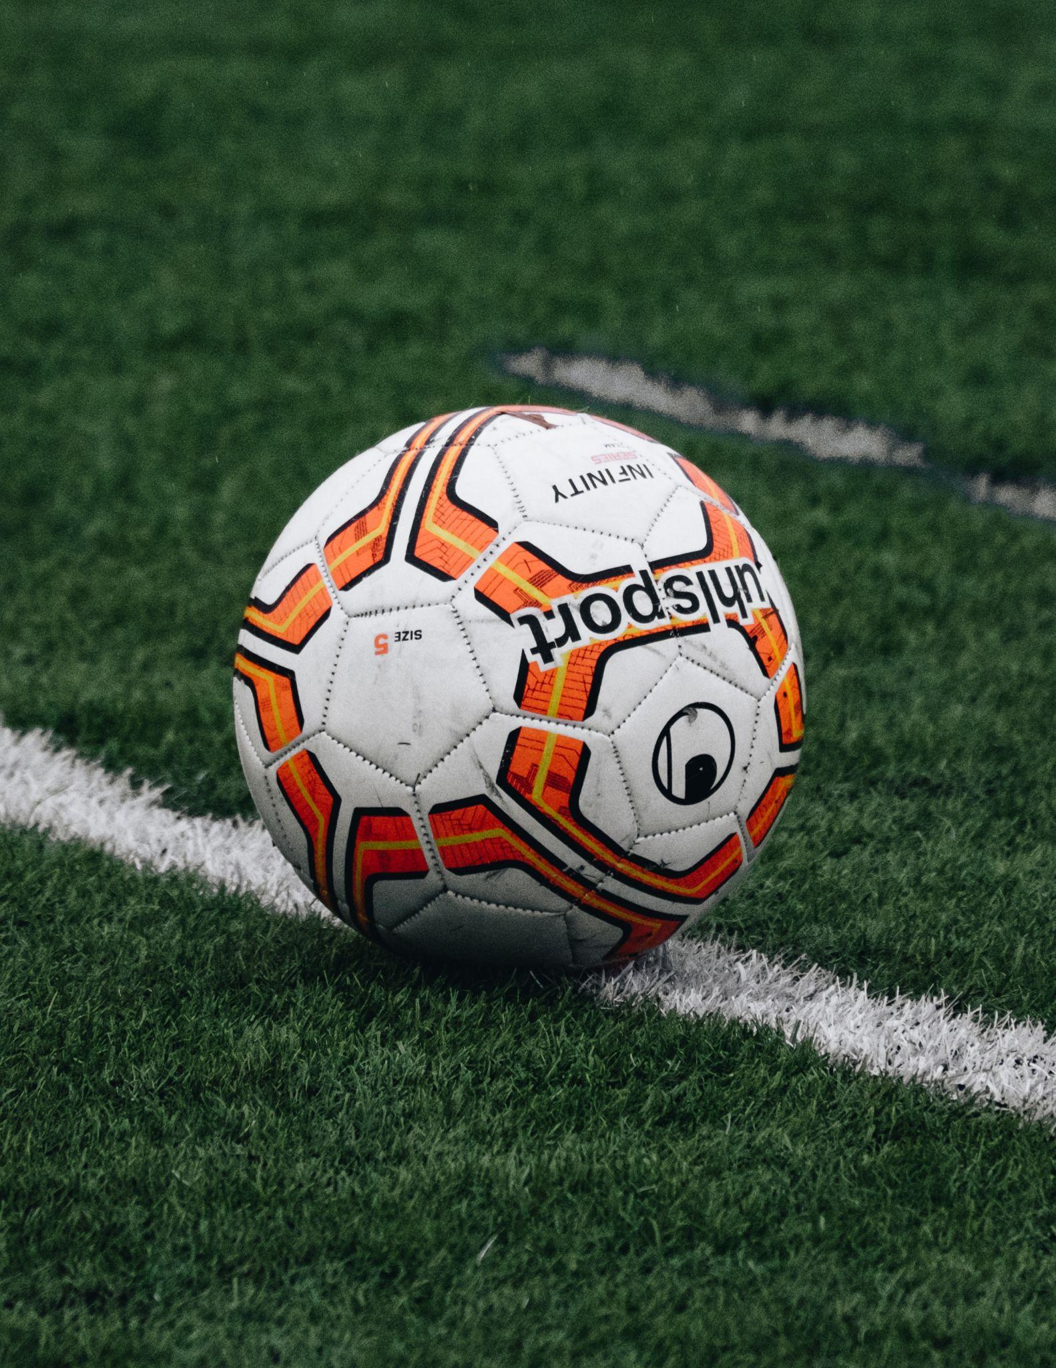
ᏅᎩᏁ ᏣᎳᎩ ᎠᏕᎶᏆᏍᏗ
ᎠᎭᏂ ᏍᏆᏞᏍᏗ. ᎧᏅᏑᎸ ᎢᏗᏅᎦᎳ.
ᏍᏆᏞᏍᏗ ᎠᎩᎭ, Ꮩ ᎤᏍᏗ ᏣᎭ? X3
ᎧᏅᏑᎸ ᎢᏗᏅᎦᎳᎢ.

Slide 8
ᏅᎩᏁ ᏣᎳᎩ ᎠᏕᎶᏆᏍᏗ
Now it’s your turn. Make a verse about………
A bird (ᏥᏍᏆ)
ᏥᏍᏆ ᎠᎩᎧ, Ꮩ ᎤᏍᏗ ᏣᎧ?
A pencil (ᏗᎪᏪᎶᏗ)
ᏗᎪᏪᎶᏗ ᎠᏋᏯ. Ꮩ ᎤᏍᏗ ᏨᏯ?
chain (ᎤᎾᏓᏕᏒᏓ)
ᎤᎾᏓᏕᏒᏓ ᎠᎩᎾ. Ꮩ ᎤᏍᏗ ᏣᎾ?
beer (ᎠᏬᎩᏢᏍᎩ)
ᎠᏬᎩᏢᏍᎩ ᎠᎩᏁ. Ꮩ ᎤᏍᏗ ᏣᏁ?
Television (ᎠᏓᏴᎳᏛᏍᎩ)
ᎠᏓᏴᎳᏛᏍᎩ ᎠᎩᎭ. Ꮩ ᎤᏍᏗ ᏣᎭ?

Slide 9
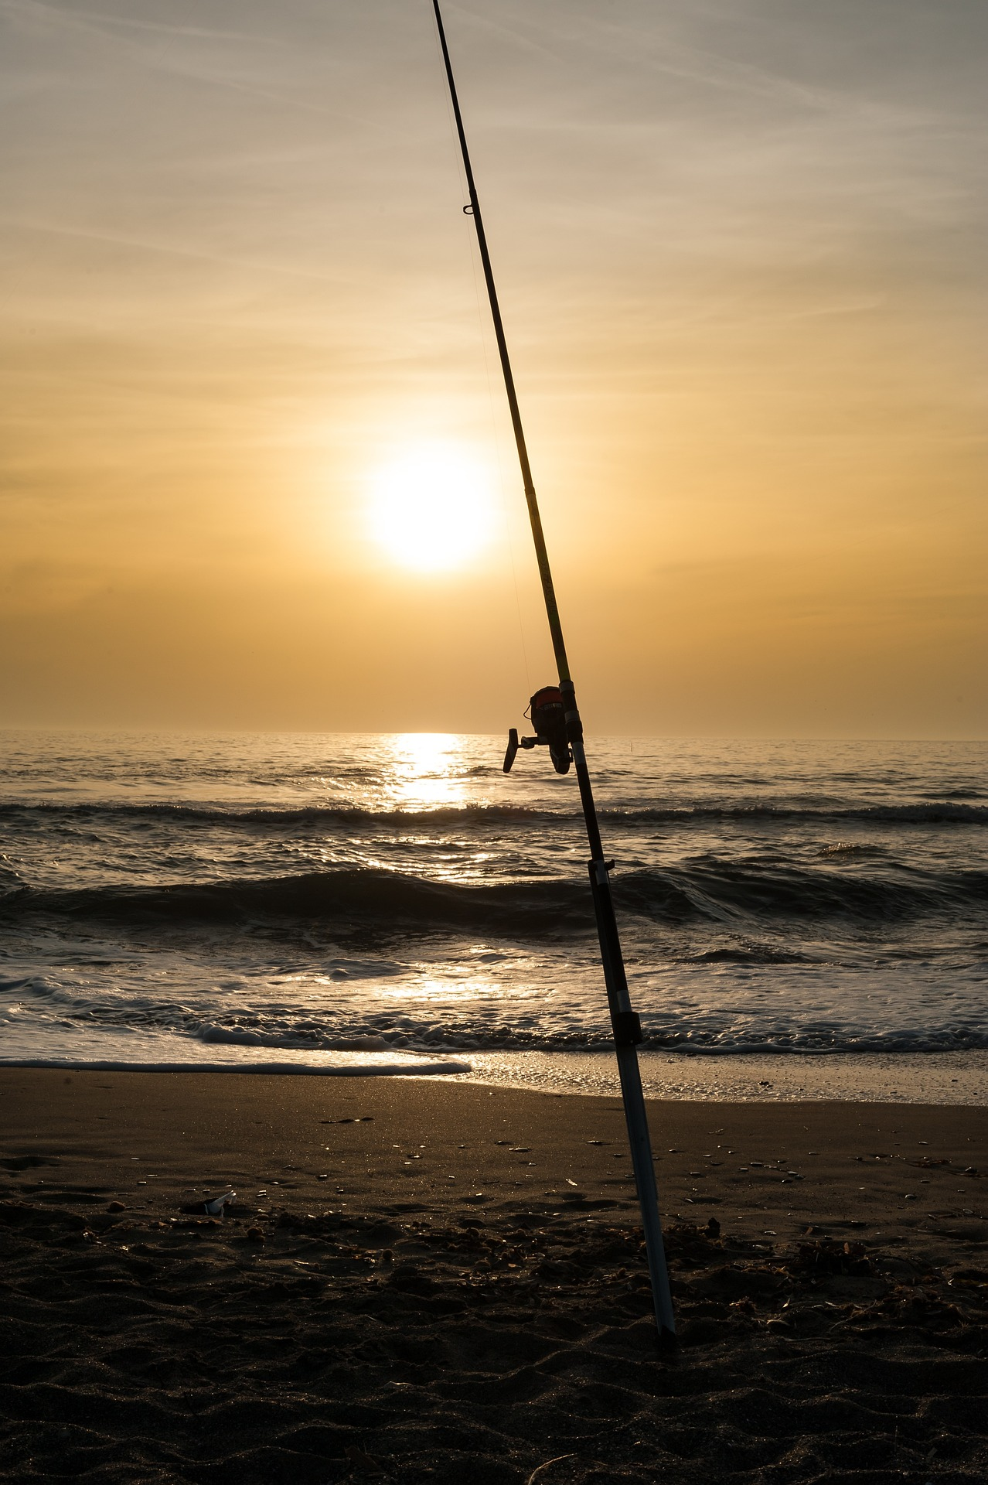
ᏅᎩᏁ ᏣᎳᎩ ᎠᏕᎶᏆᏍᏗ
ᎢᏤ ᎦᏛᏗ ____________
ᎠᎩᎧ
ᎠᎩᏁ
ᎦᏛᏗ
ᎠᏑᏙᏗ
ᎠᏋᏯ
ᎠᎩᎾ
ᎠᎩᎭ
I have 2 fishing poles.
ᏔᎵ ᏱᎦ ᏗᎦᏛᏗ ᏓᏋᏯ.

Slide 10
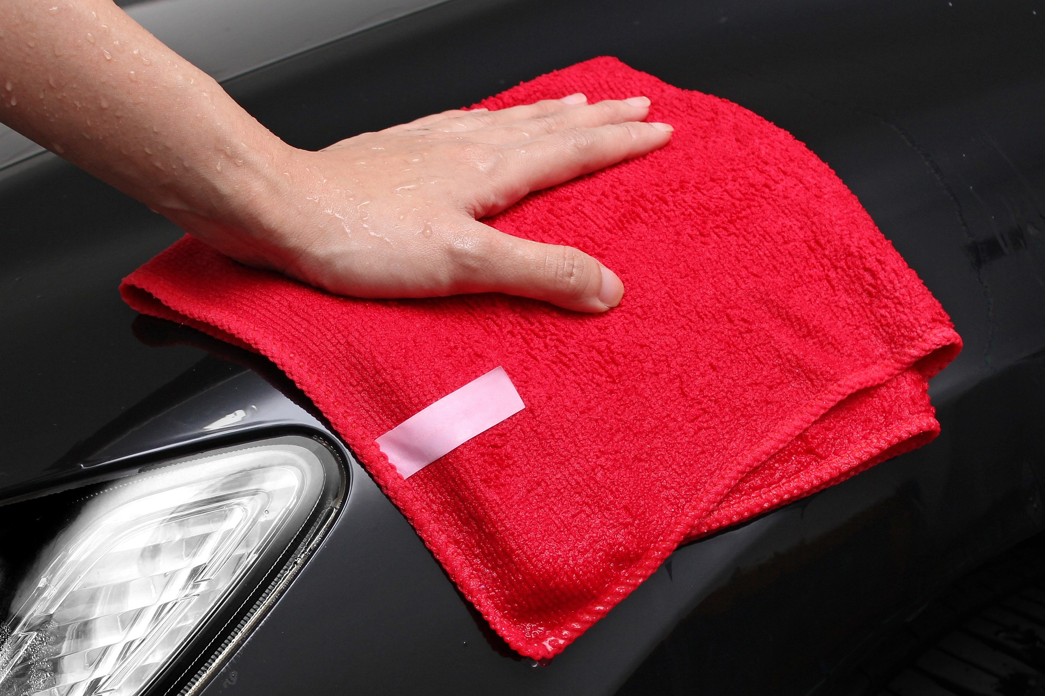
ᏅᎩᏁ ᏣᎳᎩ ᎠᏕᎶᏆᏍᏗ
ᎩᎦᎨ ᎠᎵᎧᏲᏙᏚ ____________
ᎠᎩᎧ
ᎠᎩᏁ
ᎠᎵᎧᏲᏙᏗ
ᎠᏋᏯ
ᎠᎩᎾ
ᎠᎩᎭ
I don’t have a towel.
Ꮭ ᏯᎩᎾ ᎠᎵᎧᏲᏙᏗ.

Slide 11
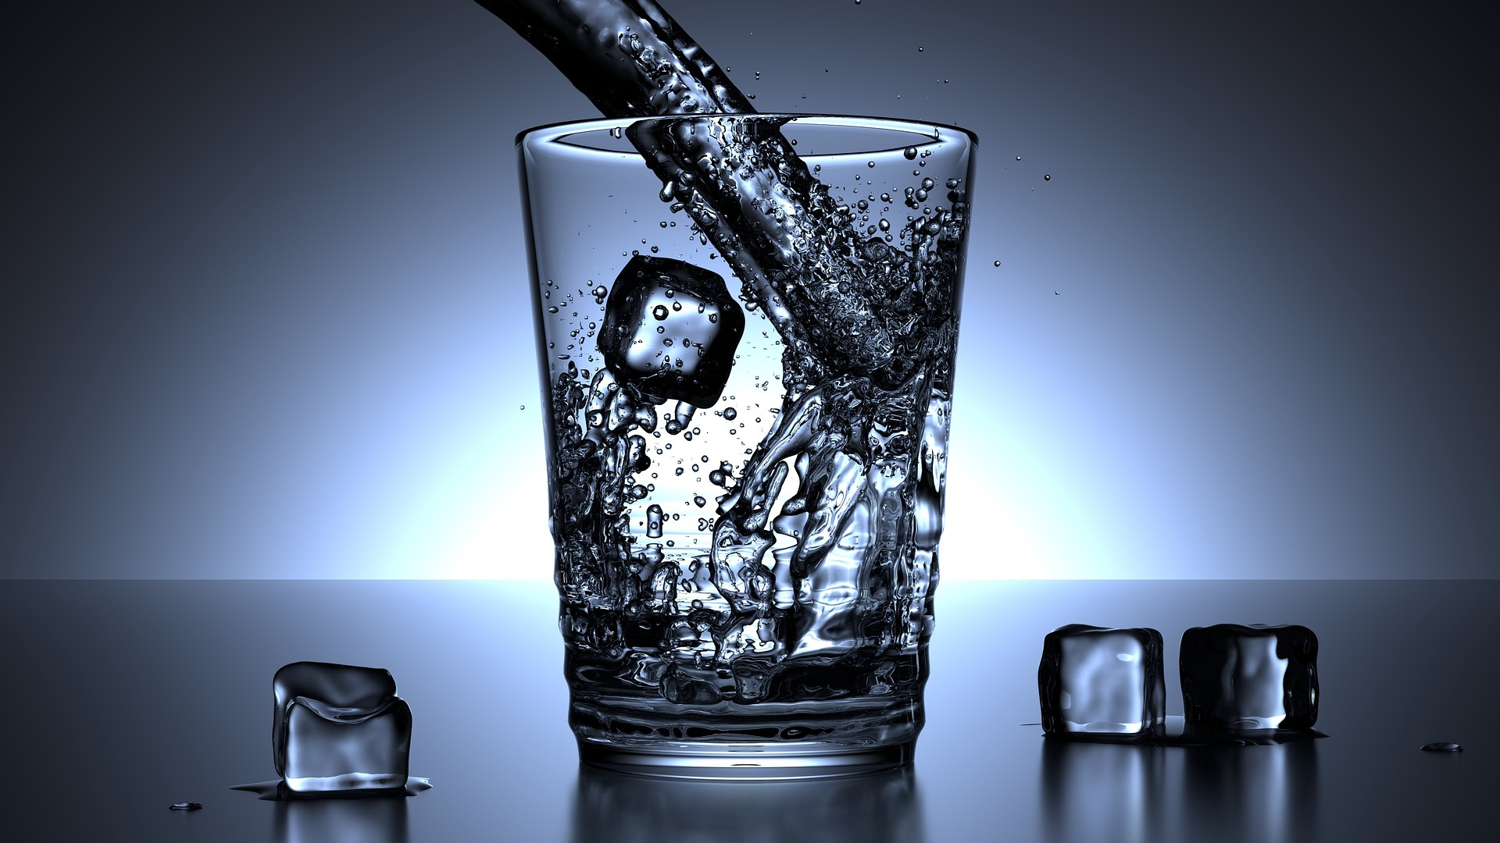
ᏅᎩᏁ ᏣᎳᎩ ᎠᏕᎶᏆᏍᏗ
ᎤᏴᏜ ᎠᏗᏔᏍᏗ ____________
ᎠᎩᎧ
ᎠᎩᏁ
ᎠᏗᏔᏍᏗ
ᎠᏋᏯ
ᎠᎩᎾ
ᎠᎩᎭ
I have warm milk.
ᎤᎦᏅᏩ ᎤᏅᏗ ᎠᎩᏁ.

Slide 12
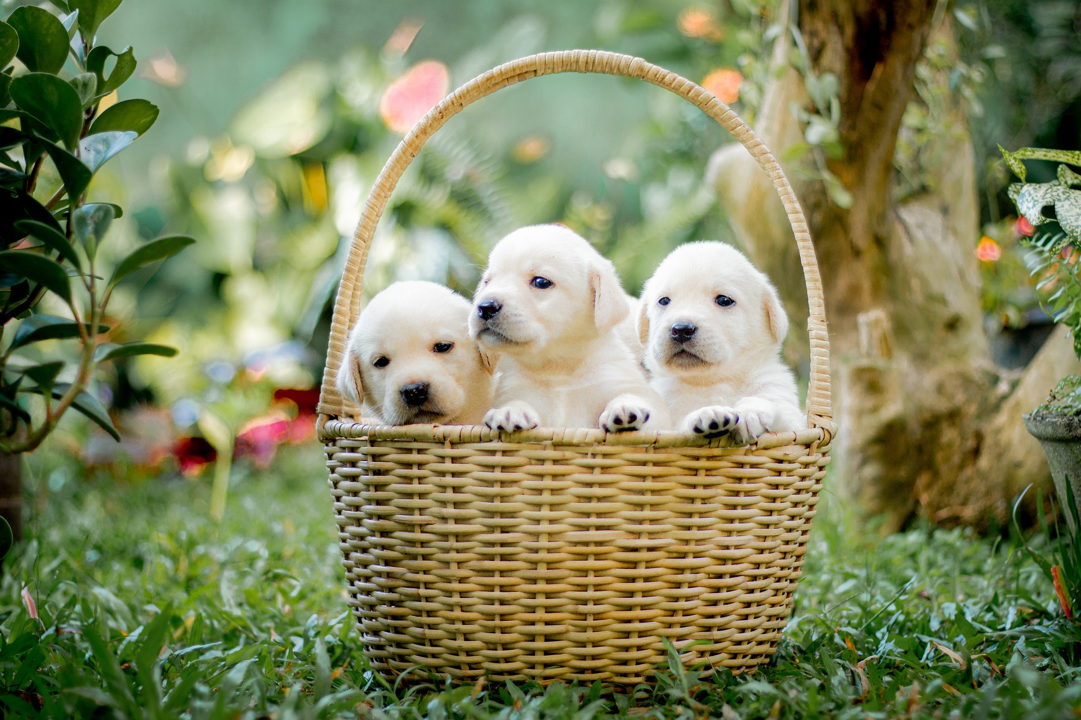
ᏅᎩᏁ ᏣᎳᎩ ᎠᏕᎶᏆᏍᏗ
ᏦᎢ ᎾᏂ ᎩᏟ ᎠᏂᏓ ____________
ᎠᎩᎧ
ᎠᎩᏁ
ᎩᏟ ᎠᏂᏓ
ᎠᏋᏯ
ᎠᎩᎾ
ᎠᎩᎭ
I have a snake.
ᎢᎾᏓ ᎠᎩᎧ.

Slide 13
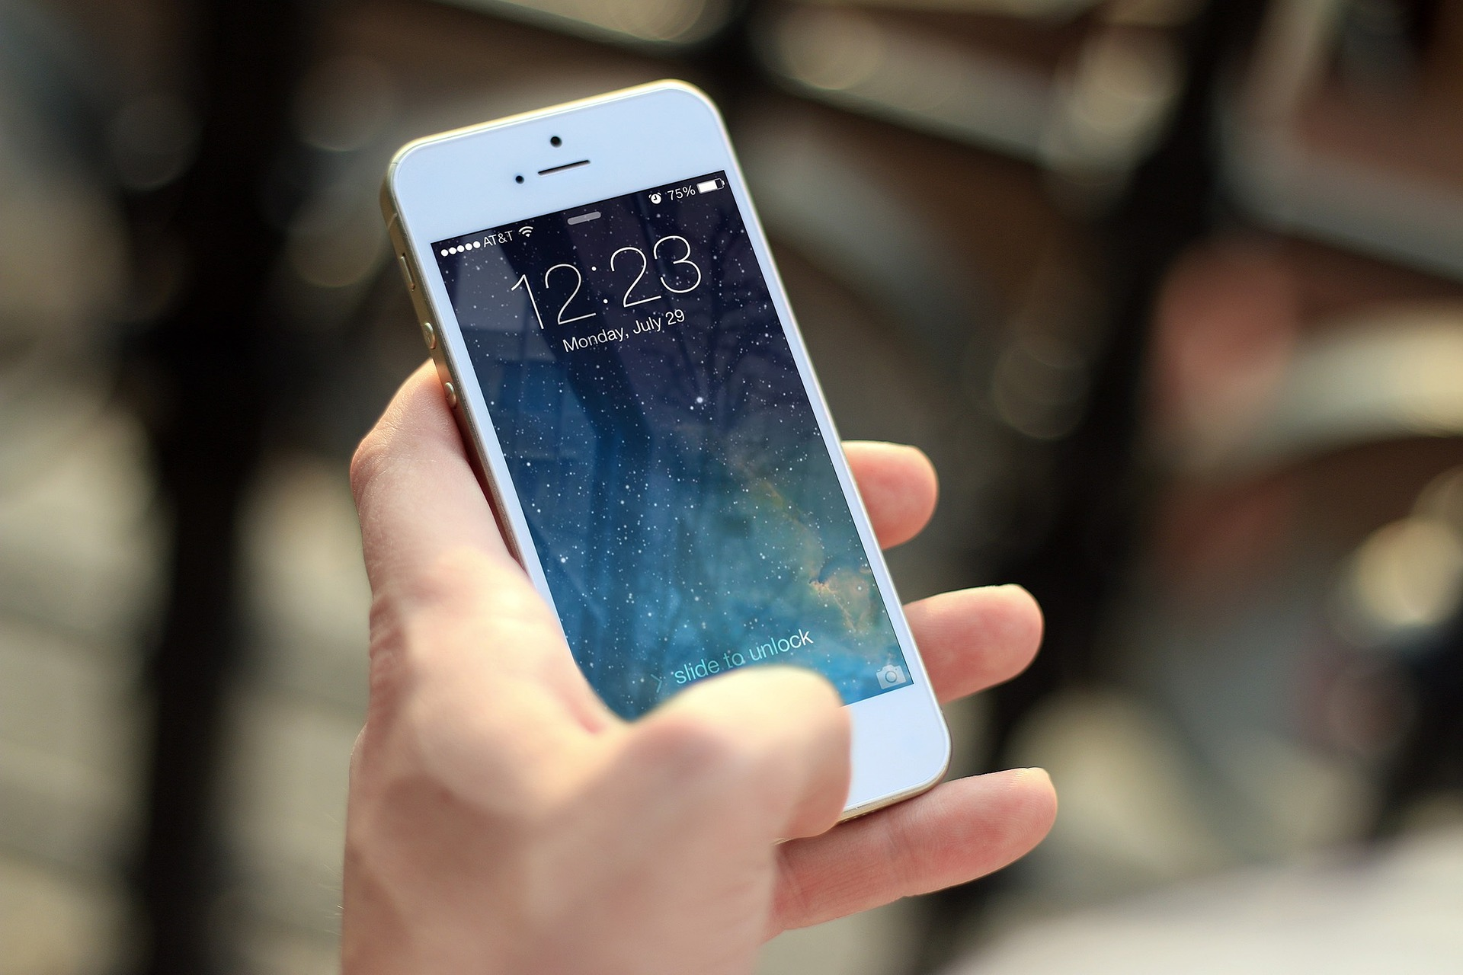
ᏅᎩᏁ ᏣᎳᎩ ᎠᏕᎶᏆᏍᏗ
ᎢᏤ ᏗᏝᏃᎮᏗ ____________
ᎠᎩᎧ
ᎠᎩᏁ
ᏗᏝᏃᎮᏗ
ᎠᏋᏯ
ᎠᎩᎾ
ᎠᎩᎭ
I have a pretty rock.
ᎤᏬᏚ ᏅᏯ ᎠᎩᎭ.

Slide 14
ᏅᎩᏁ ᏣᎳᎩ ᎠᏕᎶᏆᏍᏗ
ᎾᏛᏁᎲ- Verbs
Single subject, single object
ᎠᎩ | I- it
Ꮳ | You- it
Ꭴ | he/she- it

Slide 15
ᏅᎩᏁ ᏣᎳᎩ ᎠᏕᎶᏆᏍᏗ
ᎾᏛᏁᎲ- Verbs
we 2 subject
ᎩᏂ | We two
ᎣᎩᏂ | We 2 but not you

Slide 16
ᏅᎩᏁ ᏣᎳᎩ ᎠᏕᎶᏆᏍᏗ
ᎾᏛᏁᎲ- Verbs
Let’s use a verb we already know. To have a living thing.
ᎩᏂᎧ- we 2 have it
ᎣᎩᏂᎧ- we 2 but not you have it.
Ex- ᎤᏪᏥ ᎠᏧᏣ ᎣᎩᏂᎧ. We 2 have a son.
ᎤᏥᏯᏍ ᏕᎩᏂᎧ? Do we have any worms?

Slide 17
ᏅᎩᏁ ᏣᎳᎩ ᎠᏕᎶᏆᏍᏗ
ᎾᏛᏁᎲ- Verbs
Have is a classificatory verb, meaning that the verb is different depending on what you have. There are 5 types:
Living
Liquid
Long
Flexible
Everything else

Slide 18
ᏅᎩᏁ ᏣᎳᎩ ᎠᏕᎶᏆᏍᏗ
ᎾᏛᏁᎲ- Verbs
Have alive
ᎠᎩᎧ
ᏣᎧ
ᎤᏪᎧ
ᎩᏂᎧ
ᎣᎩᏂᎧ
Have
liquid
ᎠᎩᏁ
ᏣᏁ
ᎤᏁ
ᎩᏂᏁ
ᎣᎩᏂᏁ
Have long
ᎠᏋᏯ
ᏨᏯ
ᎤᏮᏯ
ᎩᏅᏯ
ᎣᎩᏅᏯ
Have flexible
ᎠᎩᎾ
ᏣᎾ
ᎤᎾ
ᎩᏂᎾ
ᎣᎩᏂᎾ
Have other
ᎠᎩᎭ
ᏣᎭ
ᎤᎭ
ᎩᏂᎭ
ᎣᎩᏂᎭ

Slide 19
ᏅᎩᏁ ᏣᎳᎩ ᎠᏕᎶᏆᏍᏗ
ᎾᏛᏁᎲ- Verbs
I don’t have any socks. Do you have any?
Ꮭ ᏗᎵᏲ ᏱᏛᎩᎾ. ᏕᏣᎾᏍ?

Slide 20
ᏅᎩᏁ ᏣᎳᎩ ᎠᏕᎶᏆᏍᏗ
ᎾᏛᏁᎲ- Verbs
I have
ᎠᎩᎧ
ᎠᎩᏁ
ᎠᏋᏯ
ᎠᎩᎾ
ᎠᎩᎭ
I have……..
Juice (ᎤᏓᏁᏅ, ᎦᏁᎲ)
Coffee (ᎧᏫ)
Gravy (ᎠᏑᏍᏗ)
Soup (ᎤᎦᎹ)

Slide 21
ᏅᎩᏁ ᏣᎳᎩ ᎠᏕᎶᏆᏍᏗ
ᎾᏛᏁᎲ- Verbs
I have
ᎠᎩᎧ
ᎠᎩᏁ
ᎠᏋᏯ
ᎠᎩᎾ
ᎠᎩᎭ
I have……..
A cigarette (ᎪᎦᏍᏗ)
A feather (ᎤᎩᏓᏟ)
A .22 rifle (ᏔᎵᏦᏁ)
A board (ᏯᏖᎾ)

Slide 22
ᏅᎩᏁ ᏣᎳᎩ ᎠᏕᎶᏆᏍᏗ
ᎾᏛᏁᎲ- Verbs
I have
ᎠᎩᎧ
ᎠᎩᏁ
ᎠᏋᏯ
ᎠᎩᎾ
ᎠᎩᎭ
I have……..
A dress (ᎠᏌᏃ)
A coat (ᎦᏌᎴᏂ)
A dead snake (ᎢᎾᏓ ᎤᎵᏬᏨ)
A dollar bill (ᎤᏃᏍᏓ)
A flower (ᎠᏥᎸᏍᎩ)

Slide 23
ᏅᎩᏁ ᏣᎳᎩ ᎠᏕᎶᏆᏍᏗ
ᎾᏛᏁᎲ- Verbs
I have
ᎠᎩᎧ
ᎠᎩᏁ
ᎠᏋᏯ
ᎠᎩᎾ
ᎠᎩᎭ
I have……..
A new car (ᎢᏤ ᏓᏆᎴᎵ)
A box (ᎧᏁᏌ)
A turtle shell (ᎤᏯᏍᎦ)
A rock (nvya)

