Slide 1
ᎣᏏᏲ
ᎯᏍᎩᏁ ᏣᎳᎩ ᎠᏕᎶᏆᏍᏗ

Slide 2
ᎯᏍᎩᏁ ᏣᎳᎩ ᎠᏕᎶᏆᏍᏗ
ᎢᏓᎴᎾ- Let’s begin
ᏣᎳᎩ ᎢᏗᏬᏂ- Let’s talk Cherokee

Slide 3
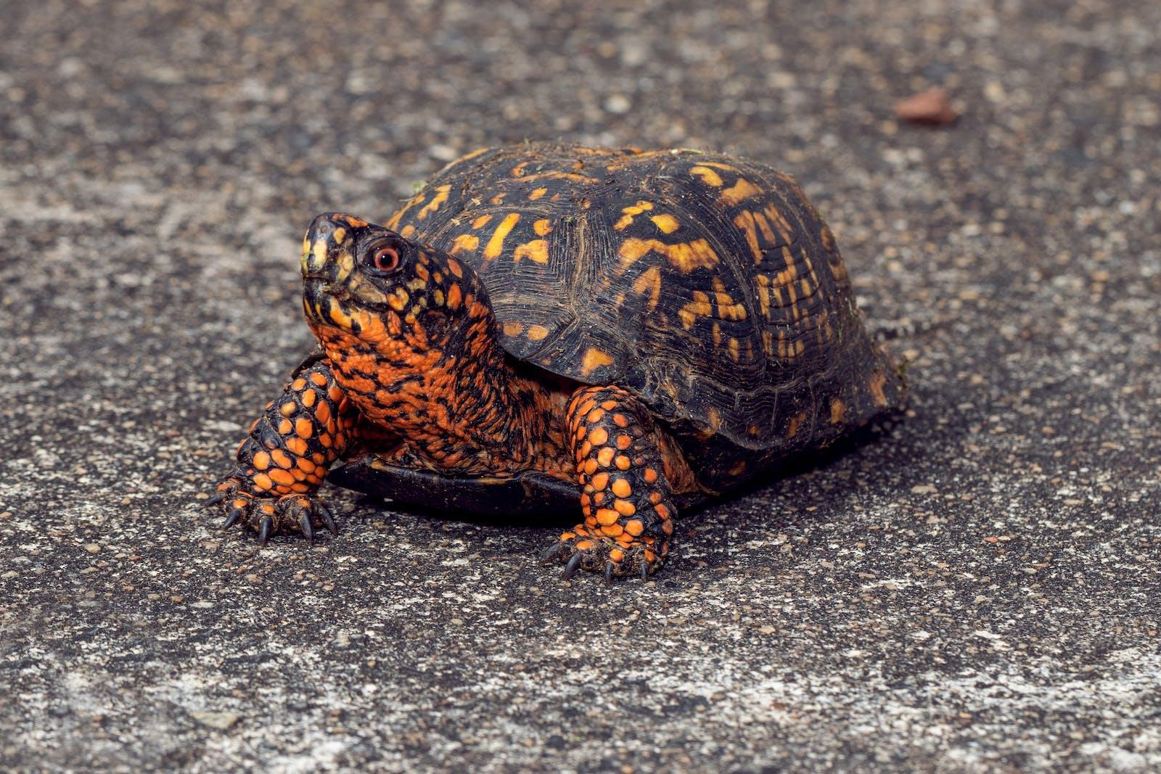
ᎯᏍᎩᏁ ᏣᎳᎩ ᎠᏕᎶᏆᏍᏗ
ᏓᎦᏏ ᎠᎩᎧ. ᎧᏅᏑᎸ ᎢᏗᏅᎦᎳ.
ᏓᎦᏏ ᎠᎩᎧ. Ꮩ ᎤᏍᏗ ᏣᎧ? X3
ᎧᏅᏑᎸ ᎢᏗᏅᎦᎳᎢ.

Slide 4
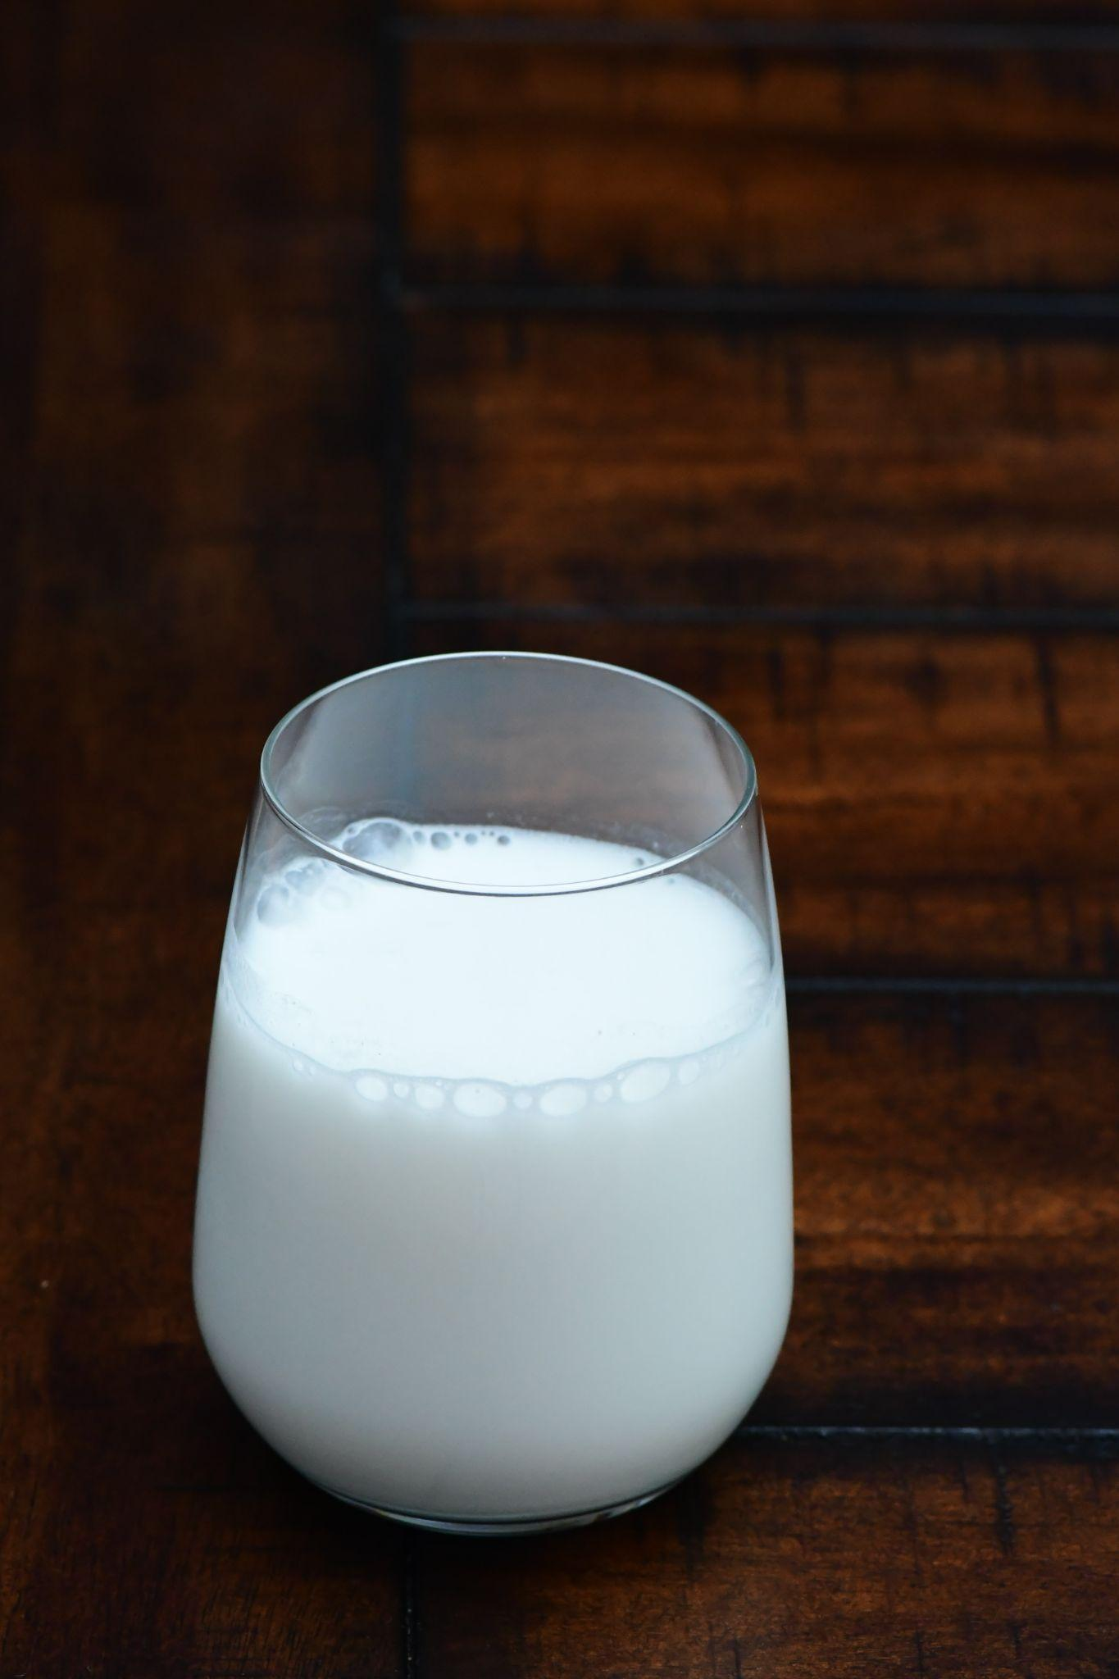
ᎯᏍᎩᏁ ᏣᎳᎩ ᎠᏕᎶᏆᏍᏗ
ᎯᎠ ᎤᏅᏗ. ᎧᏅᏑᎸ ᎢᏗᏅᎦᎳ.
ᎤᏅᏗ ᎠᎩᏁ, Ꮩ ᎤᏍᏗ ᏣᏁ? X3
ᎧᏅᏑᎸ ᎢᏗᏅᎦᎳᎢ.

Slide 5
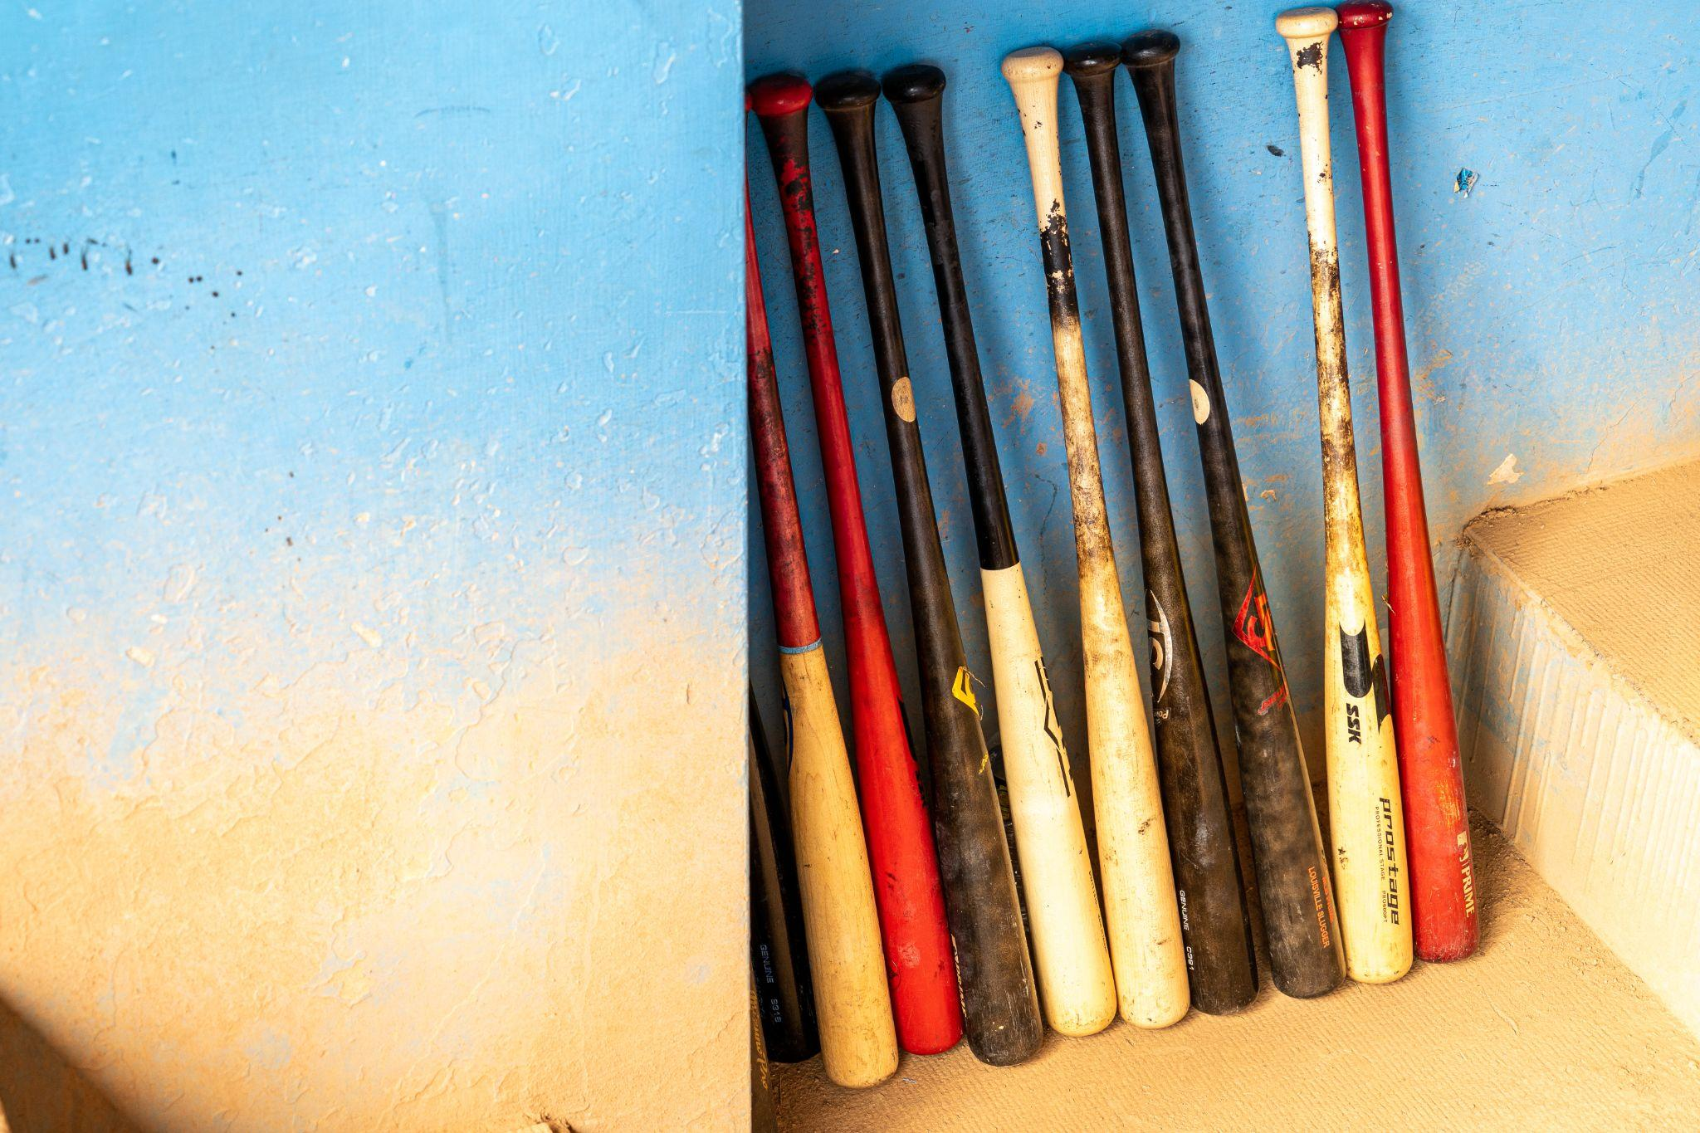
ᎯᏍᎩᏁ ᏣᎳᎩ ᎠᏕᎶᏆᏍᏗ
ᏣᎾᏘᏍ ᏳᏍᏗ ᎨᏒ ᎯᎠ? ᎯᎠ ᎪᏍᏛᏂᏍᏗ. ᎧᏅᏑᎸ ᎢᏗᏅᎦᎳ.
ᎪᏍᏛᏂᏍᏗ ᎠᏋᏯ, Ꮩ ᎤᏍᏗ ᏨᏯ? X3
ᎧᏅᏑᎸ ᎢᏗᏅᎦᎳᎢ.

Slide 6
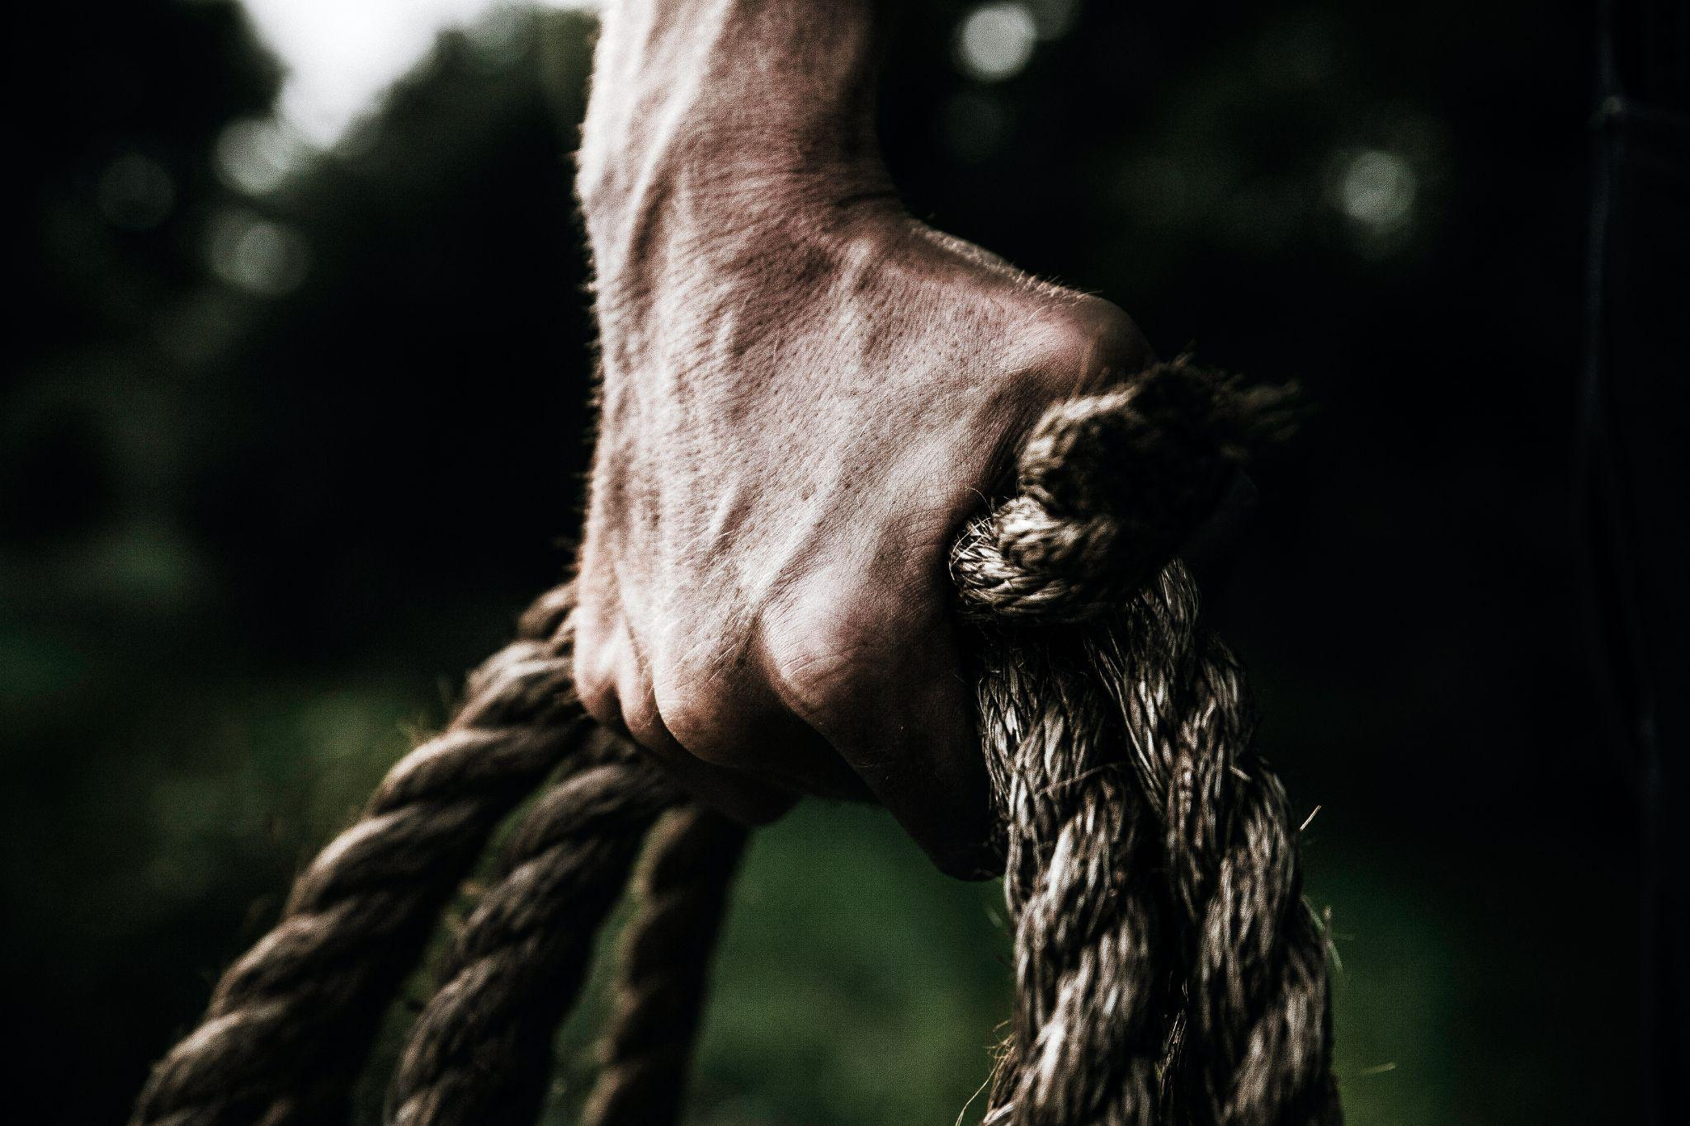
ᎯᏍᎩᏁ ᏣᎳᎩ ᎠᏕᎶᏆᏍᏗ
Ꮒ! ᏍᏕᏱᏓ ᎠᎩᎾ. ᎧᏅᏑᎸ ᎢᏗᏅᎦᎳ.
ᏍᏕᏱᏓ ᎠᎩᎾ, Ꮩ ᎤᏍᏗ ᏣᎾ? X3
ᎧᏅᏑᎸ ᎢᏗᏅᎦᎳᎢ.

Slide 7
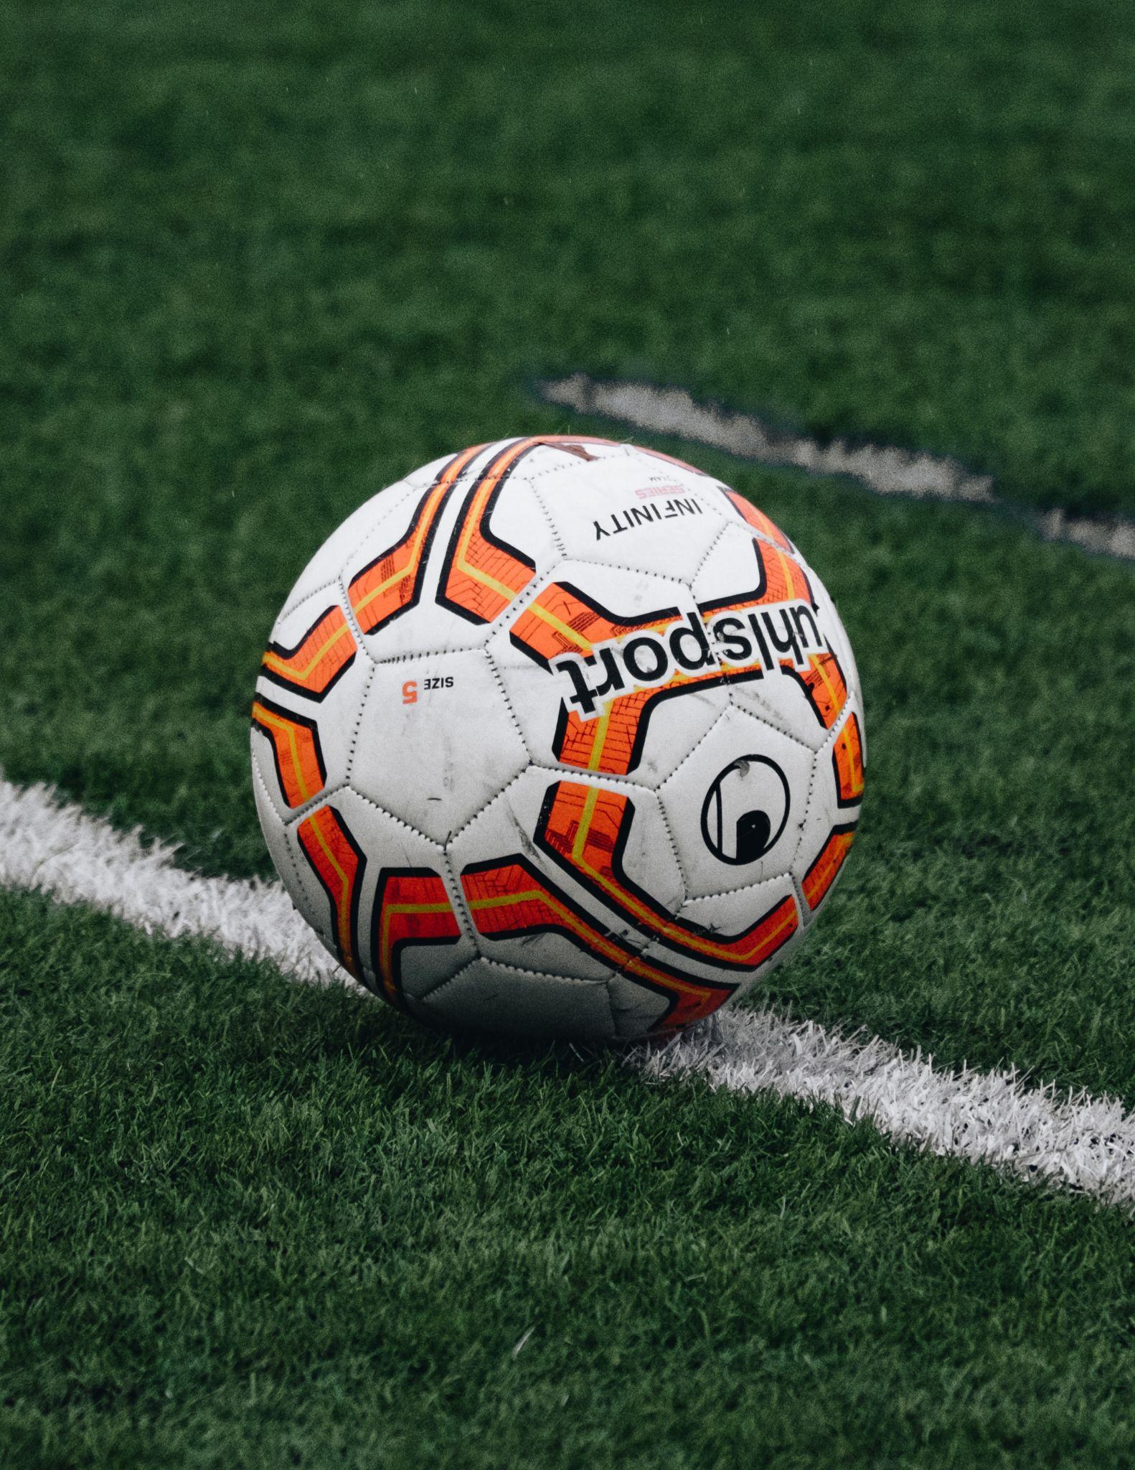
ᎯᏍᎩᏁ ᏣᎳᎩ ᎠᏕᎶᏆᏍᏗ
ᎠᎭᏂ ᏍᏆᏞᏍᏗ. ᎧᏅᏑᎸ ᎢᏗᏅᎦᎳ.
ᏍᏆᏞᏍᏗ ᎠᎩᎭ, Ꮩ ᎤᏍᏗ ᏣᎭ? X3
ᎧᏅᏑᎸ ᎢᏗᏅᎦᎳᎢ.

Slide 8
ᎯᏍᎩᏁ ᏣᎳᎩ ᎠᏕᎶᏆᏍᏗ
Now it’s your turn. Make a verse about………
A lizard (ᏘᏲᎭᏟ)
ᏘᏲᎭᏟ ᎠᎩᎧ, Ꮩ ᎤᏍᏗ ᏣᎧ?
A cucumber (ᎦᎦᎹ)
ᎦᎦᎹ ᎠᏋᏯ. Ꮩ ᎤᏍᏗ ᏨᏯ?
string (ᎠᏍᏗ)
ᎠᏍᏗ ᎠᎩᎾ. Ꮩ ᎤᏍᏗ ᏣᎾ?
soup (ᎤᎦᎹ)
ᎤᎦᎹ ᎠᎩᏁ. Ꮩ ᎤᏍᏗ ᏣᏁ?
apple (ᏒᎦᏔ)
ᏒᎦᏔ ᎠᎩᎭ. Ꮩ ᎤᏍᏗ ᏣᎭ?

Slide 9
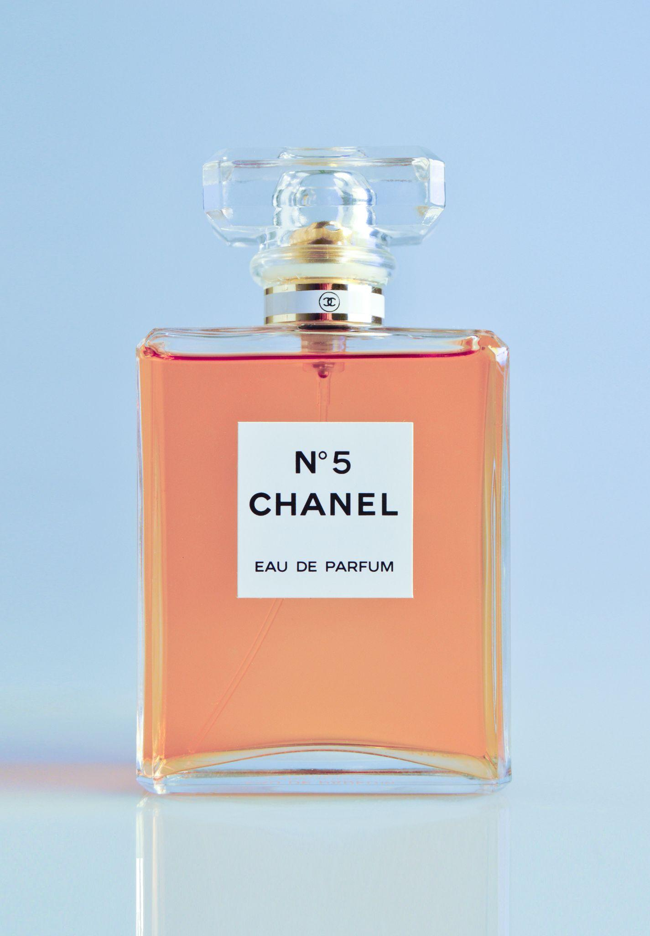
ᎯᏍᎩᏁ ᏣᎳᎩ ᎠᏕᎶᏆᏍᏗ
ᎢᏤ ᎠᎵᏍᏚᏟᏍᏗ ____________
ᎤᏪᎧ
ᎤᏁ
ᎠᎵᏍᏚᏟᏍᏗ
ᎤᏮᏯ
ᎤᎾ
ᎤᎭ

Slide 10
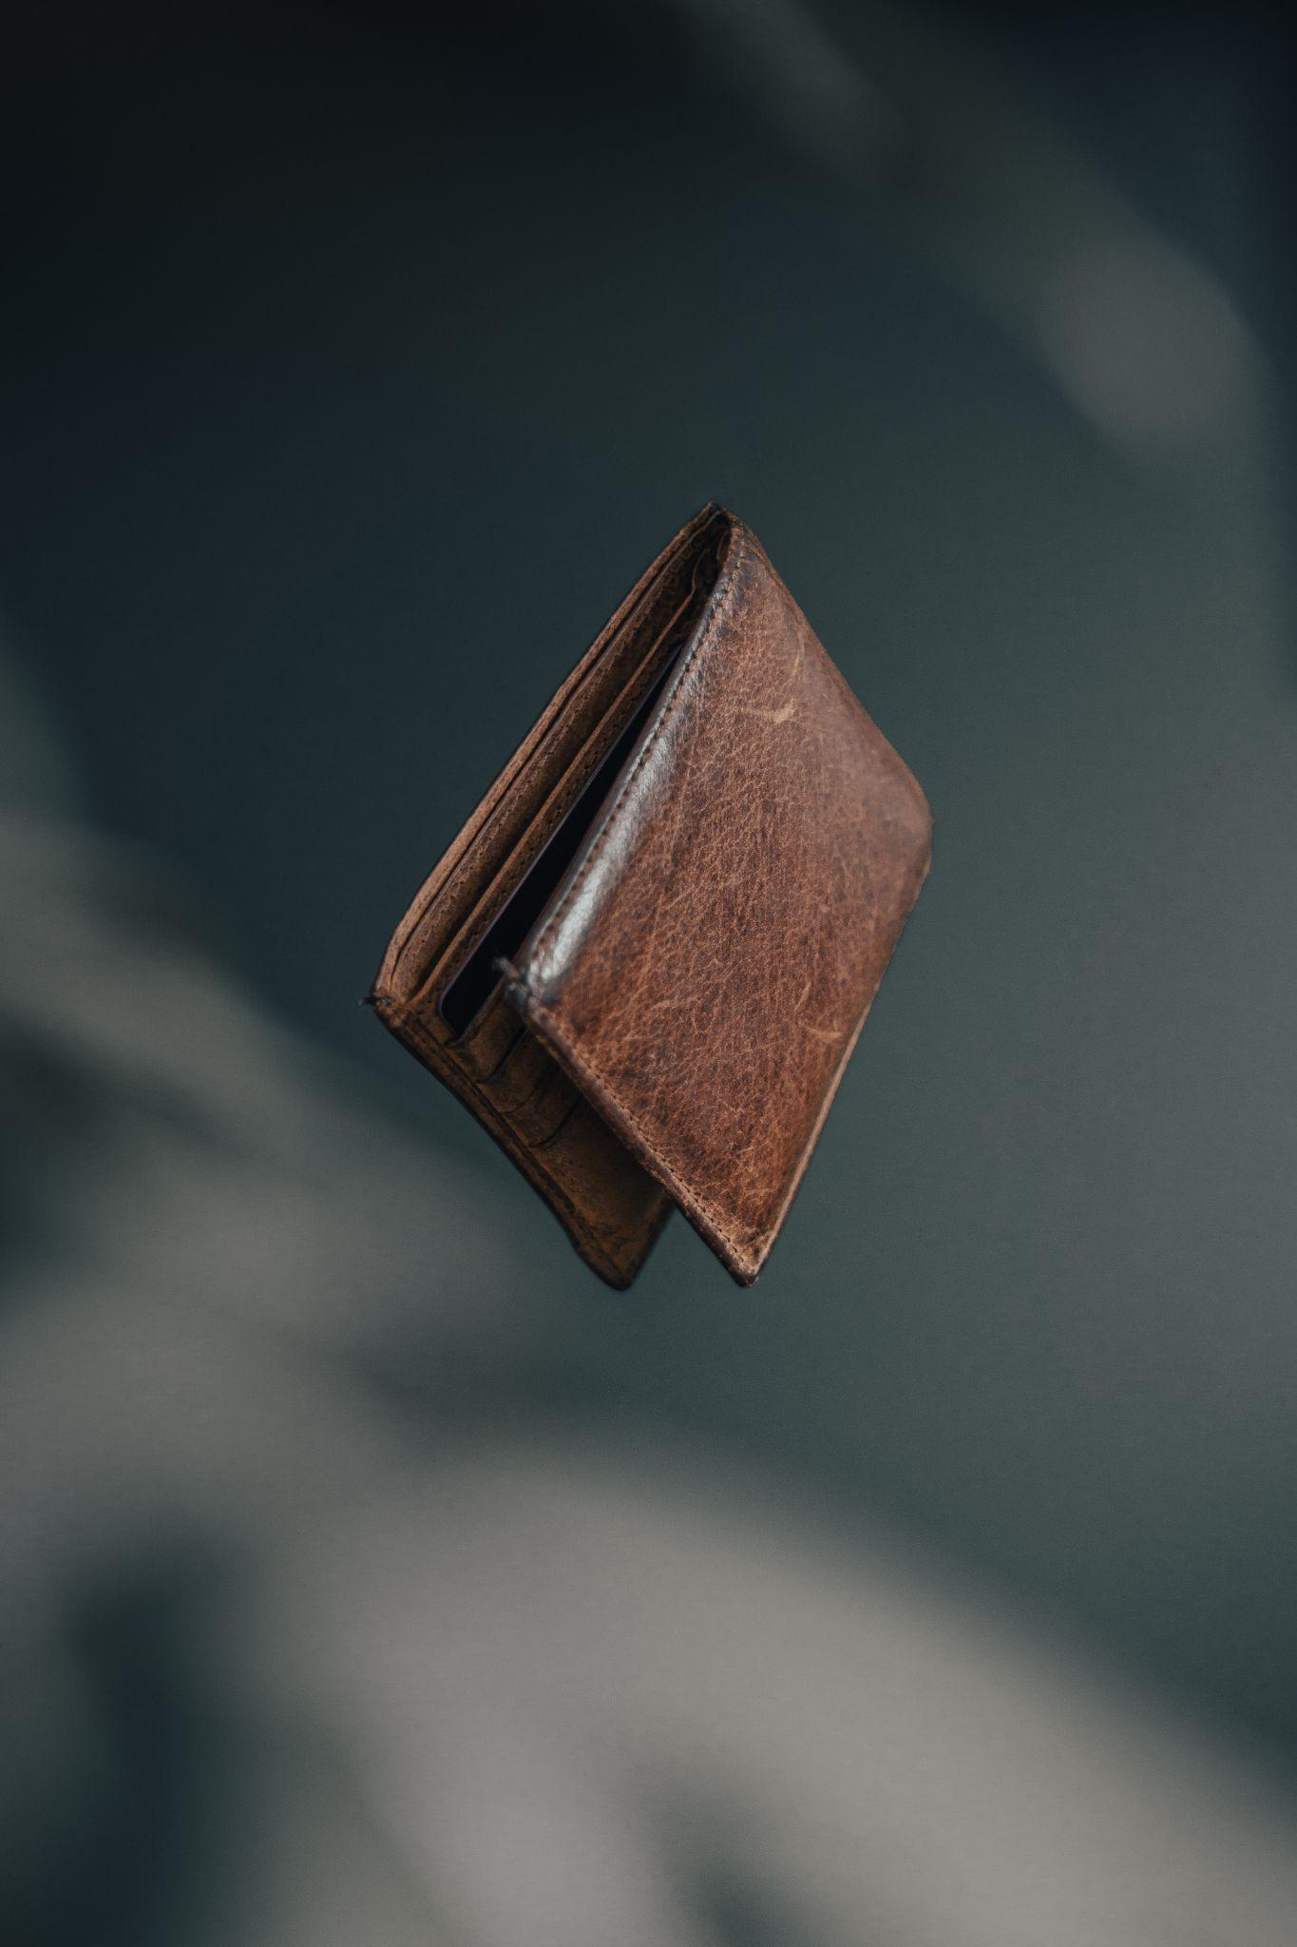
ᎯᏍᎩᏁ ᏣᎳᎩ ᎠᏕᎶᏆᏍᏗ
ᎦᏃᏥ ᎠᏕᎳ ᏗᎦᎵᏙᏗ ____________
ᎤᏪᎧ
ᎤᏁ
ᎠᏕᎳ ᏗᎦᎵᏙᏗ
ᎤᏮᏯ
ᎤᎾ
ᎤᎭ

Slide 11
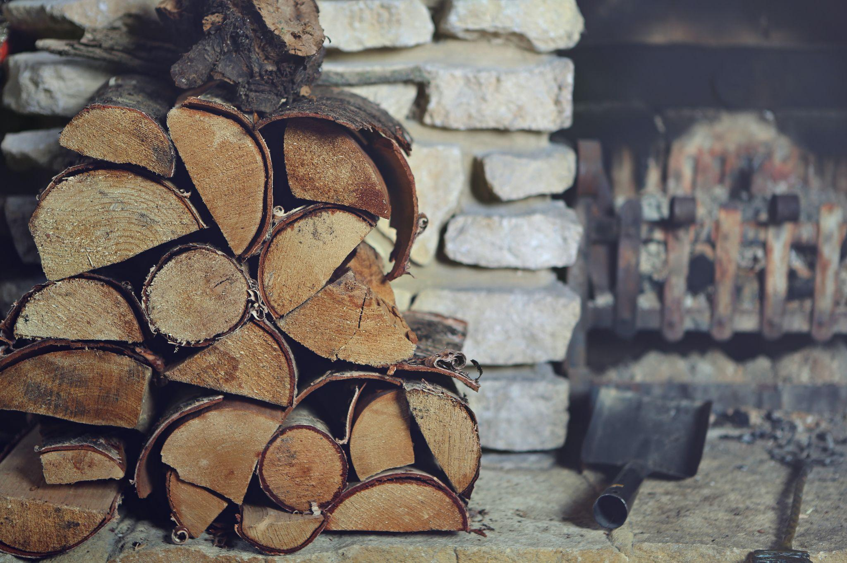
ᎯᏍᎩᏁ ᏣᎳᎩ ᎠᏕᎶᏆᏍᏗ
ᏦᎢ ᎢᎦᏒᏘ ᎠᏓ ____________
ᏚᏪᎧ
ᏚᏁ
ᎠᏓ
ᏚᏮᏯ
ᏚᎾ
ᏚᎭ

Slide 12
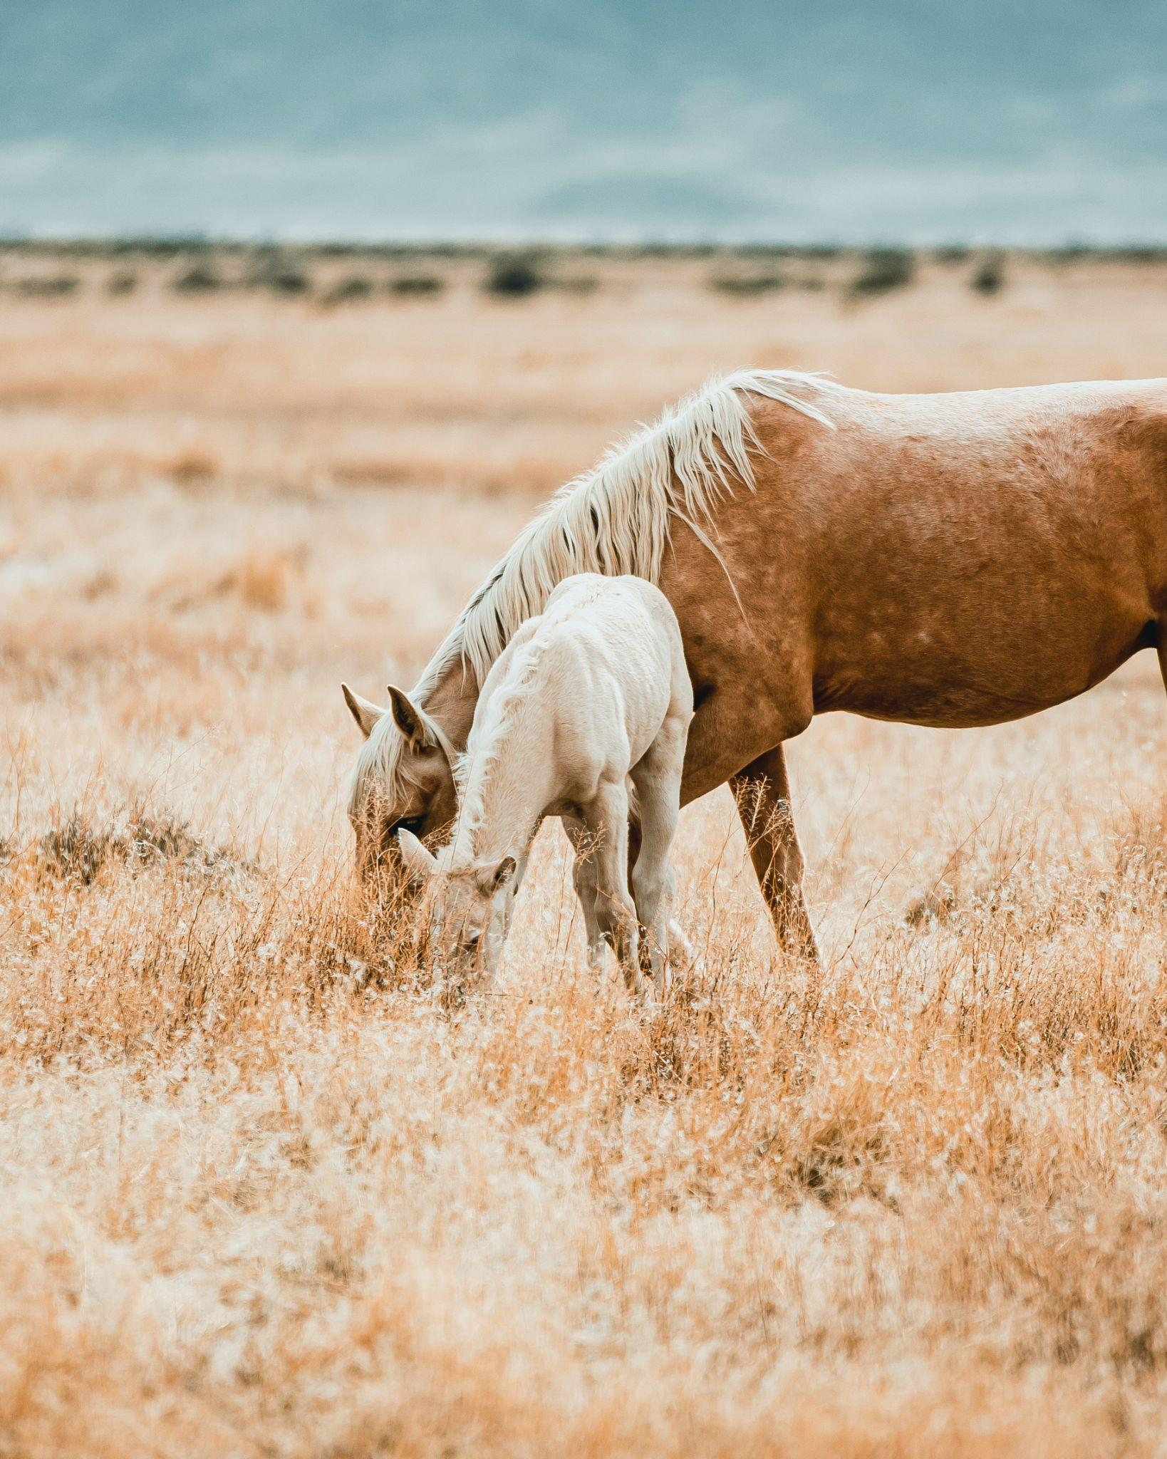
ᎯᏍᎩᏁ ᏣᎳᎩ ᎠᏕᎶᏆᏍᏗ
ᏐᏈᎵ ᎠᏆᏤᎵ ᎠᎩᎾ ____________
ᎤᏪᎧ
ᎤᏁ
ᎠᎩᎾ
ᎤᏮᏯ
ᎤᎾ
ᎤᎭ

Slide 13
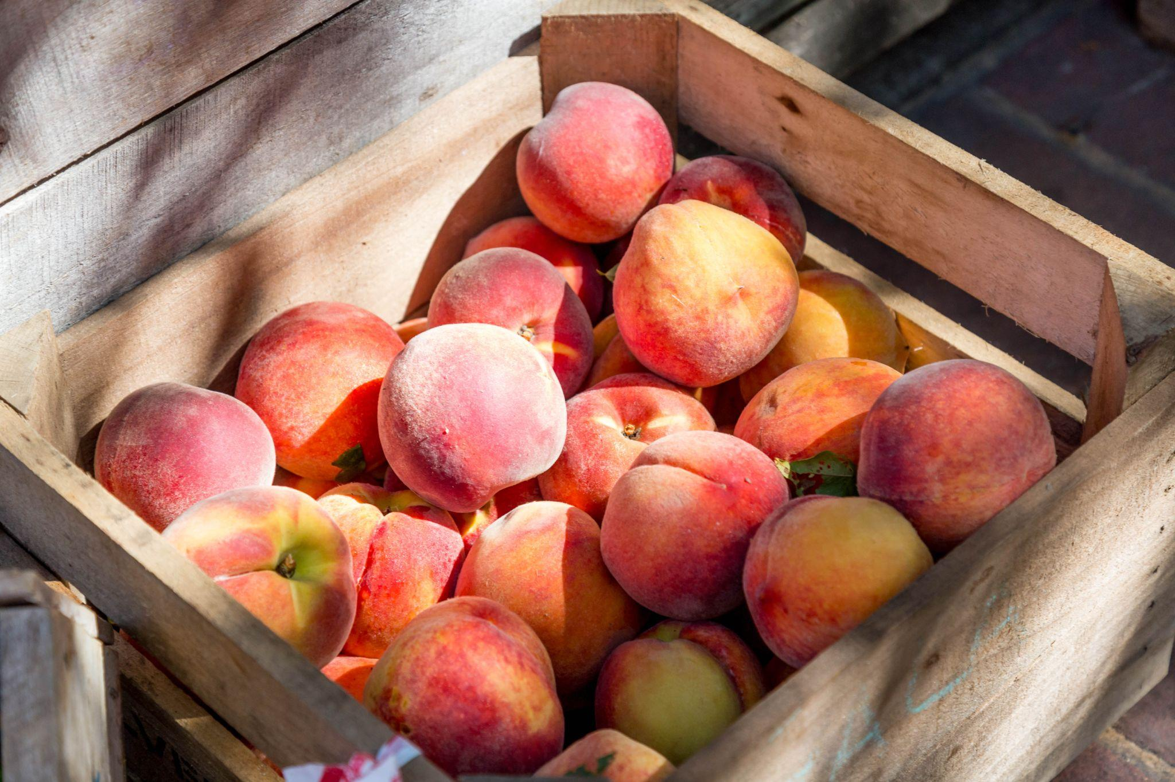
ᎯᏍᎩᏁ ᏣᎳᎩ ᎠᏕᎶᏆᏍᏗ
ᏑᏟᎶᏓ ᏆᎾ ____________
ᏚᏪᎧ
ᏚᏁ
ᏑᏟᎶᏓ
ᏚᏮᏯ
ᏚᎾ
ᏚᎭ

Slide 14
ᎯᏍᎩᏁ ᏣᎳᎩ ᎠᏕᎶᏆᏍᏗ
ᎾᏛᏁᎲ- Verbs
Single subject, single object
ᎠᎩ | I- it
Ꮳ | You- it
Ꭴ | he/she- it

Slide 15
ᎯᏍᎩᏁ ᏣᎳᎩ ᎠᏕᎶᏆᏍᏗ
ᎾᏛᏁᎲ- Verbs
we 2 subject
ᎩᏂ | We two
ᎣᎩᏂ | We 2 but not you

Slide 16
ᎯᏍᎩᏁ ᏣᎳᎩ ᎠᏕᎶᏆᏍᏗ
ᎾᏛᏁᎲ- Verbs
we subject
ᎢᎩ | All of us (including you)
ᎣᎩ | All of us (but not you)

Slide 17
ᎯᏍᎩᏁ ᏣᎳᎩ ᎠᏕᎶᏆᏍᏗ
ᎾᏛᏁᎲ- Verbs
You plural
ᏍᏗ | you two
ᎢᏥ | All of you

Slide 18
ᎯᏍᎩᏁ ᏣᎳᎩ ᎠᏕᎶᏆᏍᏗ
ᎾᏛᏁᎲ- Verbs
Have alive
ᎠᎩᎧ
ᏣᎧ
ᎤᏪᎧ
ᎩᏂᎧ
ᎣᎩᏂᎧ
ᎢᎩᎧ
ᎣᎩᎧ
ᏍᏗᎧ
ᎢᏥᎧ

Slide 19
ᎯᏍᎩᏁ ᏣᎳᎩ ᎠᏕᎶᏆᏍᏗ
ᎾᏛᏁᎲ- Verbs
Have liquid
ᎠᎩᏁ
ᏣᏁ
ᎤᏁ
ᎩᏂᏁ
ᎣᎩᏂᏁ
ᎢᎩᏁ
ᎣᎩᏁ
ᏍᏗᏁ
ᎢᏥᏁ

Slide 20
ᎯᏍᎩᏁ ᏣᎳᎩ ᎠᏕᎶᏆᏍᏗ
ᎾᏛᏁᎲ- Verbs
Have long
ᎠᏋᏯ
ᏨᏯ
ᎤᏮᏯ
ᎩᏅᏯ
ᎣᎩᏅᏯ
ᎢᎬᏯ
ᎣᎬᏯ
ᏍᏛᏯ
ᎢᏨᏯ

Slide 21
ᎯᏍᎩᏁ ᏣᎳᎩ ᎠᏕᎶᏆᏍᏗ
ᎾᏛᏁᎲ- Verbs
Have flexible
ᎠᎩᎾ
ᏣᎾ
ᎤᎾ
ᎩᏂᎾ
ᎣᎩᏂᎾ
ᎢᎩᎾ
ᎣᎩᎾ
ᏍᏗᎾ
ᎢᏥᎾ

Slide 22
ᎯᏍᎩᏁ ᏣᎳᎩ ᎠᏕᎶᏆᏍᏗ
ᎾᏛᏁᎲ- Verbs
Have other
ᎠᎩᎭ
ᏣᎭ
ᎤᎭ
ᎩᏂᎭ
ᎣᎩᏂᎭ
ᎢᎩᎭ
ᎣᎩᎭ
ᏍᏗᎭ
ᎢᏥᎭ

