Slide 1
ᎣᏏᏲ
ᏣᏁᎵᏁ ᏣᎳᎩ ᎠᏕᎶᏆᏍᏗ

Slide 2
ᏣᏁᎵᏁ ᏣᎳᎩ ᎠᏕᎶᏆᏍᏗ
ᎢᏓᎴᎾ- Let’s begin
ᏣᎳᎩ ᎢᏗᏬᏂ- Let’s talk Cherokee

Slide 3
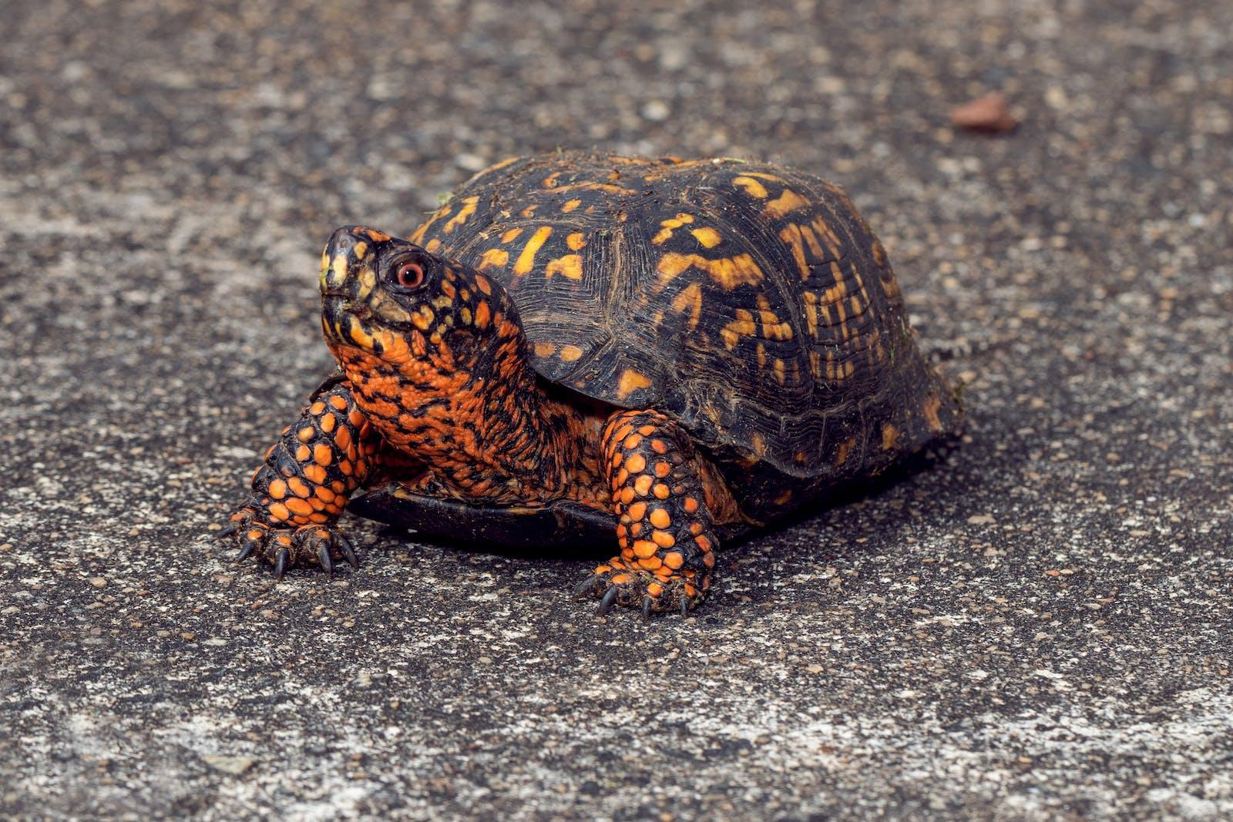
ᏣᏁᎵᏁ ᏣᎳᎩ ᎠᏕᎶᏆᏍᏗ
ᏓᎦᏏ ______. ᎧᏅᏑᎸ ᎢᏗᏅᎦᎳ.
ᏓᎦᏏ ____. Ꮩ ᎤᏍᏗ ____? X3
ᎧᏅᏑᎸ ᎢᏗᏅᎦᎳᎢ.
ᎠᎩᎧ, ᏣᎧ

Slide 4
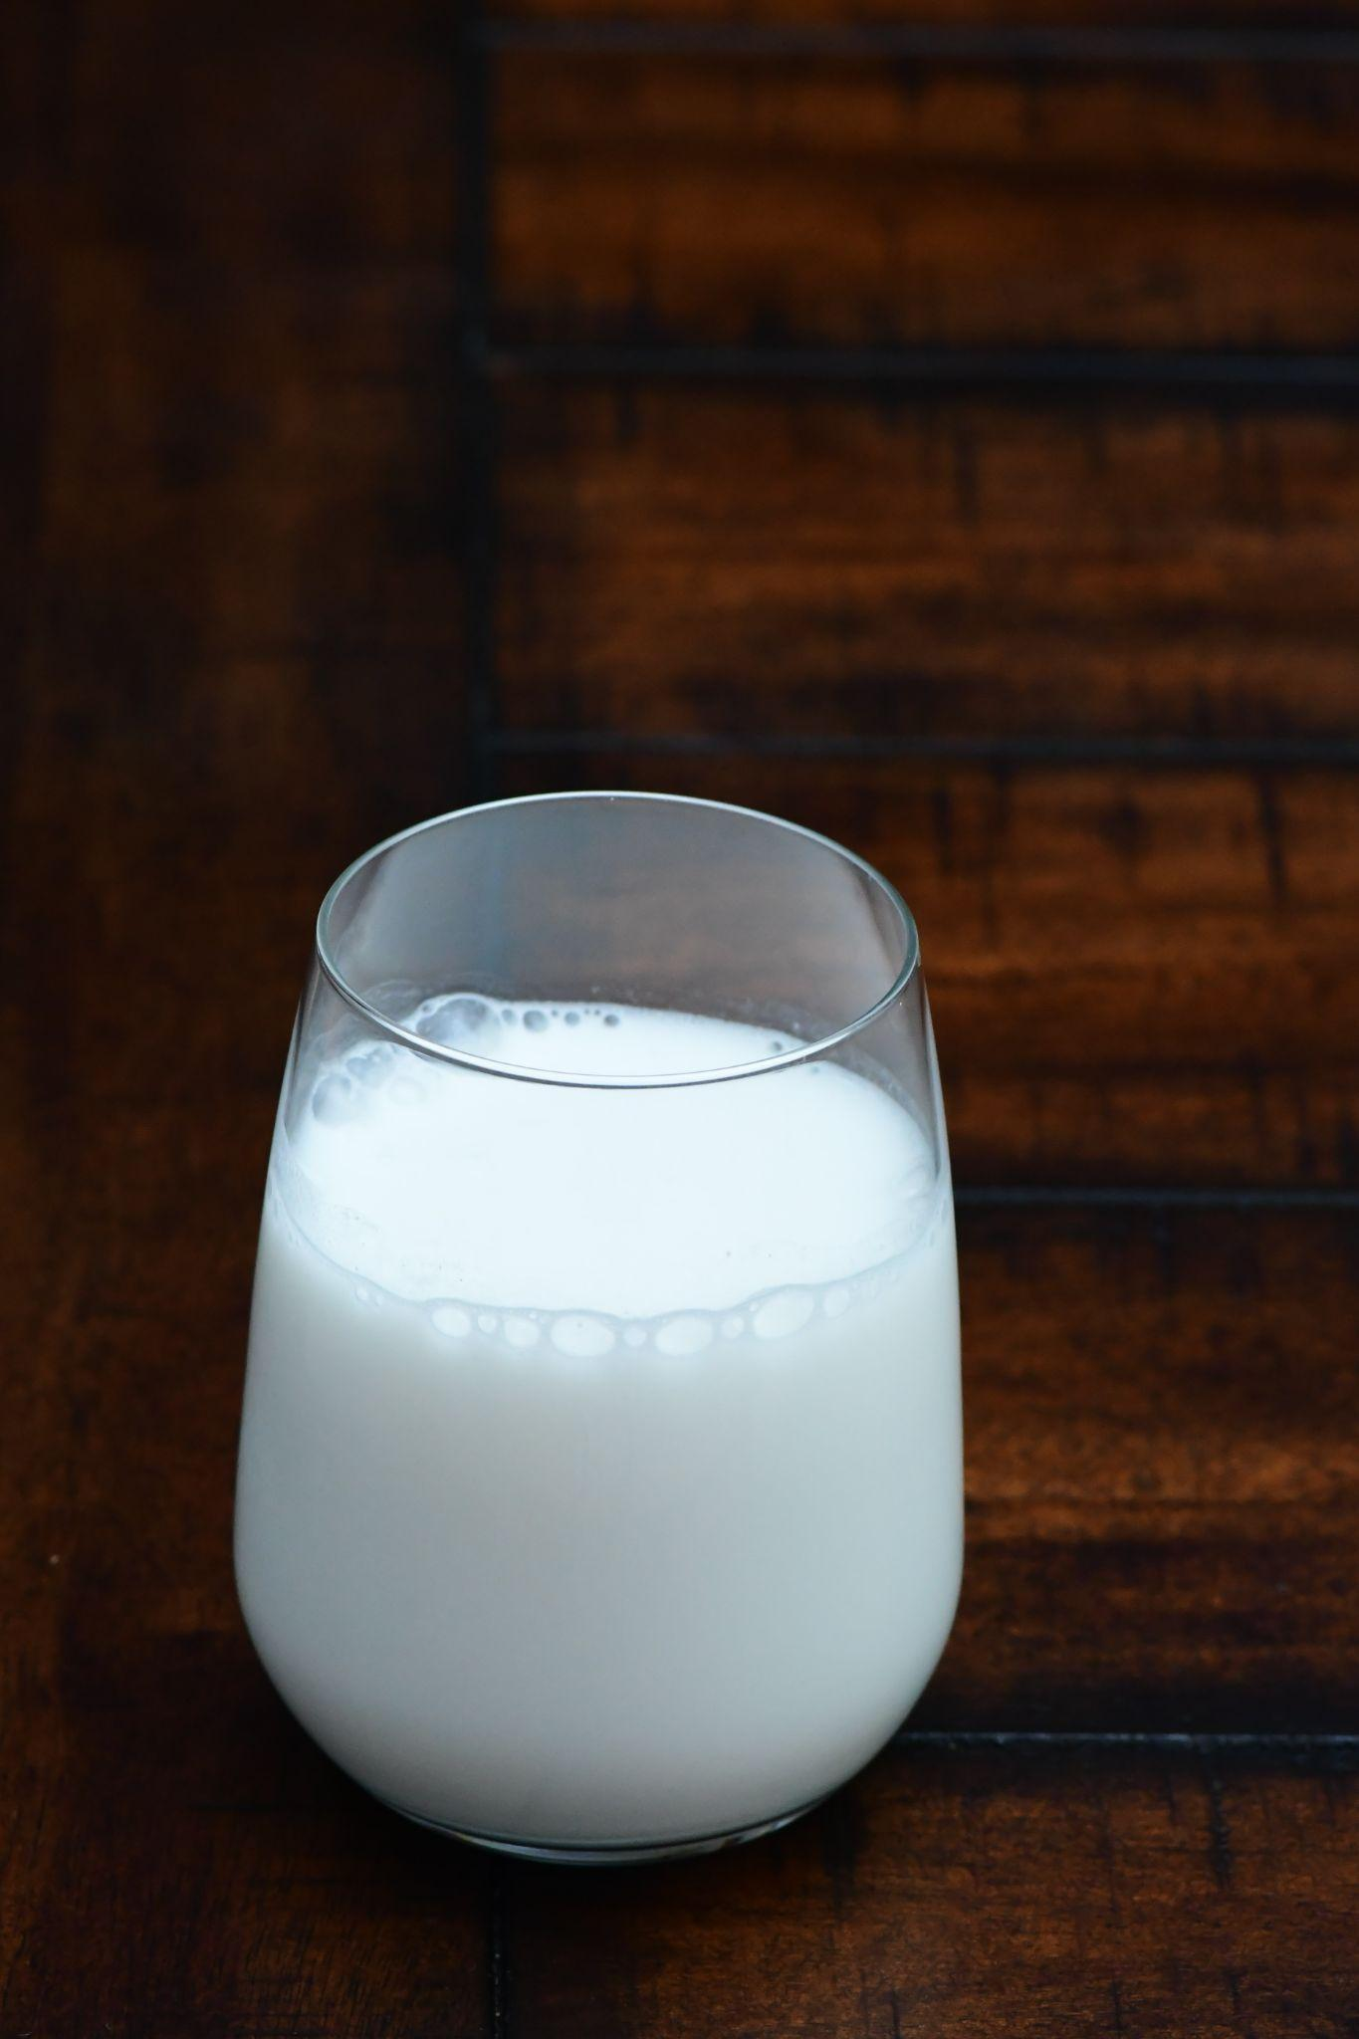
ᏣᏁᎵᏁ ᏣᎳᎩ ᎠᏕᎶᏆᏍᏗ
ᎯᎠ ᎤᏅᏗ. ᎧᏅᏑᎸ ᎢᏗᏅᎦᎳ.
ᎤᏅᏗ ___, Ꮩ ᎤᏍᏗ ___? X3
ᎧᏅᏑᎸ ᎢᏗᏅᎦᎳᎢ.
ᎠᎩᏁ, ᏣᏁ

Slide 5
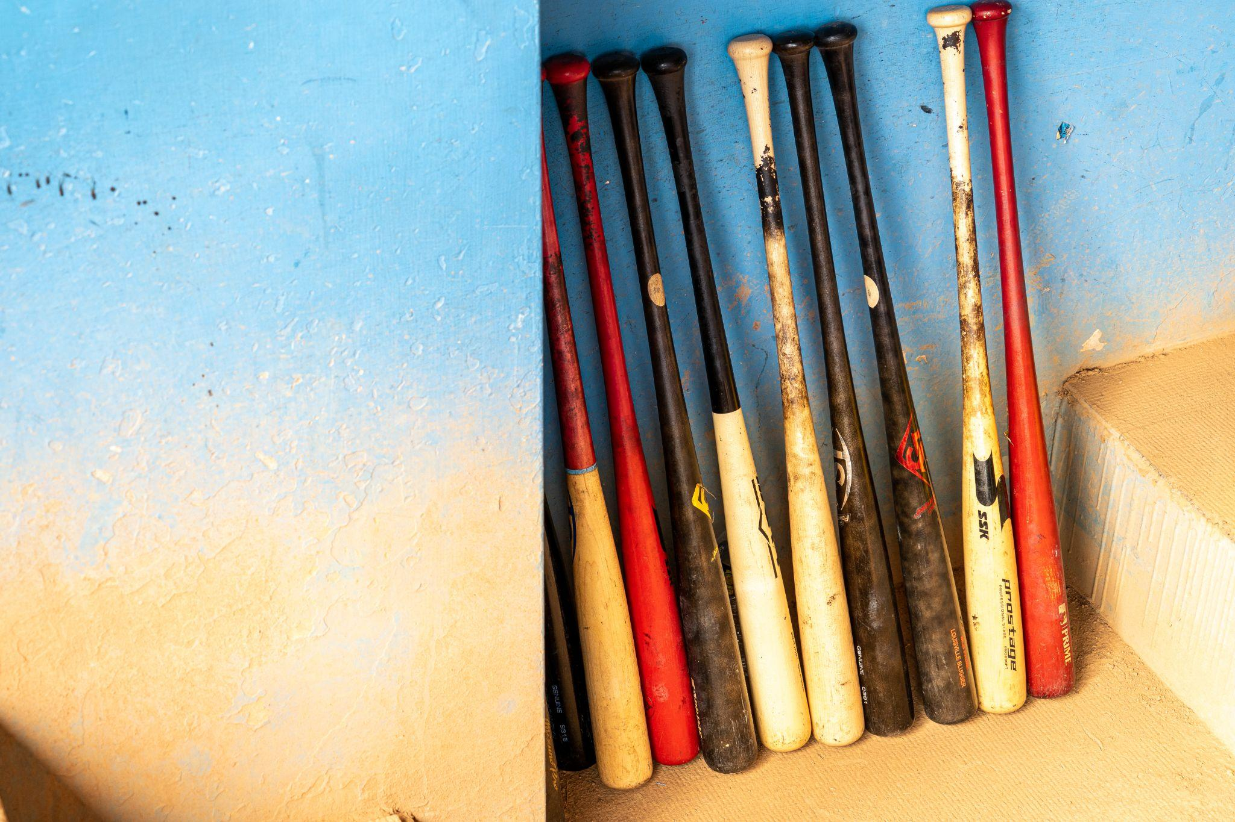
ᏣᏁᎵᏁ ᏣᎳᎩ ᎠᏕᎶᏆᏍᏗ
ᏣᎾᏘᏍ ᏳᏍᏗ ᎨᏒ ᎯᎠ? ᎯᎠ ᎪᏍᏛᏂᏍᏗ. ᎧᏅᏑᎸ ᎢᏗᏅᎦᎳ.
ᎪᏍᏛᏂᏍᏗ ___, Ꮩ ᎤᏍᏗ ___? X3
ᎧᏅᏑᎸ ᎢᏗᏅᎦᎳᎢ.
ᎠᏋᏯ, ᏨᏯ

Slide 6
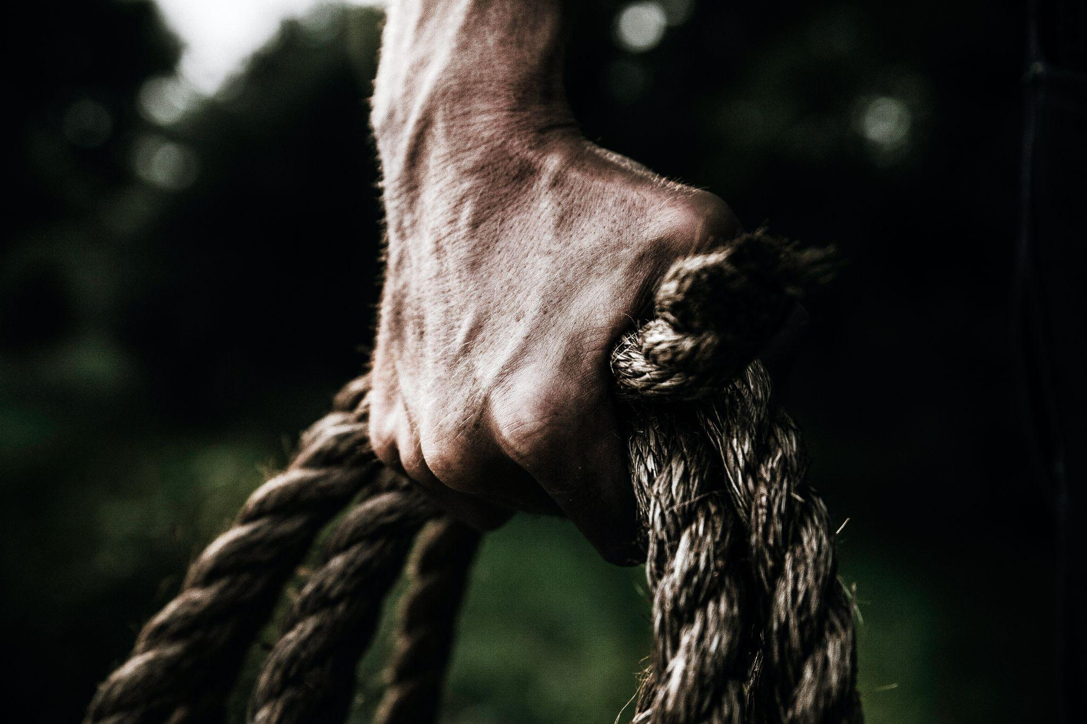
ᏣᏁᎵᏁ ᏣᎳᎩ ᎠᏕᎶᏆᏍᏗ
Ꮒ! ᏍᏕᏱᏓ ____. ᎧᏅᏑᎸ ᎢᏗᏅᎦᎳ.
ᏍᏕᏱᏓ ___, Ꮩ ᎤᏍᏗ __? X3
ᎧᏅᏑᎸ ᎢᏗᏅᎦᎳᎢ.
ᎠᎩᎾ, ᏣᎾ

Slide 7
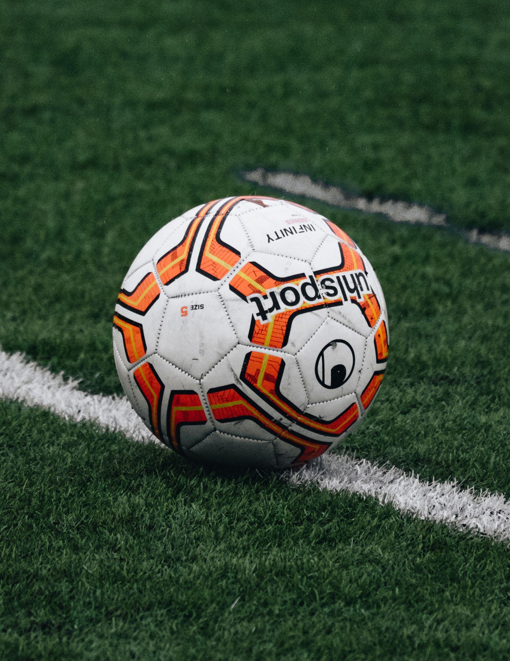
ᏣᏁᎵᏁ ᏣᎳᎩ ᎠᏕᎶᏆᏍᏗ
ᎠᎭᏂ ᏍᏆᏞᏍᏗ. ᎧᏅᏑᎸ ᎢᏗᏅᎦᎳ.
ᏍᏆᏞᏍᏗ ___ , Ꮩ ᎤᏍᏗ __? X3
ᎧᏅᏑᎸ ᎢᏗᏅᎦᎳᎢ.
ᎠᎩᎭ, ᏣᎭ

Slide 8
ᏣᏁᎵᏁ ᏣᎳᎩ ᎠᏕᎶᏆᏍᏗ
ᎩᎶᏍ ᏗᎪᏪᎶᏗ _____?
ᎤᎦᎹ _______(I) ?
ᎢᎦᏓ ᎠᏂᏣᎳᎩ ᏧᏓᏣᎦᎸᏓ ᏗᏌᏃ Ꮪ___.
ᎢᏤ ᎩᏟ ᎠᎩᎾ ___ ᎺᎵ.
ᏖᎵᏙ ᎤᏲᏨ ____(I).
ᎤᏮᏯ
ᎠᎩᏁ
ᎤᏂᎾ
ᎤᏪᎧ
ᎠᎩᎭ

Slide 9
ᏣᏁᎵᏁ ᏣᎳᎩ ᎠᏕᎶᏆᏍᏗ
ᎾᏛᏁᎲ- Verbs
Set B Single subject, single object
ᎠᎩ | I- it
Ꮳ | You- it
Ꭴ | he/she- it

Slide 10
ᏣᏁᎵᏁ ᏣᎳᎩ ᎠᏕᎶᏆᏍᏗ
ᎾᏛᏁᎲ- Verbs
Set B Single subject, single object
ᎩᏂ | We two
ᎣᎩᏂ | We 2 but not you

Slide 11
ᏣᏁᎵᏁ ᏣᎳᎩ ᎠᏕᎶᏆᏍᏗ
ᎾᏛᏁᎲ- Verbs
Set B Single subject, single object
ᎢᎩ | All of us (including you)
ᎣᎩ | All of us (but not you)

Slide 12
ᏣᏁᎵᏁ ᏣᎳᎩ ᎠᏕᎶᏆᏍᏗ
ᎾᏛᏁᎲ- Verbs
Set B Single subject, single object
ᏍᏗ | you two
ᎢᏥ | All of you

Slide 13
ᏣᏁᎵᏁ ᏣᎳᎩ ᎠᏕᎶᏆᏍᏗ
ᎾᏛᏁᎲ- Verbs
Set B Single subject, single object
ᎤᏂ | they

Slide 14
ᏑᏓᎵᏁ ᏣᎳᎩ ᎠᏕᎶᏆᏍᏗ
ᎾᏛᏁᎲ- Verbs
Have liquid-Ꮑ
ᎠᎩᏁ
ᏣᏁ
ᎤᏁ
ᎩᏂᏁ
ᎣᎩᏂᏁ
ᎢᎩᏁ
ᎣᎩᏁ
ᏍᏗᏁ
ᎢᏥᏁ
ᎤᏂᏁ

Slide 15
ᏣᏁᎵᏁ ᏣᎳᎩ ᎠᏕᎶᏆᏍᏗ
ᎾᏛᏁᎲ- Verbs
Have long- ᎥᏯ
ᎠᏋᏯ
ᏨᏯ
ᎤᏮᏯ
ᎩᏅᏯ
ᎣᎩᏅᏯ
ᎢᎬᏯ
ᎣᎬᏯ
ᏍᏛᏯ
ᎢᏨᏯ
ᎤᏅᏯ

Slide 16
ᏣᏁᎵᏁ ᏣᎳᎩ ᎠᏕᎶᏆᏍᏗ
ᎾᏛᏁᎲ- Verbs
Set B , vowel stem
agw | I- it
j | You- it
uw | he/she- it

Slide 17
ᏣᏁᎵᏁ ᏣᎳᎩ ᎠᏕᎶᏆᏍᏗ
ᎾᏛᏁᎲ- Verbs
Set B Single subject, single object
gin | We two
ogin | We 2 but not you

Slide 18
ᏣᏁᎵᏁ ᏣᎳᎩ ᎠᏕᎶᏆᏍᏗ
ᎾᏛᏁᎲ- Verbs
Set B Single subject, single object
ig | All of us (including you)
og | All of us (but not you)

Slide 19
ᏣᏁᎵᏁ ᏣᎳᎩ ᎠᏕᎶᏆᏍᏗ
ᎾᏛᏁᎲ- Verbs
Set B Single subject, single object
sd | you two
ij | All of you

Slide 20
ᏣᏁᎵᏁ ᏣᎳᎩ ᎠᏕᎶᏆᏍᏗ
ᎾᏛᏁᎲ- Verbs
Set B Single subject, single object
un | they

Slide 21
ᏣᏁᎵᏁ ᏣᎳᎩ ᎠᏕᎶᏆᏍᏗ
ᎾᏛᏁᎲ- Verbs
Want- ᎠᏚᎵ
ᎠᏩᏚᎵ
ᏣᏚᎵ
ᎤᏚᎵ
ᎩᎾᏚᎵ
ᎣᎩᎾᏚᎵ
ᎢᎦᏚᎵ
ᎣᎦᏚᎵ
ᏍᏓᏚᎵ
ᎢᏣᏚᎵ
ᎤᎾᏚᎵ

Slide 22
ᏣᏁᎵᏁ ᏣᎳᎩ ᎠᏕᎶᏆᏍᏗ
ᎾᏛᏁᎲ- Verbs
forgetting-ᎠᎨᏫᏍᎬ
ᎠᏩᎨᏫᏍᎬ
ᏣᎨᏫᏍᎬ
ᎤᏮᎨᏫᏍᎬ
ᎩᏅᎨᏫᏍᎬ
ᎣᎩᏅᎨᏫᏍᎬ
ᎢᎬᎨᏫᏍᎬ
ᎣᎬᎨᏫᏍᎬ
ᏍᏛᎨᏫᏍᎬ
ᎢᏨᎨᏫᏍᎬ
ᎤᏅᎨᏫᏍᎬ

Slide 23
ᏣᏁᎵᏁ ᏣᎳᎩ ᎠᏕᎶᏆᏍᏗ
ᎾᏛᏁᎲ- Verbs
Set A ,
Ꮵ | I- it
Ꭿ | You- it
Ꭶ, Ꭰ | he/she- it

Slide 24
ᏣᏁᎵᏁ ᏣᎳᎩ ᎠᏕᎶᏆᏍᏗ
ᎾᏛᏁᎲ- Verbs
Set A
ᎢᏂ | We two
ᎣᏍᏗ | We 2 but not you

Slide 25
ᏣᏁᎵᏁ ᏣᎳᎩ ᎠᏕᎶᏆᏍᏗ
ᎾᏛᏁᎲ- Verbs
Set A
ᎢᏗ | All of us (including you)
ᎣᏥ | All of us (but not you)

Slide 26
ᏣᏁᎵᏁ ᏣᎳᎩ ᎠᏕᎶᏆᏍᏗ
ᎾᏛᏁᎲ- Verbs
Set A
ᏍᏗ | you two
ᎢᏥ | All of you

Slide 27
ᏣᏁᎵᏁ ᏣᎳᎩ ᎠᏕᎶᏆᏍᏗ
ᎾᏛᏁᎲ- Verbs
Set A
ᎠᏂ | they

Slide 28
ᏣᏁᎵᏁ ᏣᎳᎩ ᎠᏕᎶᏆᏍᏗ
ᎾᏛᏁᎲ- Verbs
speaking-ᏬᏂ
ᏥᏬᏂ
ᎯᏬᏂ
ᎦᏬᏂ
ᎢᏂᏬᏂ
ᎣᏍᏗᏬᏂ
ᎢᏗᏬᏂ
ᎣᏥᏬᏂ
ᏍᏗᏬᏂ
ᎢᏥᏬᏂ
ᎠᏂᏬᏂ

