Slide 1
ᎣᏏᏲ
ᏐᏁᎵᏁ ᏣᎳᎩ ᎠᏕᎶᏆᏍᏗ

Slide 2
ᏐᏁᎵᏁ ᏣᎳᎩ ᎠᏕᎶᏆᏍᏗ
ᎢᏓᎴᎾ- Let’s begin
ᏣᎳᎩ ᎢᏗᏬᏂ- Let’s talk Cherokee

Slide 3
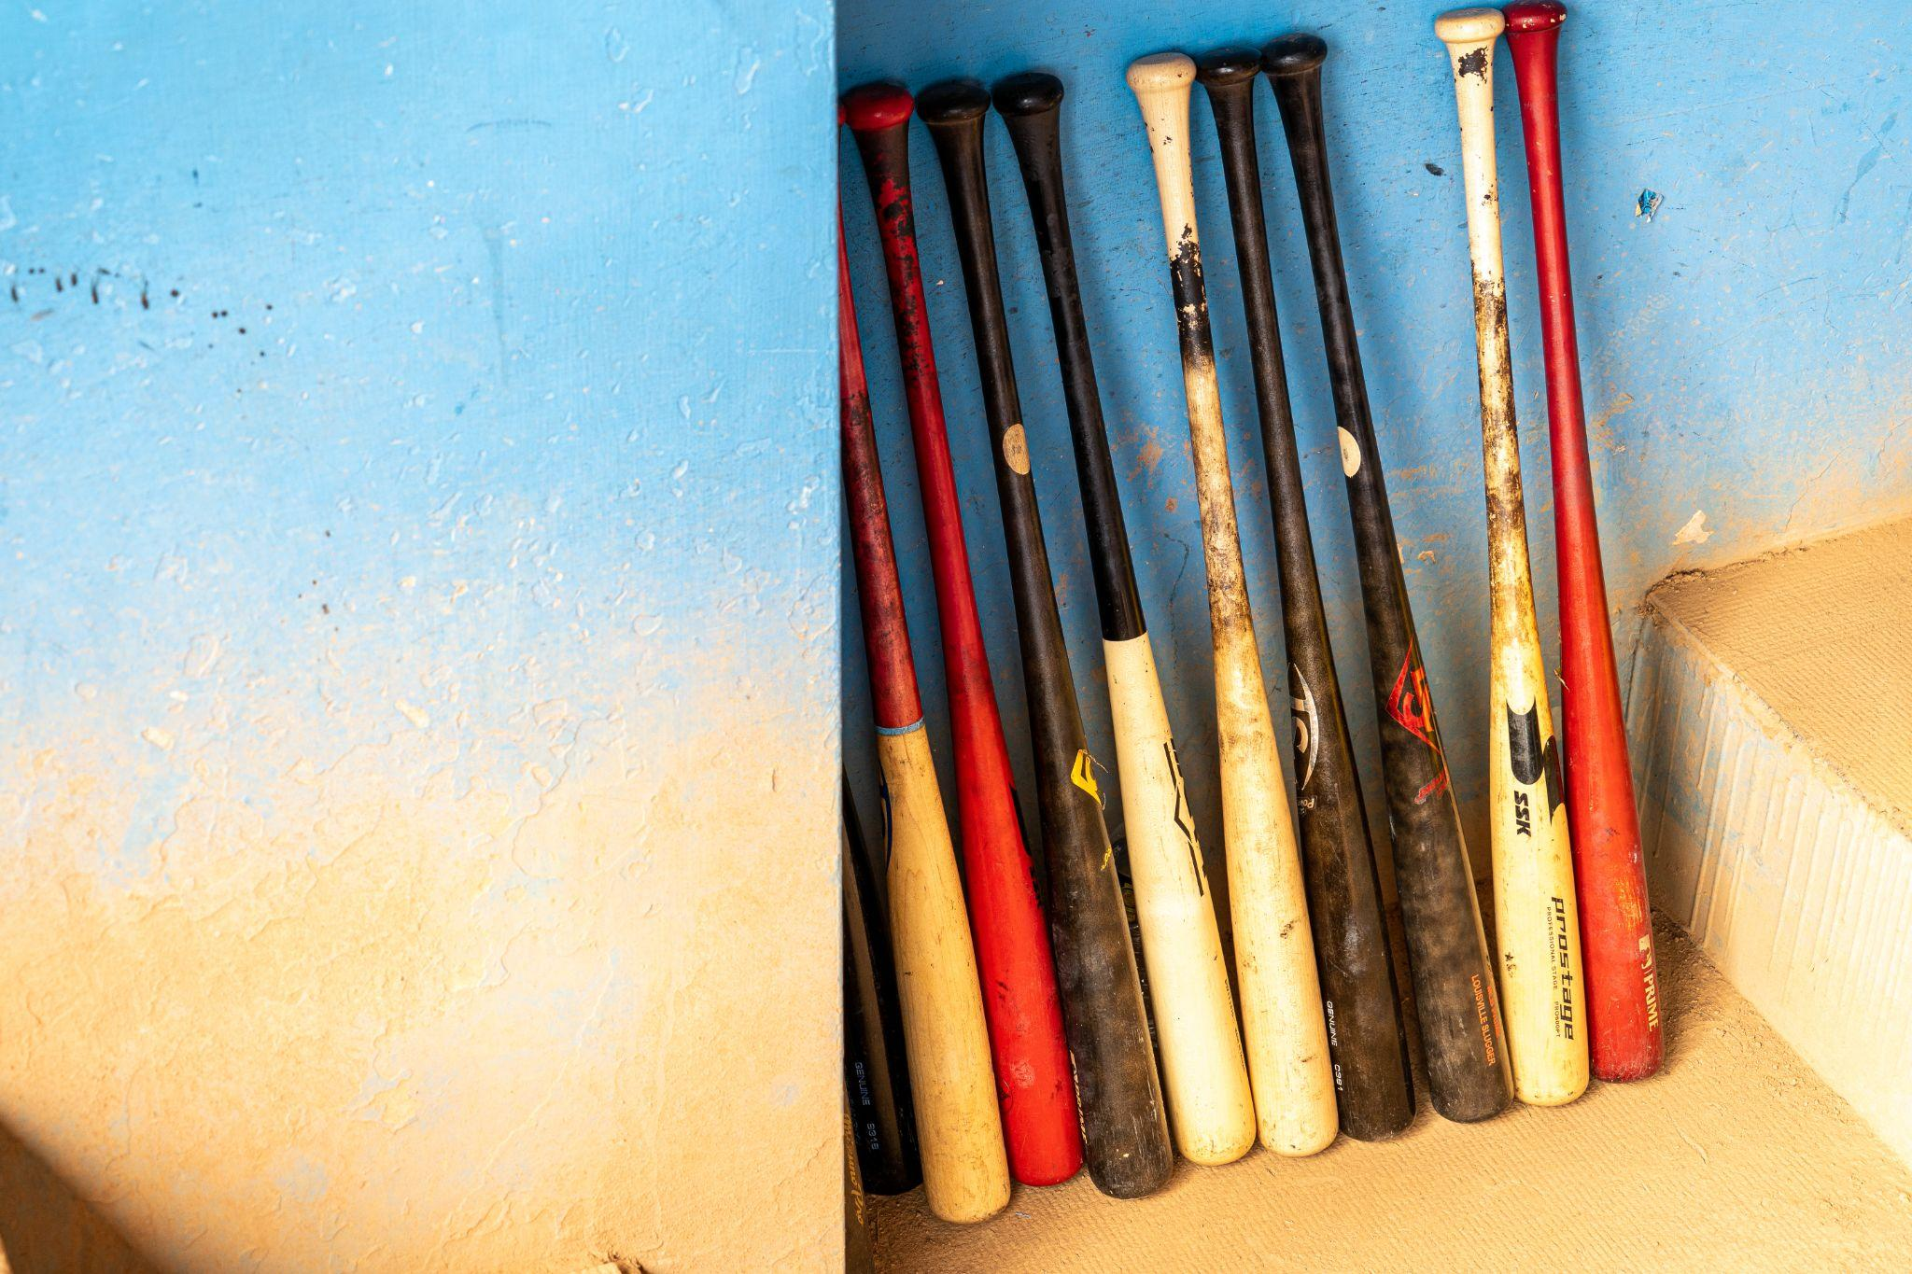
ᏐᏁᎵᏁ ᏣᎳᎩ ᎠᏕᎶᏆᏍᏗ
ᏣᎾᏘᏍ ᏳᏍᏗ ᎨᏒ ᎯᎠ? ᎯᎠ ᎪᏍᏛᏂᏍᏗ. ᎧᏅᏑᎸ ᎢᏗᏅᎦᎳ.
ᎪᏍᏛᏂᏍᏗ ___, Ꮩ ᎤᏍᏗ ___? X3
ᎧᏅᏑᎸ ᎢᏗᏅᎦᎳᎢ.
ᎠᏋᏯ, ᏨᏯ

Slide 4
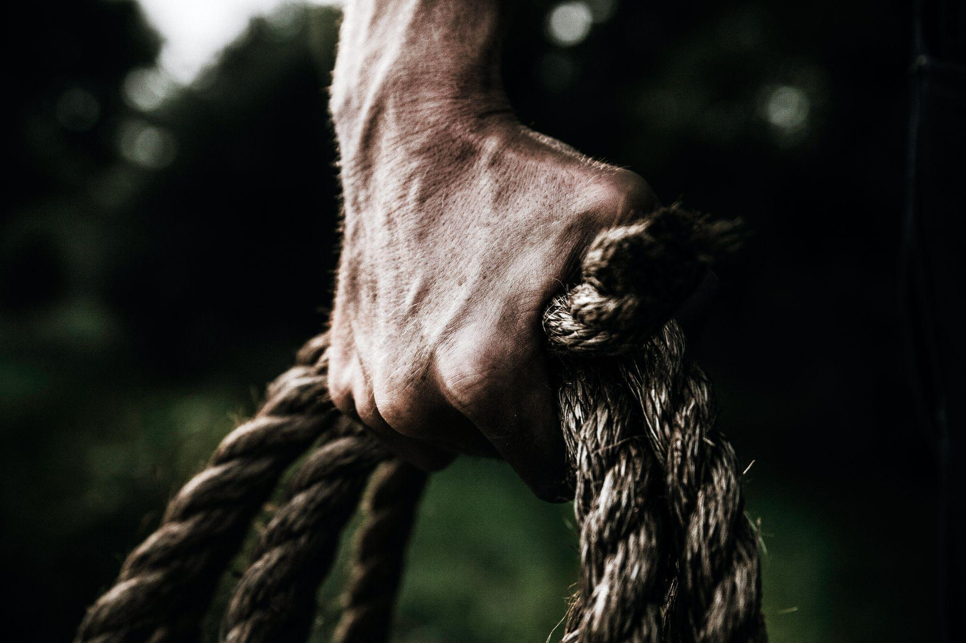
ᏐᏁᎵᏁ ᏣᎳᎩ ᎠᏕᎶᏆᏍᏗ
Ꮒ! ᏍᏕᏱᏓ ____. ᎧᏅᏑᎸ ᎢᏗᏅᎦᎳ.
ᏍᏕᏱᏓ ___, Ꮩ ᎤᏍᏗ __? X3
ᎧᏅᏑᎸ ᎢᏗᏅᎦᎳᎢ.
ᎠᎩᎾ, ᏣᎾ

Slide 5
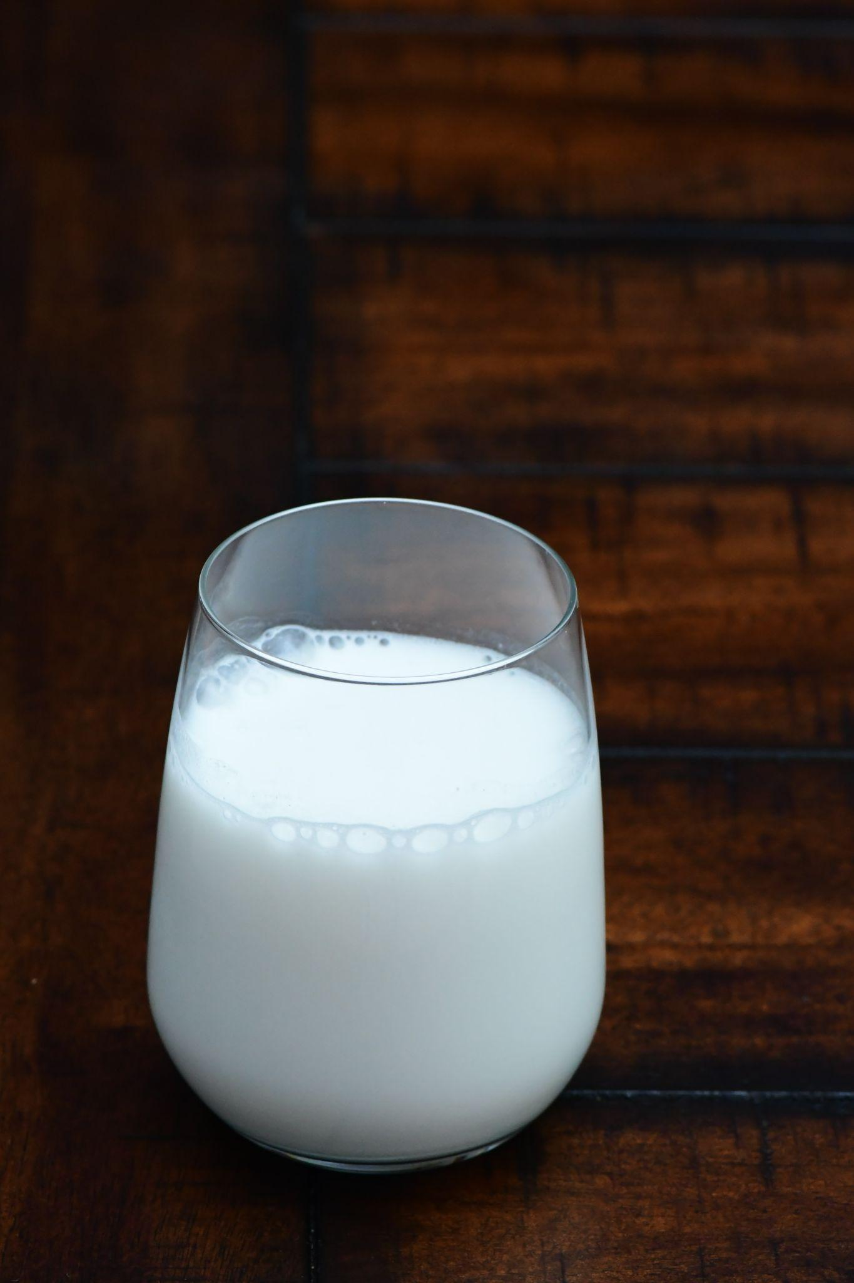
ᏐᏁᎵᏁ ᏣᎳᎩ ᎠᏕᎶᏆᏍᏗ
ᎯᎠ ᎤᏅᏗ. ᎧᏅᏑᎸ ᎢᏗᏅᎦᎳ.
ᎤᏅᏗ ___, Ꮩ ᎤᏍᏗ ___? X3
ᎧᏅᏑᎸ ᎢᏗᏅᎦᎳᎢ.
ᎠᎩᏁ, ᏣᏁ

Slide 6
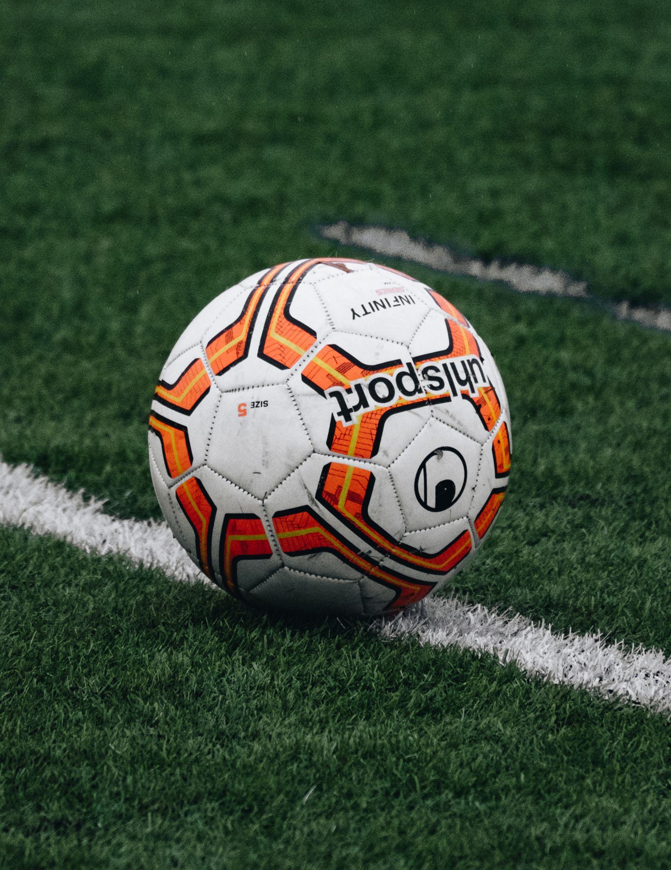
ᏐᏁᎵᏁ ᏣᎳᎩ ᎠᏕᎶᏆᏍᏗ
ᎠᎭᏂ ᏍᏆᏞᏍᏗ. ᎧᏅᏑᎸ ᎢᏗᏅᎦᎳ.
ᏍᏆᏞᏍᏗ ___ , Ꮩ ᎤᏍᏗ __? X3
ᎧᏅᏑᎸ ᎢᏗᏅᎦᎳᎢ.
ᎠᎩᎭ, ᏣᎭ

Slide 7
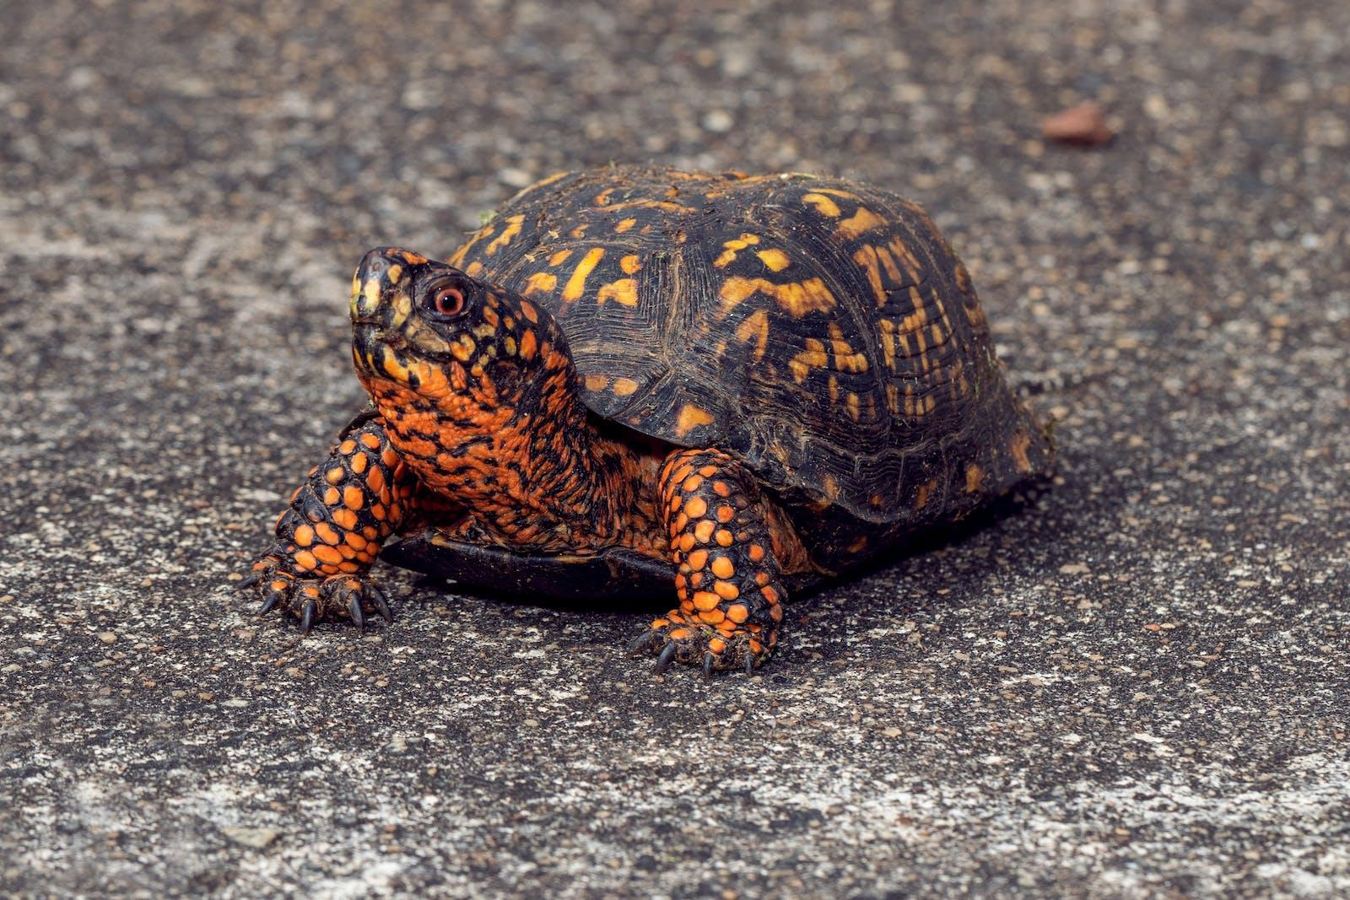
ᏐᏁᎵᏁ ᏣᎳᎩ ᎠᏕᎶᏆᏍᏗ
ᏓᎦᏏ ______. ᎧᏅᏑᎸ ᎢᏗᏅᎦᎳ.
ᏓᎦᏏ ____. Ꮩ ᎤᏍᏗ ____? X3
ᎧᏅᏑᎸ ᎢᏗᏅᎦᎳᎢ.
ᎠᎩᎧ, ᏣᎧ

Slide 8
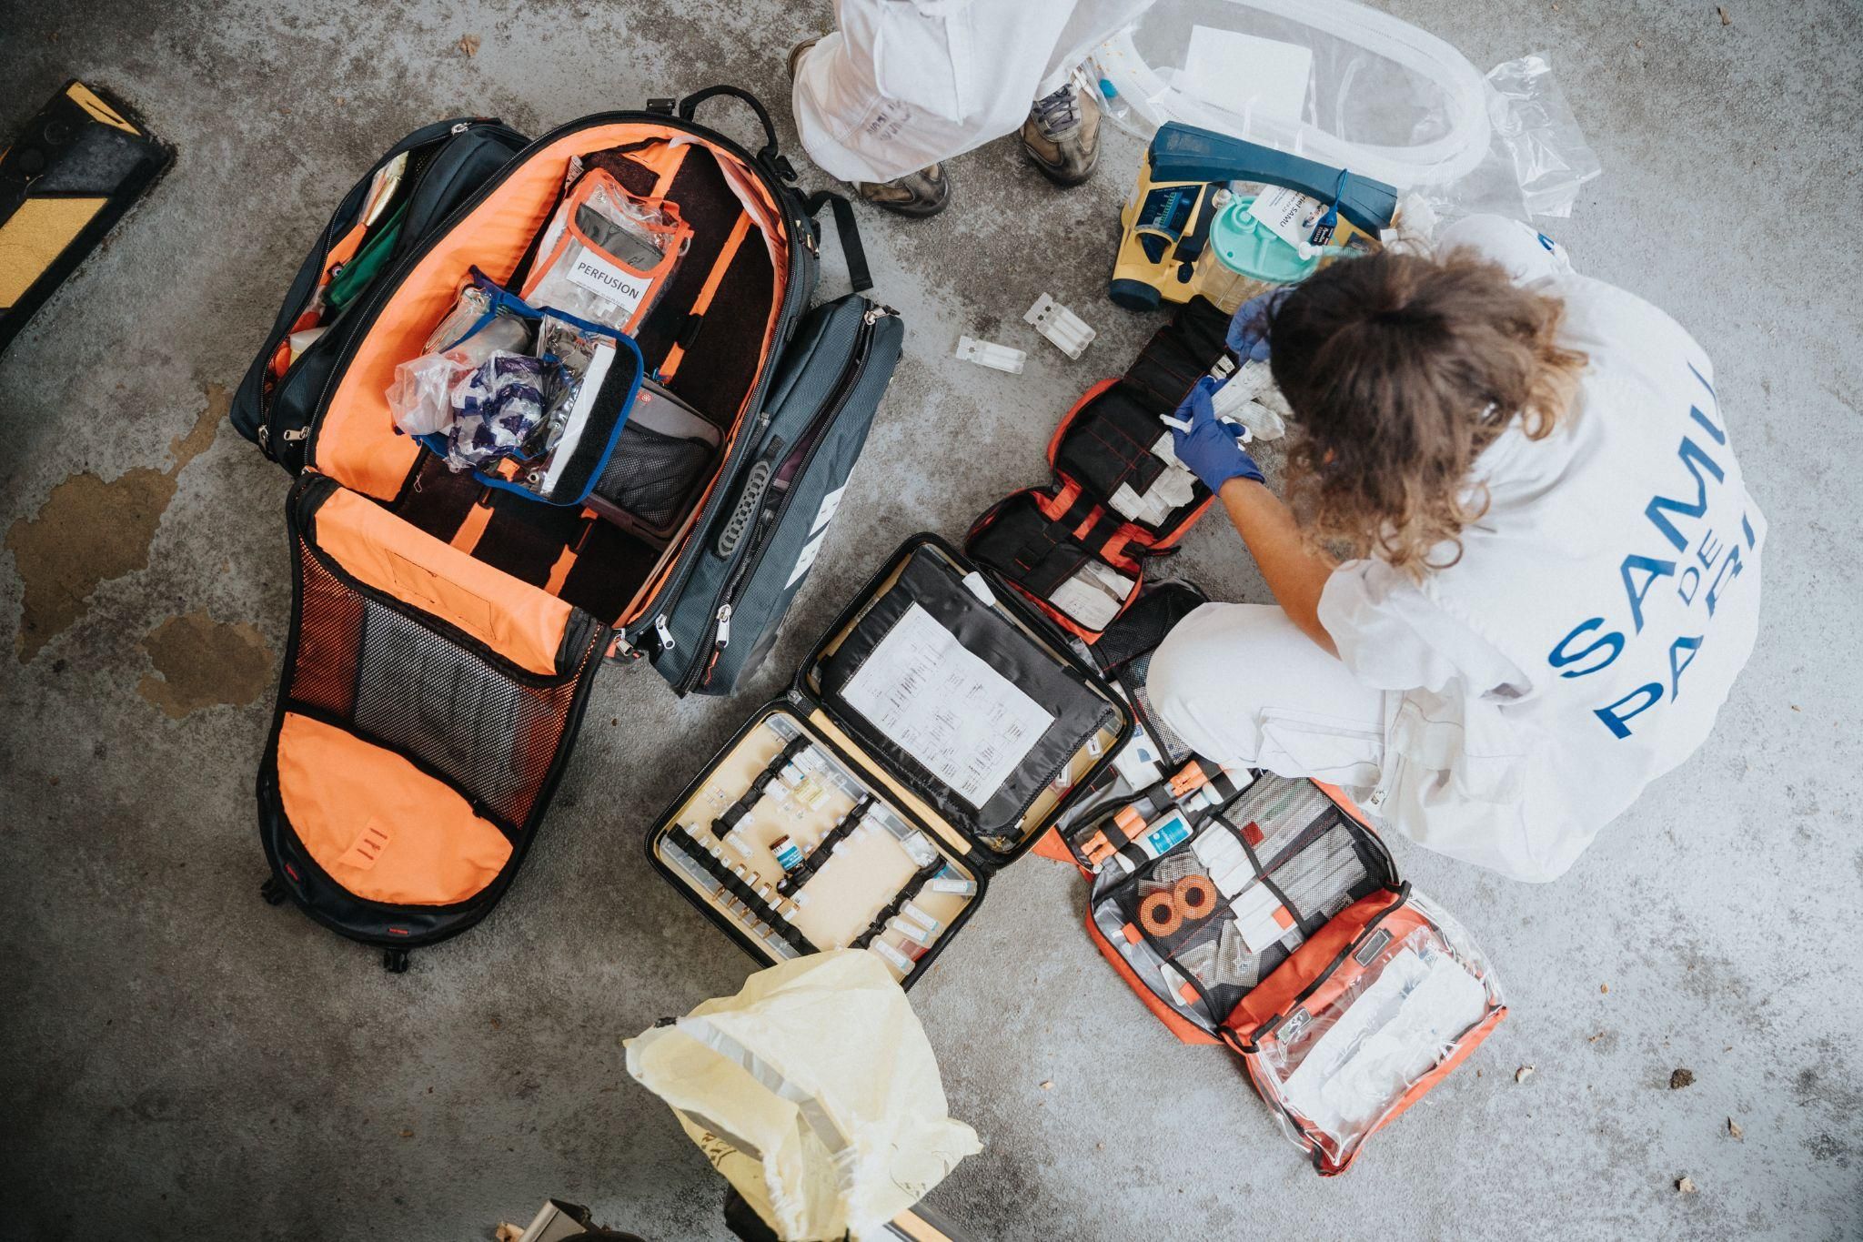
ᏐᏁᎵᏁ ᏣᎳᎩ ᎠᏕᎶᏆᏍᏗ
ᎪᎱᏍᏗ ᏅᎦᏖᏃᎲᎾ ᏱᏄᎵᏍᏔᏂ, ᎯᎠ ᏧᏓᎴᏅᏓ ᏧᎵᏍᎨᏗ ᏕᏣᎭᏍᎨᏍᏗ.

Slide 9
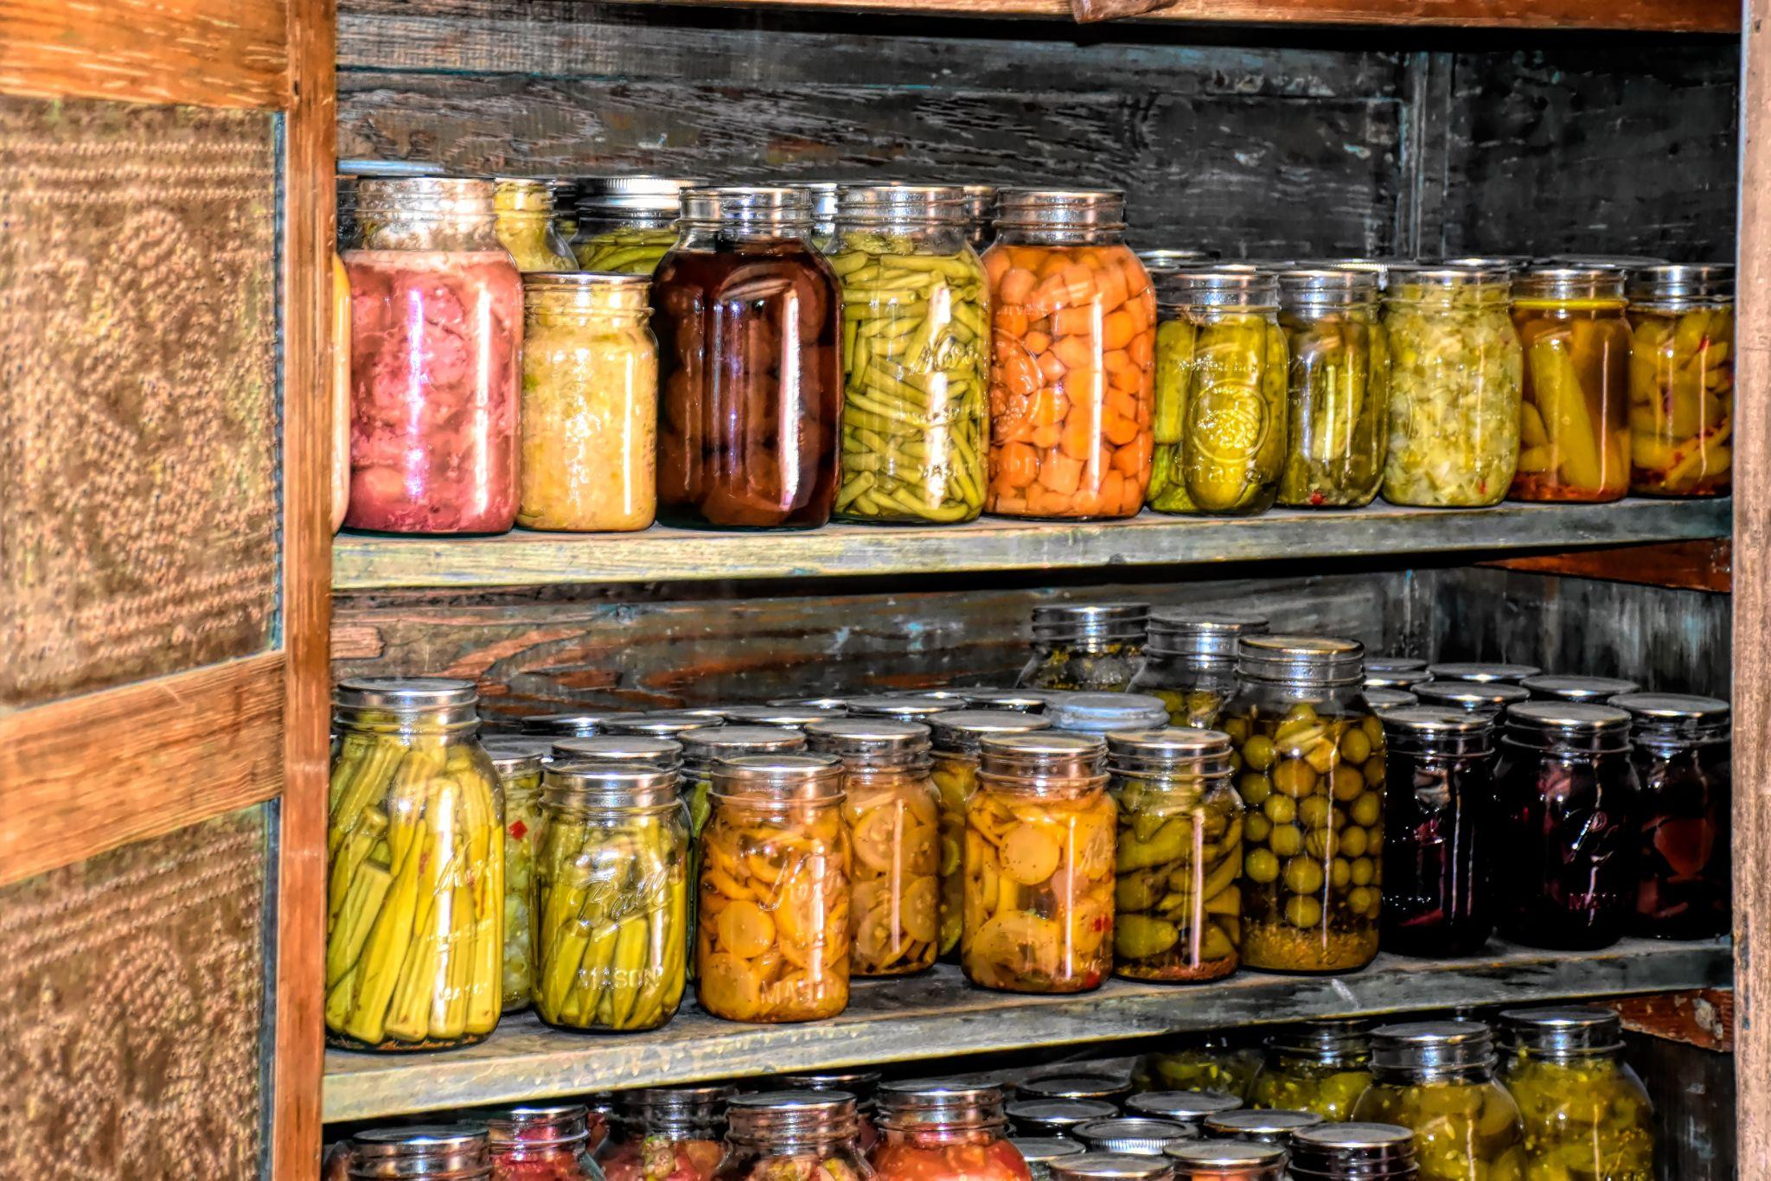
ᏐᏁᎵᏁ ᏣᎳᎩ ᎠᏕᎶᏆᏍᏗ
ᎠᎬᏱ, ᏞᏍᏗ ᎠᏲᎩ ᎠᎵᏍᏓᏱᏗ ᏕᏣᎮᏍᏗ. ᎤᎧᏲᏗ ᎠᎴ ᎦᎵᏔᏅ ᎠᎵᏍᏓᏱᏗ ᎣᏍᏓ ᎨᏎᏍᏗ.

Slide 10
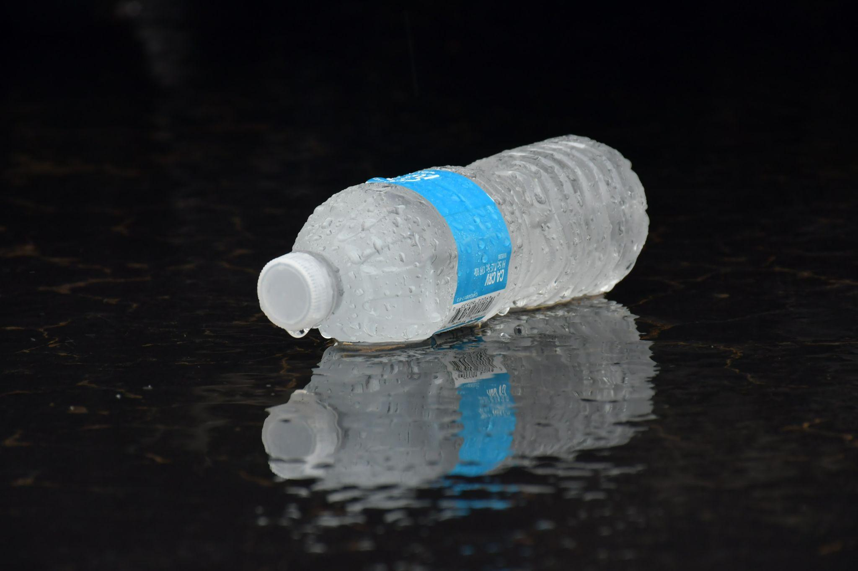
ᏐᏁᎵᏁ ᏣᎳᎩ ᎠᏕᎶᏆᏍᏗ
ᏃᎴ, ᎠᎹ ᏣᏁᎮᏍᏗ. ᎠᎹ ᎣᏍᏓ ᎠᏗᏔᏍᏗ ᎤᎵᏍᎨᏗ.

Slide 11
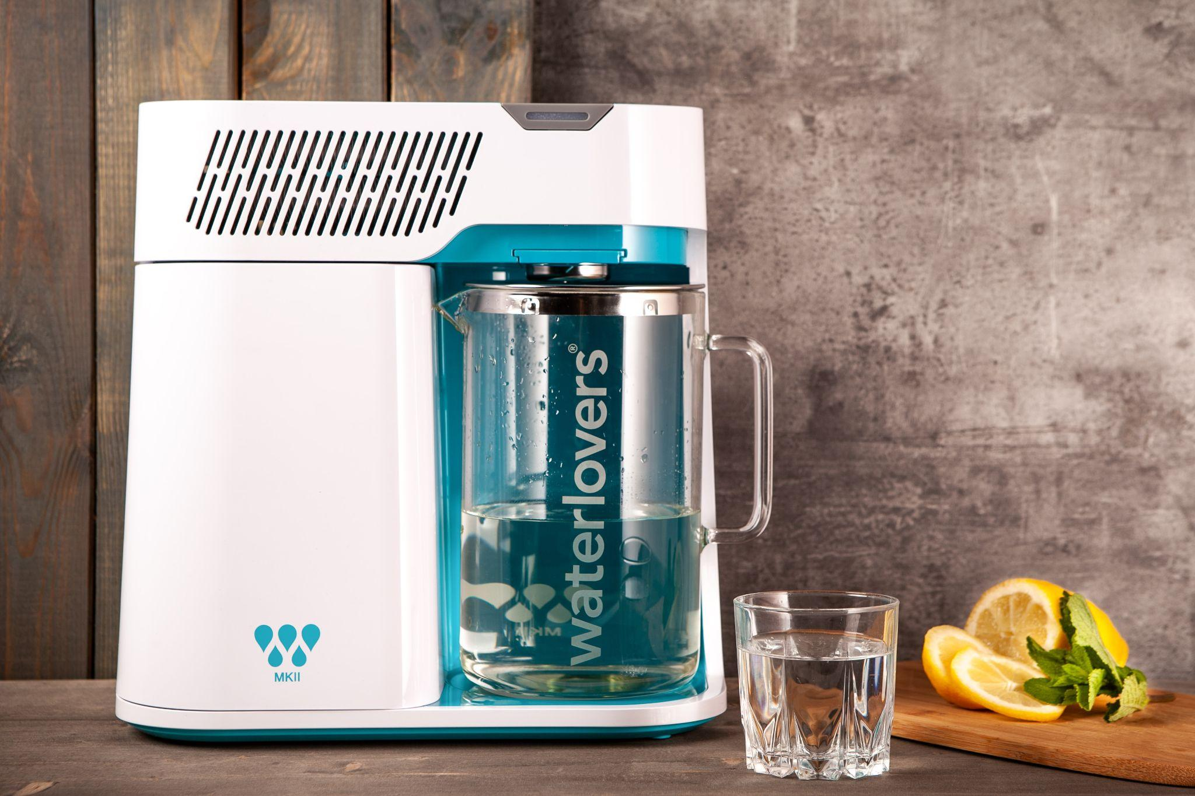
ᏐᏁᎵᏁ ᏣᎳᎩ ᎠᏕᎶᏆᏍᏗ
ᎥᏍᏊ, ᎠᎹ ᎬᎫᏍᏙᏗ ᏣᎮᏍᏗ.

Slide 12
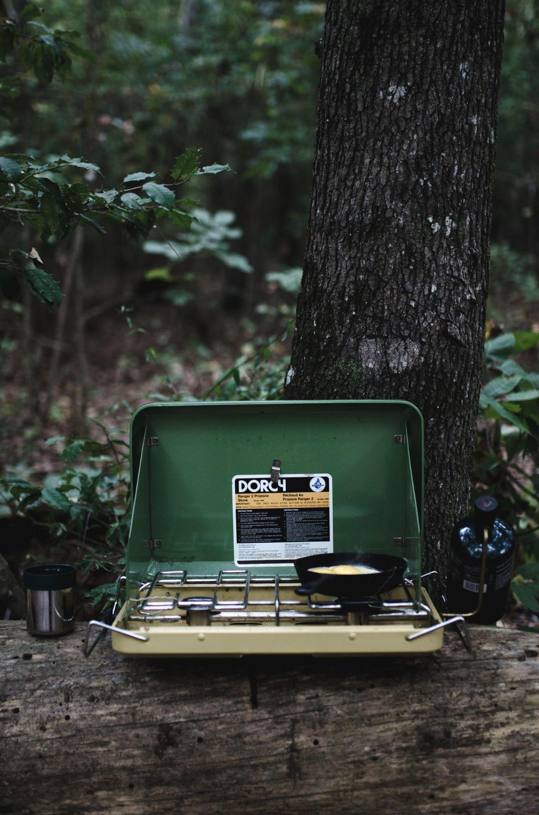
ᏐᏁᎵᏁ ᏣᎳᎩ ᎠᏕᎶᏆᏍᏗ
ᎤᏍᏗ ᎣᏏ ᏣᎮᏍᏗ

Slide 13
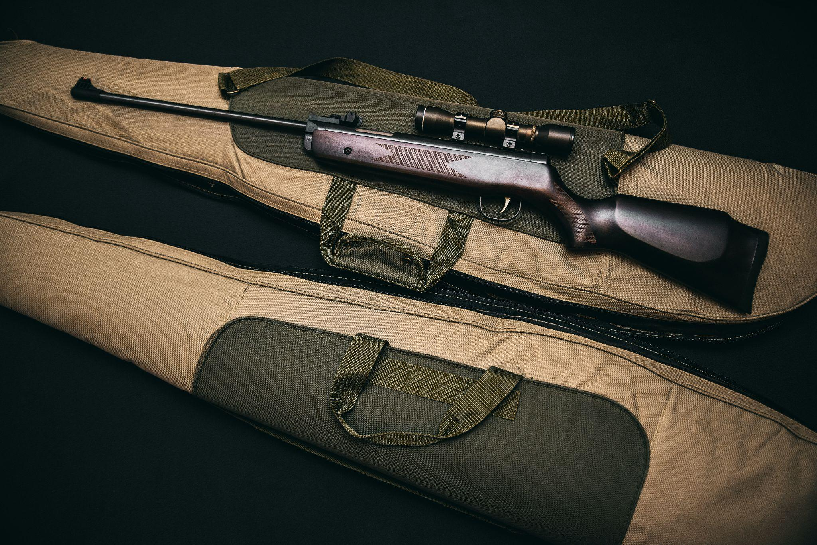
ᏐᏁᎵᏁ ᏣᎳᎩ ᎠᏕᎶᏆᏍᏗ
ᎦᎶᏇ ᏨᏰᏍᏗ ᎠᎴ ᎦᏂ ᏍᏊ.

Slide 14
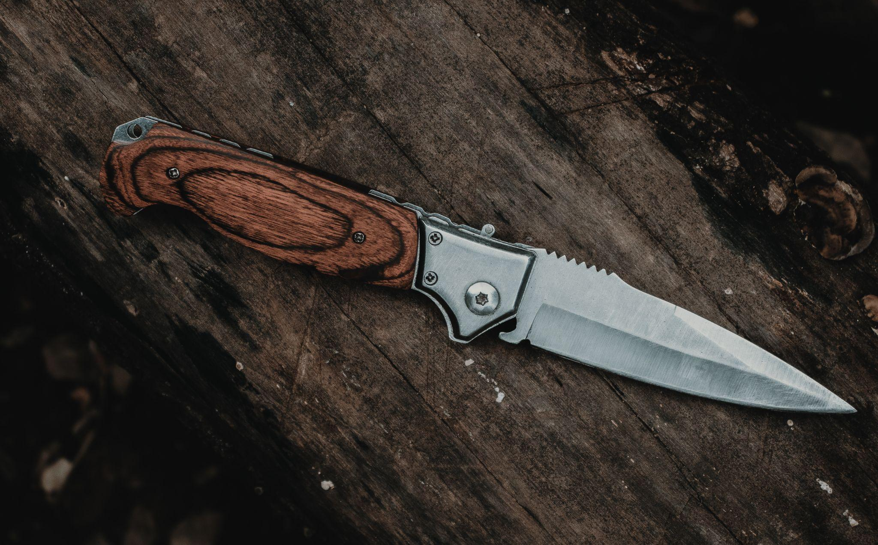
ᏐᏁᎵᏁ ᏣᎳᎩ ᎠᏕᎶᏆᏍᏗ
ᎭᏰᎵᏍᏗ ᏨᏰᏍᏗ.

Slide 15
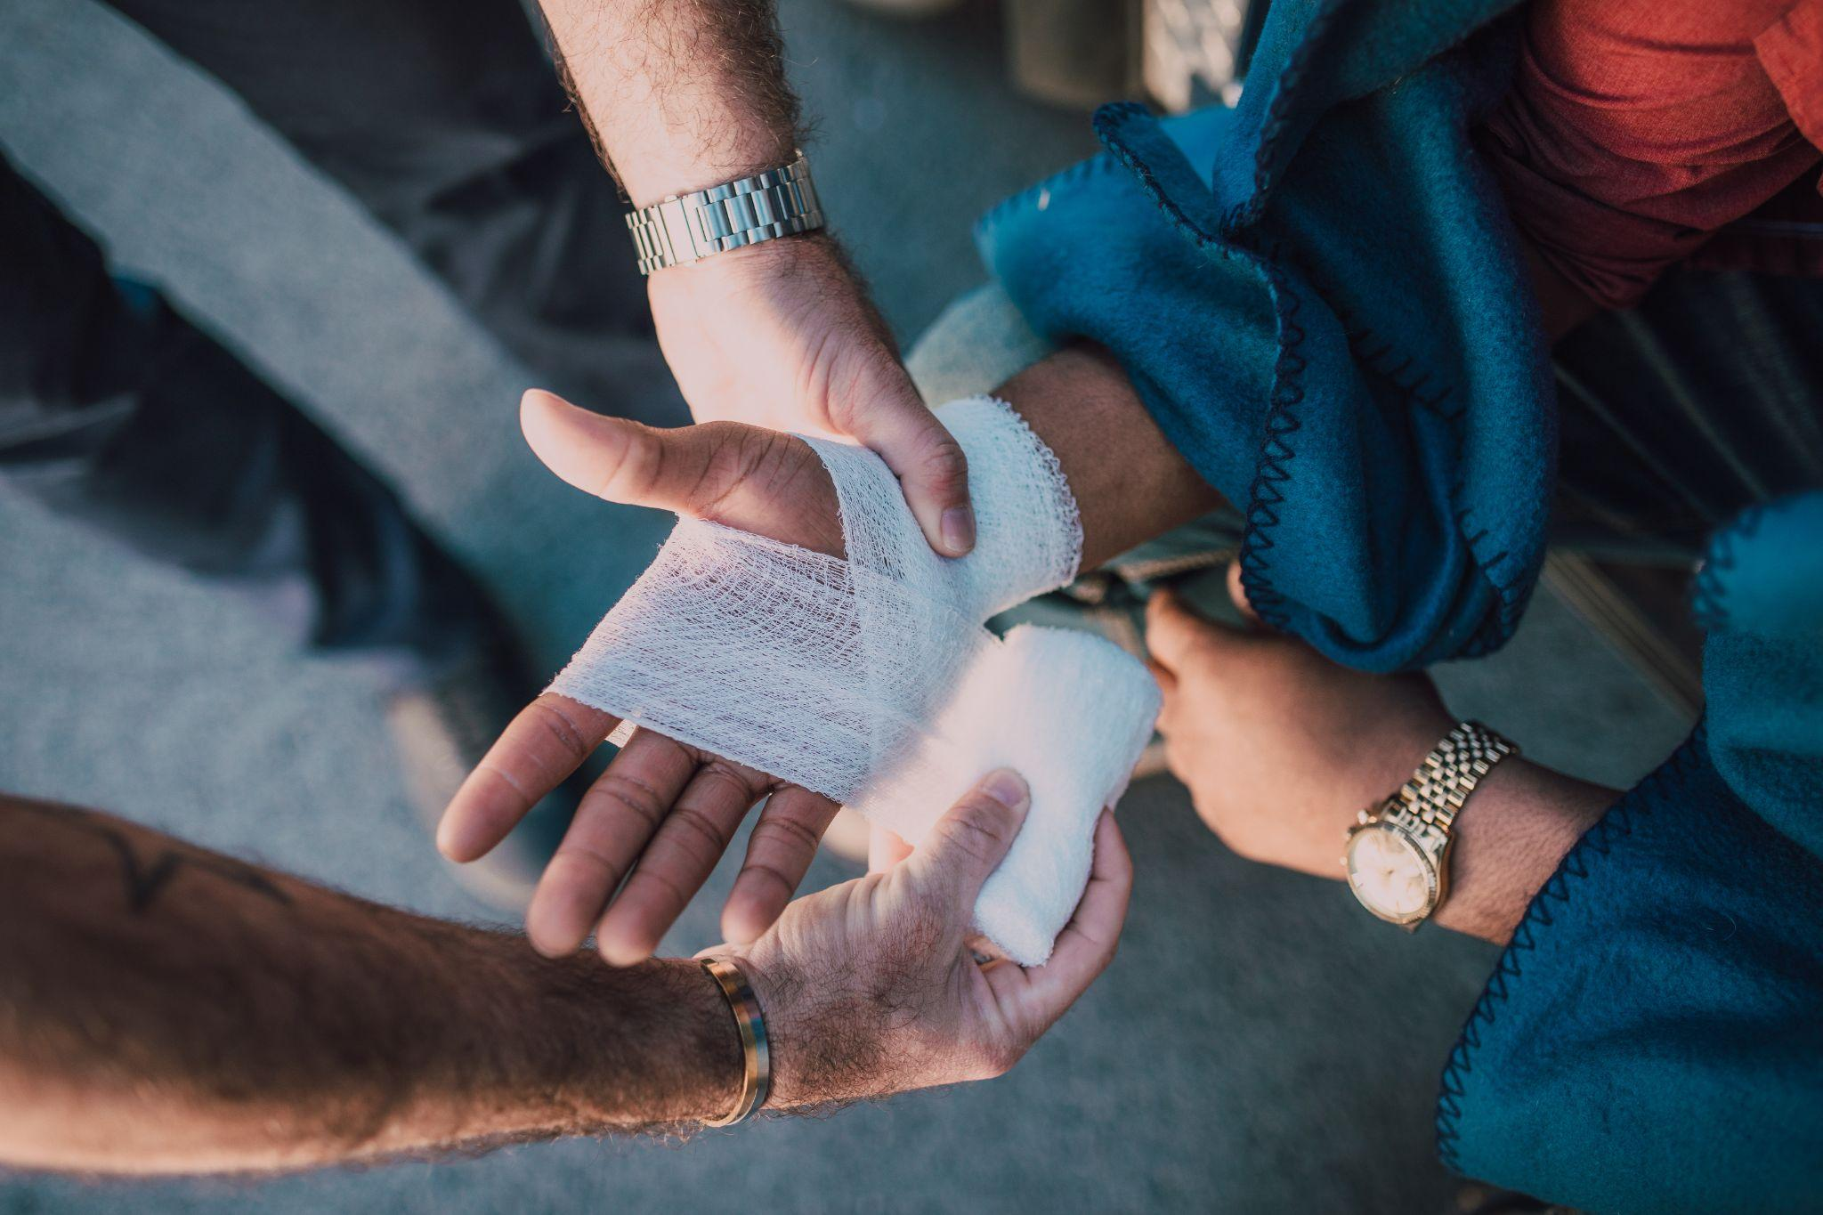
ᏐᏁᎵᏁ ᏣᎳᎩ ᎠᏕᎶᏆᏍᏗ
ᏗᏣᏢᏍᏙᏗ ᏕᏣᏁᏍᏗ.

Slide 16
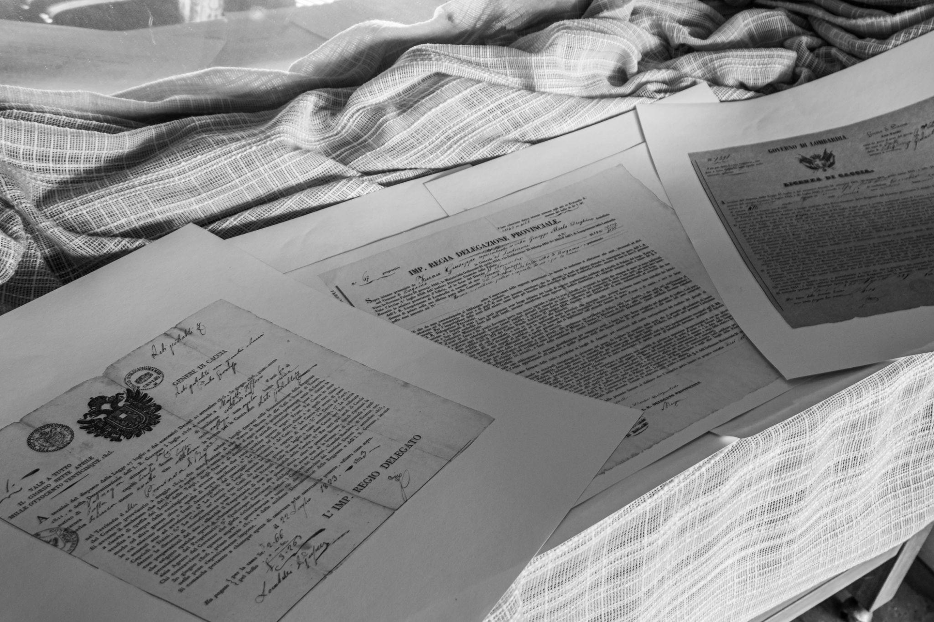
ᏐᏁᎵᏁ ᏣᎳᎩ ᎠᏕᎶᏆᏍᏗ
ᎯᎸᏍᎩ ᏗᏟᎶᏍᏔᏅ ᏗᎪᏪᎵ ᏧᎵᏍᎨᏗ ᏕᏣᏁᏍᏗ.

Slide 17
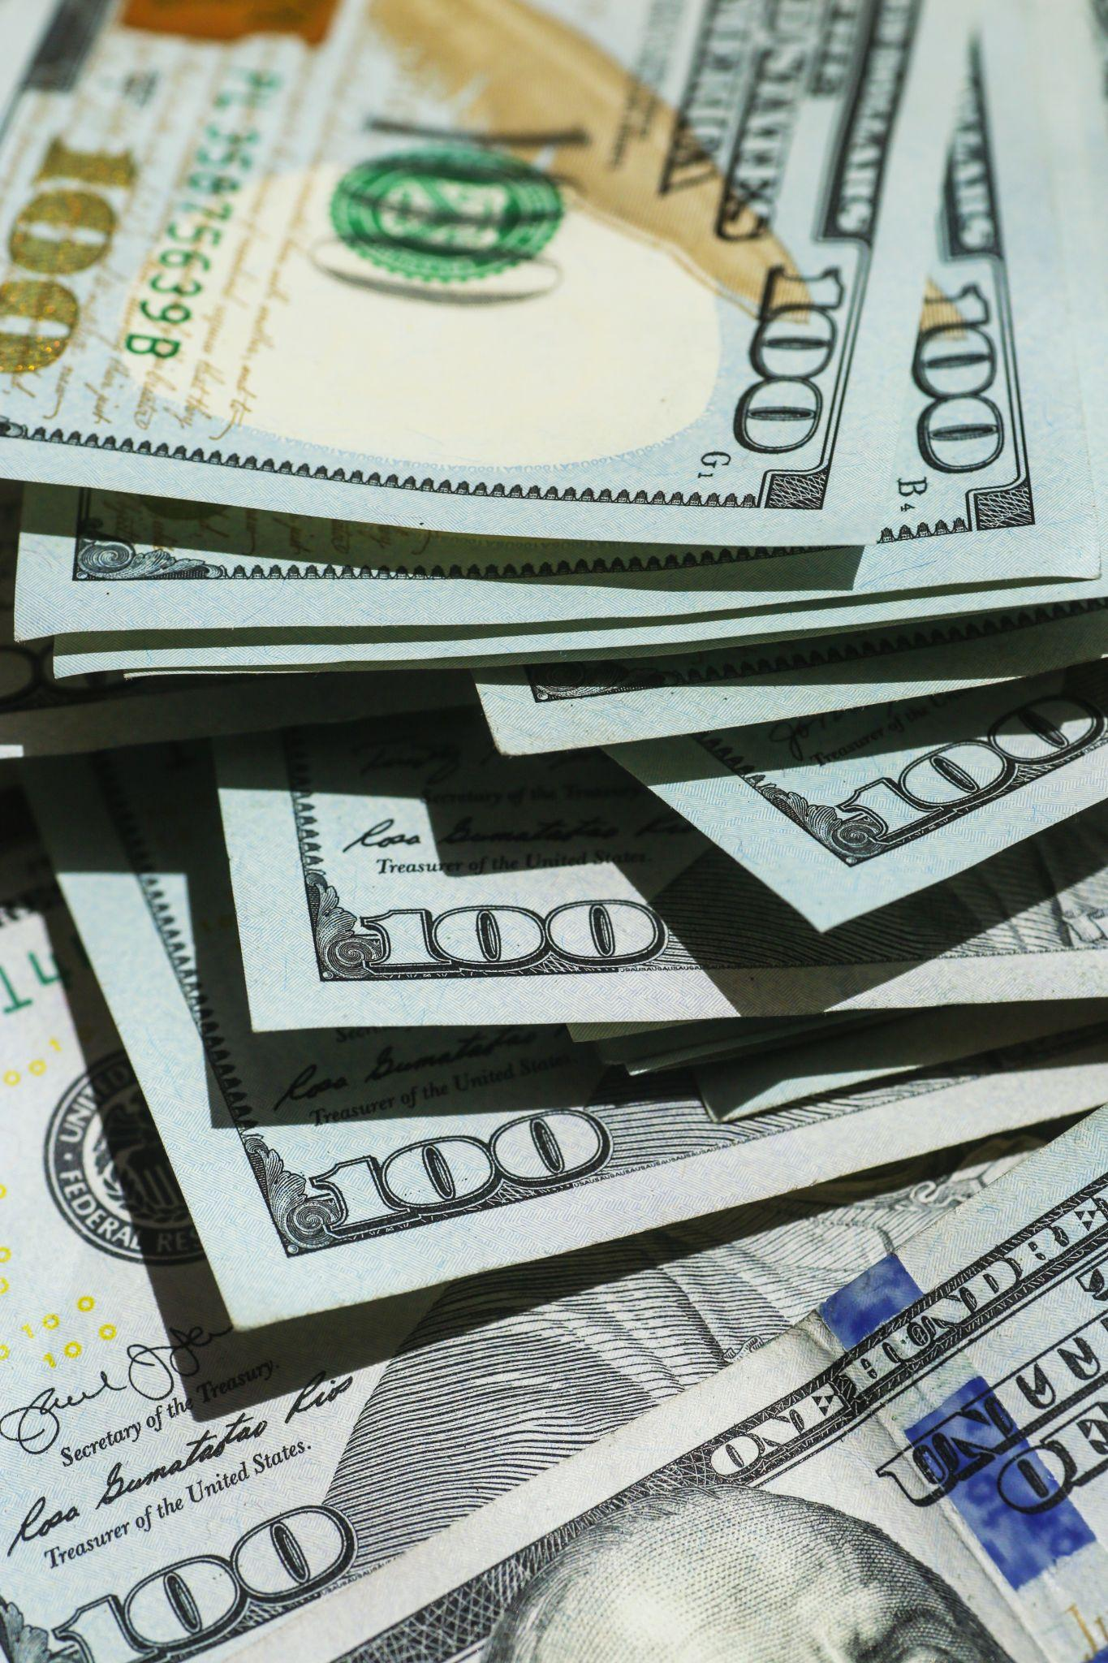
ᏐᏁᎵᏁ ᏣᎳᎩ ᎠᏕᎶᏆᏍᏗ
ᎢᎦᏓ ᎠᏕᎳ ᏕᏍᏆᏂᎪᏕᏍᏗ.

Slide 18
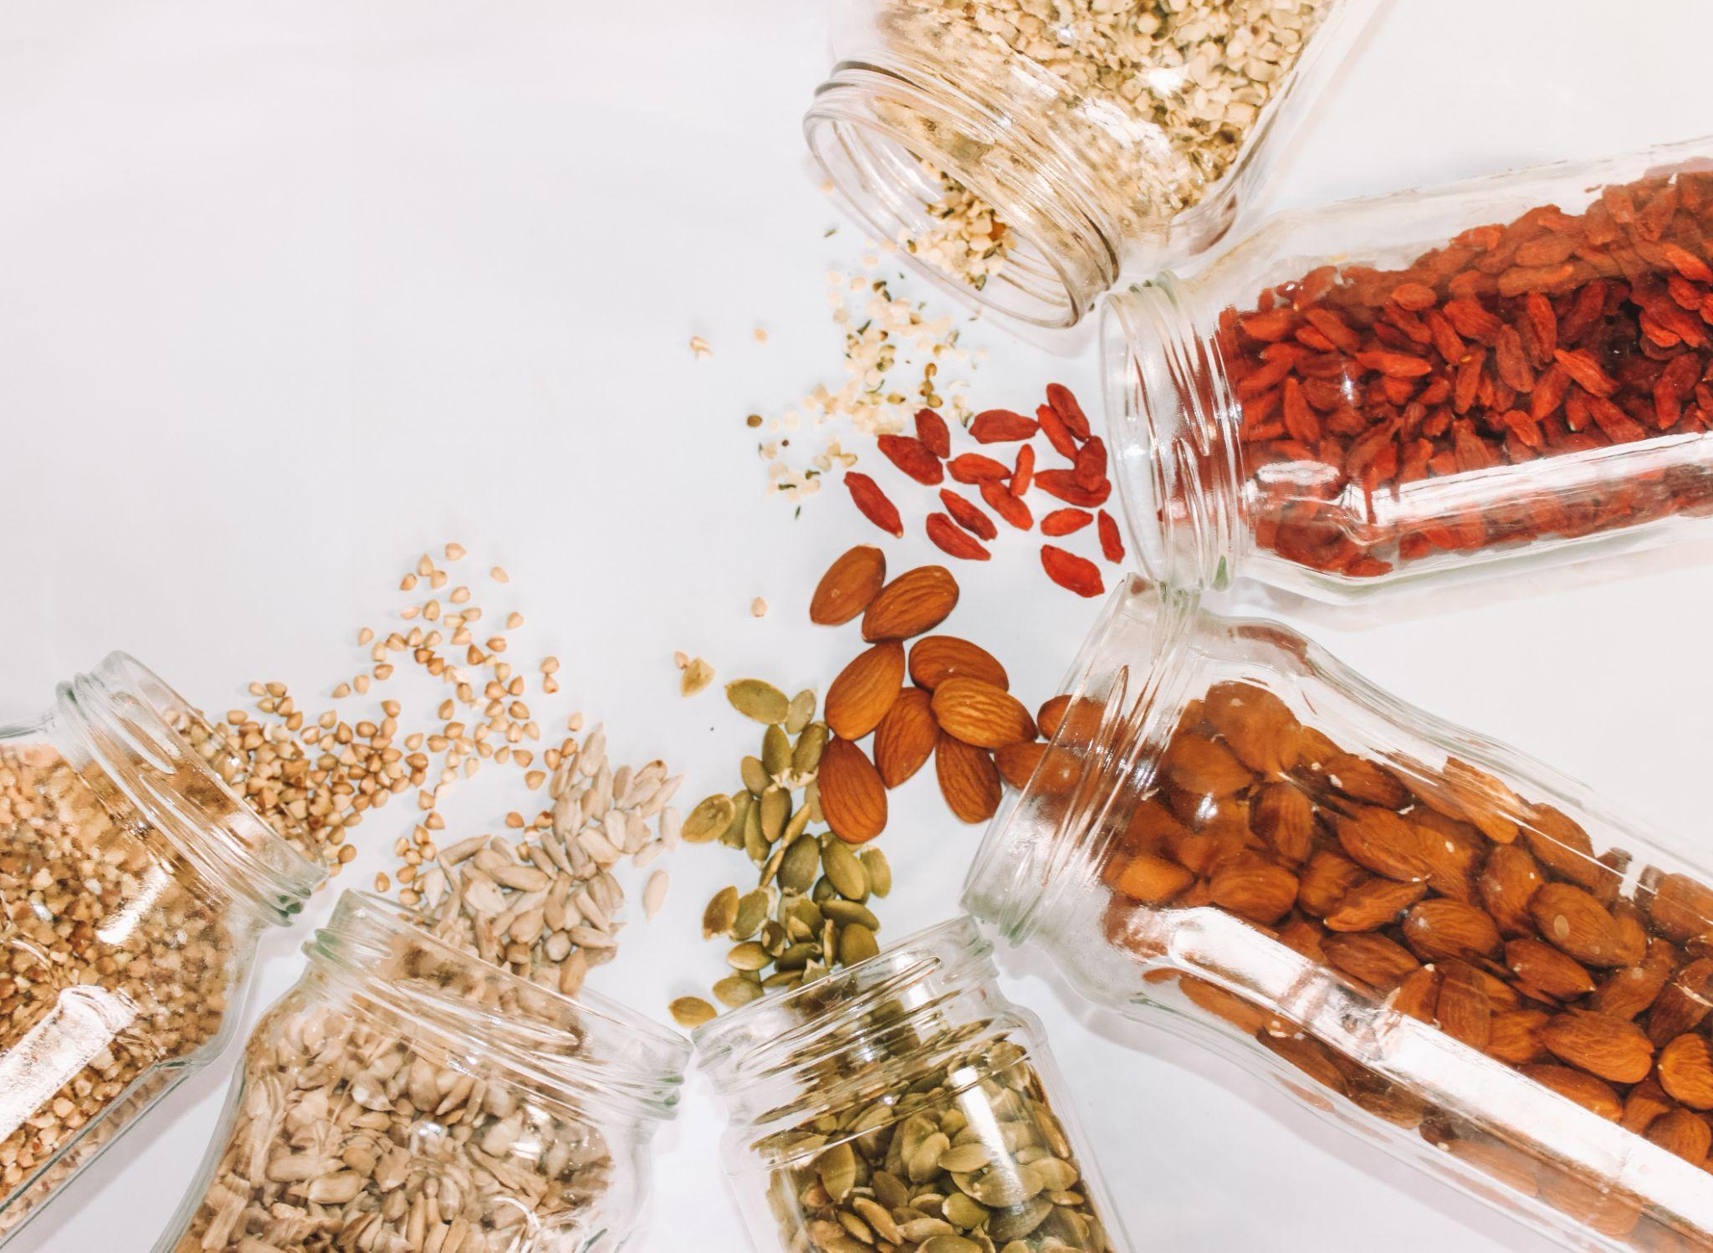
ᏐᏁᎵᏁ ᏣᎳᎩ ᎠᏕᎶᏆᏍᏗ
ᎤᏂᎧᏔ ᏧᏕᎴᏅᏓ ᏕᏣᎮᏍᏗ

Slide 19
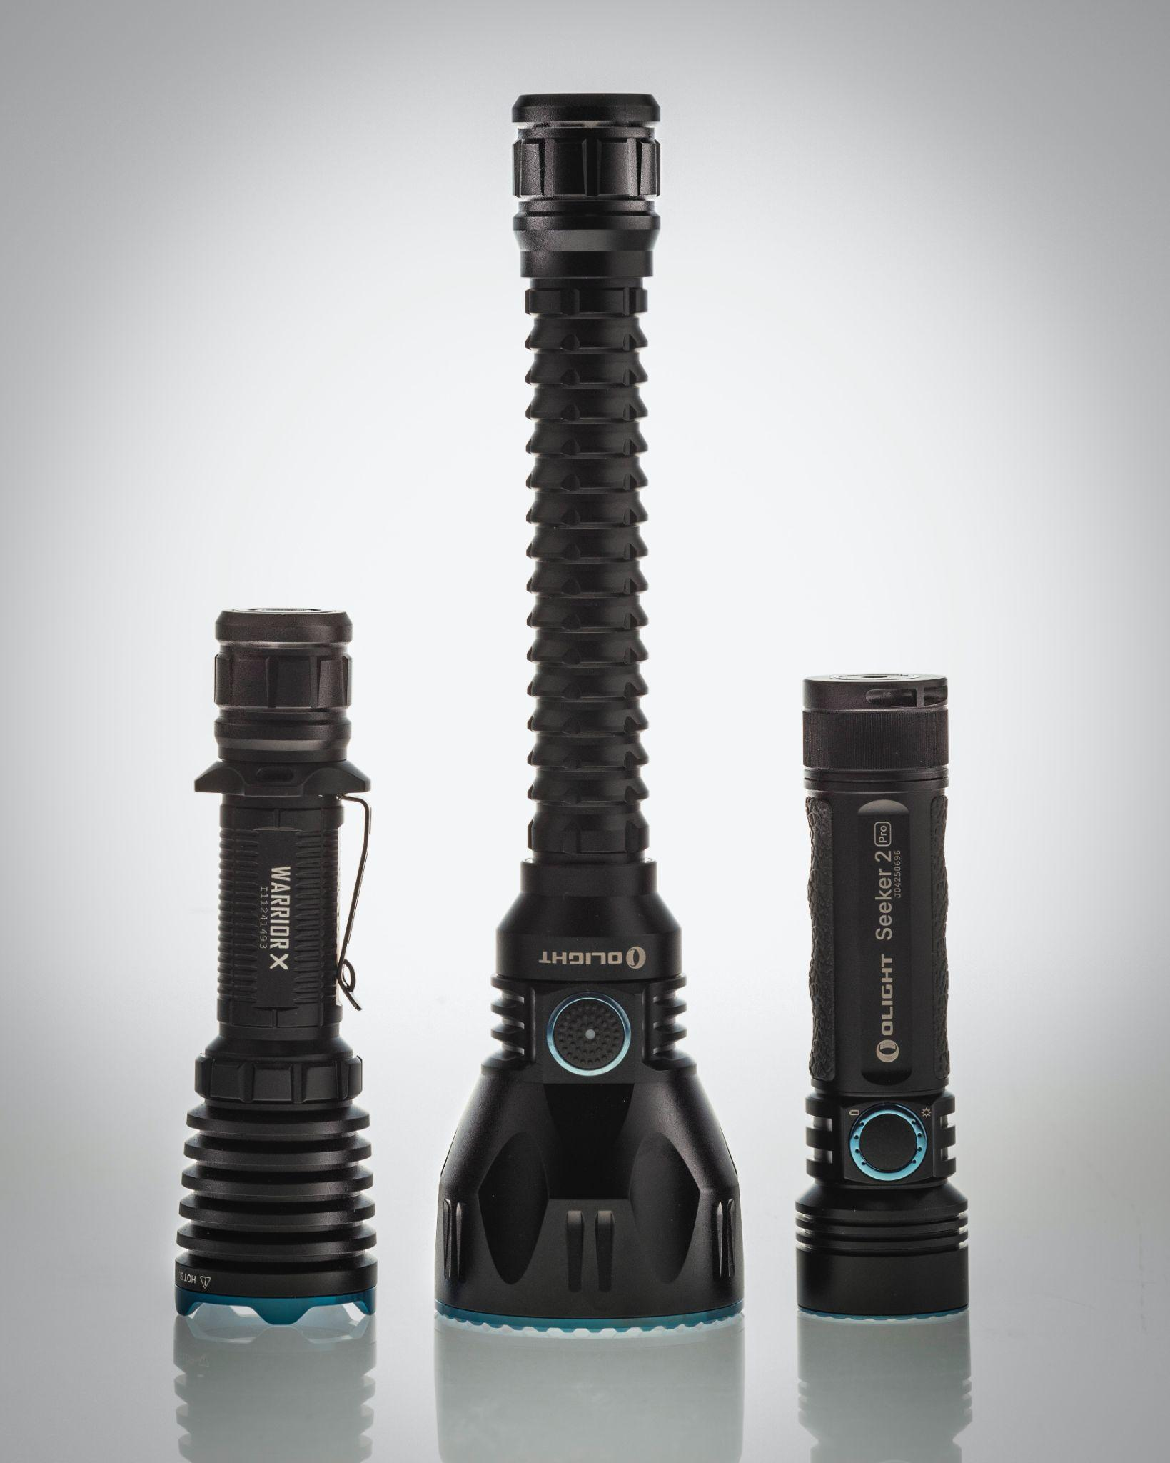
ᏐᏁᎵᏁ ᏣᎳᎩ ᎠᏕᎶᏆᏍᏗ
ᎯᎸᏍᎩ ᏗᏨᏍᏗ ᏕᏨᏰᏍᏗ

Slide 20
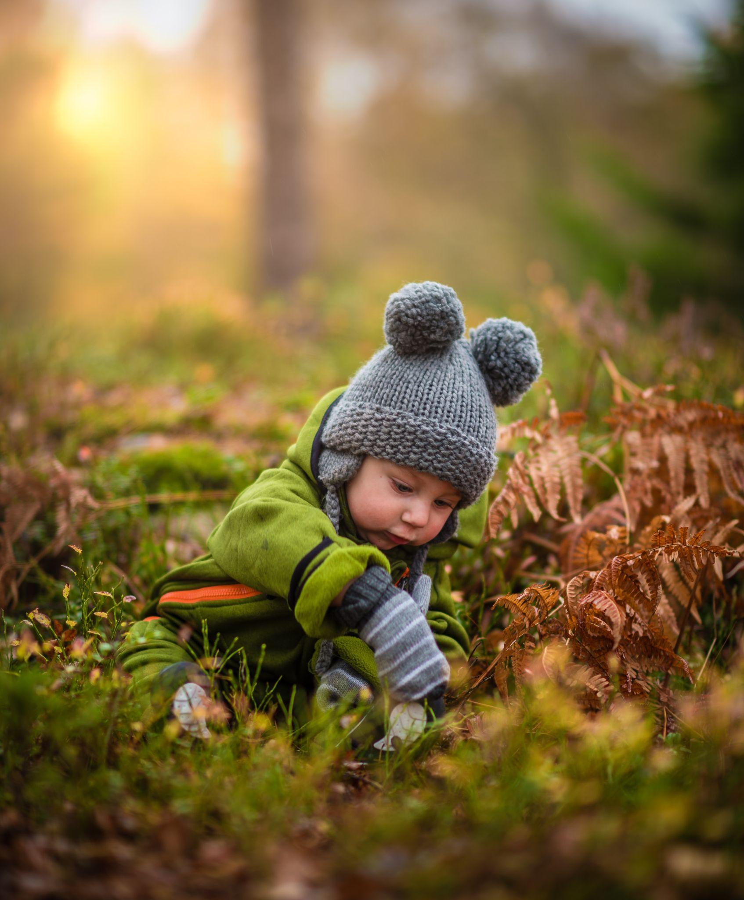
ᏐᏁᎵᏁ ᏣᎳᎩ ᎠᏕᎶᏆᏍᏗ
ᏗᎿᏬ ᏧᎦᎾᏩ ᏕᏣᏁᏍᏗ.

Slide 21
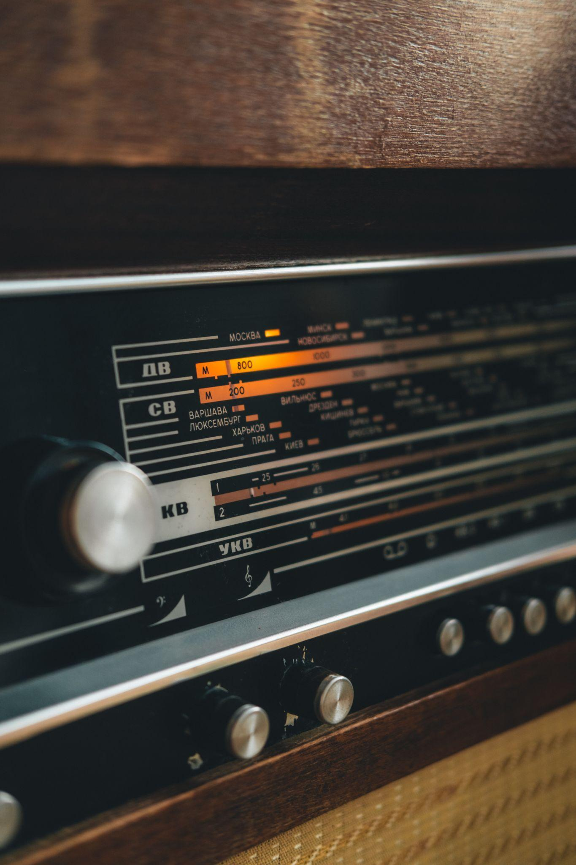
ᏐᏁᎵᏁ ᏣᎳᎩ ᎠᏕᎶᏆᏍᏗ
ᎦᏬᏂᏍᎩ ᏣᎮᏍᏗ.

Slide 22
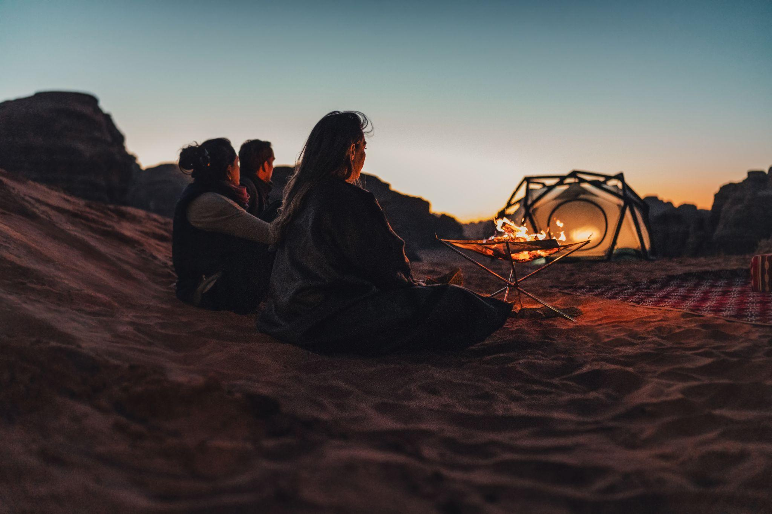
ᏐᏁᎵᏁ ᏣᎳᎩ ᎠᏕᎶᏆᏍᏗ
ᎦᎵᏦᏛᎢ ᎤᏴᏟ ᏣᎭᎷᎩᏍᎩ ᏣᎾᎮᏍᏗ

Slide 23
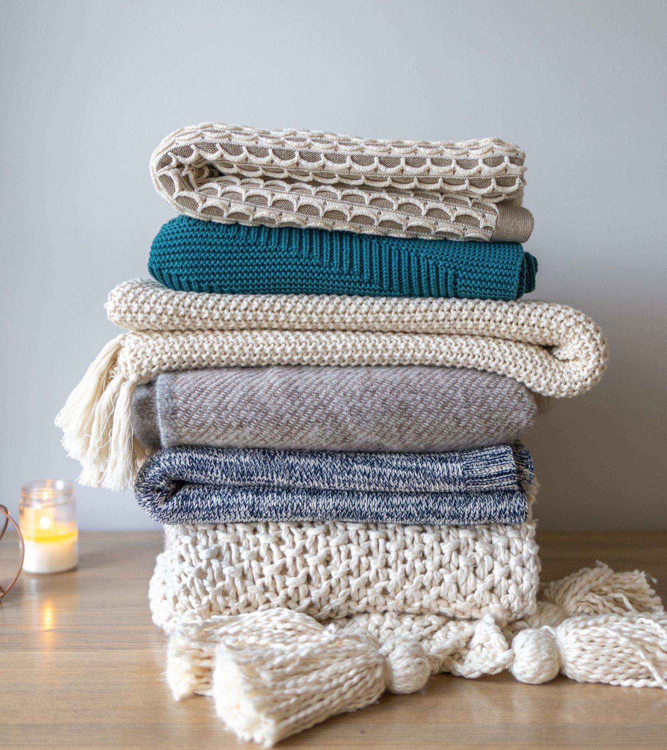
ᏐᏁᎵᏁ ᏣᎳᎩ ᎠᏕᎶᏆᏍᏗ
ᏧᏁᎦᎭ ᏕᏣᏁᏍᏗ

Slide 24
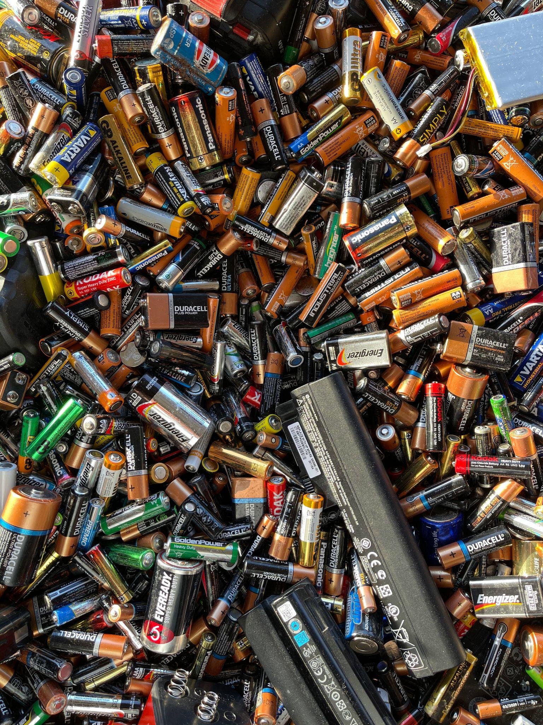
ᏐᏁᎵᏁ ᏣᎳᎩ ᎠᏕᎶᏆᏍᏗ
ᎯᎸᏍᎩ ᏗᎦᎾᎵᏍᎩ ᏕᏨᏰᏍᏗ.

Slide 25
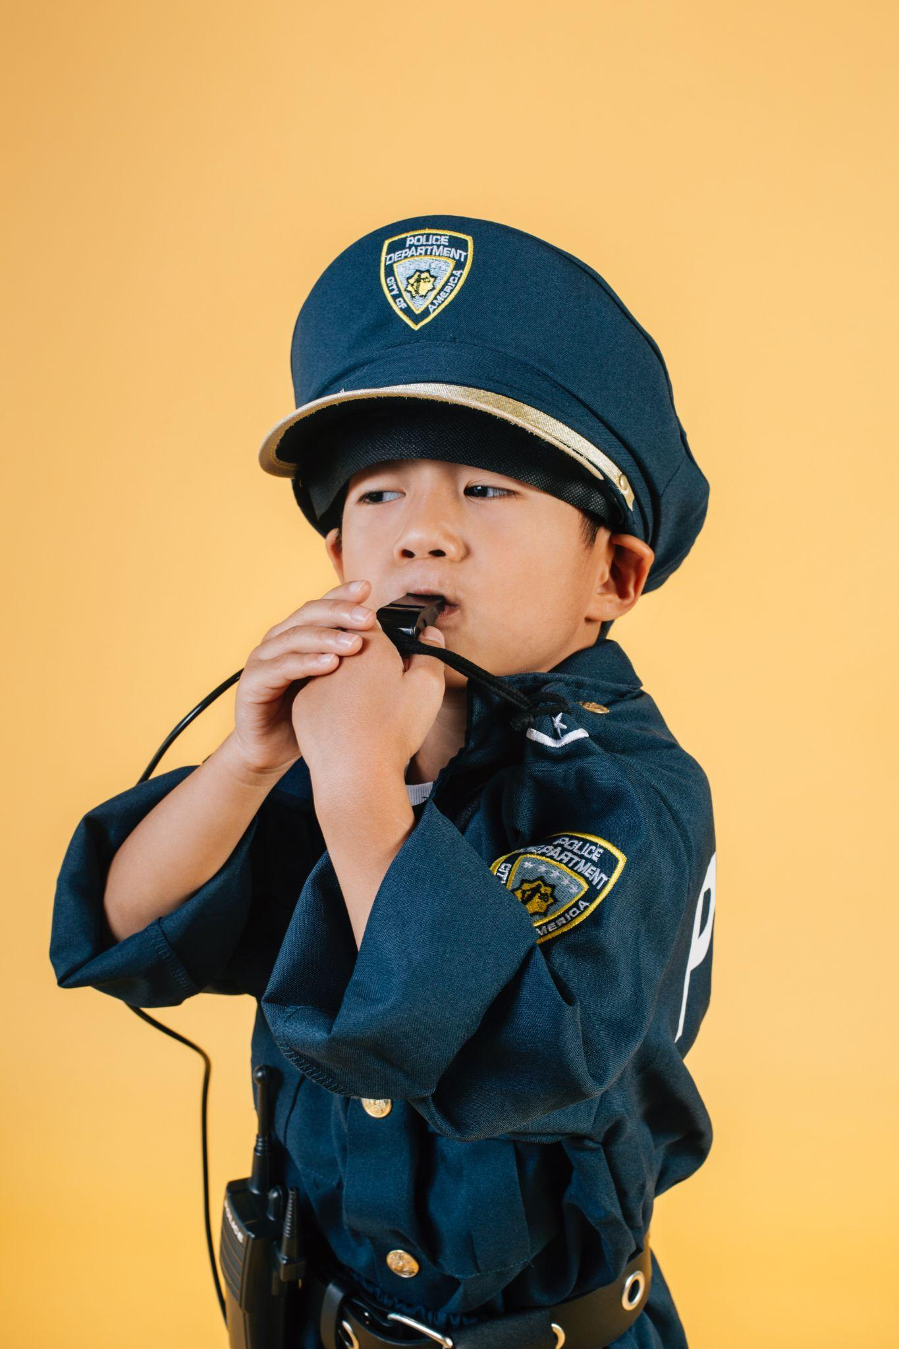
ᏐᏁᎵᏁ ᏣᎳᎩ ᎠᏕᎶᏆᏍᏗ
ᎠᏦᏔᏍᏗ ᏣᎮᏍᏗ

Slide 26
ᏐᏁᎵᏁ ᏣᎳᎩ ᎠᏕᎶᏆᏍᏗ
ᎦᏆᏕᏍᏙᏗ ᎠᎴ ᏗᎦᏂᏴᏙᏗ ᏕᏨᏰᏍᏗ

Slide 27
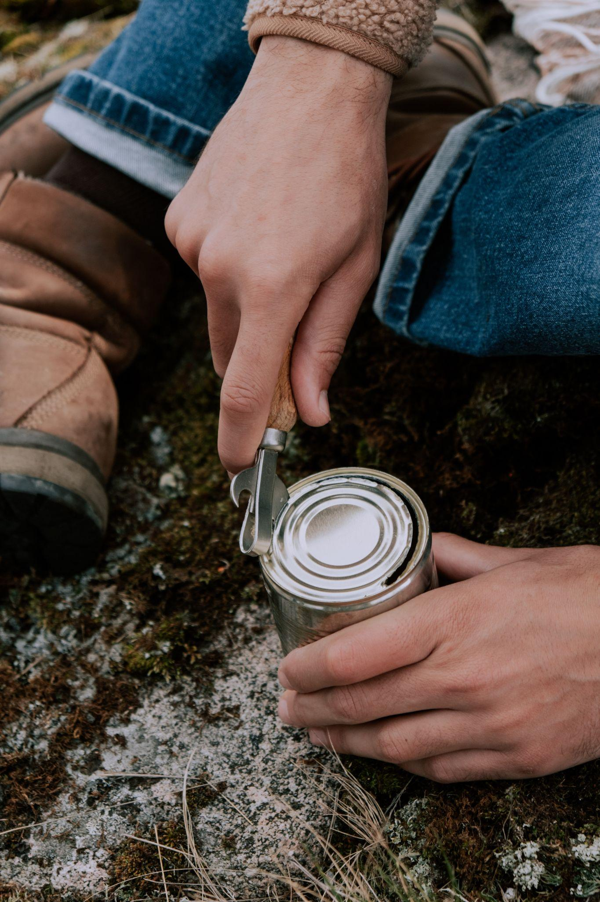
ᏐᏁᎵᏁ ᏣᎳᎩ ᎠᏕᎶᏆᏍᏗ
ᏔᎷᎩᏍᎩ ᎠᏍᏚᎢᏍᏙᏗ ᏨᏰᏍᏗ.

Slide 28
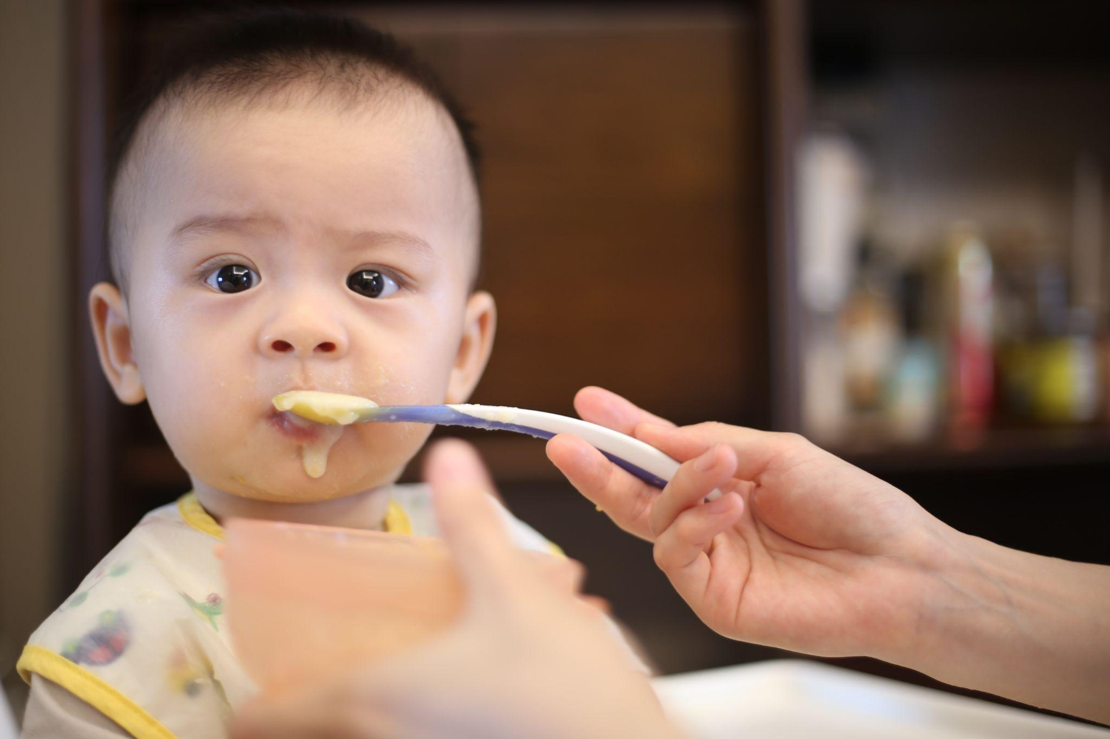
ᏐᏁᎵᏁ ᏣᎳᎩ ᎠᏕᎶᏆᏍᏗ
ᎤᏍᏗ ᏱᏣᎧ, ᎤᏍᏗ ᎠᎵᏍᏓᏱᏗ ᏕᏣᎮᏍᏗ.

Slide 29
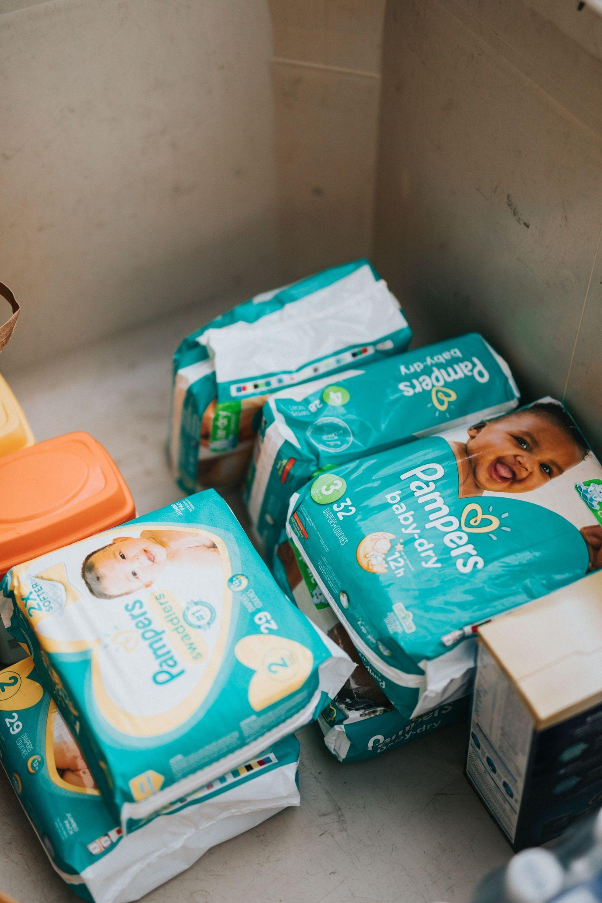
ᏐᏁᎵᏁ ᏣᎳᎩ ᎠᏕᎶᏆᏍᏗ
ᎥᏍᏊ, ᎢᎦᏓᏧᎾᏎᎶᏗ ᏕᏣᏁᏍᏗ.

Slide 30
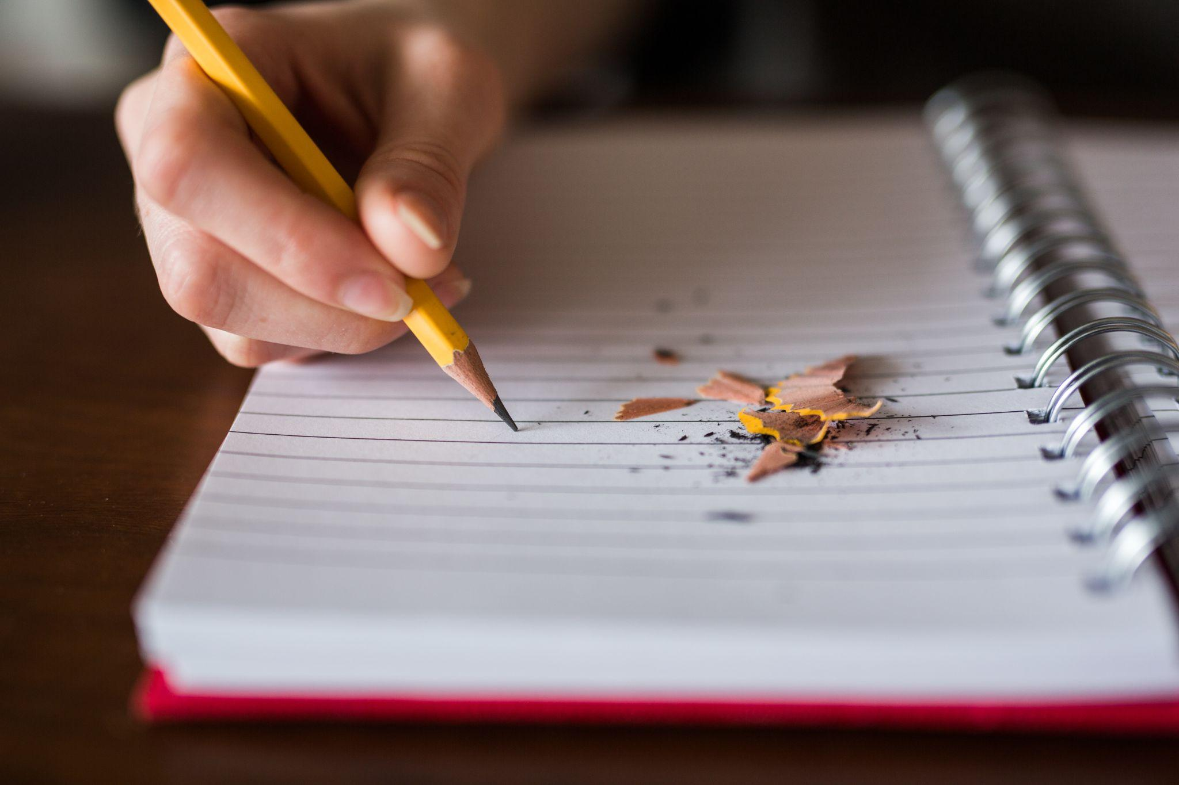
ᏐᏁᎵᏁ ᏣᎳᎩ ᎠᏕᎶᏆᏍᏗ
ᏗᎪᏪᎵ ᏕᏣᏁᏍᏗ.
ᎥᏍᏊ ᏗᎪᏪᎶᏗ ᏕᏨᏰᏍᏗ.

Slide 31
ᏐᏁᎵᏁ ᏣᎳᎩ ᎠᏕᎶᏆᏍᏗ
ᎾᏛᏁᎲ- Verbs
Set B Single subject, single object
ᎠᎩ | I- it
Ꮳ | You- it
Ꭴ | he/she- it

Slide 32
ᏐᏁᎵᏁ ᏣᎳᎩ ᎠᏕᎶᏆᏍᏗ
ᎾᏛᏁᎲ- Verbs
Set B Single subject, single object
ᎩᏂ | We two
ᎣᎩᏂ | We 2 but not you

Slide 33
ᏐᏁᎵᏁ ᏣᎳᎩ ᎠᏕᎶᏆᏍᏗ
ᎾᏛᏁᎲ- Verbs
Set B Single subject, single object
ᎢᎩ | All of us (including you)
ᎣᎩ | All of us (but not you)

Slide 34
ᏐᏁᎵᏁ ᏣᎳᎩ ᎠᏕᎶᏆᏍᏗ
ᎾᏛᏁᎲ- Verbs
Set B Single subject, single object
ᏍᏗ | you two
ᎢᏥ | All of you

Slide 35
ᏐᏁᎵᏁ ᏣᎳᎩ ᎠᏕᎶᏆᏍᏗ
ᎾᏛᏁᎲ- Verbs
Set B Single subject, single object
ᎤᏂ | they

Slide 36
ᏑᏓᎵᏁ ᏣᎳᎩ ᎠᏕᎶᏆᏍᏗ
ᎾᏛᏁᎲ- Verbs
Have liquid
ᎠᎩᏁ
ᏣᏁ
ᎤᏁ
ᎩᏂᏁ
ᎣᎩᏂᏁ
ᎢᎩᏁ
ᎣᎩᏁ
ᏍᏗᏁ
ᎢᏥᏁ
ᎤᏂᏁ

Slide 37
ᏐᏁᎵᏁ ᏣᎳᎩ ᎠᏕᎶᏆᏍᏗ
ᎾᏛᏁᎲ- Verbs
Have long
ᎠᏋᏯ
ᏨᏯ
ᎤᏮᏯ
ᎩᏅᏯ
ᎣᎩᏅᏯ
ᎢᎬᏯ
ᎣᎬᏯ
ᏍᏛᏯ
ᎢᏨᏯ
ᎤᏅᏯ

Slide 38
ᏐᏁᎵᏁ ᏣᎳᎩ ᎠᏕᎶᏆᏍᏗ
ᎾᏛᏁᎲ- Verbs
Set B , vowel stem
agw | I- it
j | You- it
uw | he/she- it

Slide 39
ᏐᏁᎵᏁ ᏣᎳᎩ ᎠᏕᎶᏆᏍᏗ
ᎾᏛᏁᎲ- Verbs
Set B Single subject, single object
gin | We two
ogin | We 2 but not you

Slide 40
ᏐᏁᎵᏁ ᏣᎳᎩ ᎠᏕᎶᏆᏍᏗ
ᎾᏛᏁᎲ- Verbs
Set B Single subject, single object
ig | All of us (including you)
og | All of us (but not you)

Slide 41
ᏐᏁᎵᏁ ᏣᎳᎩ ᎠᏕᎶᏆᏍᏗ
ᎾᏛᏁᎲ- Verbs
Set B Single subject, single object
sd | you two
ij | All of you

Slide 42
ᏐᏁᎵᏁ ᏣᎳᎩ ᎠᏕᎶᏆᏍᏗ
ᎾᏛᏁᎲ- Verbs
Set B Single subject, single object
un | they

Slide 43
ᏐᏁᎵᏁ ᏣᎳᎩ ᎠᏕᎶᏆᏍᏗ
ᎾᏛᏁᎲ- Verbs
want
ᎠᏩᏚᎵ
ᏣᏚᎵ
ᎤᏚᎵ
ᎩᎾᏚᎵ
ᎣᎩᎾᏚᎵ
ᎢᎦᏚᎵ
ᎣᎦᏚᎵ
ᏍᏓᏚᎵ
ᎢᏣᏚᎵ
ᎤᎾᏚᎵ

Slide 44
ᏐᏁᎵᏁ ᏣᎳᎩ ᎠᏕᎶᏆᏍᏗ
ᎾᏛᏁᎲ- Verbs
forgetting
ᎠᏩᎨᏫᏍᎬ
ᏣᎨᏫᏍᎬ
ᎤᏮᎨᏫᏍᎬ
ᎩᏅᎨᏫᏍᎬ
ᎣᎩᏅᎨᏫᏍᎬ
ᎢᎬᎨᏫᏍᎬ
ᎣᎬᎨᏫᏍᎬ
ᏍᏛᎨᏫᏍᎬ
ᎢᏨᎨᏫᏍᎬ
ᎤᏅᎨᏫᏍᎬ

Slide 45
ᏐᏁᎵᏁ ᏣᎳᎩ ᎠᏕᎶᏆᏍᏗ
ᎾᏛᏁᎲ- Verbs
Like- lvqdi
ᎩᏂᎸᏈᏗ
ᎣᎩᏂᎸᏈᏗ
ᎢᎩᎸᏈᏗ
ᎣᎩᎸᏈᏗ
ᏍᏗᎸᏈᏗ
ᎢᏥᎸᏈᏗ
ᎤᏂᎸᏈᏗ
ᎠᎩᎸᏈᏗ
ᏣᎸᏈᏗ
ᎤᎸᏈᏗ

Slide 46
ᏐᏁᎵᏁ ᏣᎳᎩ ᎠᏕᎶᏆᏍᏗ
ᎾᏛᏁᎲ- Verbs
Set A ,
Ꮵ | I- it
Ꭿ | You- it
Ꭶ, Ꭰ | he/she- it

Slide 47
ᏐᏁᎵᏁ ᏣᎳᎩ ᎠᏕᎶᏆᏍᏗ
ᎾᏛᏁᎲ- Verbs
Set B Single subject, single object
ᎢᏂ | We two
ᎣᏍᏗ | We 2 but not you

Slide 48
ᏐᏁᎵᏁ ᏣᎳᎩ ᎠᏕᎶᏆᏍᏗ
ᎾᏛᏁᎲ- Verbs
Set B Single subject, single object
ᎢᏗ | All of us (including you)
ᎣᏥ | All of us (but not you)

Slide 49
ᏐᏁᎵᏁ ᏣᎳᎩ ᎠᏕᎶᏆᏍᏗ
ᎾᏛᏁᎲ- Verbs
Set B Single subject, single object
ᏍᏗ | you two
ᎢᏥ | All of you

Slide 50
ᏐᏁᎵᏁ ᏣᎳᎩ ᎠᏕᎶᏆᏍᏗ
ᎾᏛᏁᎲ- Verbs
Set B Single subject, single object
ᎠᏂ | they

Slide 51
ᏐᏁᎵᏁ ᏣᎳᎩ ᎠᏕᎶᏆᏍᏗ
ᎾᏛᏁᎲ- Verbs
Speaking- ᏬᏂ
ᏥᏬᏂ
ᎯᏬᏂ
ᎦᏬᏂ
ᎢᏂᏬᏂ
ᎣᏍᏗᏬᏂ
ᎢᏗᏬᏂ
ᎣᏥᏬᏂ
ᏍᏗᏬᏂ
ᎢᏥᏬᏂ
ᎠᏂᏬᏂ

Slide 52
ᏐᏁᎵᏁ ᏣᎳᎩ ᎠᏕᎶᏆᏍᏗ
ᎾᏛᏁᎲ- Verbs
Set A , vowel stem
g | I- it
h | You- it
g | he/she- it

Slide 53
ᏐᏁᎵᏁ ᏣᎳᎩ ᎠᏕᎶᏆᏍᏗ
ᎾᏛᏁᎲ- Verbs
Set A , vowel stem
in | We two
osd | We 2 but not you

Slide 54
ᏐᏁᎵᏁ ᏣᎳᎩ ᎠᏕᎶᏆᏍᏗ
ᎾᏛᏁᎲ- Verbs
Set A , vowel stem
id | All of us (including you)
oj | All of us (but not you)

Slide 55
ᏐᏁᎵᏁ ᏣᎳᎩ ᎠᏕᎶᏆᏍᏗ
ᎾᏛᏁᎲ- Verbs
Set A , vowel stem
sd | you two
ij | All of you

Slide 56
ᏐᏁᎵᏁ ᏣᎳᎩ ᎠᏕᎶᏆᏍᏗ
ᎾᏛᏁᎲ- Verbs
Set A , vowel stem
an | they

Slide 57
ᏐᏁᎵᏁ ᏣᎳᎩ ᎠᏕᎶᏆᏍᏗ
ᎾᏛᏁᎲ- Verbs
Trying- ᎠᏁᏟᏗ
ᎦᏁᏟᏗ
ᎭᏁᏟᏗ
ᎨᏁᏟᏗ
ᎢᎾᏁᏟᏗ
ᎣᏍᏓᏁᏟᏗ
ᎢᏓᏁᏟᏗ
ᎣᏣᏁᏟᏗ
ᏍᏓᏁᏟᏗ
ᎢᏣᏁᏟᏗ
ᎠᎾᏁᏟᏗ

