Slide 1
ᎣᏏᏲ
ᏦᏍᎪᎯ ᏑᏓᎵᏁ ᏣᎳᎩ ᎠᏕᎶᏆᏍᏗ

Slide 2
ᏦᏍᎪᎯ ᏑᏓᎵᏁ ᏣᎳᎩ ᎠᏕᎶᏆᏍᏗ
ᎢᏓᎴᎾ- Let’s begin
ᏣᎳᎩ ᎢᏗᏬᏂ- Let’s talk Cherokee

Slide 3
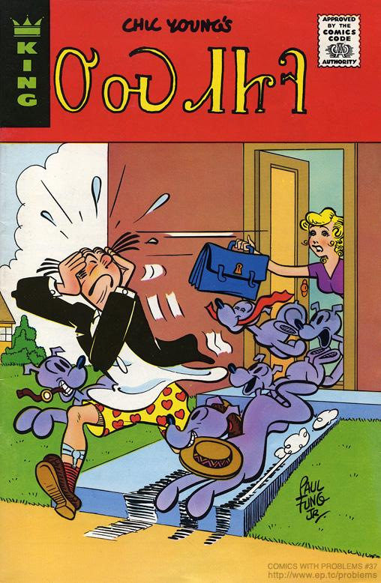
ᏦᏍᎪᎯ ᏑᏓᎵᏁ ᏣᎳᎩ ᎠᏕᎶᏆᏍᏗ
ᎤᏍᏗᏥᎸ
1975

Slide 4
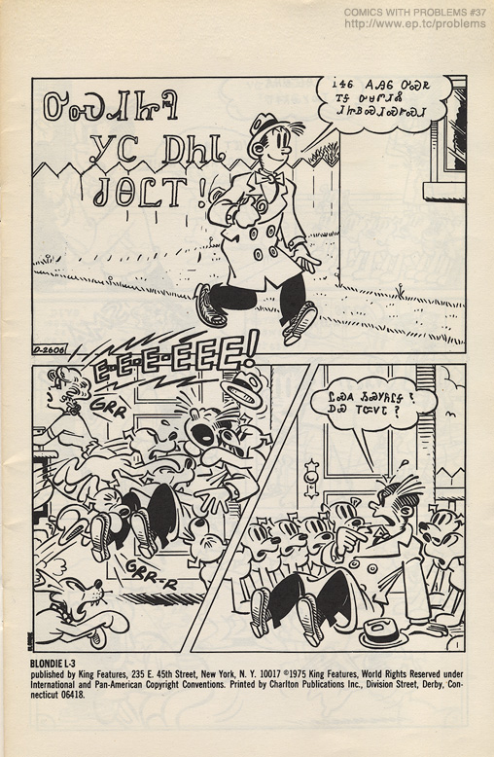
ᏦᏍᎪᎯ ᏑᏓᎵᏁ ᏣᎳᎩ ᎠᏕᎶᏆᏍᏗ
ᎤᏍᏗᏥᎸ ᎩᏟ ᎠᏂᏓ ᏧᎾᏝᎢ!

Slide 5
ᏦᏍᎪᎯ ᏑᏓᎵᏁ ᏣᎳᎩ ᎠᏕᎶᏆᏍᏗ
ᎥᏎᏮ ᎪᎯᏮ ᎤᏍᏒ ᎢᎦ ᎤᏌᏛᏗᏜ ᏗᏥᏴᏍᏗᏍᎨᏍᏗ

Slide 6
ᏦᏍᎪᎯ ᏑᏓᎵᏁ ᏣᎳᎩ ᎠᏕᎶᏆᏍᏗ
ᏝᏍᎪ ᏱᏍᎩᏲᎵᎦ? ᎠᏯ ᎢᏨᏙᏓ?

Slide 7
ᏦᏍᎪᎯ ᏑᏓᎵᏁ ᏣᎳᎩ ᎠᏕᎶᏆᏍᏗ
ᏙᎯᏳᎧᏲᎪ ᎢᏍᎩᏯᏦᏎᏓ.
ᏙᏳᎢ ᎥᏎᏃ Ꮭ ᏔᎵᏁ ᏱᏓᎦᏁᎵᏔᏂ!

Slide 8
ᏦᏍᎪᎯ ᏑᏓᎵᏁ ᏣᎳᎩ ᎠᏕᎶᏆᏍᏗ
ᎠᏓᏤᏫ ᏨᎨᏩᎴ ᏍᎩᏔᏪᏙᏗ
Ꭳ, ᏙᎯᏳᎴ!

Slide 9
ᏦᏍᎪᎯ ᏑᏓᎵᏁ ᏣᎳᎩ ᎠᏕᎶᏆᏍᏗ
ᏙᏳᎧᏲ ᎤᏁᎩᎵᏗ ᎢᏣᏓᏅᏘᏗ.

Slide 10
ᏦᏍᎪᎯ ᏑᏓᎵᏁ ᏣᎳᎩ ᎠᏕᎶᏆᏍᏗ
ᎠᏓᏤᏫ ᎭᏫᏯᎡᏍ ᏃᏮ ᎤᏩᏂᏏᏗ!

Slide 11
ᏦᏍᎪᎯ ᏑᏓᎵᏁ ᏣᎳᎩ ᎠᏕᎶᏆᏍᏗ
ᎣᏌᏂ! ᎩᎶᏮᎢᏳᏍᏗ ᏫᎬᏯᏕᎳᏕᎸᎢ ᎩᏟ ᏕᎨᎶᏣᏅᎢ.

Slide 12
ᏦᏍᎪᎯ ᏑᏓᎵᏁ ᏣᎳᎩ ᎠᏕᎶᏆᏍᏗ
ᎠᎭᏂ… ᎦᏙᎲ ᎢᏣᎦᏙᏍᏗᏇ ᎥᏍᎨᎦ Ꮎ ᎢᏥᎸᏉᏗ ᏥᎩ.

Slide 13
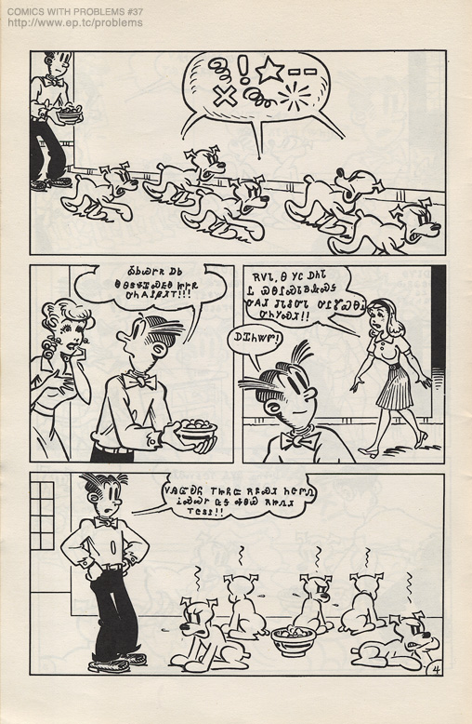
ᏦᏍᎪᎯ ᏑᏓᎵᏁ ᏣᎳᎩ ᎠᏕᎶᏆᏍᏗ
ᎣᏏᏊᎨᏒ ᎠᏏ Ꮎ ᎾᏕᏠᏆᏍᎬᎾ ᏥᎨᏒ ᎤᏂᎪᎵᏰᏗᎢ!!!

Slide 14
ᏦᏍᎪᎯ ᏑᏓᎵᏁ ᏣᎳᎩ ᎠᏕᎶᏆᏍᏗ
ᎡᏙᏓ, Ꮎ ᎩᏟ ᎠᏂᏓ Ꮭ ᏯᎾᎵᏍᏓᏴᎲᏍᎦ ᎤᎪᏗ ᏧᏓᎴᏅᏓ ᎤᎵᏑᏯᎾᎥ ᎤᏂᎩᏍᏗ!!

Slide 15
ᏦᏍᎪᎯ ᏑᏓᎵᏁ ᏣᎳᎩ ᎠᏕᎶᏆᏍᏗ
ᎠᏆᏂᏔᏛ!

Slide 16
ᏦᏍᎪᎯ ᏑᏓᎵᏁ ᏣᎳᎩ ᎠᏕᎶᏆᏍᏗ
ᏙᎯᏳᎧᏲ ᎢᏥᏲᏨ ᎡᏄᏍᏗ ᏂᏣᏛᏁ ᎥᏍᏊᎨ ᏩᎦ ᎭᏫᏯ ᎡᏥᏁᏗ ᎢᏣᏚᎵ!!

Slide 17
ᏦᏍᎪᎯ ᏑᏓᎵᏁ ᏣᎳᎩ ᎠᏕᎶᏆᏍᏗ
ᎤᏠᏱᏊ ᎠᏴ ᏥᏓᏗᎩ!
ᎥᎥ_ ᎠᏴᎥᏍᏊ ᏖᎵᏙ ᏫᏍᎩᎵᏓᏏ

Slide 18
ᏦᏍᎪᎯ ᏑᏓᎵᏁ ᏣᎳᎩ ᎠᏕᎶᏆᏍᏗ
ᎿᏊᏃ ᏓᎦᏥᏯᎵᎢᎦᎵ ᎠᏎᎮᏃ ᎤᎾᏕᏠᏆᏍᏗ!

Slide 19
ᏦᏍᎪᎯ ᏑᏓᎵᏁ ᏣᎳᎩ ᎠᏕᎶᏆᏍᏗ
ᏙᎯᏳ ᎤᎦᎾᎭᏊ ᏗᎧᏅᏗᎢ, ᏯᏆᏚᎳᏊ ᎠᎩᎩᏍᏗ ᎠᏋᏌ!

Slide 20
ᏦᏍᎪᎯ ᏑᏓᎵᏁ ᏣᎳᎩ ᎠᏕᎶᏆᏍᏗ
Ah…… yummy! Ah, ᏙᏳ ᎣᏍᏓ ᎨᏒᎢ.

Slide 21
ᏦᏍᎪᎯ ᏑᏓᎵᏁ ᏣᎳᎩ ᎠᏕᎶᏆᏍᏗ
Ꮭ ᏃᏊ ᏱᏙᏓᏁᏝᎵ ᏑᎾᎴ ᎢᎪᎯᏓ. ᎾᎯᏳᏃ ᎢᏳᏍᏗᏊ ᏕᏂᏁᎲ ᏛᏂᎩ.

Slide 22
ᏦᏍᎪᎯ ᏑᏓᎵᏁ ᏣᎳᎩ ᎠᏕᎶᏆᏍᏗ
ᎤᏍᏗᏥᎸᎯ, ᎬᏯᏎᎯᏏ ᎾᏂᎥ ᎤᏂᎪᏩᏛᏗ, ᎠᏍᎦᏯ ᎠᏌᎹᏗᏴ ᏏᏅ ᎩᏟ ᎨᏒᎢ!!

Slide 23
ᏦᏍᎪᎯ ᏑᏓᎵᏁ ᏣᎳᎩ ᎠᏕᎶᏆᏍᏗ
ᎭᏩ, ᏗᏂᏲᏟ ᏫᏘᏯᎾ, ᏃᏊᎮᏅ ᎠᎵᏍᏓᏴᏗᎢ!!

Slide 24
ᏦᏍᎪᎯ ᏑᏓᎵᏁ ᏣᎳᎩ ᎠᏕᎶᏆᏍᏗ
ᎠᏴᏛ ᏙᏳ ᏥᎪᎾ, Ꮭ ᎩᎶ ᎠᏆᏍᏗᏰᏙᏗ ᏱᎩ ᎠᏆᎵᏍᏓᏴᏗᎢ!

Slide 25
ᏦᏍᎪᎯ ᏑᏓᎵᏁ ᏣᎳᎩ ᎠᏕᎶᏆᏍᏗ
ᎡᏙᏓ ᏙᎯᏳ ᏚᏳᎦᏛ ᎯᏁᎩ!

Slide 26
ᏦᏍᎪᎯ ᏑᏓᎵᏁ ᏣᎳᎩ ᎠᏕᎶᏆᏍᏗ
ᎠᏴᏛ ᎥᏍᏊ!

Slide 27
ᏦᏍᎪᎯ ᏑᏓᎵᏁ ᏣᎳᎩ ᎠᏕᎶᏆᏍᏗ
ᎠᏎᏛ ᏂᎦᏓᏊ ᎥᏍᎩ ᎢᎦ ᏕᎩᏲᏏ ᎪᎯ ᎤᏒᎢ.

Slide 28
ᏦᏍᎪᎯ ᏑᏓᎵᏁ ᏣᎳᎩ ᎠᏕᎶᏆᏍᏗ
ᏂᎦᏓ ᎨᎩᏒᎲᏏ! ᎤᏒ ᎡᎯ ᎢᎦᎵᏍᏓᏴᏗ!

Slide 29
ᏦᏍᎪᎯ ᏑᏓᎵᏁ ᏣᎳᎩ ᎠᏕᎶᏆᏍᏗ
ᎠᏓᏤᏫ, ᏝᏛ ᏍᎩᎾ ᏱᎾᏅᏂᏌ ᎤᏃᎯᏳᏒᎮᏃ ᎬᏩᏂᎩᏍᏗᏊ ᎨᏒ ᏣᎵᏍᏓᏴᏗ ᏂᎯᏃ ᏥᎦ ᎤᎾᎵᏍᏓᏴᏗ!

Slide 30
ᏦᏍᎪᎯ ᏑᏓᎵᏁ ᏣᎳᎩ ᎠᏕᎶᏆᏍᏗ
ᎠᏴᏛ ᏩᏂᎨ ᎤᏩᏂᏒ ᎠᏩᏚᎵ!

Slide 31
ᏦᏍᎪᎯ ᏑᏓᎵᏁ ᏣᎳᎩ ᎠᏕᎶᏆᏍᏗ
ᏙᎯᏳ. ᎣᏍᏓ ᎠᏰᎸᏗ

Slide 32
ᏦᏍᎪᎯ ᏑᏓᎵᏁ ᏣᎳᎩ ᎠᏕᎶᏆᏍᏗ
ᎥᎥ, ᎠᏴᏛ ᎢᎦ ᎠᎩᎸᏈᏗ ᏧᎾᎵᏍᏓᏴᏗ ᎠᏆᎵᏍᏓᏴᏗᎢ.

Slide 33
ᏦᏍᎪᎯ ᏑᏓᎵᏁ ᏣᎳᎩ ᎠᏕᎶᏆᏍᏗ
Bah! ᎠᏴᏛ Ꮭ ᏯᎩᏲᏏ!

