Slide 1
ᎣᏏᏲ
ᏦᏍᎪᎯ ᎦᎵᏉᎩᏁ ᏣᎳᎩ ᎠᏕᎶᏆᏍᏗ

Slide 2
ᏦᏍᎪᎯ ᎦᎵᏉᎩᏁ ᏣᎳᎩ ᎠᏕᎶᏆᏍᏗ
ᎢᏓᎴᎾ- Let’s begin
ᏣᎳᎩ ᎢᏗᏬᏂ- Let’s talk Cherokee

Slide 3
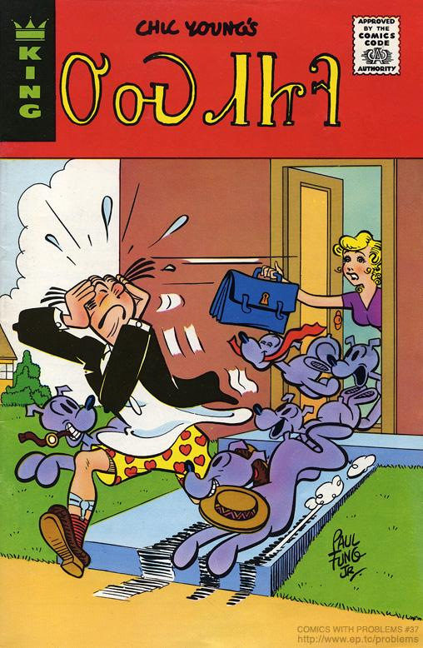
ᏦᏍᎪᎯ ᎦᎵᏉᎩᏁ ᏣᎳᎩ ᎠᏕᎶᏆᏍᏗ
ᎤᏍᏗᏥᎸ
1975

Slide 4
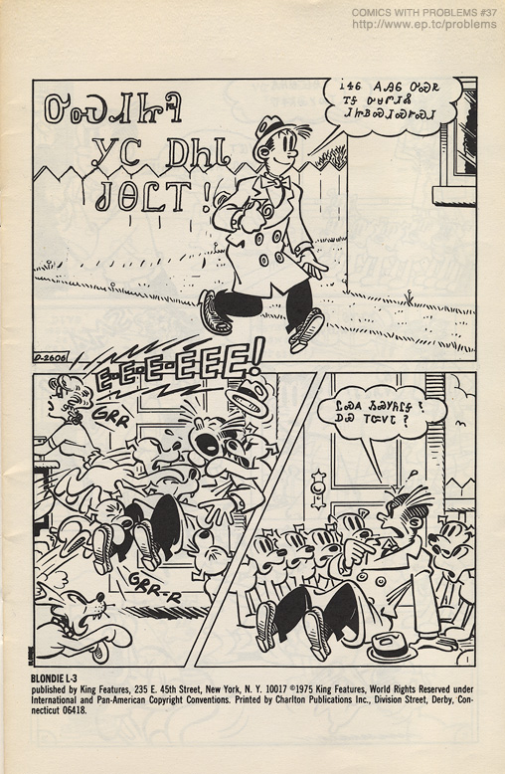
ᏦᏍᎪᎯ ᎦᎵᏉᎩᏁ ᏣᎳᎩ ᎠᏕᎶᏆᏍᏗ
ᎤᏍᏗᏥᎸ ᎩᏟ ᎠᏂᏓ ᏧᎾᏝᎢ!

Slide 5
ᏦᏍᎪᎯ ᎦᎵᏉᎩᏁ ᏣᎳᎩ ᎠᏕᎶᏆᏍᏗ
ᎥᏎᏮ ᎪᎯᏮ ᎤᏍᏒ ᎢᎦ ᎤᏌᏛᏗᏜ ᏗᏥᏴᏍᏗᏍᎨᏍᏗ

Slide 6
ᏦᏍᎪᎯ ᎦᎵᏉᎩᏁ ᏣᎳᎩ ᎠᏕᎶᏆᏍᏗ
ᏝᏍᎪ ᏱᏍᎩᏲᎵᎦ? ᎠᏯ ᎢᏨᏙᏓ?

Slide 7
ᏦᏍᎪᎯ ᎦᎵᏉᎩᏁ ᏣᎳᎩ ᎠᏕᎶᏆᏍᏗ
ᏙᎯᏳᎧᏲᎪ ᎢᏍᎩᏯᏦᏎᏓ.
ᏙᏳᎢ ᎥᏎᏃ Ꮭ ᏔᎵᏁ ᏱᏓᎦᏁᎵᏔᏂ!

Slide 8
ᏦᏍᎪᎯ ᎦᎵᏉᎩᏁ ᏣᎳᎩ ᎠᏕᎶᏆᏍᏗ
ᎠᏓᏤᏫ ᏨᎨᏩᎴ ᏍᎩᏔᏪᏙᏗ
Ꭳ, ᏙᎯᏳᎴ!

Slide 9
ᏦᏍᎪᎯ ᎦᎵᏉᎩᏁ ᏣᎳᎩ ᎠᏕᎶᏆᏍᏗ
ᏙᏳᎧᏲ ᎤᏁᎩᎵᏗ ᎢᏣᏓᏅᏘᏗ.

Slide 10
ᏦᏍᎪᎯ ᎦᎵᏉᎩᏁ ᏣᎳᎩ ᎠᏕᎶᏆᏍᏗ
ᎠᏓᏤᏫ ᎭᏫᏯᎡᏍ ᏃᏮ ᎤᏩᏂᏏᏗ!

Slide 11
ᏦᏍᎪᎯ ᎦᎵᏉᎩᏁ ᏣᎳᎩ ᎠᏕᎶᏆᏍᏗ
ᎣᏌᏂ! ᎩᎶᏮᎢᏳᏍᏗ ᏫᎬᏯᏕᎳᏕᎸᎢ ᎩᏟ ᏕᎨᎶᏣᏅᎢ.

Slide 12
ᏦᏍᎪᎯ ᎦᎵᏉᎩᏁ ᏣᎳᎩ ᎠᏕᎶᏆᏍᏗ
ᎠᎭᏂ… ᎦᏙᎲ ᎢᏣᎦᏙᏍᏗᏇ ᎥᏍᎨᎦ Ꮎ ᎢᏥᎸᏉᏗ ᏥᎩ.

Slide 13
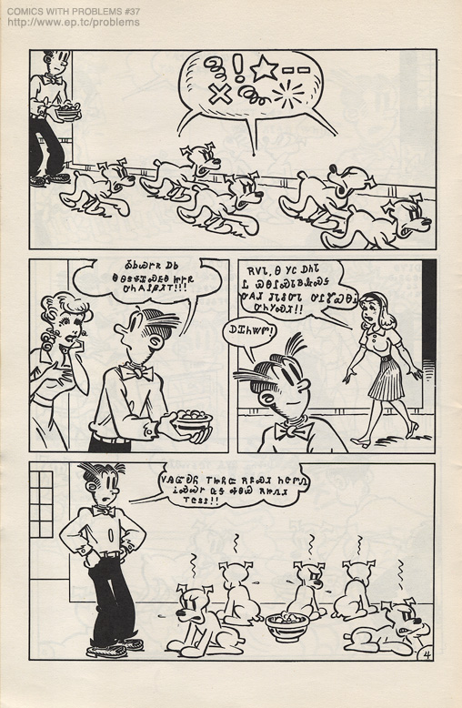
ᏦᏍᎪᎯ ᎦᎵᏉᎩᏁ ᏣᎳᎩ ᎠᏕᎶᏆᏍᏗ
ᎣᏏᏊᎨᏒ ᎠᏏ Ꮎ ᎾᏕᏠᏆᏍᎬᎾ ᏥᎨᏒ ᎤᏂᎪᎵᏰᏗᎢ!!!

Slide 14
ᏦᏍᎪᎯ ᎦᎵᏉᎩᏁ ᏣᎳᎩ ᎠᏕᎶᏆᏍᏗ
ᎡᏙᏓ, Ꮎ ᎩᏟ ᎠᏂᏓ Ꮭ ᏯᎾᎵᏍᏓᏴᎲᏍᎦ ᎤᎪᏗ ᏧᏓᎴᏅᏓ ᎤᎵᏑᏯᎾᎥ ᎤᏂᎩᏍᏗ!!

Slide 15
ᏦᏍᎪᎯ ᎦᎵᏉᎩᏁ ᏣᎳᎩ ᎠᏕᎶᏆᏍᏗ
ᎠᏆᏂᏔᏛ!

Slide 16
ᏦᏍᎪᎯ ᎦᎵᏉᎩᏁ ᏣᎳᎩ ᎠᏕᎶᏆᏍᏗ
ᏙᎯᏳᎧᏲ ᎢᏥᏲᏨ ᎡᏄᏍᏗ ᏂᏣᏛᏁ ᎥᏍᏊᎨ ᏩᎦ ᎭᏫᏯ ᎡᏥᏁᏗ ᎢᏣᏚᎵ!!

Slide 17
ᏦᏍᎪᎯ ᎦᎵᏉᎩᏁ ᏣᎳᎩ ᎠᏕᎶᏆᏍᏗ
ᎤᏠᏱᏊ ᎠᏴ ᏥᏓᏗᎩ!
ᎥᎥ_ ᎠᏴᎥᏍᏊ ᏖᎵᏙ ᏫᏍᎩᎵᏓᏏ

Slide 18
ᏦᏍᎪᎯ ᎦᎵᏉᎩᏁ ᏣᎳᎩ ᎠᏕᎶᏆᏍᏗ
ᎿᏊᏃ ᏓᎦᏥᏯᎵᎢᎦᎵ ᎠᏎᎮᏃ ᎤᎾᏕᏠᏆᏍᏗ!

Slide 19
ᏦᏍᎪᎯ ᎦᎵᏉᎩᏁ ᏣᎳᎩ ᎠᏕᎶᏆᏍᏗ
ᏙᎯᏳ ᎤᎦᎾᎭᏊ ᏗᎧᏅᏗᎢ, ᏯᏆᏚᎳᏊ ᎠᎩᎩᏍᏗ ᎠᏋᏌ!

Slide 20
ᏦᏍᎪᎯ ᎦᎵᏉᎩᏁ ᏣᎳᎩ ᎠᏕᎶᏆᏍᏗ
Ah…… yummy! Ah, ᏙᏳ ᎣᏍᏓ ᎨᏒᎢ.

Slide 21
ᏦᏍᎪᎯ ᎦᎵᏉᎩᏁ ᏣᎳᎩ ᎠᏕᎶᏆᏍᏗ
Ꮭ ᏃᏊ ᏱᏙᏓᏁᏝᎵ ᏑᎾᎴ ᎢᎪᎯᏓ. ᎾᎯᏳᏃ ᎢᏳᏍᏗᏊ ᏕᏂᏁᎲ ᏛᏂᎩ.

Slide 22
ᏦᏍᎪᎯ ᎦᎵᏉᎩᏁ ᏣᎳᎩ ᎠᏕᎶᏆᏍᏗ
ᎤᏍᏗᏥᎸᎯ, ᎬᏯᏎᎯᏏ ᎾᏂᎥ ᎤᏂᎪᏩᏛᏗ, ᎠᏍᎦᏯ ᎠᏌᎹᏗᏴ ᏏᏅ ᎩᏟ ᎨᏒᎢ!!

Slide 23
ᏦᏍᎪᎯ ᎦᎵᏉᎩᏁ ᏣᎳᎩ ᎠᏕᎶᏆᏍᏗ
ᎭᏩ, ᏗᏂᏲᏟ ᏫᏘᏯᎾ, ᏃᏊᎮᏅ ᎠᎵᏍᏓᏴᏗᎢ!!

Slide 24
ᏦᏍᎪᎯ ᎦᎵᏉᎩᏁ ᏣᎳᎩ ᎠᏕᎶᏆᏍᏗ
ᎠᏴᏛ ᏙᏳ ᏥᎪᎾ, Ꮭ ᎩᎶ ᎠᏆᏍᏗᏰᏙᏗ ᏱᎩ ᎠᏆᎵᏍᏓᏴᏗᎢ!

Slide 25
ᏦᏍᎪᎯ ᎦᎵᏉᎩᏁ ᏣᎳᎩ ᎠᏕᎶᏆᏍᏗ
ᎡᏙᏓ ᏙᎯᏳ ᏚᏳᎦᏛ ᎯᏁᎩ!

Slide 26
ᏦᏍᎪᎯ ᎦᎵᏉᎩᏁ ᏣᎳᎩ ᎠᏕᎶᏆᏍᏗ
ᎠᏴᏛ ᎥᏍᏊ!

Slide 27
ᏦᏍᎪᎯ ᎦᎵᏉᎩᏁ ᏣᎳᎩ ᎠᏕᎶᏆᏍᏗ
ᎠᏎᏛ ᏂᎦᏓᏊ ᎥᏍᎩ ᎢᎦ ᏕᎩᏲᏏ ᎪᎯ ᎤᏒᎢ.

Slide 28
ᏦᏍᎪᎯ ᎦᎵᏉᎩᏁ ᏣᎳᎩ ᎠᏕᎶᏆᏍᏗ
ᏂᎦᏓ ᎨᎩᏒᎲᏏ! ᎤᏒ ᎡᎯ ᎢᎦᎵᏍᏓᏴᏗ!

Slide 29
ᏦᏍᎪᎯ ᎦᎵᏉᎩᏁ ᏣᎳᎩ ᎠᏕᎶᏆᏍᏗ
ᎠᏓᏤᏫ, ᏝᏛ ᏍᎩᎾ ᏱᎾᏅᏂᏌ ᎤᏃᎯᏳᏒᎮᏃ ᎬᏩᏂᎩᏍᏗᏊ ᎨᏒ ᏣᎵᏍᏓᏴᏗ ᏂᎯᏃ ᏥᎦ ᎤᎾᎵᏍᏓᏴᏗ!

Slide 30
ᏦᏍᎪᎯ ᎦᎵᏉᎩᏁ ᏣᎳᎩ ᎠᏕᎶᏆᏍᏗ
ᎠᏴᏛ ᏩᏂᎨ ᎤᏩᏂᏒ ᎠᏩᏚᎵ!

Slide 31
ᏦᏍᎪᎯ ᎦᎵᏉᎩᏁ ᏣᎳᎩ ᎠᏕᎶᏆᏍᏗ
ᏙᎯᏳ ᎣᏍᏓ ᎠᏰᎸᏗ.

Slide 32
ᏦᏍᎪᎯ ᎦᎵᏉᎩᏁ ᏣᎳᎩ ᎠᏕᎶᏆᏍᏗ
ᎥᎥ, ᎠᏴᏛ ᎢᎦ ᎠᎩᎸᏈᏗ ᏧᎾᎵᏍᏓᏴᏗ ᎠᏆᎵᏍᏓᏴᏗᎢ.

Slide 33
ᏦᏍᎪᎯ ᎦᎵᏉᎩᏁ ᏣᎳᎩ ᎠᏕᎶᏆᏍᏗ
Bah! ᎠᏴᏛ Ꮭ ᏯᎩᏲᏏ!

