Slide 1
ᎣᏏᏲ
ᏅᎩᏍᎪᎯᏁ ᏣᎳᎩ ᎠᏕᎶᏆᏍᏗ

Slide 2
ᏅᎩᏍᎪᎯᏁ ᏣᎳᎩ ᎠᏕᎶᏆᏍᏗ
ᎢᏓᎴᎾ- Let’s begin
ᏣᎳᎩ ᎢᏗᏬᏂ- Let’s talk Cherokee

Slide 3
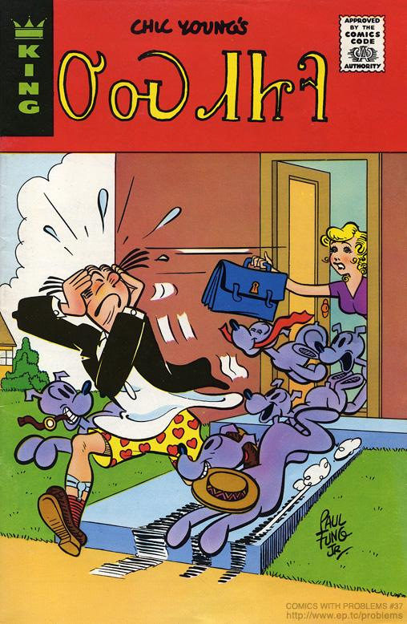
ᏅᎩᏍᎪᎯᏁ ᏣᎳᎩ ᎠᏕᎶᏆᏍᏗ
ᎤᏍᏗᏥᎸ
1975

Slide 4
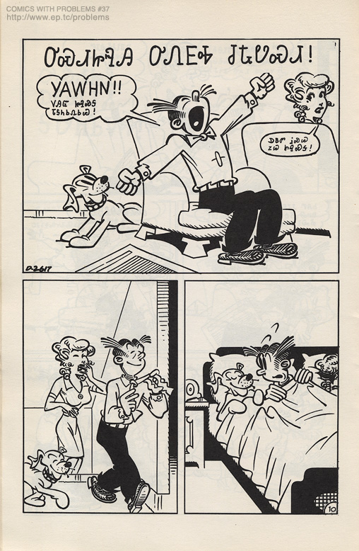
ᏅᎩᏍᎪᎯᏁ ᏣᎳᎩ ᎠᏕᎶᏆᏍᏗ
ᎤᏍᏗᏥᎸᎯ ᎤᏁᎬᎭ ᏧᎿᏬᏍᏗ
Yawhn!! ᏙᎯᏳ ᏥᎸᏍᎦ ᏓᎦᏂᏏᏁᏏᏊ!
ᎠᏴᏛ ᎥᏍᏊ ᏃᏊ ᏥᎸᏍᎦ!

Slide 5
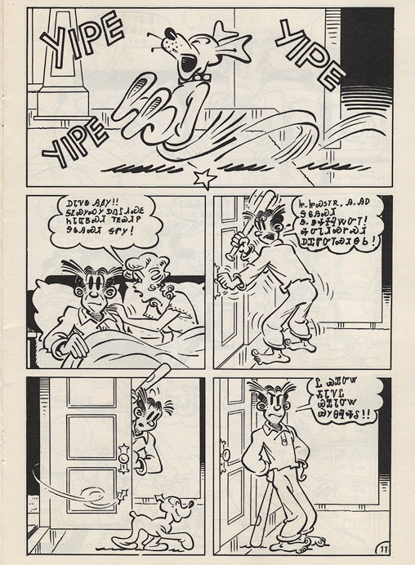
ᏅᎩᏍᎪᎯᏁ ᏣᎳᎩ ᎠᏕᎶᏆᏍᏗ
ᎠᏓᏤᏫ ᎯᏰᎩ!!
ᎦᏃᏍᎩᏍᎩ ᎠᏁᎵᏗᏍᎬ ᏂᏓᏳᏴᏍᏗ ᎢᎬᏯᏗᏢ
ᎦᎶᎯᏍᏗ ᎦᏛᎩ!

Slide 6
ᏅᎩᏍᎪᎯᏁ ᏣᎳᎩ ᎠᏕᎶᏆᏍᏗ
Ꮵ..ᏥᏍᏚᎢᏒ, Ꭿ..ᎯᎠ ᎦᎶᎯᏍᏗ
Ꮥ..ᏕᎭᏐᎸᏔᏅᎢ!
ᎭᏅᏓᏗᏍᎨᏍᏗ
ᎠᏆᏛᏅᎢᏍᏗᎾᏏ!

Slide 7
ᏅᎩᏍᎪᎯᏁ ᏣᎳᎩ ᎠᏕᎶᏆᏍᏗ
Ꮭ ᏯᏆᏅᏔ ᏱᏓᏤᏝ
ᏯᏆᏓᏅᏔ ᏯᎩᎾᎸᎭᎴ!!

Slide 8
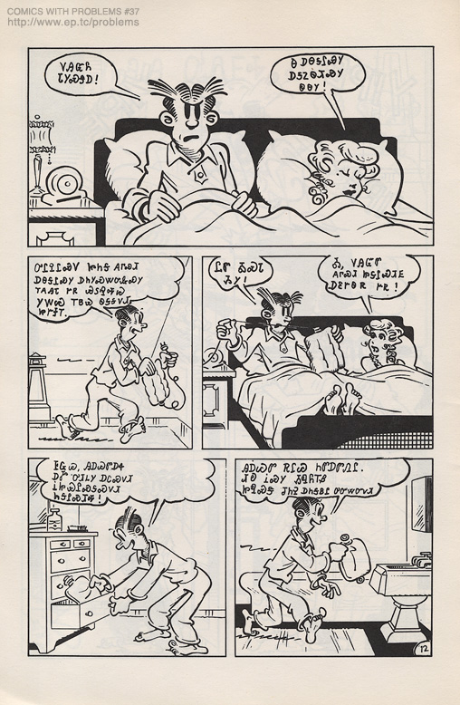
ᏅᎩᏍᎪᎯᏁ ᏣᎳᎩ ᎠᏕᎶᏆᏍᏗ
ᏙᎯᏳᏲ ᏓᎩᏍᏕᎠ!

Slide 9
ᏅᎩᏍᎪᎯᏁ ᏣᎳᎩ ᎠᏕᎶᏆᏍᏗ
Ꮎ ᎠᎾᎦᎵᏍᎩ ᎠᎦᏃᏫᏗᏍᎩ ᏫᎾᎩ!

Slide 10
ᏅᎩᏍᎪᎯᏁ ᏣᎳᎩ ᎠᏕᎶᏆᏍᏗ
ᎤᎵᎮᎵᏍᏙ ᏥᏂᎦ ᎪᎱᏍᏗ ᎠᎾᎦᎵᏍᎩ ᎠᏂᎩᏍᏔᏅᎲᏍᎩ ᎢᎪᎯᏓ ᎨᏒ ᏯᏚᎸᎭᏊ ᎩᎳᏊ ᎢᏴᏊ ᏫᎦᎦᏙᏗ ᏥᎨᏐᎢ.

Slide 11
ᏅᎩᏍᎪᎯᏁ ᏣᎳᎩ ᎠᏕᎶᏆᏍᏗ
ᏝᏛ ᎣᏍᏓ ᏱᎩ! Ꭳ, ᏙᎯᏳᏛ ᎪᎱᏍᏗ ᏥᎦᎵᏍᏗᎬ ᎠᏋᎨᏫᏒ ᎨᏒ!

Slide 12
ᏅᎩᏍᎪᎯᏁ ᏣᎳᎩ ᎠᏕᎶᏆᏍᏗ
ᎰᏩᏊ, ᎯᎠᏊᏛ ᎠᏎ ᎠᎹ ᎤᏗᏞᎩ ᎠᏟᏍᏙᏗ ᎥᏥᏯᎵᏍᎦᏍᏙᏗ ᏂᎦᎵᏍᏗᎭ!

Slide 13
ᏅᎩᏍᎪᎯᏁ ᏣᎳᎩ ᎠᏕᎶᏆᏍᏗ
ᎯᎠᏊᏛ ᎡᎵᏊ ᏂᏛᎠᏛᏁᎵ. ᏗᎧ ᎥᏍᎩ ᏱᏄᏲᎢᏰ ᏥᏄᏍᏕ ᏧᏂᎮ ᎠᏂᎦᏴᎵ ᎤᏅᏔᏅᏙᏗ.

Slide 14
ᏅᎩᏍᎪᎯᏁ ᏣᎳᎩ ᎠᏕᎶᏆᏍᏗ
Ꭳ, ᏙᎯᏳᎧᏲᎪ!
Ꮒ! ᎬᎫᏍᎨᎦ ᎤᏟ ᏫᏴᏍᏓ ᎠᏏ ᏂᏣᏚᎳᏍᏔᏃᏅᎦ ᎦᏂᏟ ᏄᎳ!!

Slide 15
ᏅᎩᏍᎪᎯᏁ ᏣᎳᎩ ᎠᏕᎶᏆᏍᏗ
Ꭳ, ᎠᏓᏤᏫ ᎭᏓᏅᏖᎯᎶᏣ, ᎣᏍᏓᏰᏃ ᎤᏅᏥᏓ ᏣᏝ ᎲᏓ!!

Slide 16
ᏅᎩᏍᎪᎯᏁ ᏣᎳᎩ ᎠᏕᎶᏆᏍᏗ
ᏥᏩᏔ! Ꮎ ᎠᎾᎦᎵᏍᎩ ᎠᏓᏍᏓᏴᏙᏗ, ᏯᏊᏓᎸᎾ ᎤᎦᎾᏩᏊ ᏱᎾᏋᏁᎳ!!
Ꭳ, Ꮭ!

Slide 17
ᏅᎩᏍᎪᎯᏁ ᏣᎳᎩ ᎠᏕᎶᏆᏍᏗ
ᎠᏎᏃ, ᎤᏍᏗᏥᎸᎯ! ᏞᏍᏗ ᏗᏣᎳᏏᏕᎾ ᎤᎿ ᏗᏣᎳᏛᎢ!! ᏫᎯᏗᎦ ᏫᏣᏴᎲᎢ, ᎠᏓᏍᏓᏴᏗᎢ!!!

Slide 18
ᏅᎩᏍᎪᎯᏁ ᏣᎳᎩ ᎠᏕᎶᏆᏍᏗ
ᏙᎯᏳᎧᏲ ᏳᎵᎮᎵᏍᏗ ᎯᎠ ᏱᎾᏆᏛᏁᎳ ᎥᏍᎩᏛ ᏂᏓᎦᏛᏁᎵ…..

Slide 19
ᏅᎩᏍᎪᎯᏁ ᏣᎳᎩ ᎠᏕᎶᏆᏍᏗ
ᎯᎸᏍᎩᏛ ᏄᏓᎴᎠ ᎢᎦᎬᏁᏗ ᏪᏌ ᎦᏁᎦᎵᏗ ᏧᏛᏁ, ᎩᏟᎴᎧ ᏧᎾᏝᎢ ᎨᏎᎢ.

Slide 20
ᏅᎩᏍᎪᎯᏁ ᏣᎳᎩ ᎠᏕᎶᏆᏍᏗ

