Slide 1
ᎣᏏᏲ
ᏅᎩᏍᎪ ᏌᏊᎯᏁ ᏣᎳᎩ ᎠᏕᎶᏆᏍᏗ

Slide 2
ᏅᎩᏍᎪ ᏌᏊᎯᏁ ᏣᎳᎩ ᎠᏕᎶᏆᏍᏗ
ᎢᏓᎴᎾ- Let’s begin
ᏣᎳᎩ ᎢᏗᏬᏂ- Let’s talk Cherokee

Slide 3
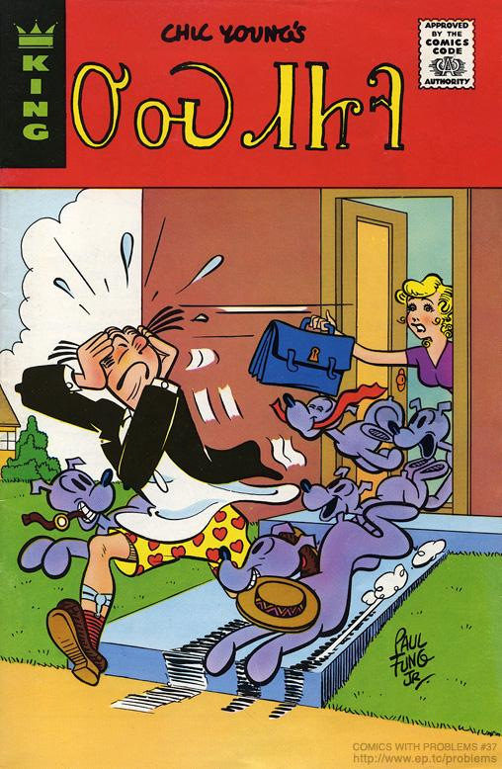
ᏅᎩᏍᎪ ᏌᏊᎯᏁ ᏣᎳᎩ ᎠᏕᎶᏆᏍᏗ
ᎤᏍᏗᏥᎸ
1975

Slide 4
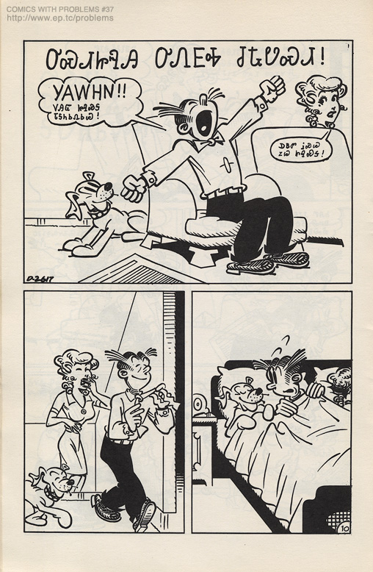
ᏅᎩᏍᎪ ᏌᏊᎯᏁ ᏣᎳᎩ ᎠᏕᎶᏆᏍᏗ
ᎤᏍᏗᏥᎸᎯ ᎤᏁᎬᎭ ᏧᎿᏬᏍᏗ
Yawhn!! ᏙᎯᏳ ᏥᎸᏍᎦ ᏓᎦᏂᏏᏁᏏᏊ!
ᎠᏴᏛ ᎥᏍᏊ ᏃᏊ ᏥᎸᏍᎦ!

Slide 5
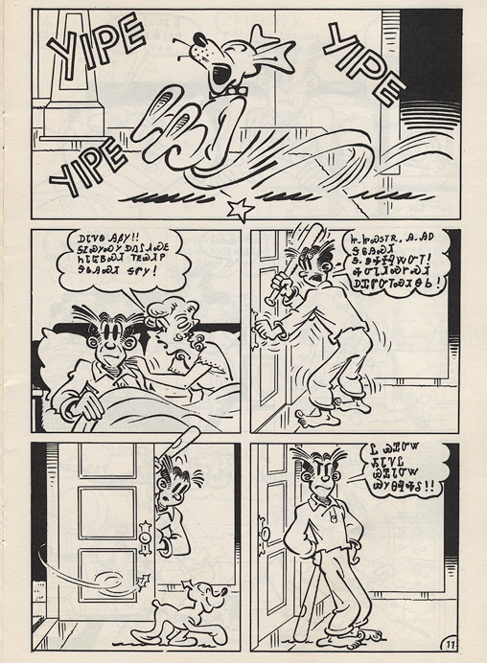
ᏅᎩᏍᎪ ᏌᏊᎯᏁ ᏣᎳᎩ ᎠᏕᎶᏆᏍᏗ
ᎠᏓᏤᏫ ᎯᏰᎩ!!
ᎦᏃᏍᎩᏍᎩ ᎠᏁᎵᏗᏍᎬ ᏂᏓᏳᏴᏍᏗ ᎢᎬᏯᏗᏢ
ᎦᎶᎯᏍᏗ ᎦᏛᎩ!

Slide 6
ᏅᎩᏍᎪ ᏌᏊᎯᏁ ᏣᎳᎩ ᎠᏕᎶᏆᏍᏗ
Ꮵ..ᏥᏍᏚᎢᏒ, Ꭿ..ᎯᎠ ᎦᎶᎯᏍᏗ
Ꮥ..ᏕᎭᏐᎸᏔᏅᎢ!
ᎭᏅᏓᏗᏍᎨᏍᏗ
ᎠᏆᏛᏅᎢᏍᏗᎾᏏ!

Slide 7
ᏅᎩᏍᎪ ᏌᏊᎯᏁ ᏣᎳᎩ ᎠᏕᎶᏆᏍᏗ
Ꮭ ᏯᏆᏅᏔ ᏱᏓᏤᏝ
ᏯᏆᏓᏅᏔ ᏯᎩᎾᎸᎭᎴ!!

Slide 8
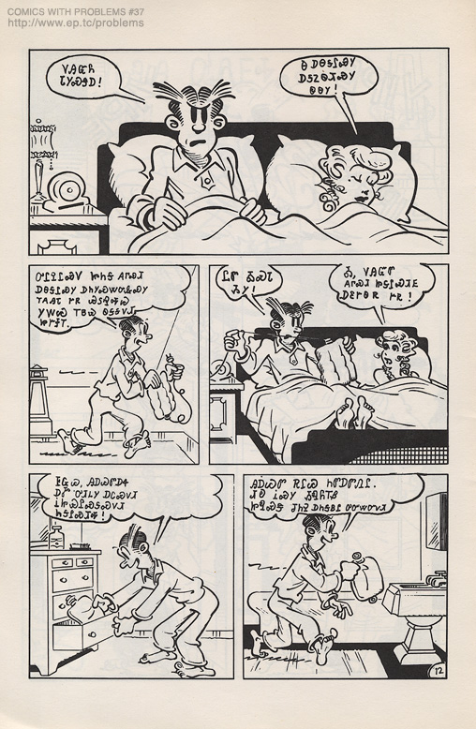
ᏅᎩᏍᎪ ᏌᏊᎯᏁ ᏣᎳᎩ ᎠᏕᎶᏆᏍᏗ
ᏙᎯᏳᏲ ᏓᎩᏍᏕᎠ!

Slide 9
ᏅᎩᏍᎪ ᏌᏊᎯᏁ ᏣᎳᎩ ᎠᏕᎶᏆᏍᏗ
Ꮎ ᎠᎾᎦᎵᏍᎩ ᎠᎦᏃᏫᏗᏍᎩ ᏫᎾᎩ!

Slide 10
ᏅᎩᏍᎪ ᏌᏊᎯᏁ ᏣᎳᎩ ᎠᏕᎶᏆᏍᏗ
ᎤᎵᎮᎵᏍᏙ ᏥᏂᎦ ᎪᎱᏍᏗ ᎠᎾᎦᎵᏍᎩ ᎠᏂᎩᏍᏔᏅᎲᏍᎩ ᎢᎪᎯᏓ ᎨᏒ ᏯᏚᎸᎭᏊ ᎩᎳᏊ ᎢᏴᏊ ᏫᎦᎦᏙᏗ ᏥᎨᏐᎢ.

Slide 11
ᏅᎩᏍᎪ ᏌᏊᎯᏁ ᏣᎳᎩ ᎠᏕᎶᏆᏍᏗ
ᏝᏛ ᎣᏍᏓ ᏱᎩ! Ꭳ, ᏙᎯᏳᏛ ᎪᎱᏍᏗ ᏥᎦᎵᏍᏗᎬ ᎠᏋᎨᏫᏒ ᎨᏒ!

Slide 12
ᏅᎩᏍᎪ ᏌᏊᎯᏁ ᏣᎳᎩ ᎠᏕᎶᏆᏍᏗ
ᎰᏩᏊ, ᎯᎠᏊᏛ ᎠᏎ ᎠᎹ ᎤᏗᏞᎩ ᎠᏟᏍᏙᏗ ᎥᏥᏯᎵᏍᎦᏍᏙᏗ ᏂᎦᎵᏍᏗᎭ!

Slide 13
ᏅᎩᏍᎪ ᏌᏊᎯᏁ ᏣᎳᎩ ᎠᏕᎶᏆᏍᏗ
ᎯᎠᏊᏛ ᎡᎵᏊ ᏂᏛᎠᏛᏁᎵ. ᏗᎧ ᎥᏍᎩ ᏱᏄᏲᎢᏰ ᏥᏄᏍᏕ ᏧᏂᎮ ᎠᏂᎦᏴᎵ ᎤᏅᏔᏅᏙᏗ.

Slide 14
ᏅᎩᏍᎪ ᏌᏊᎯᏁ ᏣᎳᎩ ᎠᏕᎶᏆᏍᏗ
Ꭳ, ᏙᎯᏳᎧᏲᎪ!
Ꮒ! ᎬᎫᏍᎨᎦ ᎤᏟ ᏫᏴᏍᏓ ᎠᏏ ᏂᏣᏚᎳᏍᏔᏃᏅᎦ ᎦᏂᏟ ᏄᎳ!!

Slide 15
ᏅᎩᏍᎪ ᏌᏊᎯᏁ ᏣᎳᎩ ᎠᏕᎶᏆᏍᏗ
Ꭳ, ᎠᏓᏤᏫ ᎭᏓᏅᏖᎯᎶᏣ, ᎣᏍᏓᏰᏃ ᎤᏅᏥᏓ ᏣᏝ ᎲᏓ!!

Slide 16
ᏅᎩᏍᎪ ᏌᏊᎯᏁ ᏣᎳᎩ ᎠᏕᎶᏆᏍᏗ
ᏥᏩᏔ! Ꮎ ᎠᎾᎦᎵᏍᎩ ᎠᏓᏍᏓᏴᏙᏗ, ᏯᏊᏓᎸᎾ ᎤᎦᎾᏩᏊ ᏱᎾᏋᏁᎳ!!
Ꭳ, Ꮭ!

Slide 17
ᏅᎩᏍᎪ ᏌᏊᎯᏁ ᏣᎳᎩ ᎠᏕᎶᏆᏍᏗ
ᎠᏎᏃ, ᎤᏍᏗᏥᎸᎯ! ᏞᏍᏗ ᏗᏣᎳᏏᏕᎾ ᎤᎿ ᏗᏣᎳᏛᎢ!! ᏫᎯᏗᎦ ᏫᏣᏴᎲᎢ, ᎠᏓᏍᏓᏴᏗᎢ!!!

Slide 18
ᏅᎩᏍᎪ ᏌᏊᎯᏁ ᏣᎳᎩ ᎠᏕᎶᏆᏍᏗ
ᏙᎯᏳᎧᏲ ᏳᎵᎮᎵᏍᏗ ᎯᎠ ᏱᎾᏆᏛᏁᎳ ᎥᏍᎩᏛ ᏂᏓᎦᏛᏁᎵ…..

Slide 19
ᏅᎩᏍᎪ ᏌᏊᎯᏁ ᏣᎳᎩ ᎠᏕᎶᏆᏍᏗ
ᎯᎸᏍᎩᏛ ᏄᏓᎴᎠ ᎢᎦᎬᏁᏗ ᏪᏌ ᎦᏁᎦᎵᏗ ᏧᏛᏁ, ᎩᏟᎴᎧ ᏧᎾᏝᎢ ᎨᏎᎢ.

Slide 20
ᏅᎩᏍᎪ ᏌᏊᎯᏁ ᏣᎳᎩ ᎠᏕᎶᏆᏍᏗ

