Slide 1
ᎣᏏᏲ
ᏅᎩᏍᎪ ᏦᎢᏁ ᏣᎳᎩ ᎠᏕᎶᏆᏍᏗ

Slide 2
ᏅᎩᏍᎪ ᏦᎢᏁ ᏣᎳᎩ ᎠᏕᎶᏆᏍᏗ
ᎢᏓᎴᎾ- Let’s begin
ᏣᎳᎩ ᎢᏗᏬᏂ- Let’s talk Cherokee

Slide 3
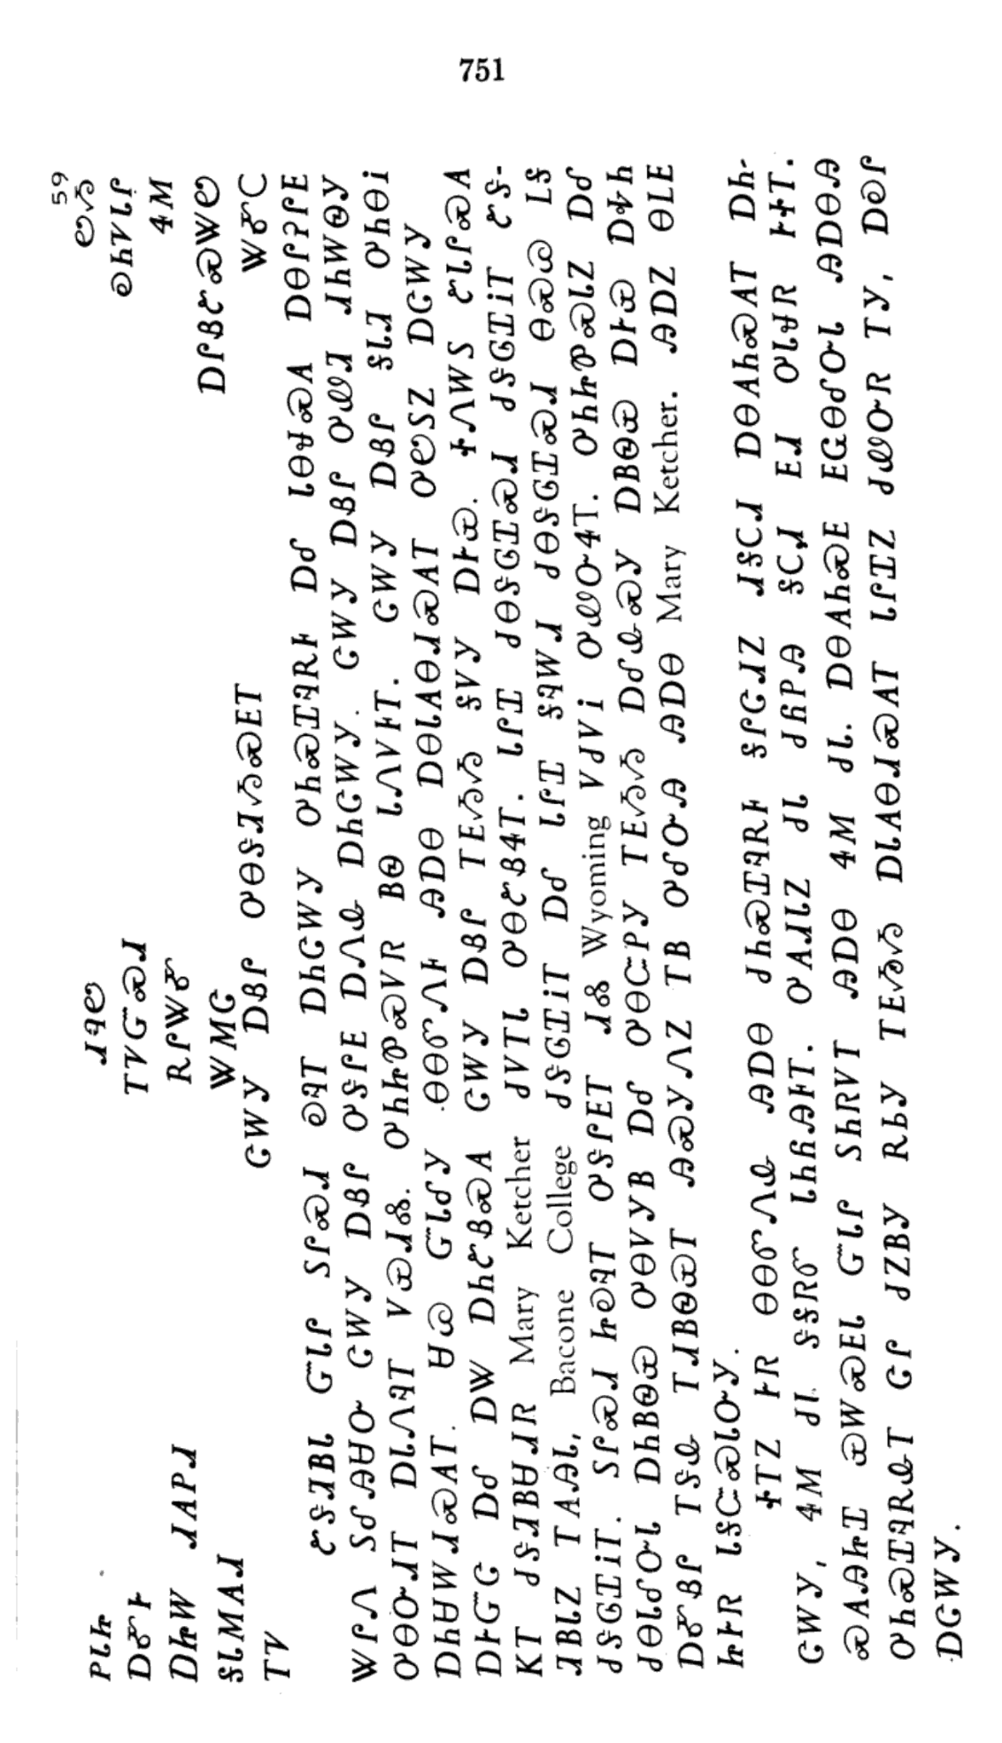
ᏅᎩᏍᎪ ᏦᎢᏁ ᏣᎳᎩ ᎠᏕᎶᏆᏍᏗ

Slide 4
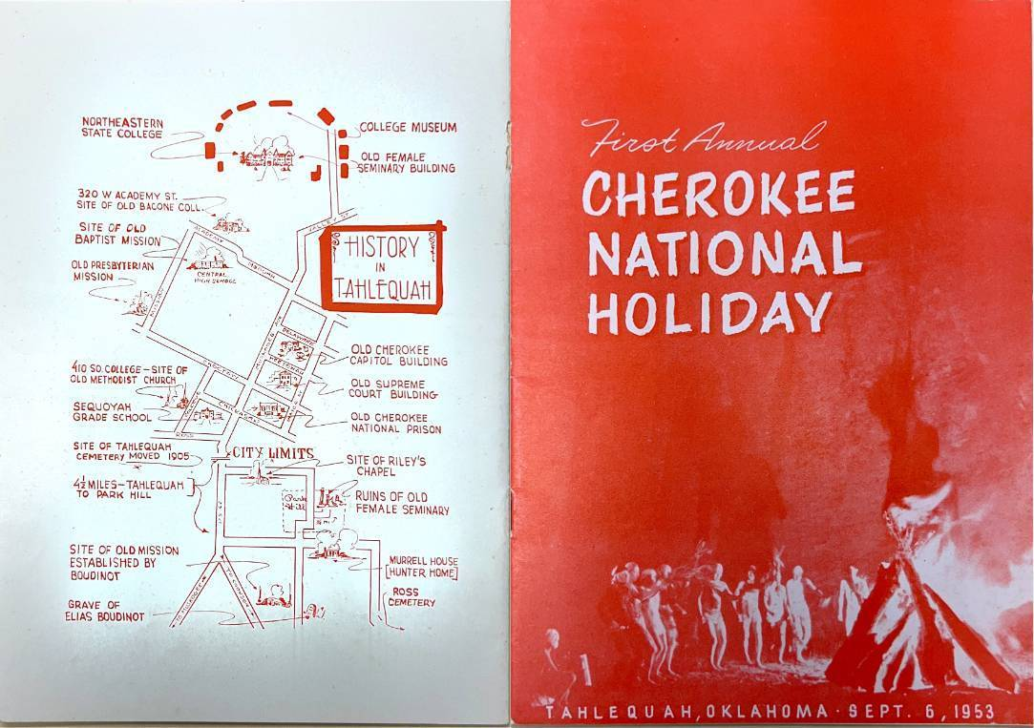
ᏅᎩᏍᎪ ᏦᎢᏁ ᏣᎳᎩ ᎠᏕᎶᏆᏍᏗ
ᏣᎳᎩ ᎠᏰᎵ ᎤᎾᏕᏘᏱᏍᎬᎢ

Slide 5
ᏅᎩᏍᎪ ᏦᎢᏁ ᏣᎳᎩ ᎠᏕᎶᏆᏍᏗ
ᏑᏕᏘᏴᏓ ᏳᏓᎵ ᏚᎵᏍᏗ ᎧᎸᎢ ᎠᏂᏣᎳᎩ ᎤᏂᏍᏆᎸᎡᎰ ᎠᎴ ᏓᎾᏠᏍᎪ ᎠᎾᎵᎮᎵᎬ ᏔᎵᏁ ᏚᎴᎯᏌᏅ ᏣᎳᎩ ᎠᏰᎵ ᎤᏕᎵᎬ ᎠᏁᎲ ᎠᏂᏣᎳᎩ.

Slide 6
ᏅᎩᏍᎪ ᏦᎢᏁ ᏣᎳᎩ ᎠᏕᎶᏆᏍᏗ
ᏣᎳᎩ ᎠᏰᎵ ᎤᏪᏘ ᏗᏂᎳᏫᎩ ᎤᎾᏅᏗᎢ ᎠᏓᏁᎸᎢ ᏙᏯᏗᏜ.

Slide 7
ᏅᎩᏍᎪ ᏦᎢᏁ ᏣᎳᎩ ᎠᏕᎶᏆᏍᏗ
ᎤᏂᏥᏈᏍᏙᏒ ᏴᏫ ᏓᏁᏙᎲᎢ.

Slide 8
ᏅᎩᏍᎪ ᏦᎢᏁ ᏣᎳᎩ ᎠᏕᎶᏆᏍᏗ
ᏣᎳᎩ ᎠᏰᎵ ᎦᏓᏘ ᎤᏂᎾᎥ ᎠᏂᏌᎳᏗᏍᎪᎢ.

Slide 9
ᏅᎩᏍᎪ ᏦᎢᏁ ᏣᎳᎩ ᎠᏕᎶᏆᏍᏗ
ᏌᏊ ᏳᏓᎴᎩ ᎾᎾᏛᏁᎰ ᎯᎠᎾ ᎠᎾᏓᎪᎾᏗᏍᎪᎢ ᎤᏬᏚᏃ ᎠᏣᎳᎩ ᎠᎨᏳᏣ ᎠᎴ ᎠᏔ ᎠᏂᏑᏰᏍᎪ ᏣᎳᎩ ᎠᏰᎵ ᎢᎬᏱᏱ ᎦᏙᎩ ᎠᎨᏯ.

Slide 10
ᏅᎩᏍᎪ ᏦᎢᏁ ᏣᎳᎩ ᎠᏕᎶᏆᏍᏗ
ᏐᏁᎳᏚ ᏑᏓᎵᏍᎪ ᏦᎢ ᏧᏕᏘᏴᏌᏗᏒ Mary Ketcher ᏧᏙᎢᏓ ᎤᎾᏑᏰᏎᎢ.

Slide 11
ᏅᎩᏍᎪ ᏦᎢᏁ ᏣᎳᎩ ᎠᏕᎶᏆᏍᏗ
ᏓᎵᏆ ᏧᎾᏕᎶᏆᏍᏗ ᏧᏕᎶᏆᎥᎢ ᏑᏕᏘᏴᏓᏃ ᎢᎪᎯᏓ, Bacone College ᏧᏕᎶᏆᎥᎢ ᎠᎴ ᏓᎵᏆ ᎦᎸᎳᏗ ᏧᎾᏕᎶᏆᏍᏗ ᎾᏍᏊ ᏞᎦ ᏧᏕᎶᏆᎥᎢ.

Slide 12
ᏅᎩᏍᎪ ᏦᎢᏁ ᏣᎳᎩ ᎠᏕᎶᏆᏍᏗ
ᏚᎵᏍᏗ ᏥᎧᎸᎢ ᎤᏕᎵᎬᎢ ᏗᏜ Wyoming ᏙᏧᏙᎥ ᎤᏪᏅᏎᎢ.

Slide 13
ᏅᎩᏍᎪ ᏦᎢᏁ ᏣᎳᎩ ᎠᏕᎶᏆᏍᏗ
ᎤᏂᏥᏈᏍᏓᏃ ᎠᎴ ᏧᎾᏓᎴᏅᏓ ᎠᏂᏴᏫᏯ ᎤᎾᏙᎩᏴ ᎠᎴ ᎤᎾᏨᏢᎩ ᎢᎬᏱᏱ ᎠᎴᎲᏍᎩ ᎠᏴᏫᏯ ᎠᎨᏯ ᎠᎭᏂ ᎠᎹᏰᎵ ᎢᏕᎲ ᎢᏗᏴᏫᏯᎢ ᎯᏍᎩᏁᏃ ᎢᏴ ᎤᎴᏅᎯ ᎯᎠᎾ Mary Ketcher.

Slide 14
ᏅᎩᏍᎪ ᏦᎢᏁ ᏣᎳᎩ ᎠᏕᎶᏆᏍᏗ
ᎯᎠᏃ ᎾᏞᎬ ᏥᎨᏒ ᏓᎦᏨᏍᏓᏅᎩ.

Slide 15
ᏅᎩᏍᎪ ᏦᎢᏁ ᏣᎳᎩ ᎠᏕᎶᏆᏍᏗ
ᏐᎢᏃ ᎨᏒ ᎾᎾᏛᏁᎲ ᎯᎠᎾ ᏧᏂᏍᏆᎸᎡᎰ ᎦᎵᏣᏗᏃ ᏗᎦᏟᏗ ᎠᎾᎪᏂᏍᎪᎢ ᎠᏂᏣᎳᎩ, ᏎᎷ ᏧᏓ ᏕᎦᏒᏛ ᏓᏂᏲᎯᎰᎢ.

Slide 16
ᏅᎩᏍᎪ ᏦᎢᏁ ᏣᎳᎩ ᎠᏕᎶᏆᏍᏗ
ᎤᎪᏗᏓᏃ ᏧᏓ ᏧᏲᏢᎯ ᎦᏟᏗ ᎬᏗ ᎤᏓᏠᏒ ᎨᏐᎢ.

Slide 17
ᏅᎩᏍᎪ ᏦᎢᏁ ᏣᎳᎩ ᎠᏕᎶᏆᏍᏗ
ᏍᎪᎯᏥᏆ ᏯᎳᏍᎬᏓ ᏳᏓᎵ ᏚᏂᏒᏙᎢ ᎯᎠᎾ ᏎᎷ ᏧᏓ.

Slide 18
ᏅᎩᏍᎪ ᏦᎢᏁ ᏣᎳᎩ ᎠᏕᎶᏆᏍᏗ
ᎠᎾᎪᏂᏍᎬ ᎬᏩᎾᎴᏅᏓ ᎯᎠᎾᎯ ᎤᏂᏍᏆᎸᎡᎲᎢ ᏣᎵ ᏧᏃᏴᎩ ᎡᏏᎩ ᎢᎬᏱᏱ ᎠᏓᎪᎾᏗᏍᎪᎢ ᏓᎵᏆᏃ ᏧᏪᏅᏒ ᎢᎩ, ᎠᎧᎵ ᎠᏣᎳᎩ.

