Slide 1
ᎣᏏᏲ
ᏅᎩᏍᎪ ᏅᎩᏁ ᏣᎳᎩ ᎠᏕᎶᏆᏍᏗ

Slide 2
ᏅᎩᏍᎪ ᏅᎩᏁ ᏣᎳᎩ ᎠᏕᎶᏆᏍᏗ
ᎢᏓᎴᎾ- Let’s begin
ᏣᎳᎩ ᎢᏗᏬᏂ- Let’s talk Cherokee

Slide 3
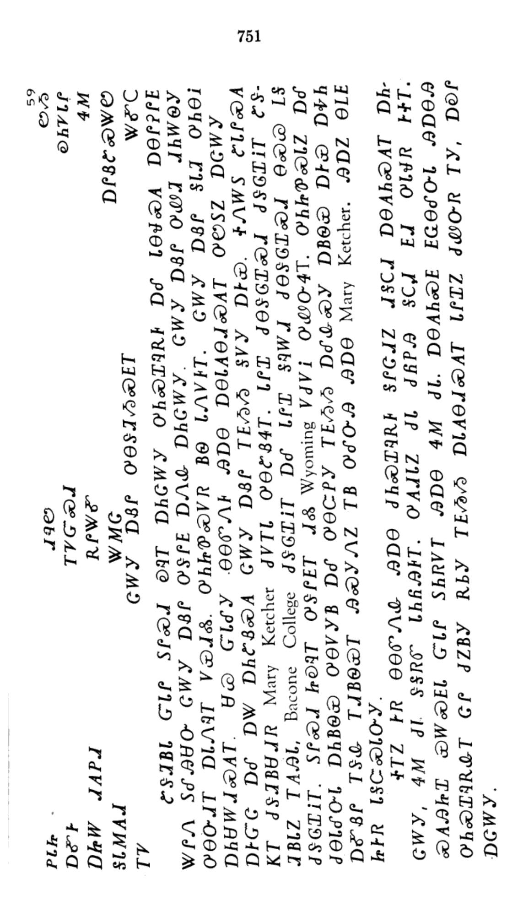
ᏅᎩᏍᎪ ᏅᎩᏁ ᏣᎳᎩ ᎠᏕᎶᏆᏍᏗ

Slide 4
ᏅᎩᏍᎪ ᏅᎩᏁ ᏣᎳᎩ ᎠᏕᎶᏆᏍᏗ
ᏣᎳᎩ ᎠᏰᎵ ᎤᎾᏕᏘᏱᏍᎬᎢ

Slide 5
ᏅᎩᏍᎪ ᏅᎩᏁ ᏣᎳᎩ ᎠᏕᎶᏆᏍᏗ
ᏑᏕᏘᏴᏓ ᏳᏓᎵ ᏚᎵᏍᏗ ᎧᎸᎢ ᎠᏂᏣᎳᎩ ᎤᏂᏍᏆᎸᎡᎰ ᎠᎴ ᏓᎾᏠᏍᎪ ᎠᎾᎵᎮᎵᎬ ᏔᎵᏁ ᏚᎴᎯᏌᏅ ᏣᎳᎩ ᎠᏰᎵ ᎤᏕᎵᎬ ᎠᏁᎲ ᎠᏂᏣᎳᎩ.

Slide 6
ᏅᎩᏍᎪ ᏅᎩᏁ ᏣᎳᎩ ᎠᏕᎶᏆᏍᏗ
ᏣᎳᎩ ᎠᏰᎵ ᎤᏪᏘ ᏗᏂᎳᏫᎩ ᎤᎾᏅᏗᎢ ᎠᏓᏁᎸᎢ ᏙᏯᏗᏜ.

Slide 7
ᏅᎩᏍᎪ ᏅᎩᏁ ᏣᎳᎩ ᎠᏕᎶᏆᏍᏗ
ᎤᏂᏥᏈᏍᏙᏒ ᏴᏫ ᏓᏁᏙᎰᎢ.

Slide 8
ᏅᎩᏍᎪ ᏅᎩᏁ ᏣᎳᎩ ᎠᏕᎶᏆᏍᏗ
ᏣᎳᎩ ᎠᏰᎵ ᎦᏓᏘ ᎤᏂᎾᎥ ᎠᏂᏌᎳᏗᏍᎪᎢ.

Slide 9
ᏅᎩᏍᎪ ᏅᎩᏁ ᏣᎳᎩ ᎠᏕᎶᏆᏍᏗ
ᏌᏊ ᏳᏓᎴᎩ ᎾᎾᏛᏁᎰ ᎯᎠᎾ ᎠᎾᏓᎪᎾᏗᏍᎪᎢ ᎤᏬᏚᏃ ᎠᏣᎳᎩ ᎠᎨᏳᏣ ᎠᎴ ᎠᏔ ᎠᏂᏑᏰᏍᎪ ᏣᎳᎩ ᎠᏰᎵ ᎢᎬᏱᏱ ᎦᏙᎩ ᎠᎨᏯ.

Slide 10
ᏅᎩᏍᎪ ᏅᎩᏁ ᏣᎳᎩ ᎠᏕᎶᏆᏍᏗ
ᏐᏁᎳᏚ ᏑᏓᎵᏍᎪ ᏦᎢ ᏧᏕᏘᏴᏌᏗᏒ Mary Ketcher ᏧᏙᎢᏓ ᎤᎾᏑᏰᏎᎢ.

Slide 11
ᏅᎩᏍᎪ ᏅᎩᏁ ᏣᎳᎩ ᎠᏕᎶᏆᏍᏗ
ᏓᎵᏆ ᏧᎾᏕᎶᏆᏍᏗ ᏧᏕᎶᏆᎥᎢ ᏑᏕᏘᏴᏓᏃ ᎢᎪᎯᏓ, Bacone College ᏧᏕᎶᏆᎥᎢ ᎠᎴ ᏓᎵᏆ ᎦᎸᎳᏗ ᏧᎾᏕᎶᏆᏍᏗ ᎾᏍᏊ ᏞᎦ ᏧᏕᎶᏆᎥᎢ.

Slide 12
ᏅᎩᏍᎪ ᏅᎩᏁ ᏣᎳᎩ ᎠᏕᎶᏆᏍᏗ
ᏚᎵᏍᏗ ᏥᎧᎸᎢ ᎤᏕᎵᎬᎢ ᏗᏜ Wyoming ᏙᏧᏙᎥ ᎤᏪᏅᏎᎢ.

Slide 13
ᏅᎩᏍᎪ ᏅᎩᏁ ᏣᎳᎩ ᎠᏕᎶᏆᏍᏗ
ᎤᏂᏥᏈᏍᏓᏃ ᎠᎴ ᏧᎾᏓᎴᏅᏓ ᎠᏂᏴᏫᏯ ᎤᎾᏙᎩᏴ ᎠᎴ ᎤᎾᏨᏢᎩ ᎢᎬᏱᏱ ᎠᎴᎲᏍᎩ ᎠᏴᏫᏯ ᎠᎨᏯ ᎠᎭᏂ ᎠᎹᏰᎵ ᎢᏕᎲ ᎢᏗᏴᏫᏯᎢ ᎯᏍᎩᏁᏃ ᎢᏴ ᎤᎴᏅᎯ ᎯᎠᎾ Mary Ketcher.

Slide 14
ᏅᎩᏍᎪ ᏅᎩᏁ ᏣᎳᎩ ᎠᏕᎶᏆᏍᏗ
ᎯᎠᏃ ᎾᏞᎬ ᏥᎨᏒ ᏓᎦᏨᏍᏓᏅᎩ.

Slide 15
ᏅᎩᏍᎪ ᏅᎩᏁ ᏣᎳᎩ ᎠᏕᎶᏆᏍᏗ
ᏐᎢᏃ ᎨᏒ ᎾᎾᏛᏁᎲ ᎯᎠᎾ ᏧᏂᏍᏆᎸᎡᎰ ᎦᎵᏣᏗᏃ ᏗᎦᏟᏗ ᎠᎾᎪᏂᏍᎪᎢ ᎠᏂᏣᎳᎩ, ᏎᎷ ᏧᏓ ᏕᎦᏒᏛ ᏓᏂᏲᎯᎰᎢ.

Slide 16
ᏅᎩᏍᎪ ᏅᎩᏁ ᏣᎳᎩ ᎠᏕᎶᏆᏍᏗ
ᎤᎪᏗᏓᏃ ᏧᏓ ᏧᏲᏢᎯ ᎦᏟᏗ ᎬᏗ ᎤᏓᏠᏒ ᎨᏐᎢ.

Slide 17
ᏅᎩᏍᎪ ᏅᎩᏁ ᏣᎳᎩ ᎠᏕᎶᏆᏍᏗ
ᏍᎪᎯᏥᏆ ᏯᎳᏍᎬᏓ ᏳᏓᎵ ᏚᏂᏒᏙᎢ ᎯᎠᎾ ᏎᎷ ᏧᏓ.

Slide 18
ᏅᎩᏍᎪ ᏅᎩᏁ ᏣᎳᎩ ᎠᏕᎶᏆᏍᏗ
ᎠᎾᎪᏂᏍᎬ ᎬᏩᎾᎴᏅᏓ ᎯᎠᎾᎯ ᎤᏂᏍᏆᎸᎡᎲᎢ ᏣᎵ ᏧᏃᏴᎩ ᎡᏏᎩ ᎢᎬᏱᏱ ᎠᏓᎪᎾᏗᏍᎪᎢ ᏓᎵᏆᏃ ᏧᏪᏅᏒ ᎢᎩ, ᎠᎧᎵ ᎠᏣᎳᎩ.

