Slide 1
ᎣᏏᏲ
ᏅᎩᏍᎪ ᎯᏍᎩᏁ ᏣᎳᎩ ᎠᏕᎶᏆᏍᏗ

Slide 2
ᏅᎩᏍᎪ ᎯᏍᎩᏁ ᏣᎳᎩ ᎠᏕᎶᏆᏍᏗ
ᎢᏓᎴᎾ- Let’s begin
ᏣᎳᎩ ᎢᏗᏬᏂ- Let’s talk Cherokee

Slide 3
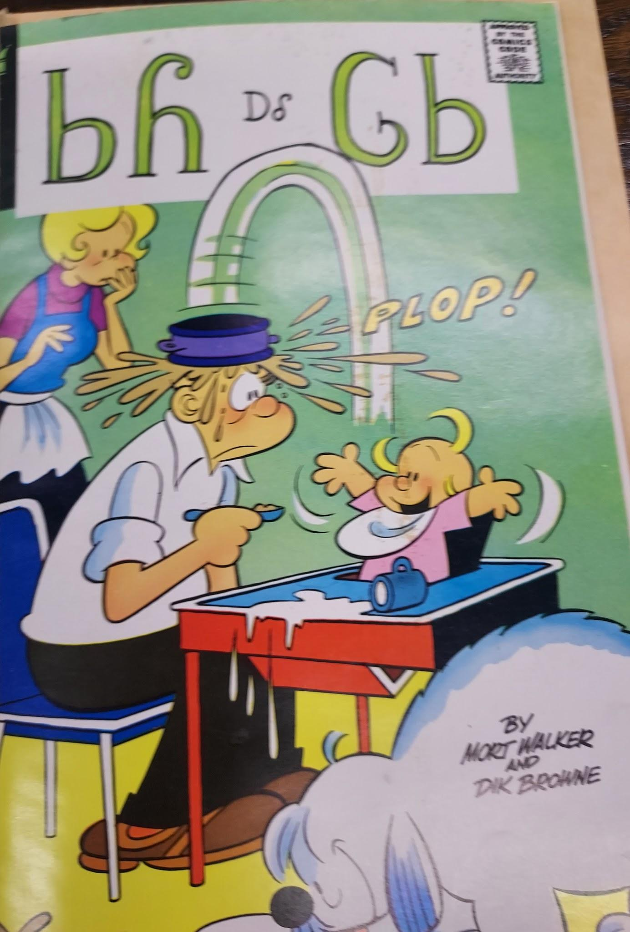
ᏅᎩᏍᎪ ᎯᏍᎩᏁ ᏣᎳᎩ ᎠᏕᎶᏆᏍᏗ
ᏏᏲ ᎠᎴ ᎶᏏ

Slide 4
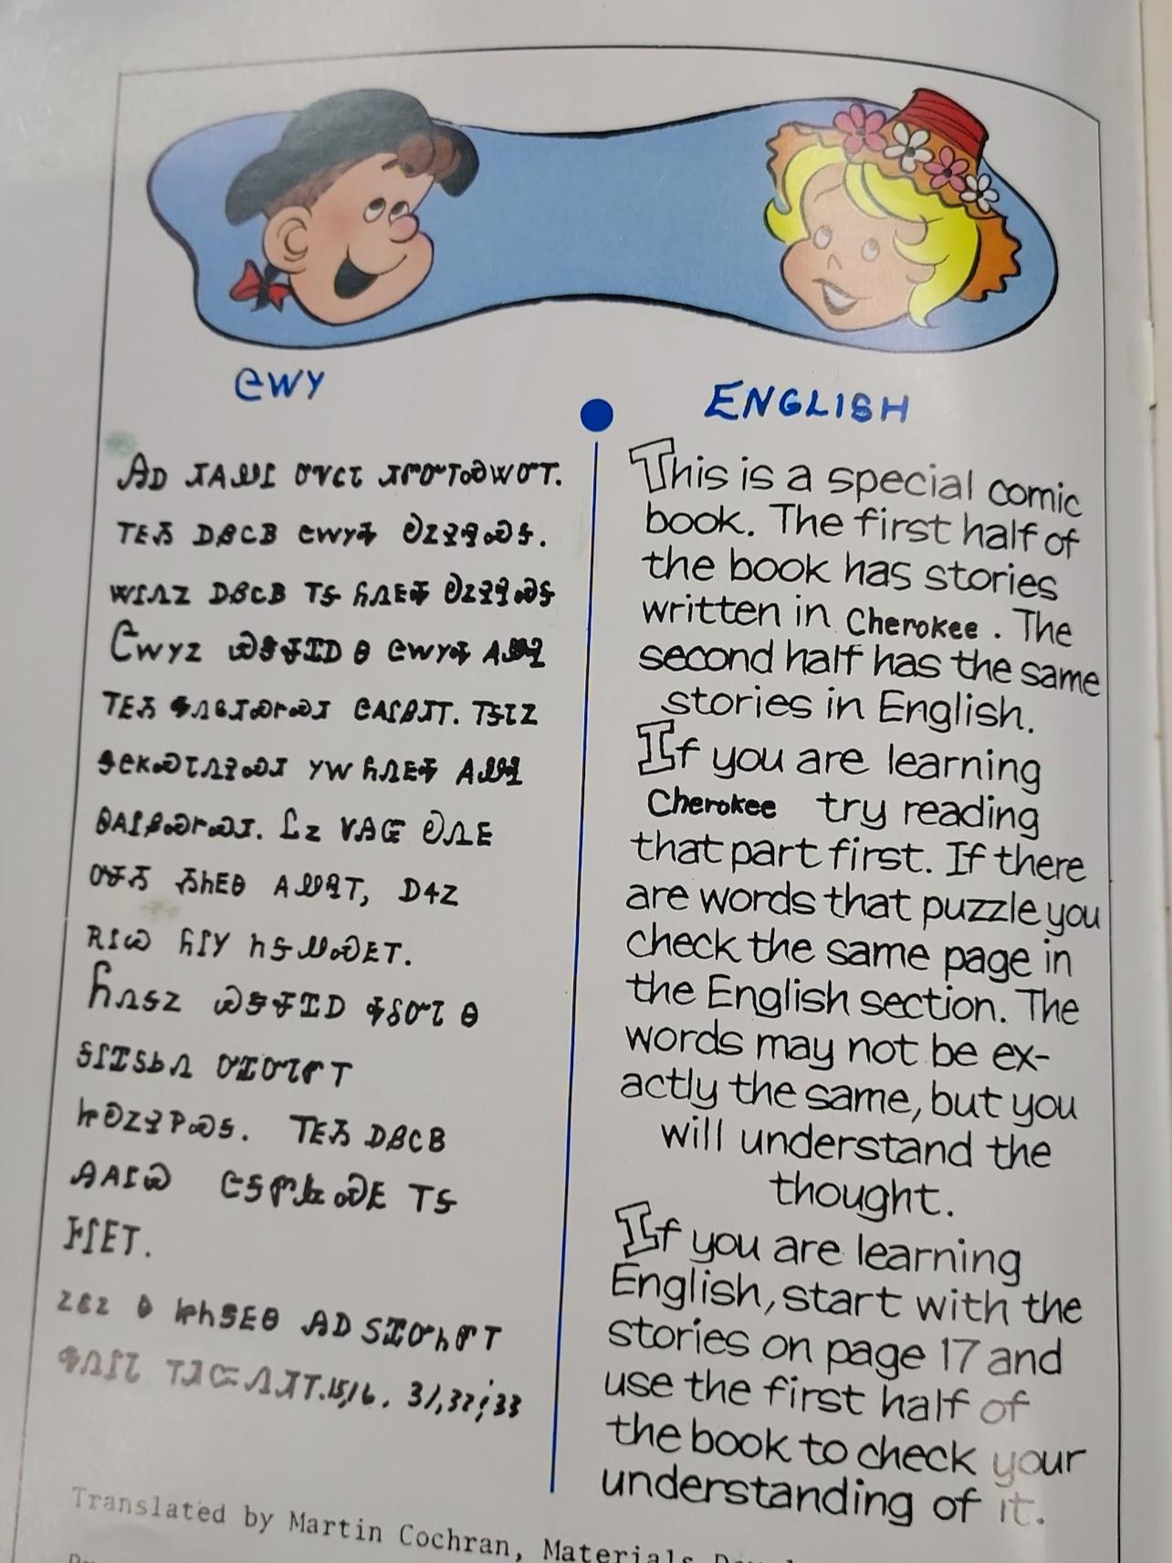
ᏅᎩᏍᎪ ᎯᏍᎩᏁ ᏣᎳᎩ ᎠᏕᎶᏆᏍᏗ
ᏣᎳᎩ
ᎯᎠ ᏗᎪᏪᎵ ᎤᏉᏟᏓ ᏗᏛᏅᎢᏍᏔᏅᎢ.ᎢᎬᏱ ᎠᏰᏟᏴ ᏣᎳᎩᎭ ᎧᏃᎮᎸᏍᎦ.ᏔᎵᏁᏃ ᎠᏰᏟᏴ ᎢᎦ ᏲᏁᎦᎭ ᎧᏃᎮᎸᏍᎦ.ᏣᎳᎩᏃ ᏯᏕᏠᏆᎠ Ꮎ ᏣᎳᎩᎭ ᎪᏪᎸ ᎢᎬᏱ ᎭᏁᎶᏗᏍᎨᏍᏗ ᏣᎪᎵᏰᏗᎢ.ᎢᎦᏓᏃ ᏕᏣᏦᏍᏓᏁᎮᏍᏗ ᎩᎳ ᏲᏁᎬᎭ ᎪᏪᎸ ᏫᎪᎵᏰᏍᎨᏍᏗ.ᏝᏃ ᏙᎯᏳ ᎧᏁᎬ ᎤᏠᏱ ᏱᏂᎬᎾ ᎪᏪᎸᎢ, ᎠᏎᏃ ᎡᎵᏊ ᏲᎵᎩ ᏂᎦᏪᏍᎬᎢ. ᏲᏁᎦᏃ ᏯᏕᏠᏆᎠ ᎭᎴᏅᏓ ᎦᎵᏆᏚᏏᏁ ᎤᏆᏅᏓᏛᎢ ᏥᎧᏃᎮᏢᏍᎦ.ᎢᎬᏱ ᎠᏰᏟᏴ ᎯᎪᎵᏯ ᏣᎦᏛᎲᏍᎬ ᎢᎦ ᎰᎵᎬᎢ. ᏃᎴᏃ Ꮎ ᏥᏂᏕᎬᎾ ᎯᎠ ᏚᏆᏅᏂᏛᎢ ᎭᏁᎵᏓ ᎢᏗᏨᏁᏗᎢ 15,16, 31,32,33 (lesson 32)

Slide 5
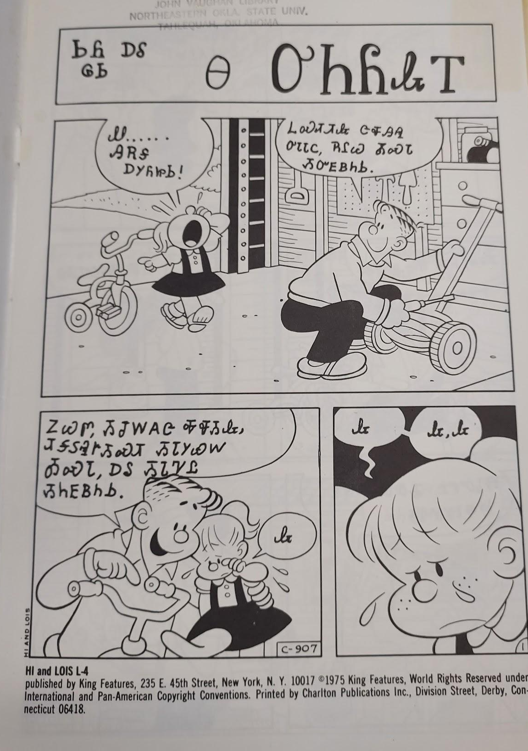
ᏅᎩᏍᎪ ᎯᏍᎩᏁ ᏣᎳᎩ ᎠᏕᎶᏆᏍᏗ
ᏏᏲ ᎠᎴ ᎶᏏ Ꮎ ᎤᏂᏲᎲᎢ
Ꮺ…..ᎯᎡᎦ ᎠᎩᏲᏥᏏ!
ᏞᏍᏗᏗᎲ ᏣᏠᎯᎸ ᎤᏓᏓᏟ, ᎡᎵᏊ ᎣᏍᏓ ᏱᏅᎬᏴᏂᏏ.
ᏃᏊᏛ, ᏱᏣᎳᎪᏣ ᎭᏠᏱᎲ, ᏗᎦᏚᎸᎨᏱᏍᏗ ᏱᏓᎩᏯᎳ ᎣᏍᏓ, ᎠᎴ ᏱᏓᏤᏝ ᏱᏂᎬᏴᏂᏏ
Ꮂ
Ꮂ
Ꮂ
Ꮂ

Slide 6
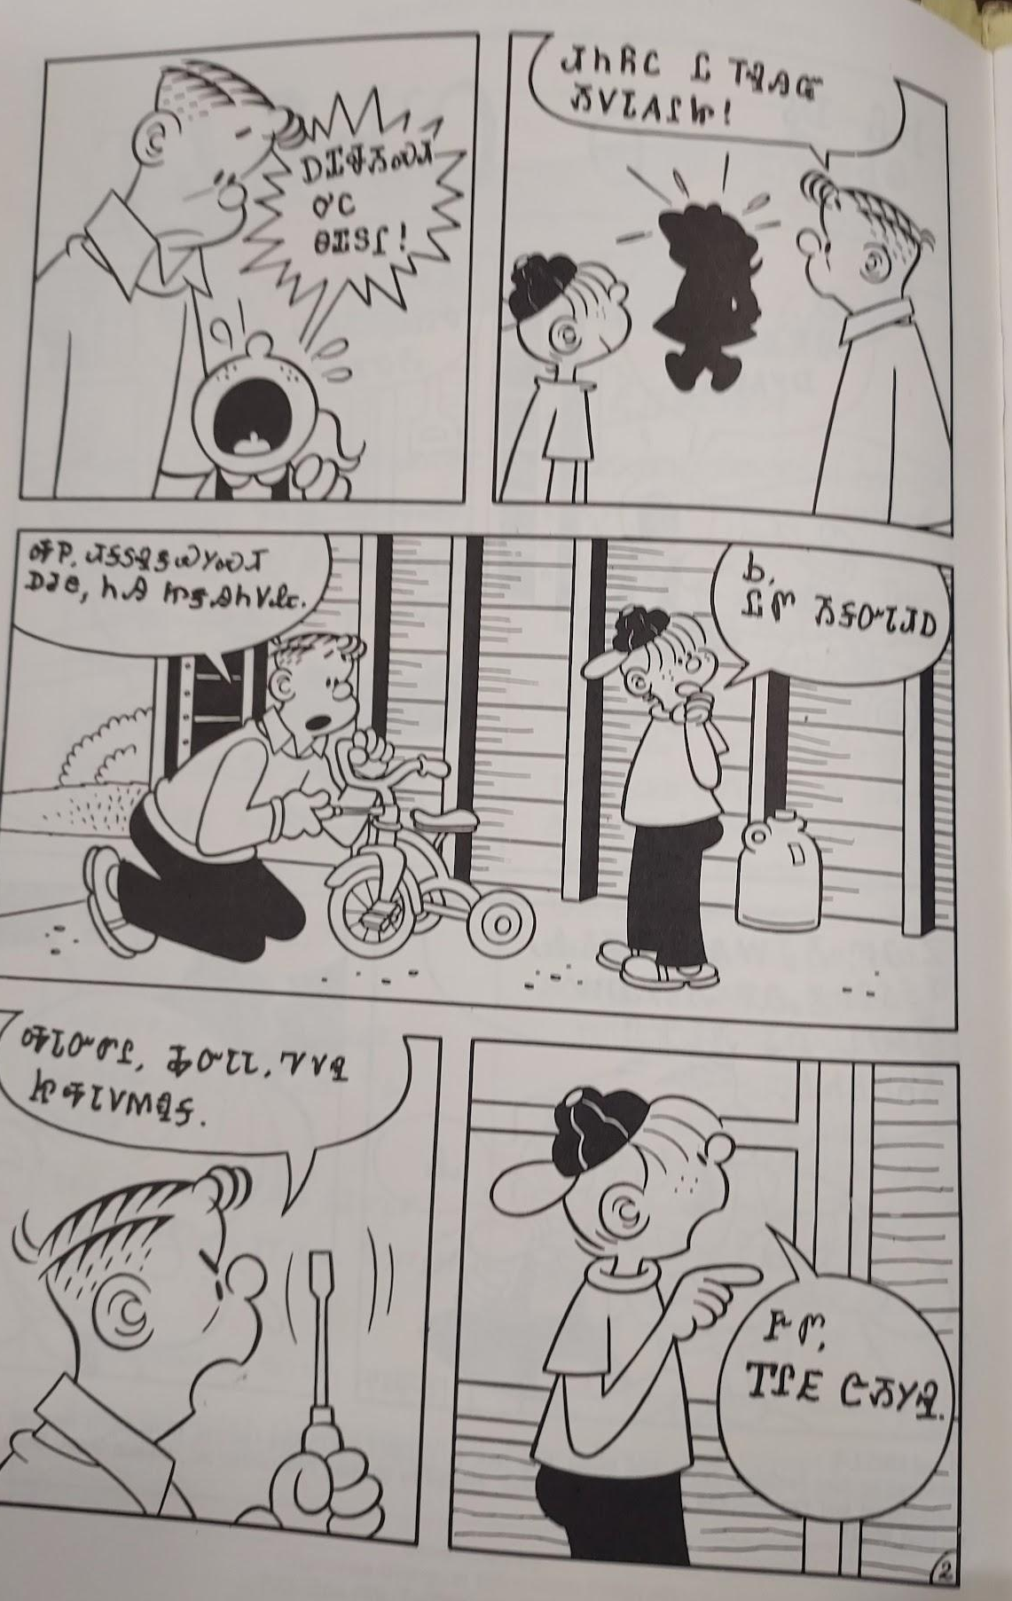
ᏅᎩᏍᎪ ᏦᎢᏁ ᏣᎳᎩ ᎠᏕᎶᏆᏍᏗ
ᎠᏆᏠᏱᏍᏗ ᎤᏟ ᎾᏆᏚᎵ!
ᏗᏂᏲᏟ Ꮭ ᎢᎸᎯᏳ ᏱᏙᏓᎪᎵᏥ!
ᎭᏢ ᏗᎦᏚᎸᏕᏯᎩᏍᏗ ᎠᏧᏣ. ᏂᎯ ᏥᏕᎯᏂᏙᎲ.
Ꮟ, ᏝᏛ ᏱᎦᏅᏓᏗᎠ
ᎭᏓᏅᏛᎵ ᎭᏅᏓᏓ, ᏤᏙᎸ ᏥᎭᏓᏙᎷᏄᎦ.
ᎨᏛ, ᎢᎵᎬ ᏣᏱᎩᎸ.

Slide 7
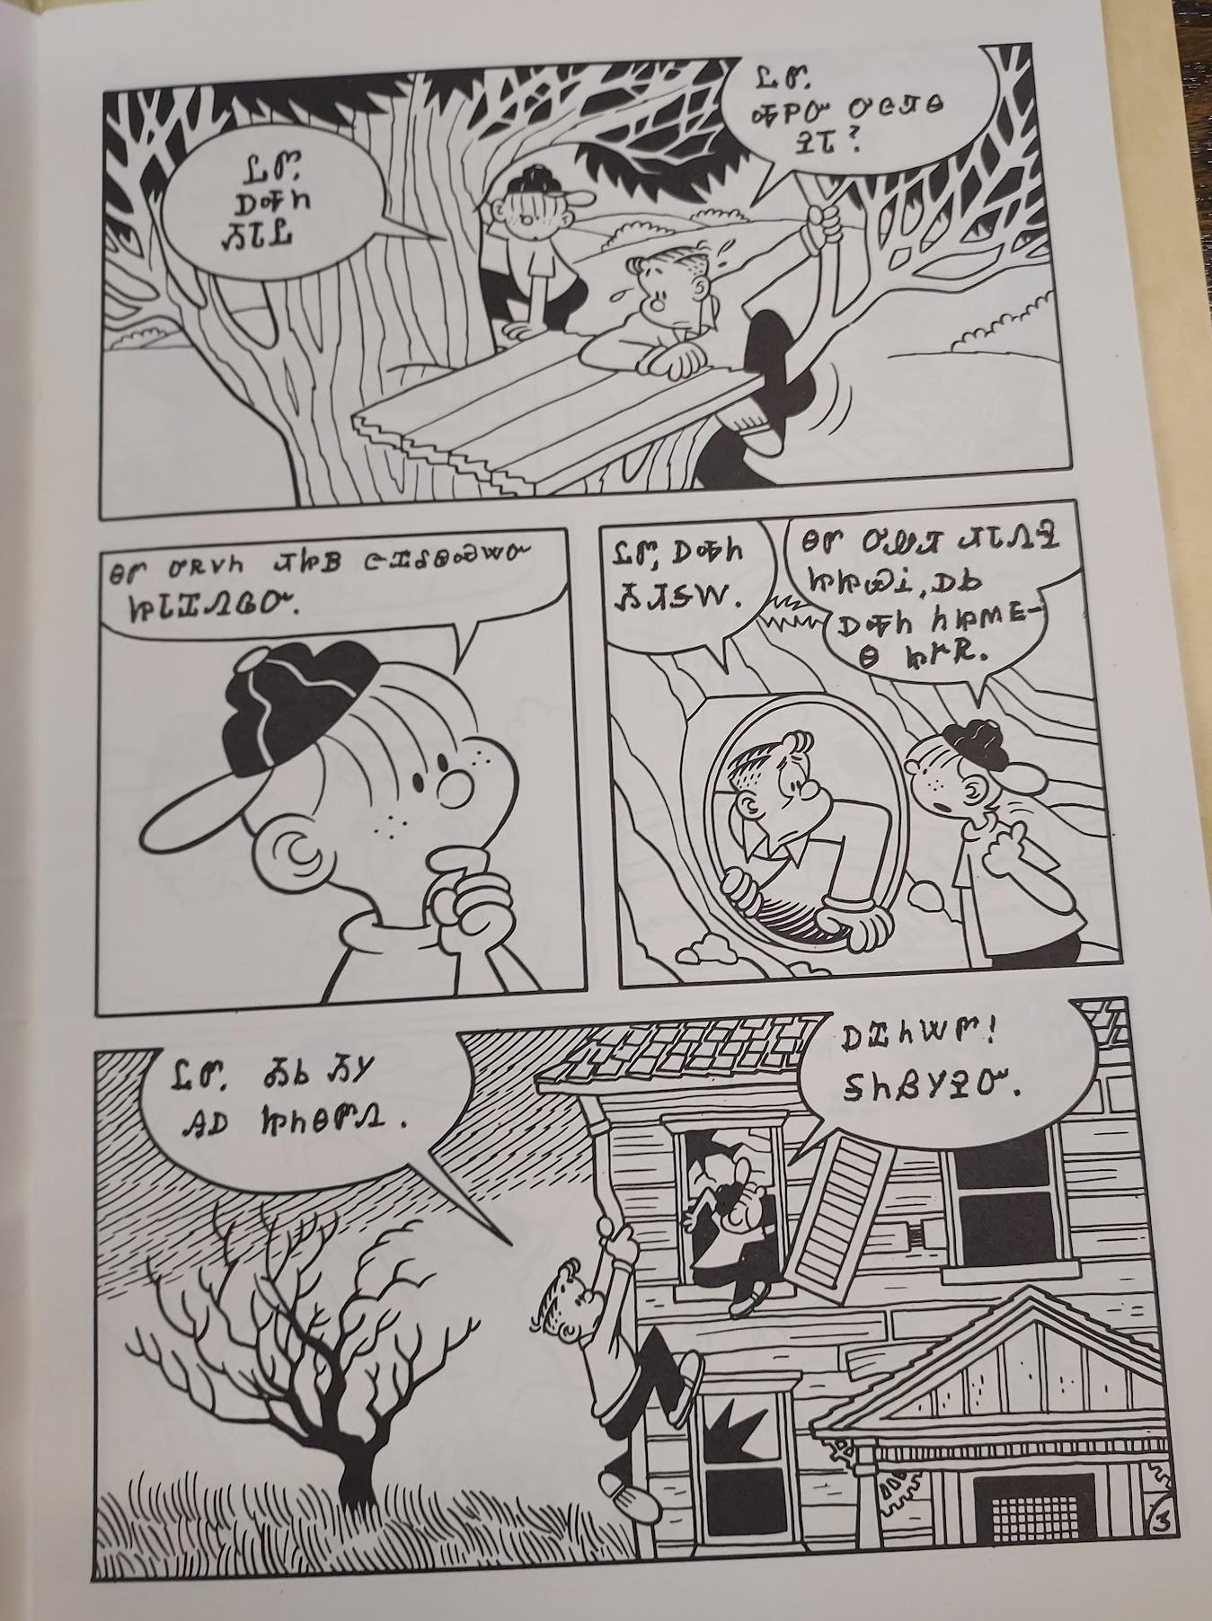
ᏅᎩᏍᎪ ᏦᎢᏁ ᏣᎳᎩ ᎠᏕᎶᏆᏍᏗ
ᏝᏛ, ᎠᎭᏂ ᏱᏓᏝ
ᏝᏛ, ᎭᏢᏅ ᎤᏣᏘᎾ ᎮᏓ?
ᎾᏛ ᎤᏒᏙᏂ ᏗᏥᏴ ᏣᏆᎴᏫᏍᏔᏅ ᏥᏓᏆᏁᎶᏅ.
ᏝᏛ, ᎠᎭᏂ ᏱᏗᎦᎳ.
ᎾᏛ ᎤᏪᏘ ᏗᏓᏁᎸ ᏥᏥᏯᎥ, ᎠᏏ ᎠᎭᏂ ᏂᏥᎷᎬᎾ ᏥᎨᏒ
ᏝᏛ ᎣᏏ ᏱᎩ ᎯᎠ ᏥᏂᎾᏛᏁ.
ᎠᏆᏂᏔᏛ! ᎦᏂᏰᏱᎮᏅ.

Slide 8
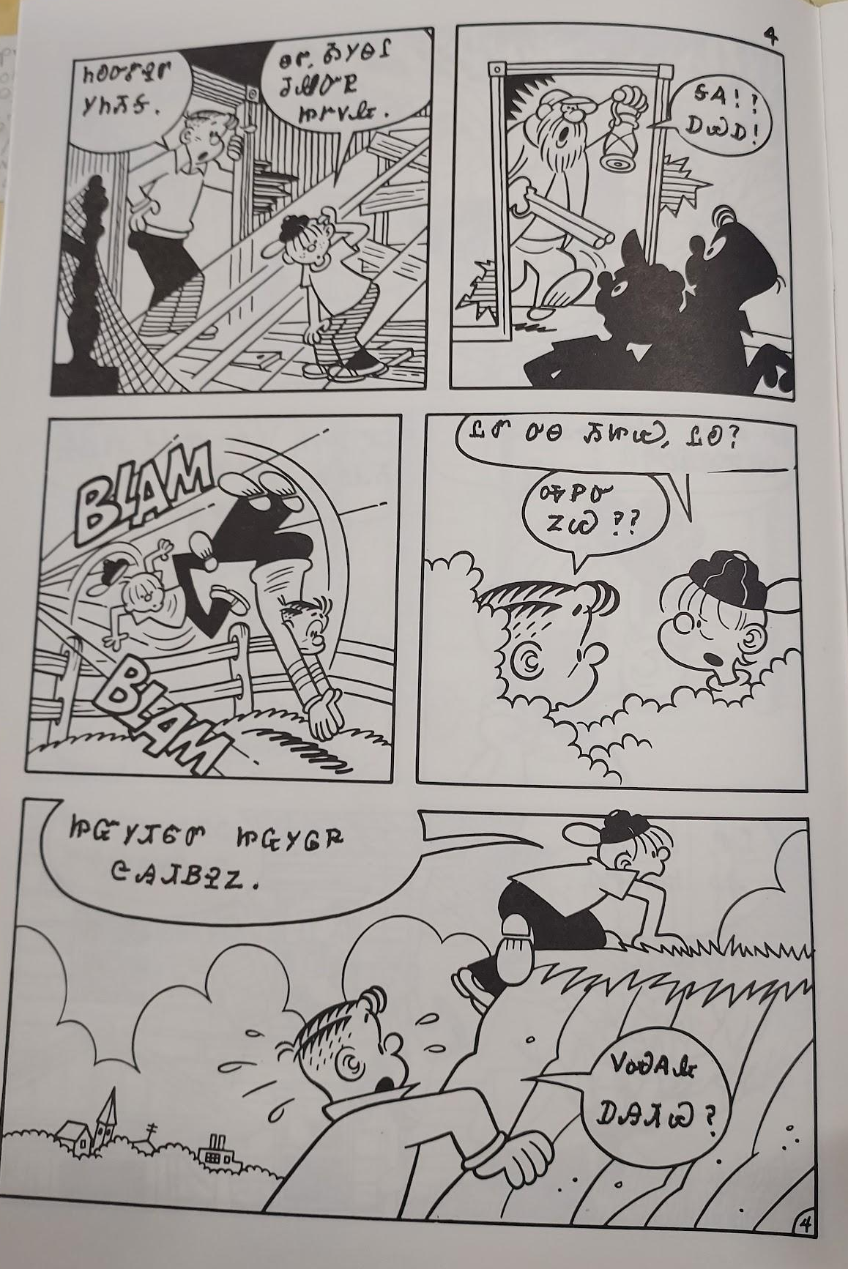
ᏅᎩᏍᎪ ᏦᎢᏁ ᏣᎳᎩ ᎠᏕᎶᏆᏍᏗ
ᏂᎧᏅᏑᎸᏛ ᎩᏂᏱᎦ
ᎾᏛ ᎣᎩᎾᎵ ᏧᏪᏅᏒ ᏥᎨᏙᎲ
ᎦᎪ ᎠᏯᎠ!
ᏝᏛ ᎤᎾ ᏱᏥᏯ, ᏝᎧ?
ᎭᏢᏅ ᏃᏊ??
ᏥᏳᎩᏗᏳᏛ ᏥᏩᎩᎶᏒ ᏣᎯᏗᏴᎮᏃ.
ᏙᏍᎪᎲ ᎠᎯᏗᏯ?

Slide 9
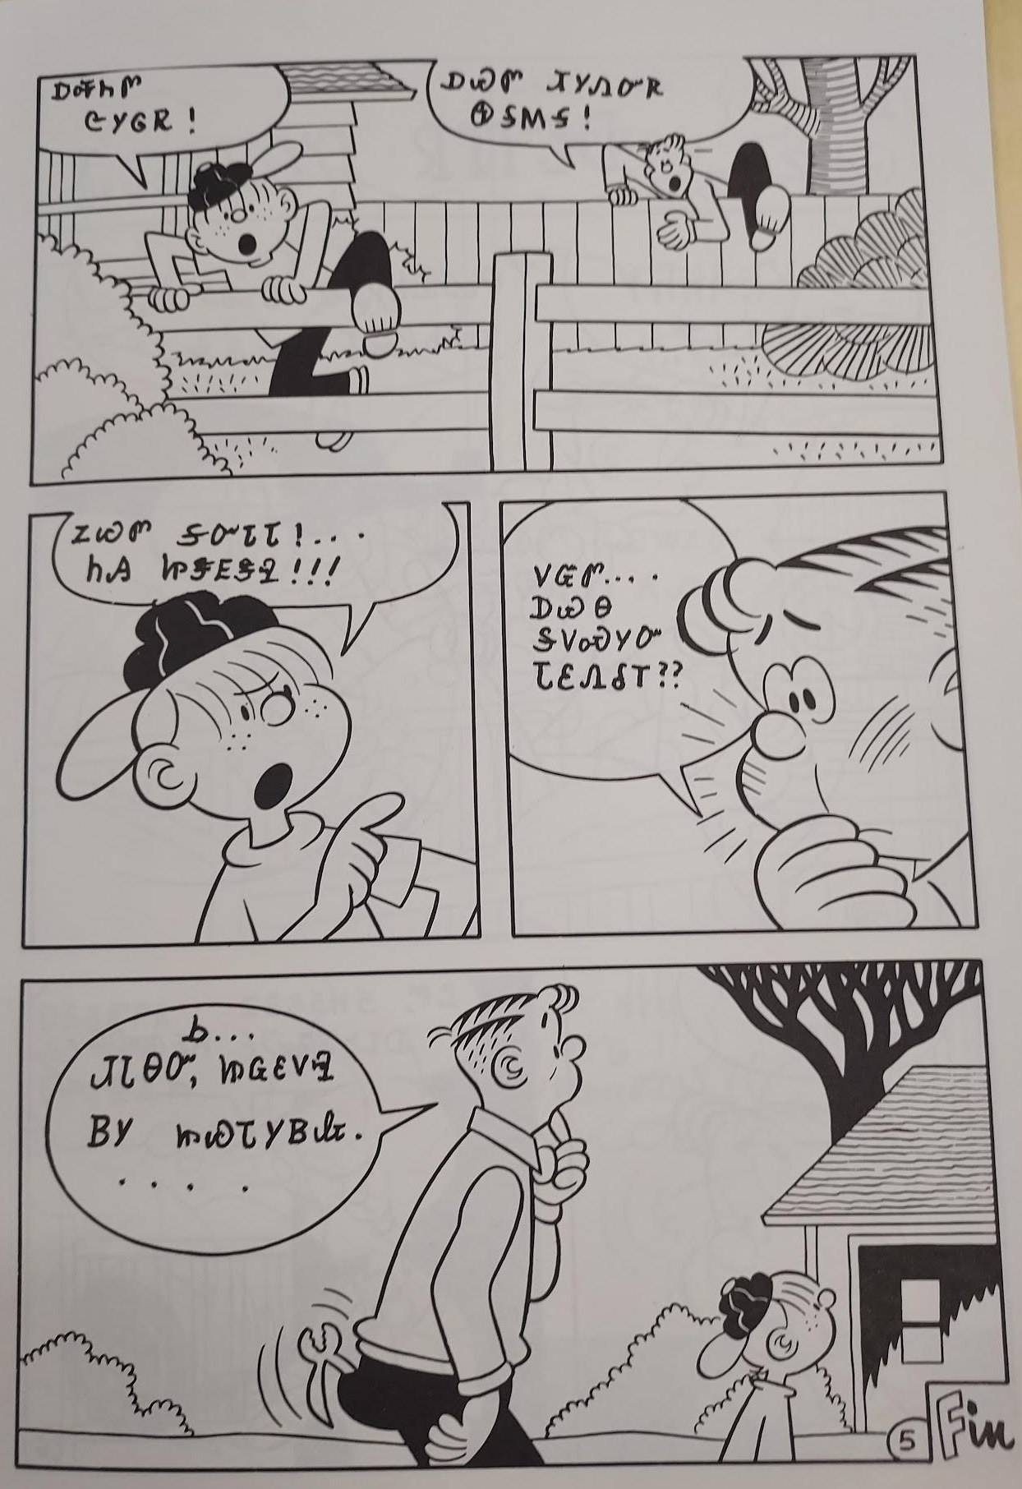
ᏅᎩᏍᎪ ᏦᎢᏁ ᏣᎳᎩ ᎠᏕᎶᏆᏍᏗ
ᎠᎭᏂᏛ ᏣᎩᎶᏒ!
ᎠᏯᏛ ᏗᎩᏁᏅᏒ ᏫᎦᎷᎦ!
ᏃᏊᏛ ᎦᏅᏓᏓ….. ᏂᎯ ᏥᏕᎬᏕᎸ!!!!
ᏙᏳᏛ ᎠᏯᎾ ᎦᏙᏍᎩᏅ ᏓᏋᏁᎴ???
Ꮟ…ᏗᏓᎾᏅ, ᏥᏩᏋᏙᎸ ᏴᎩ ᏥᏯᏓᎩᏴᎲ.

