Slide 1
ᎣᏏᏲ
ᏅᎩᏍᎪ ᏑᏓᎵᏁ ᏣᎳᎩ ᎠᏕᎶᏆᏍᏗ

Slide 2
ᏅᎩᏍᎪ ᏑᏓᎵᏁ ᏣᎳᎩ ᎠᏕᎶᏆᏍᏗ
ᎢᏓᎴᎾ- Let’s begin
ᏣᎳᎩ ᎢᏗᏬᏂ- Let’s talk Cherokee

Slide 3
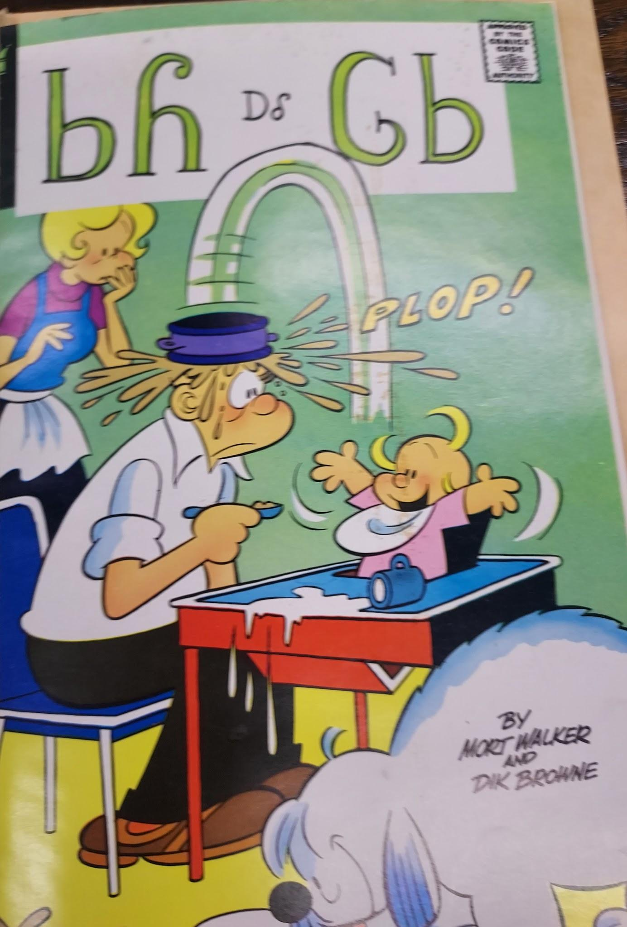
ᏅᎩᏍᎪ ᏑᏓᎵᏁ ᏣᎳᎩ ᎠᏕᎶᏆᏍᏗ
ᏏᏲ ᎠᎴ ᎶᏏ

Slide 4
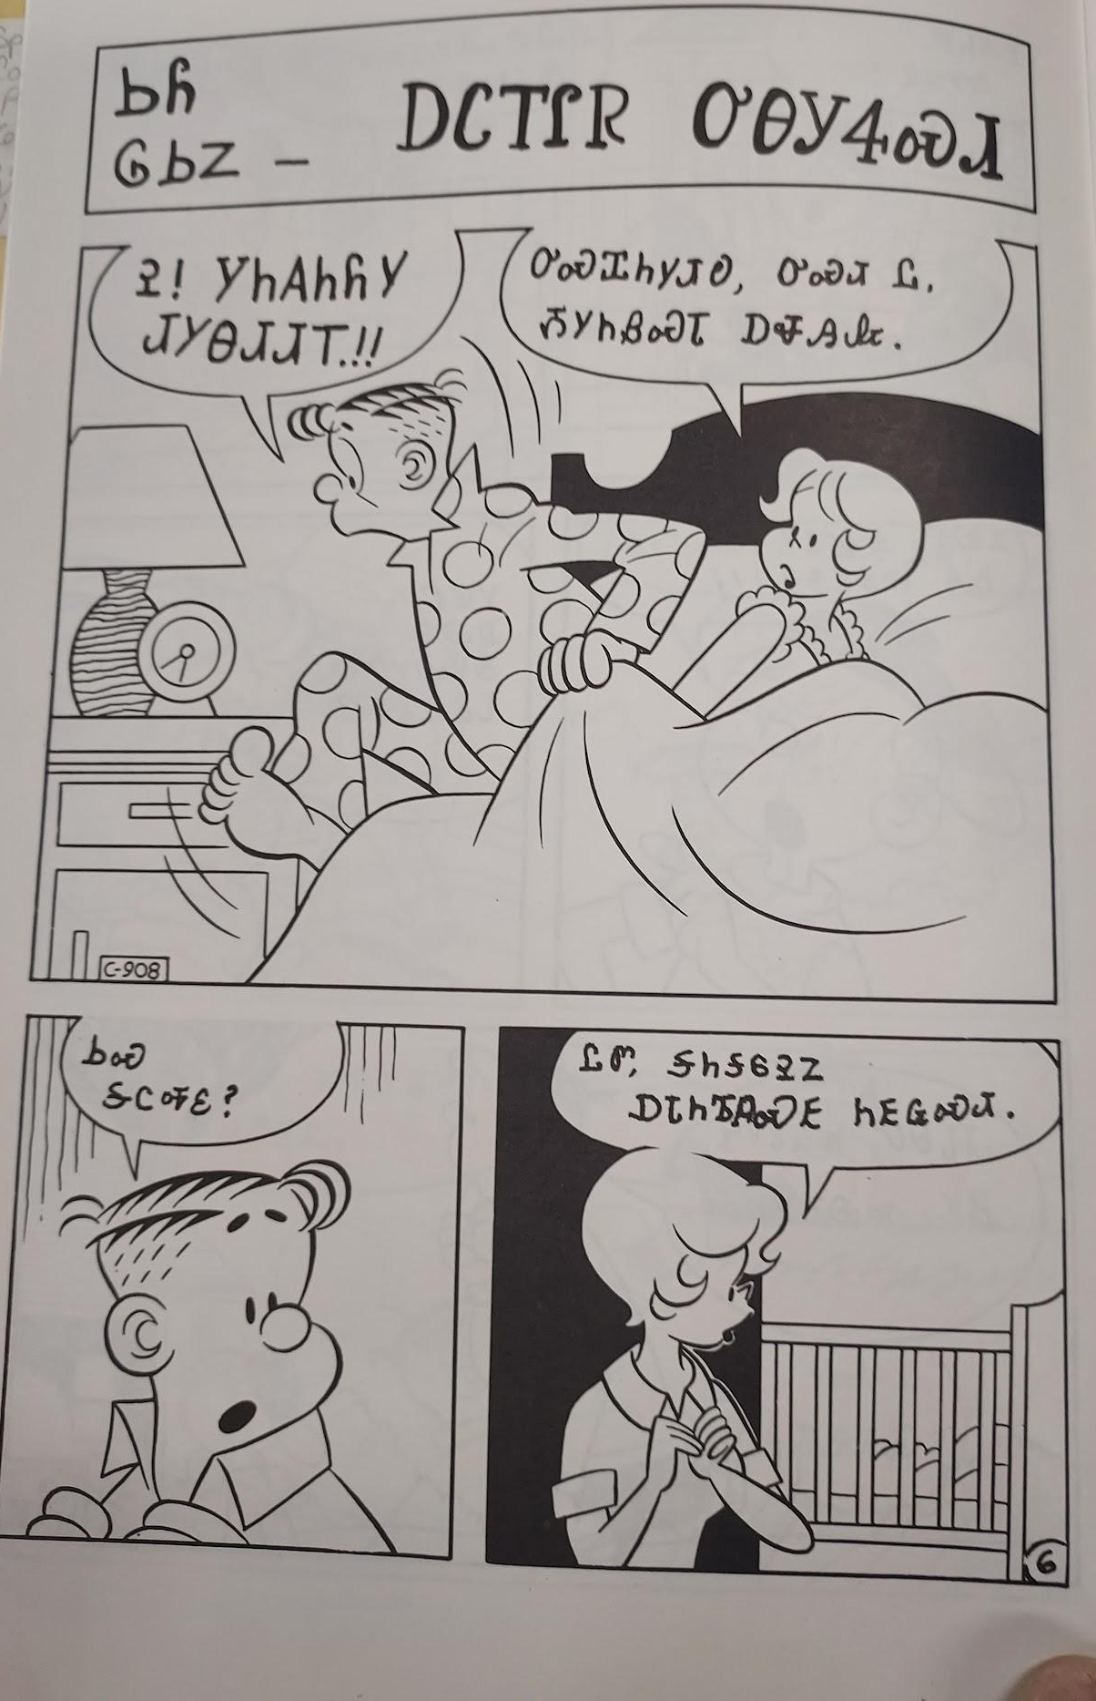
ᏅᎩᏍᎪ ᏑᏓᎵᏁ ᏣᎳᎩ ᎠᏕᎶᏆᏍᏗ
ᏏᏲ ᎶᏏᏃ ᎠᏟᎢᎵᏒ ᎤᎾᎩᏎᏍᏗ
Ꭾ! ᎩᏂᎪᏂᏲᎩ ᏗᎩᎾᏗᏗᎢ!!
ᎤᏍᏆᏂᎩᏗᎧ, ᎤᏍᏗ Ꮭ ᏱᎩᏂᏰᏍᏗ ᎠᏠᎯᎲ.
ᏏᏍ ᎦᏟᎭᏋ?
ᏝᏛ, ᎦᏂᎦᏮᎮᏃ ᎠᏓᏂᏖᏄᏍᎬ ᏂᎬᏩᏍᏗ

Slide 5
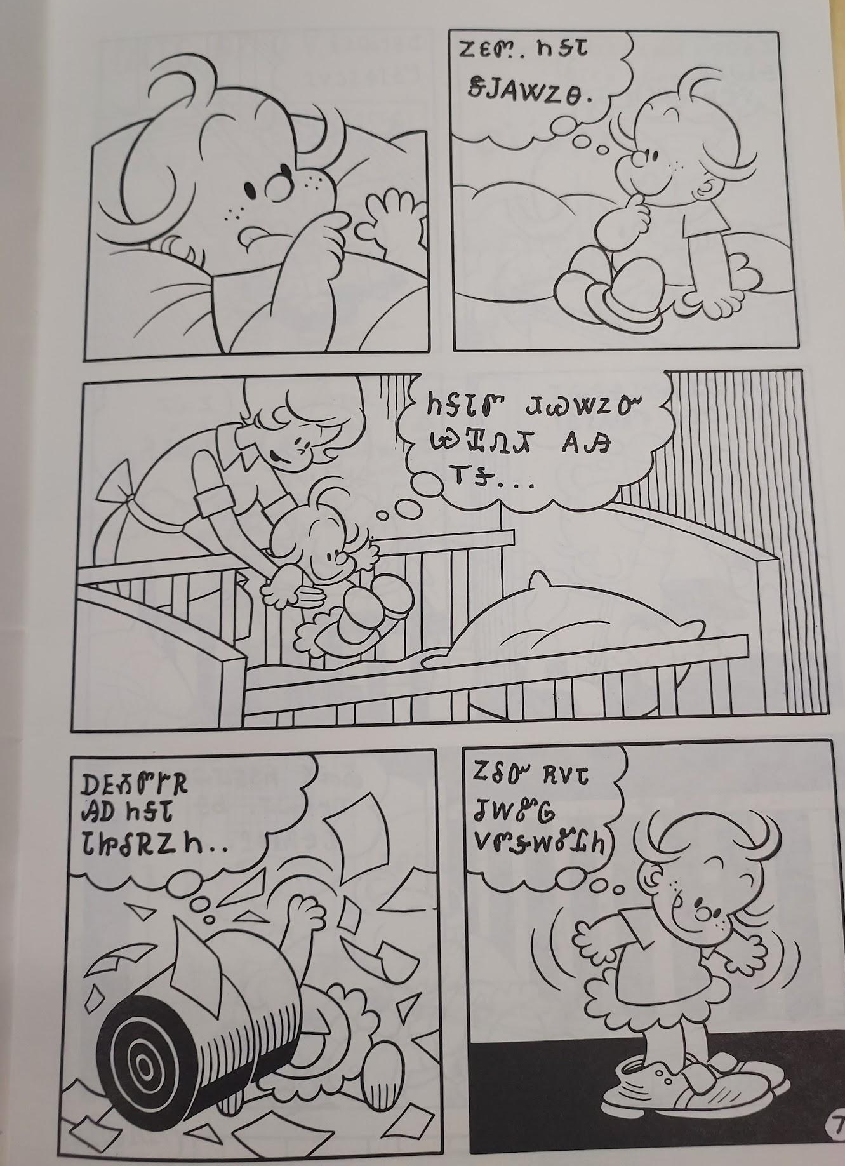
ᏅᎩᏍᎪ ᏑᏓᎵᏁ ᏣᎳᎩ ᎠᏕᎶᏆᏍᏗ
ᏃᏋᏛ ᏂᎦᏓ ᏕᎫᎪᏔᏃᎾ.
ᏂᎦᏓᏛ ᏗᏊᏔᏃᏅ ᏯᏆᏁᏗ ᎪᎯ ᎢᎦ….
ᎠᎬᏱᏛᎨᏒ ᎯᎠ ᏂᎦᏓ ᏓᏥᎴᏒᏃᏂ….
ᏃᎴᏅ ᎡᏙᏓ ᏧᎳᏑᎶ ᏙᏛᎦᎳᏑᏝᏂ

Slide 6
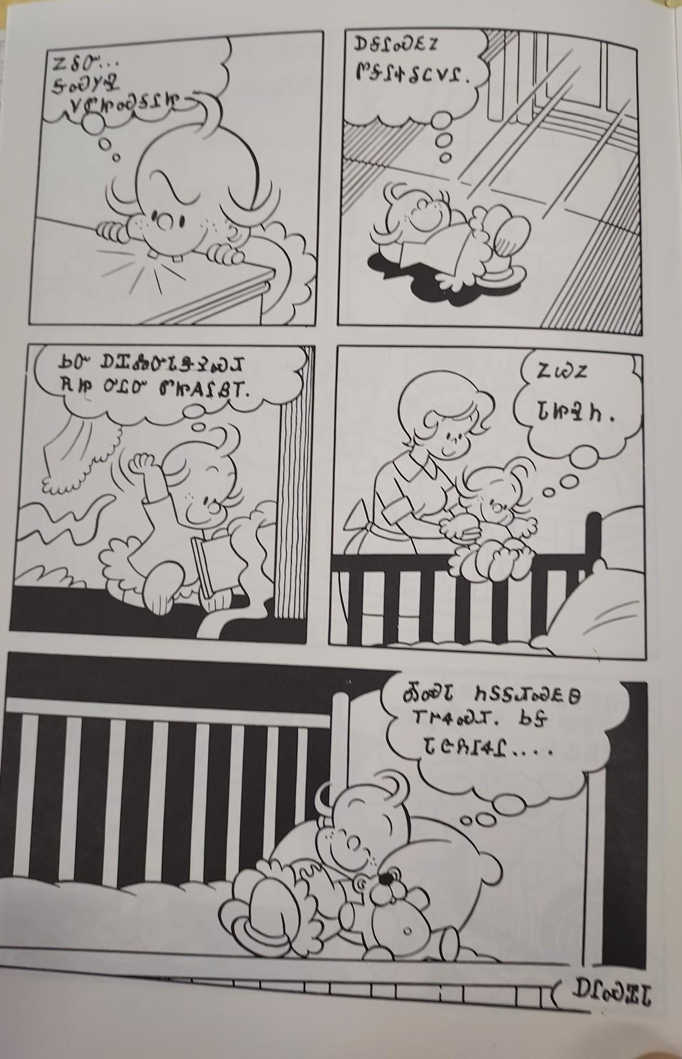
ᏅᎩᏍᎪ ᏑᏓᎵᏁ ᏣᎳᎩ ᎠᏕᎶᏆᏍᏗ
ᏃᎴᏅ…. ᎦᏍᎩᎸ ᏙᏛᏥᏍᎦᎵᏥ
ᎠᎦᎵᏍᎬᏃ ᏛᎦᎵᏐᎴᏟᏙᎵ
ᏏᏅ ᎠᏆᏜᏅᏓᏕᎮᏍᏗ ᎡᏥ ᎤᏝᏅ ᏛᏥᎪᎵᏰᎢ.
ᏃᏊᏃ ᏓᏥᎸᏂ.
ᎣᏍᏓ ᏂᏚᎦᏗᏍᎬᎾ ᎢᎨᏎᏍᏗ. ᏏᎦ ᏓᏣᏲᎱᏎᎵ….

