Slide 1
ᎣᏏᏲ
ᏅᎩᏍᎪ ᎦᎵᏉᎩᏁ ᏣᎳᎩ ᎠᏕᎶᏆᏍᏗ

Slide 2
ᏅᎩᏍᎪ ᎦᎵᏉᎩᏁ ᏣᎳᎩ ᎠᏕᎶᏆᏍᏗ
ᎢᏓᎴᎾ- Let’s begin
ᏣᎳᎩ ᎢᏗᏬᏂ- Let’s talk Cherokee

Slide 3
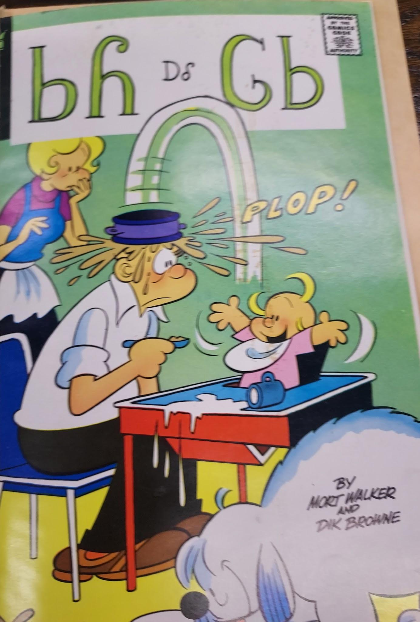
ᏅᎩᏍᎪ ᎦᎵᏉᎩᏁ ᏣᎳᎩ ᎠᏕᎶᏆᏍᏗ
ᏏᏲ ᎠᎴ ᎶᏏ

Slide 4
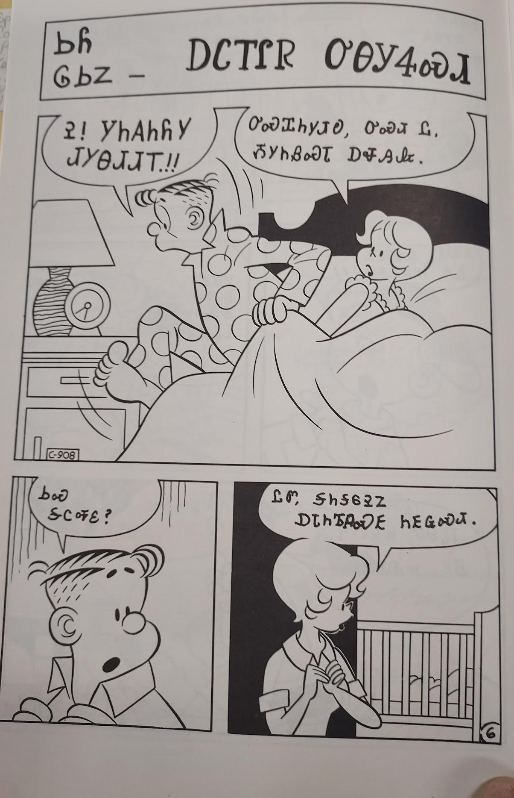
ᏅᎩᏍᎪ ᏑᏓᎵᏁ ᏣᎳᎩ ᎠᏕᎶᏆᏍᏗ
ᏏᏲ ᎶᏏᏃ ᎠᏟᎢᎵᏒ ᎤᎾᎩᏎᏍᏗ
Ꭾ! ᎩᏂᎪᏂᏲᎩ ᏗᎩᎾᏗᏗᎢ!!
ᎤᏍᏆᏂᎩᏗᎧ, ᎤᏍᏗ Ꮭ ᏱᎩᏂᏰᏍᏗ ᎠᏠᎯᎲ.
ᏏᏍ ᎦᏟᎭᏋ?
ᏝᏛ, ᎦᏂᎦᏮᎮᏃ ᎠᏓᏂᏖᏄᏍᎬ ᏂᎬᏩᏍᏗ

Slide 5
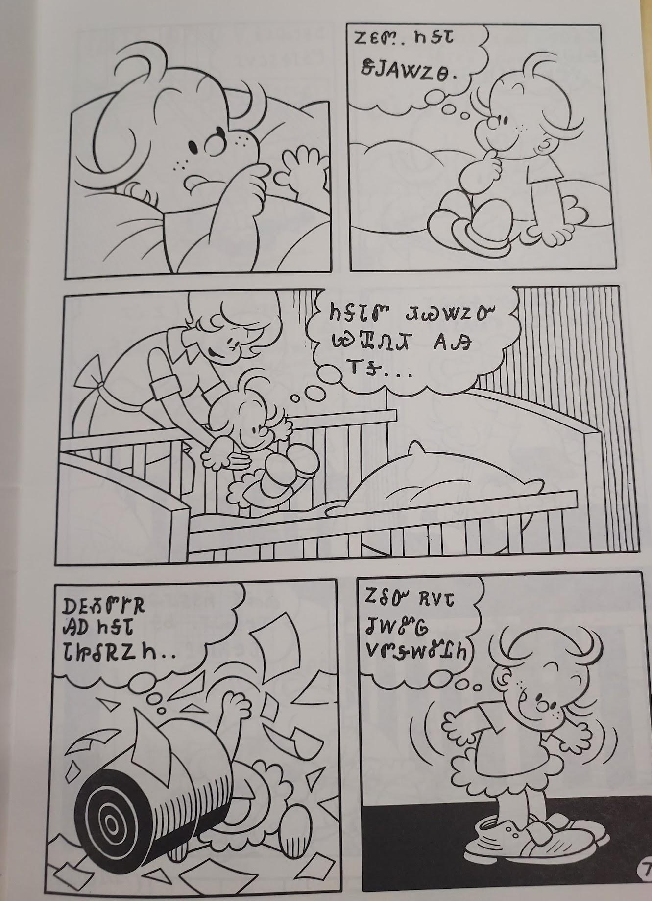
ᏅᎩᏍᎪ ᏑᏓᎵᏁ ᏣᎳᎩ ᎠᏕᎶᏆᏍᏗ
ᏃᏋᏛ ᏂᎦᏓ ᏕᎫᎪᏔᏃᎾ.
ᏂᎦᏓᏛ ᏗᏊᏔᏃᏅ ᏯᏆᏁᏗ ᎪᎯ ᎢᎦ….
ᎠᎬᏱᏛᎨᏒ ᎯᎠ ᏂᎦᏓ ᏓᏥᎴᏒᏃᏂ….
ᏃᎴᏅ ᎡᏙᏓ ᏧᎳᏑᎶ ᏙᏛᎦᎳᏑᏝᏂ

Slide 6
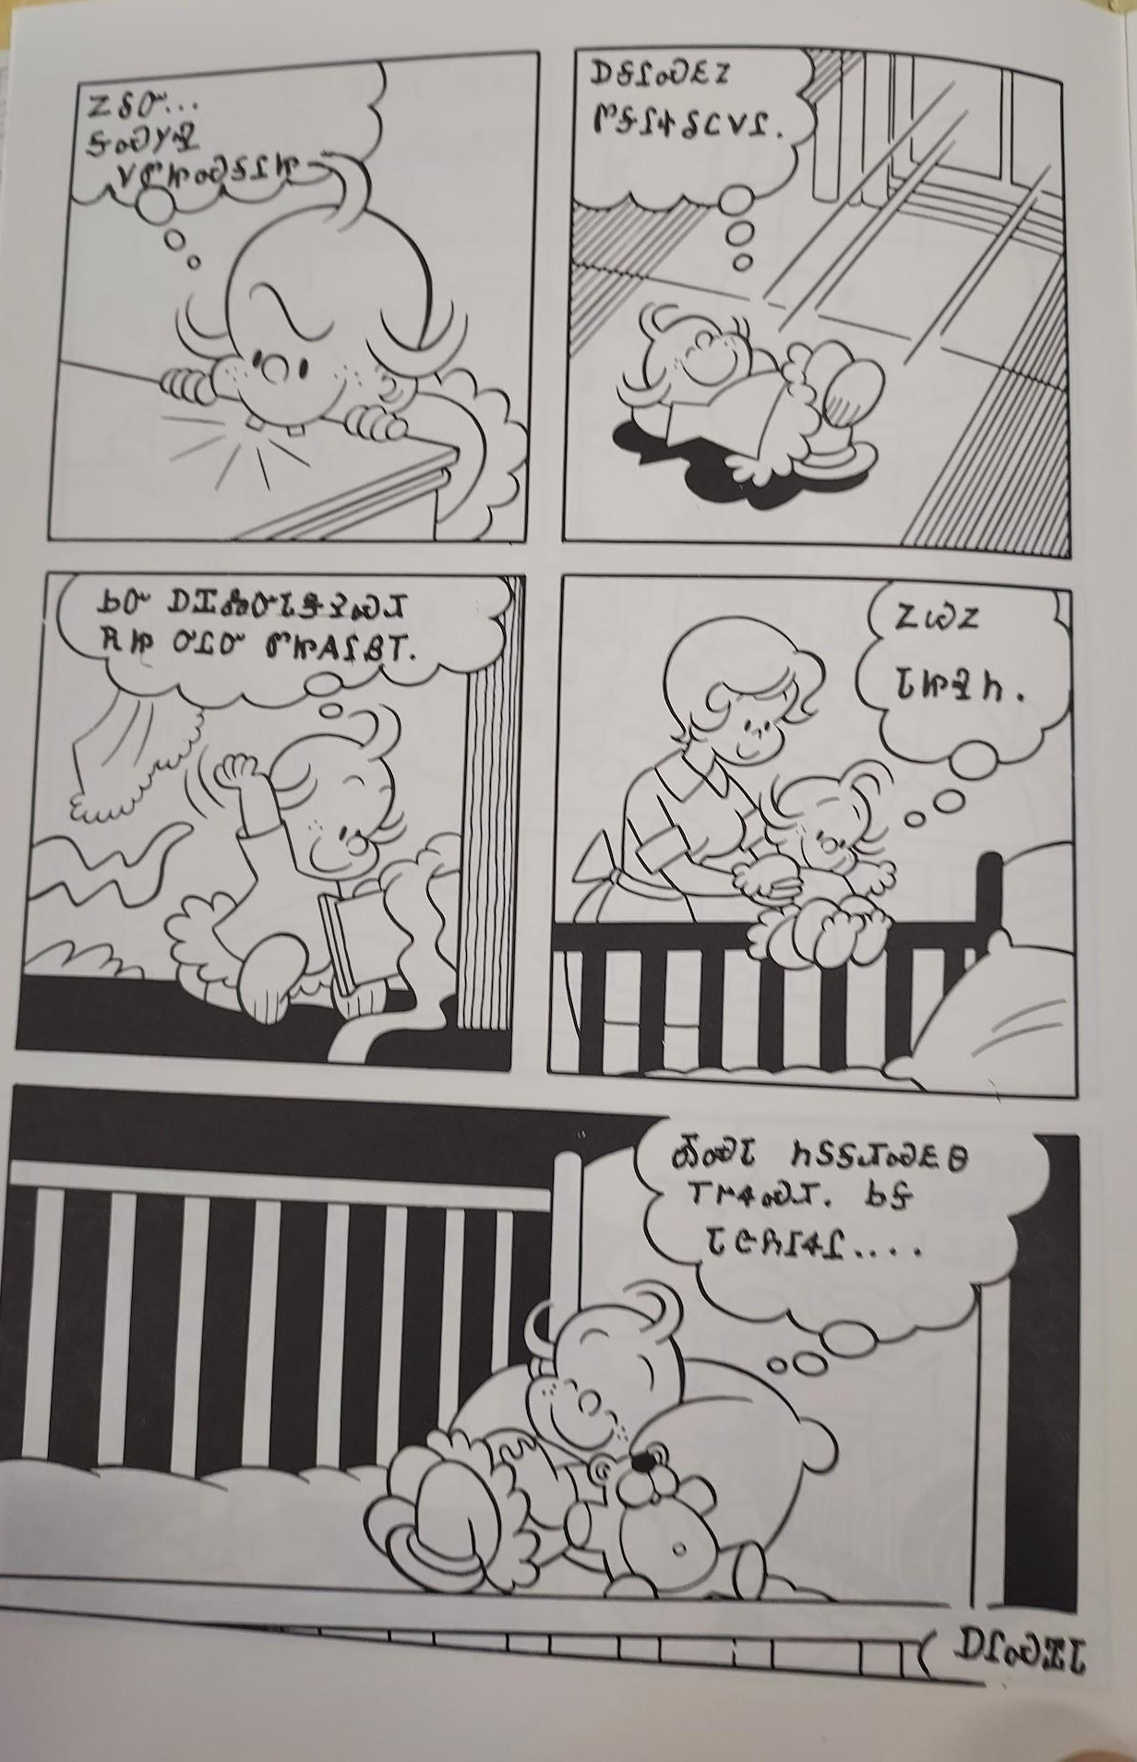
ᏅᎩᏍᎪ ᏑᏓᎵᏁ ᏣᎳᎩ ᎠᏕᎶᏆᏍᏗ
ᏃᎴᏅ…. ᎦᏍᎩᎸ ᏙᏛᏥᏍᎦᎵᏥ
ᎠᎦᎵᏍᎬᏃ ᏛᎦᎵᏐᎴᏟᏙᎵ
ᏏᏅ ᎠᏆᏜᏅᏓᏕᎮᏍᏗ ᎡᏥ ᎤᏝᏅ ᏛᏥᎪᎵᏰᎢ.
ᏃᏊᏃ ᏓᏥᎸᏂ.
ᎣᏍᏓ ᏂᏚᎦᏗᏍᎬᎾ ᎢᎨᏎᏍᏗ. ᏏᎦ ᏓᏣᏲᎱᏎᎵ….

Slide 7
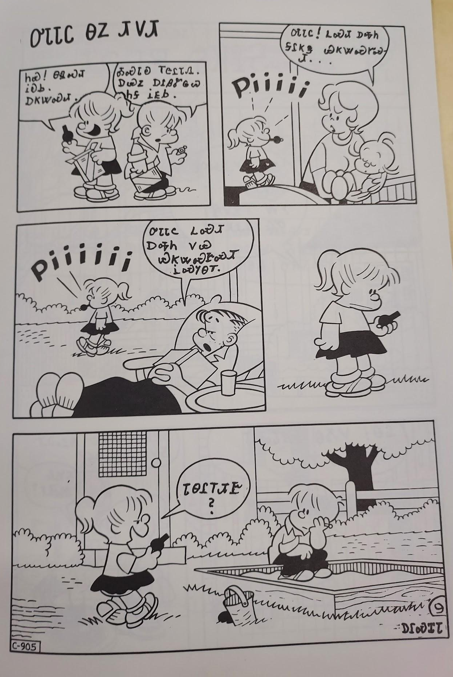
ᏅᎩᏍᎪ ᎦᎵᏉᎩᏁ ᏣᎳᎩ ᎠᏕᎶᏆᏍᏗ
ᎤᏓᏓᏟ ᎾᏃ ᏗᏙᏗ
ᏂᏍ! ᎾᏄᏍᏗ ᎥᎧᏏ.ᎠᏦᏔᏍᏗ.
ᎣᏍᏓᎧ ᎢᏣᎵᏓᏁ. ᎠᏯᏃ ᎠᎵᏰᏑᏩᏇ ᏂᎦ ᎥᎬᏏ.
ᎤᏓᏓᏟ! ᏞᏍᏗ ᎠᎭᏂ ᎦᎵᏦᏕ ᏯᏦᏔᏍᎨᏍᏗ…
ᎤᏓᏓᏟ ᏞᏍᏗ ᎠᎭᏂ ᏙᏯ ᏯᏦᏔᏍᎨᏍᏗ ᎥᏍᎩᎾᎢ
ᏓᎾᎵᎢᏗᎨ?
ᎠᎵᏍᏆᏓ

Slide 8
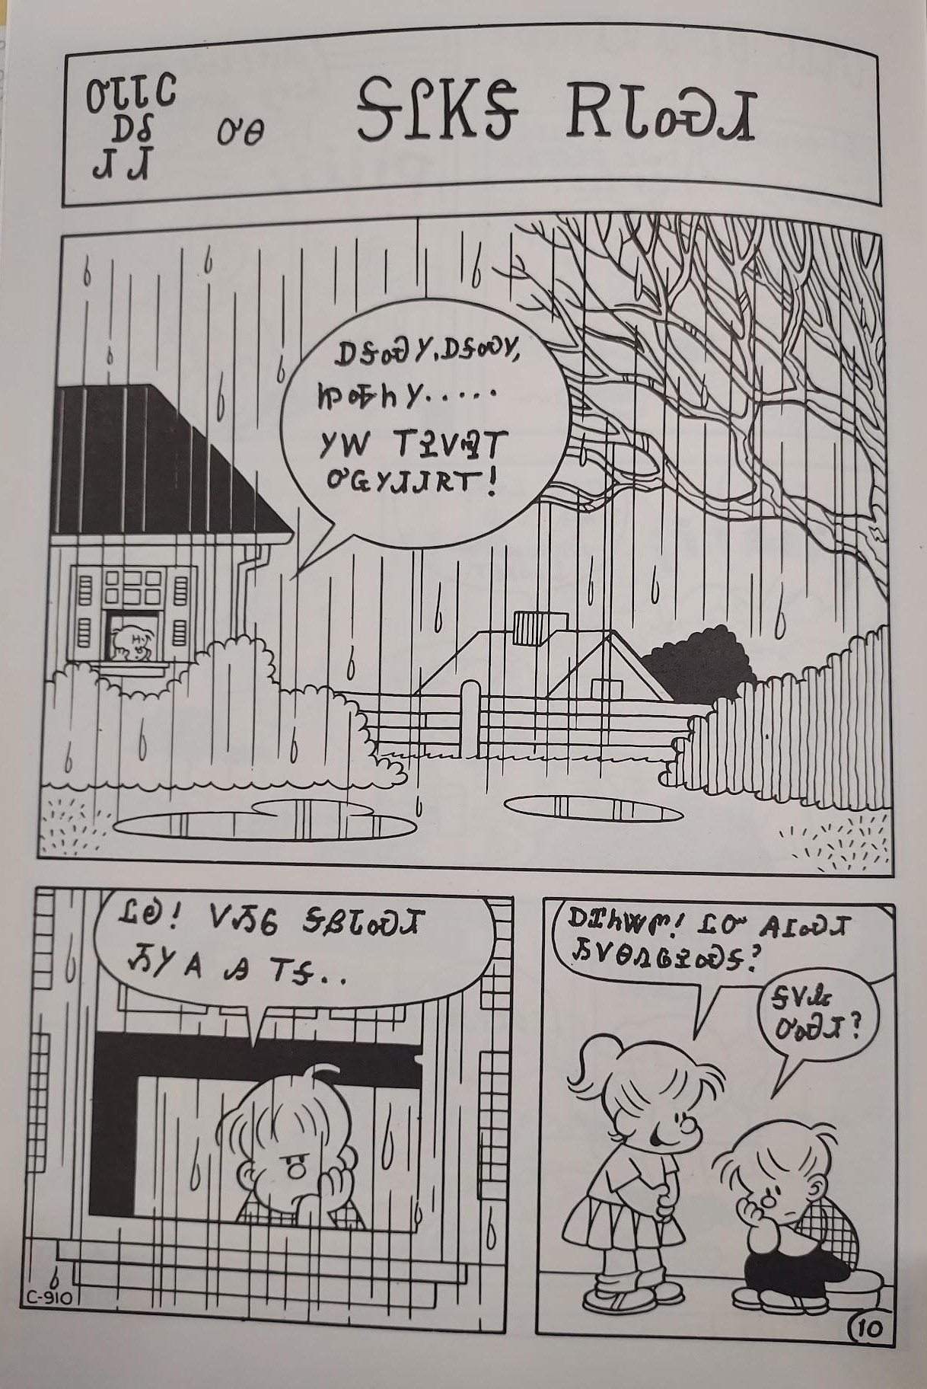
ᏅᎩᏍᎪ ᎦᎵᏉᎩᏁ ᏣᎳᎩ ᎠᏕᎶᏆᏍᏗ
ᎤᏓᏓᏟ ᎠᎴ ᏗᏙᏗ ᎤᎾ ᎦᎵᏦᏕ ᎡᏓᏍᏗ
ᎠᎦᏍᎩ, ᎠᎦᏍᎩ, ᏥᎭᏂᎩ...ᎩᎳ ᎢᎮᏙᎸᎢ ᎤᏩᎩᏗᏗᏒᎢ!
ᏝᎧ! ᏙᏱᏮ ᎦᏰᏓᏍᏗ ᏱᎩ ᎪᎯ ᎢᎦ..
ᎠᏆᏂᏔᏛ! ᏝᏅ ᎪᎱᏍᏗ ᏱᏙᎾᏁᎶᎮᏍᎦ?
ᎦᏙᎲ ᎤᏍᏗ?

Slide 9
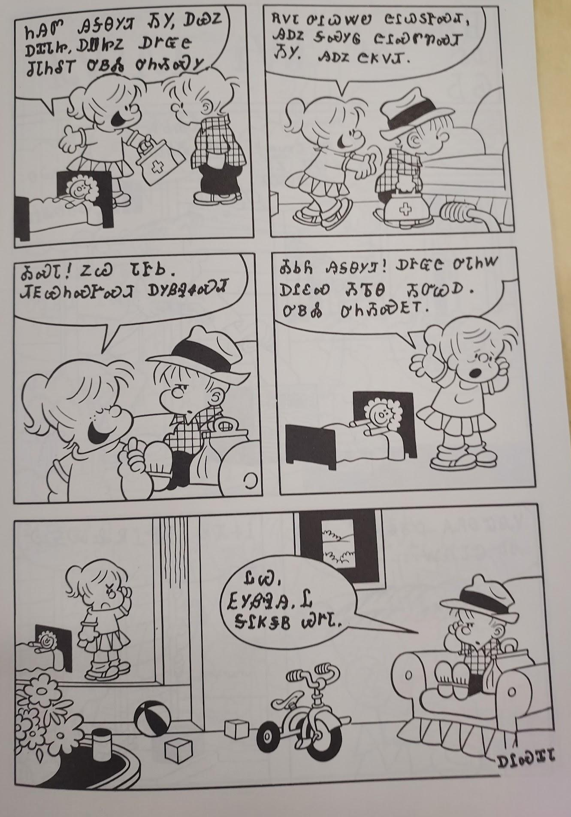
ᏅᎩᏍᎪ ᎦᎵᏉᎩᏁ ᏣᎳᎩ ᎠᏕᎶᏆᏍᏗ
ᏂᎯᏛ ᎯᎦᎾᎩᏗ ᏱᎩ, ᎠᏯᏃ ᎠᏆᏓᏥ ᎠᏪᏥᏃ ᎠᎨᏳᏣ ᏧᏓᏂᎴᎢ ᎤᏴᏜ ᎤᏂᏱᏍᎩ.
ᎡᏙᏓ ᎤᎵᏇᏔᏬ ᏣᎵᏇᏚᎨᏍᏗ, ᎯᎠᏃ ᎦᏍᎩᎶ ᏣᎵᏍᏛᏡᏍᏗ ᏱᎩ. ᎯᎠᏃ ᏣᏦᏙᏗ.
ᎣᏍᏓ! ᏃᏊ ᏓᎨᏏ. ᏗᎬᏯᏂᏍᎨᏍᏗ ᎠᎩᏰᎸᏎᏍᏗ.
ᎣᏏᏲ ᎯᎦᎾᎩᏘ! ᎠᎨᏳᏣ ᎤᏓᏂᎳ ᎠᎵᏋᏍ ᏱᏖᎾ ᏱᏅᏊᎠ. ᎤᏴᏜ ᎤᏂᏱᏍᎬᎢ.
ᏝᏊ, ᎬᎩᏰᎸᎯ. Ꮭ ᎦᎵᏦᏕᏴ ᏯᎨᏓ.
ᎠᎵᏍᏆᏓ

